Slide 1

0404 Doctype
Peter H. Chen

Slide 2
0404 Doctype
https://ucsc-extension.instructure.com/courses/3825/pages/1-dot-1-welcome?module_item_id=42202
0404 Doctype
DOCTYPE Declaration (DTD)
HTML documents actually begin with a DOCTYPE declaration (DTD) that identifies the version of the HTML page to the browser or validation service.
The doctype tells the browser what to expect from the HTML contained in the document and thus how to render it.
Without the doctype the browser pretty much assumes that this is a legacy document as opposed to a standards compliant document.
It causes the browser to go into something called “Quirks Mode” (Strange mode)!
There are three different DOCTYPE declarations for HTML 4.01 and XHTML 1.0 (please note that although it appears here that this doctype is written on two separate lines, that the code must be written all on one line - it actually makes a difference!):

Slide 3
0404 Doctype
https://ucsc-extension.instructure.com/courses/3825/pages/1-dot-1-welcome?module_item_id=42202
0404 Doctype
HTML 4.01:
Strict HTML 4.01 DOCTYPE
<!DOCTYPE html PUBLIC "-//W3C//DTD HTML 4.01//EN" "http://www.w3.org/TR/html4/strict.dtd">
Transitional HTML 4.01 DOCTYPE
<!DOCTYPE html PUBLIC "-//W3C//DTD HTML 4.01 Transitional//EN" "http://www.w3.org/TR/html4/loose.dtd">
Frameset HTML 4.01 DOCTYPE
<!DOCTYPE html PUBLIC "-//W3C//DTD HTML 4.01 Frameset//EN" "http://www.w3.org/TR/html4/frameset.dtd">

Slide 4
0404 Doctype
https://ucsc-extension.instructure.com/courses/3825/pages/1-dot-1-welcome?module_item_id=42202
0404 Doctype
XHTML 1.0:
An XHTML doctype for transitional would look like this:
<!DOCTYPE html PUBLIC "-//W3C//DTD XHTML 1.0 Transitional//EN" "http://www.w3.org/TR/xhtml1/DTD/xhtml1-transitional.dtd">
HTML5:
HTML5 has a completely new DOCTYPE!
It looks like this (we will talk more about this in the HTML5 Unit!
But we can and will use this doctype during this course.):
<!doctype html>

Slide 5
0404 Doctype
https://ucsc-extension.instructure.com/courses/3825/pages/1-dot-1-welcome?module_item_id=42202
0404 Doctype
What does this all mean or do?!
If the document strictly conforms to the HTML 4.01 specifications without the use of any deprecated attributes, then add the “Strict DOCTYPE” statement.
If the document uses deprecated elements (such as FONTS and alignments) then a “Transitional DOCTYPE” should be used.
Deprecated: means that a tag or attribute is being phased out and should be replaced with Cascading Style Sheets.
They are generally “presentational” tags/attributes that Transitional will allow. I will color in red any code that is considered “deprecated”.
The reason I include them is because you will see them everywhere and it is important to know what they are.
These links discuss the importance of using the DTD in your document.
W3C QA - Recommended List of Doctype Declarations (Links to an external site.)
Browser News: Doctypes (Links to an external site.)

Slide 6
0404.1 Doctype Video

Slide 7

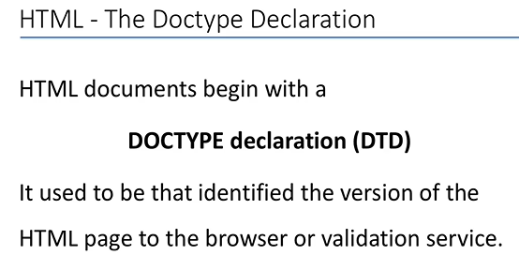
0404.1 Doctype Video
https://ucsc-extension.instructure.com/courses/3825/pages/1-dot-1-welcome?module_item_id=42202
0404.1 Doctype Video

Slide 8
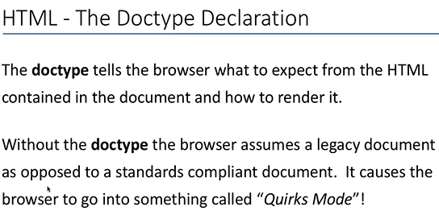
0404.1 Doctype Video
https://ucsc-extension.instructure.com/courses/3825/pages/1-dot-1-welcome?module_item_id=42202
0404.1 Doctype Video: “legacy document” means “old document”

Slide 9
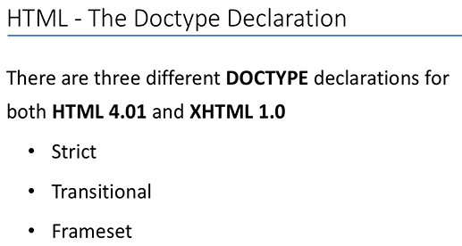
0404.1 Doctype Video
https://ucsc-extension.instructure.com/courses/3825/pages/1-dot-1-welcome?module_item_id=42202
0404.1 Doctype Video:

Slide 10
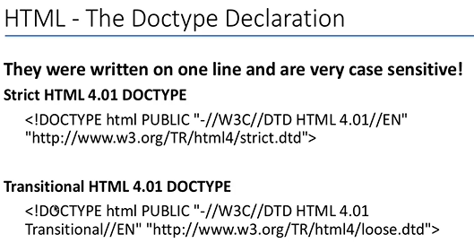
0404.1 Doctype Video
https://ucsc-extension.instructure.com/courses/3825/pages/1-dot-1-welcome?module_item_id=42202
0404.1 Doctype Video:

Slide 11
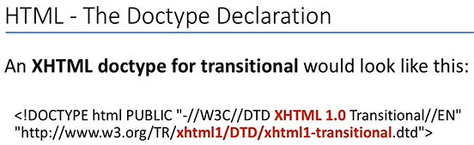
0404.1 Doctype Video
https://ucsc-extension.instructure.com/courses/3825/pages/1-dot-1-welcome?module_item_id=42202
0404.1 Doctype Video:

Slide 12
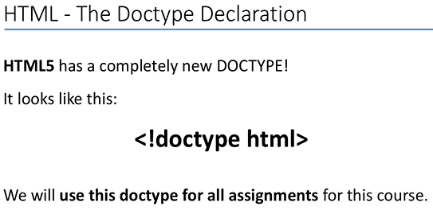
0404.1 Doctype Video
https://ucsc-extension.instructure.com/courses/3825/pages/1-dot-1-welcome?module_item_id=42202
0404.1 Doctype Video:

Slide 13
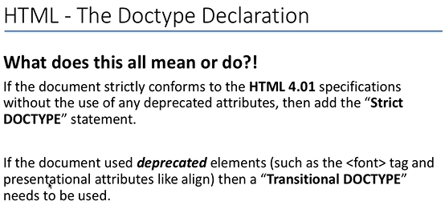
0404.1 Doctype Video
https://ucsc-extension.instructure.com/courses/3825/pages/1-dot-1-welcome?module_item_id=42202
0404.1 Doctype Video:

Slide 14
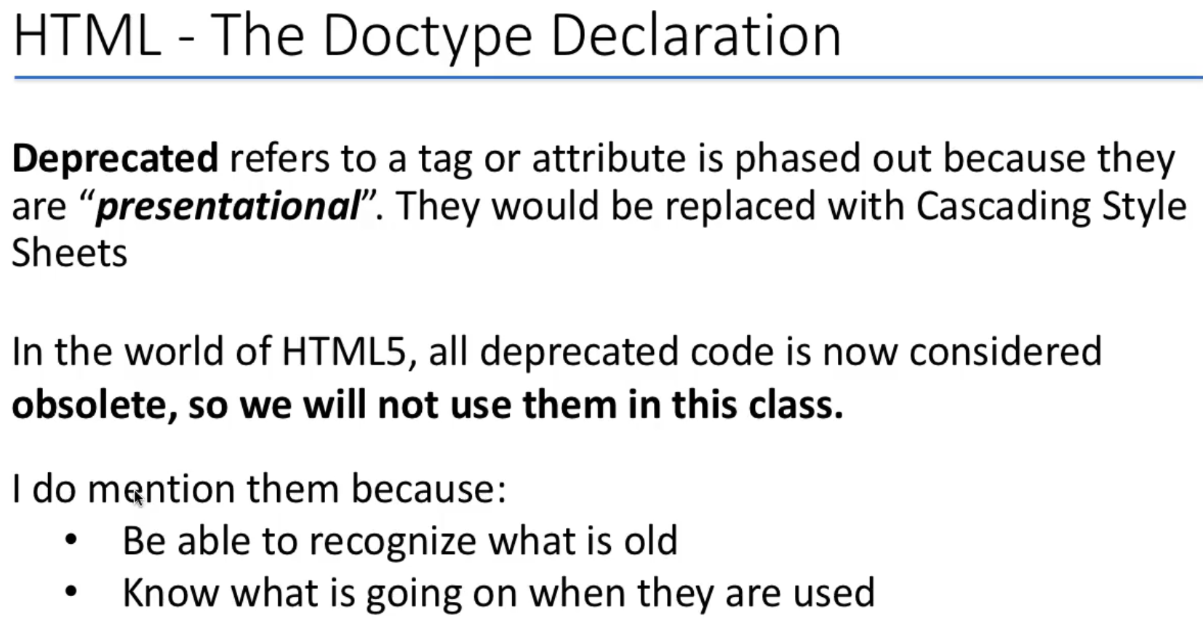
0404.1 Doctype Video
https://ucsc-extension.instructure.com/courses/3825/pages/1-dot-1-welcome?module_item_id=42202
0404.1 Doctype Video:

Slide 15
End of Chapter

