Slide 1

0405 HTML Tag
Peter H. Chen

Slide 2
0405 HTML Tag
https://ucsc-extension.instructure.com/courses/3825/pages/1-dot-1-welcome?module_item_id=42202
0405 HTML Tag
The HTML tag <html> … </html>
Once the <!doctype html> has been entered, you can now begin your HTML page with the opening <html> tag.
This tag tells your browser that this is the start of an HTML document. Place the closing </html> tag at the bottom of your page to tell the browser this is the end.
Everything you do from this point goes in-between these two tags.
An attribute that you should use in this <html> tag is the lang attribute.
It is considered optional but the W3C recommends you declare the primary language for each web page using the lang attribute inside the <html> tag.
As it will be mandatory if you wish to meet accessibility standards (which, of course you want to do!) so you might be well get into the habit of writing it!

Slide 3
0405 HTML Tag
https://ucsc-extension.instructure.com/courses/3825/pages/1-dot-1-welcome?module_item_id=42202
0405 HTML Tag
The HTML tag <html> … </html>
What it does is tell not only the browser but also a screen-reader (a software application that people use to read aloud a web page) what language the web page has been written in.
Some situations where author-supplied language information may be helpful include:
Assisting search engines
Helping a user agent (aka: browser) select glyph variants for high quality typography
Helping a browser a set of quotation marks
Helping a browser make decisions about hyphenation, ligatures, and spacing
Assisting spell checkers and grammar checkers

Slide 4
0405 HTML Tag
https://ucsc-extension.instructure.com/courses/3825/pages/1-dot-1-welcome?module_item_id=42202
0405 HTML Tag
The HTML tag <html> … </html>
The lang (Links to an external site.) attribute's value is a language code that identifies a natural language spoken, written, or otherwise used for the communication of information among people. Computer languages are explicitly excluded from language codes.
Here are some sample language codes:
"en": English
"en-US": the U.S. version of English.
"en-cockney": the Cockney version of English.
"i-navajo": the Navajo language spoken by some Native Americans.
"x-klingon": The primary tag "x" indicates an experimental language tag

Slide 5
0405 HTML Tag
https://ucsc-extension.instructure.com/courses/3825/pages/1-dot-1-welcome?module_item_id=42202
0405 HTML Tag
The HTML tag <html> … </html>
Two-letter primary codes are reserved for [ISO639] (Links to an external site.) language abbreviations. Two-letter codes include fr (French), de (German), it (Italian), nl (Dutch), el (Greek), es (Spanish), pt (Portuguese), ar (Arabic), he (Hebrew), ru (Russian), zh (Chinese), ja (Japanese), hi (Hindi), ur (Urdu), and sa (Sanskrit).
Source: http://www.w3.org/TR/html4/struct/dirlang.html (Links to an external site.)
The code would look like:
<html lang="en">
If you are using XHTML, use xml:lang. If you use XHTML served as text/html, use both lang and xml:lang.

Slide 6
0405.1 Html Tag Video

Slide 7

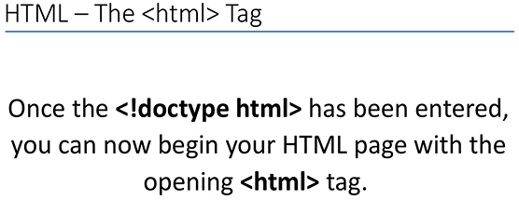
0405.1 Html Tag Video
https://ucsc-extension.instructure.com/courses/3825/pages/1-dot-1-welcome?module_item_id=42202
0405.1 Html Tag Video

Slide 8
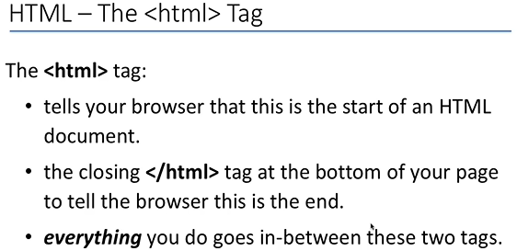
0405.1 Html Tag Video
https://ucsc-extension.instructure.com/courses/3825/pages/1-dot-1-welcome?module_item_id=42202
0405.1 Html Tag Video

Slide 9
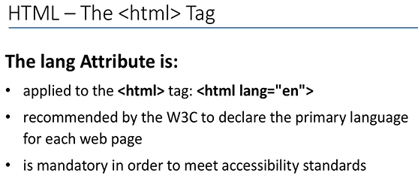
0405.1 Html Tag Video
https://ucsc-extension.instructure.com/courses/3825/pages/1-dot-1-welcome?module_item_id=42202
0405.1 Html Tag Video

Slide 10
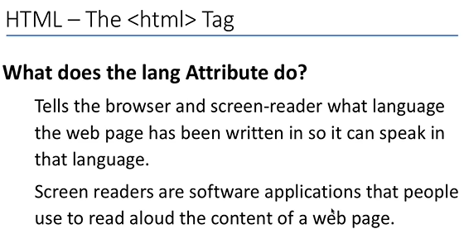
0405.1 Html Tag Video
https://ucsc-extension.instructure.com/courses/3825/pages/1-dot-1-welcome?module_item_id=42202
0405.1 Html Tag Video

Slide 11
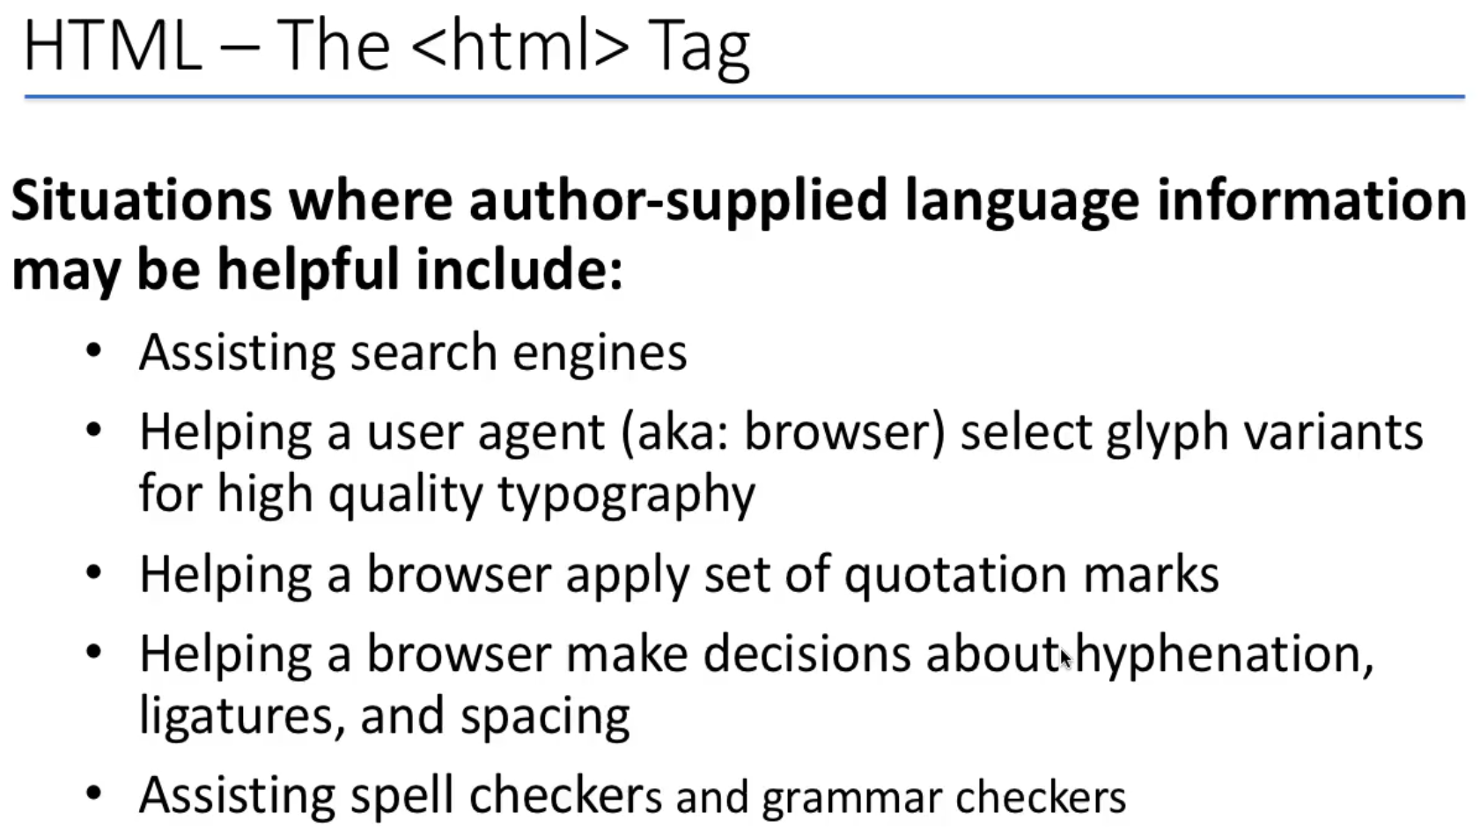
0405.1 Html Tag Video
https://ucsc-extension.instructure.com/courses/3825/pages/1-dot-1-welcome?module_item_id=42202
0405.1 Html Tag Video: Glyph (character shape), hyphenation (punctuation), ligature (synthesize words)

Slide 12
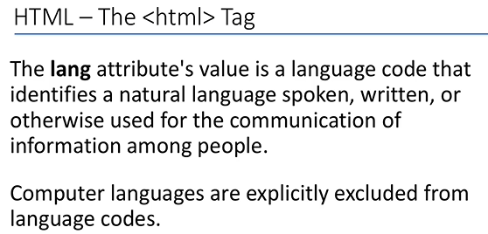
0405.1 Html Tag Video
https://ucsc-extension.instructure.com/courses/3825/pages/1-dot-1-welcome?module_item_id=42202
0405.1 Html Tag Video:

Slide 13
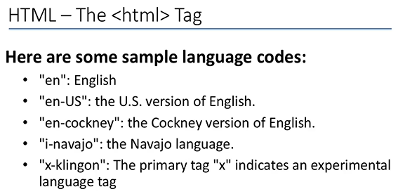
0405.1 Html Tag Video
https://ucsc-extension.instructure.com/courses/3825/pages/1-dot-1-welcome?module_item_id=42202
0405.1 Html Tag Video: Cockney (London worker), Navajo (Arizona Indian), Klingon (Star War language)

Slide 14
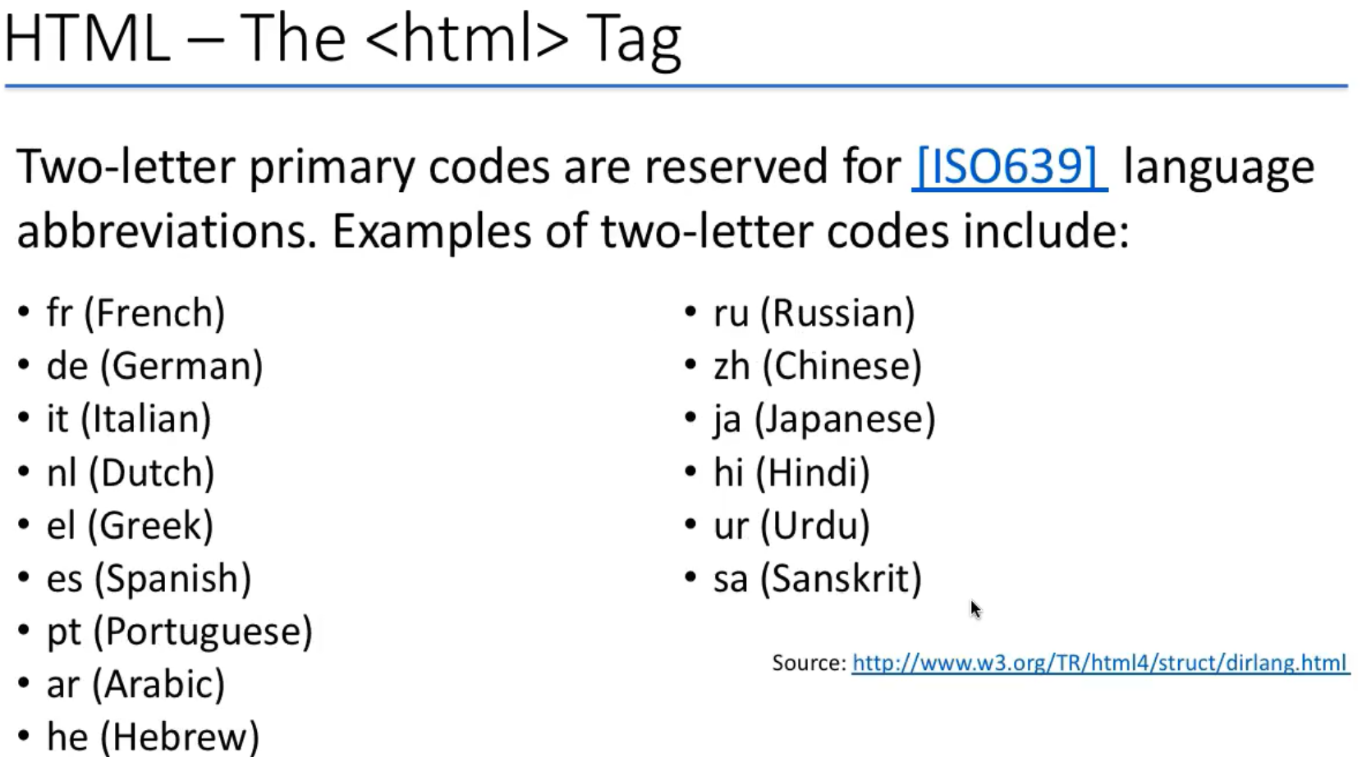
0405.1 Html Tag Video
https://ucsc-extension.instructure.com/courses/3825/pages/1-dot-1-welcome?module_item_id=42202
0405.1 Html Tag Video:

Slide 15
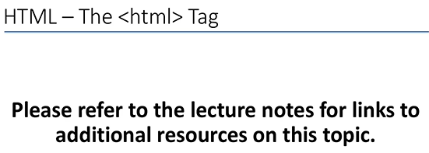
0405.1 Html Tag Video
https://ucsc-extension.instructure.com/courses/3825/pages/1-dot-1-welcome?module_item_id=42202
0405.1 Html Tag Video:

Slide 16
End of Chapter

