Slide 1

0407 Meta Tag
Peter H. Chen

Slide 2
0407 Meta Tag
https://ucsc-extension.instructure.com/courses/3825/pages/1-dot-1-welcome?module_item_id=42202
0407 Meta Tag: Character Entities
Declaring the Character Encoding <meta> Tag:
All text documents are saved with a “Character Encoding”. This makes it easier for browsers on systems with different default encodings to view the characters in your pages correctly. The standard today is utf-8 (Unicode Transformation Format) and is the encoding that represents every character in the Unicode character set.
To learn more about this topic, which goes beyond the scope of this class, go to the Unicode (Links to an external site.) website.
What’s important for this class is how to set the character encoding for your webpage, as it is mandated for validation and if you don’t include it, the browser will have to “guess” and it might mess up your page!
Technically this tag information should go right after your opening <head> tag (or within the first 1024 bytes) so that it can start interpreting and encoding your page correctly from the start.

Slide 3
0407 Meta Tag
https://ucsc-extension.instructure.com/courses/3825/pages/1-dot-1-welcome?module_item_id=42202
0407 Meta Tag: Character Entities
HTML4.01
For HTML 4.01, you write the character encoding within a <meta> tag like this:
<meta http-equiv="content-type" content="text/html; charset=utf-8">
XHTML 1.0
If using XHTML it would be written like this (note the forward slash at the end of the code):
<meta http-equiv="content-type" content="text/html; charset=utf-8" />
HTML5+
And if it’s HTML5 doctype then this meta tag gets written like this (note the quotation mark in front of the utf-8):
<meta charset="utf-8">
As you can see, HTML5 has shortened the <meta> tag content significantly.

Slide 4
0407 Meta Tag
https://ucsc-extension.instructure.com/courses/3825/pages/1-dot-1-welcome?module_item_id=42202
0407 Meta Tag: Character Entities
NOTES:
The value utf-8 is case-insensitive so, UTF-8 and utf-8 both work just fine, however, be consistent and keep everything lower-case.
There is no closing <meta> tag because it is not a container tag which is why for XHTML you put in the forward slash at the end of the tag.

Slide 5
0407.1 Meta Tag Video

Slide 6

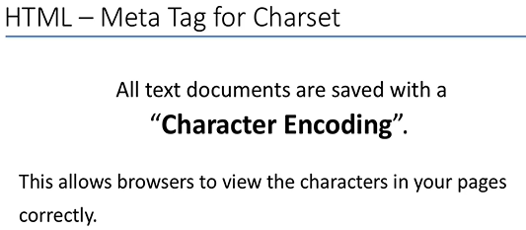
0407 Meta Tag Video
https://ucsc-extension.instructure.com/courses/3825/pages/1-dot-1-welcome?module_item_id=42202
0407 Meta Tag Video:

Slide 7
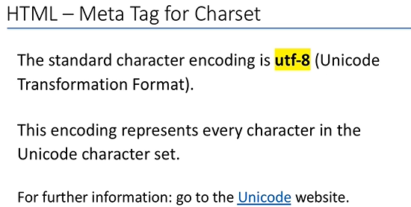
0407 Meta Tag Video
https://ucsc-extension.instructure.com/courses/3825/pages/1-dot-1-welcome?module_item_id=42202
0407 Meta Tag Video:

Slide 8
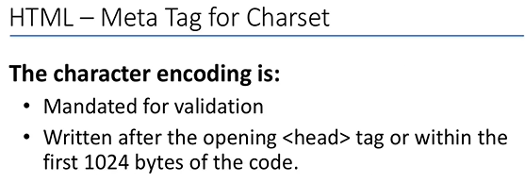
0407 Meta Tag Video
https://ucsc-extension.instructure.com/courses/3825/pages/1-dot-1-welcome?module_item_id=42202
0407 Meta Tag Video:

Slide 9
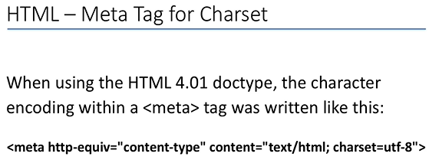
0407 Meta Tag Video
https://ucsc-extension.instructure.com/courses/3825/pages/1-dot-1-welcome?module_item_id=42202
0407 Meta Tag Video:

Slide 10
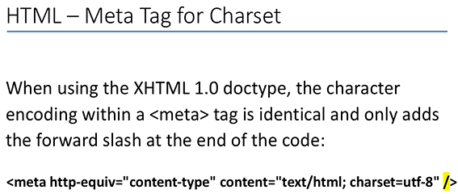
0407 Meta Tag Video
https://ucsc-extension.instructure.com/courses/3825/pages/1-dot-1-welcome?module_item_id=42202
0407 Meta Tag Video:

Slide 11
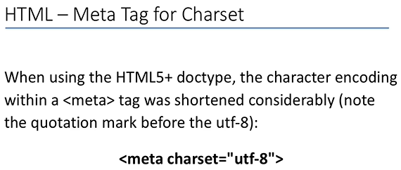
0407 Meta Tag Video
https://ucsc-extension.instructure.com/courses/3825/pages/1-dot-1-welcome?module_item_id=42202
0407 Meta Tag Video:

Slide 12
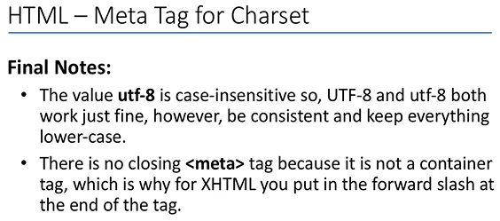
0407 Meta Tag Video
https://ucsc-extension.instructure.com/courses/3825/pages/1-dot-1-welcome?module_item_id=42202
0407 Meta Tag Video:

Slide 13
End of Chapter

