Slide 1

0408 Other Meta Tags
Peter H. Chen

Slide 2
0408 Other Meta Tags
https://ucsc-extension.instructure.com/courses/3825/pages/1-dot-1-welcome?module_item_id=42202
0408 Other Meta Tags:
Other <meta> Tags:
There area many other uses of the meta tag and in this page we will look at the application of two very important ones that provide both the search engines and the users of search engines some additional information about your web page!
Description
Robots
KeywordsVideo Demo

Slide 3
0408 Other Meta Tags
https://ucsc-extension.instructure.com/courses/3825/pages/1-dot-1-welcome?module_item_id=42202
0408 Other Meta Tags:
The "description" value:
There are additional <meta> tags that are used to present information to search engines (robots and spiders) and browsers, but not to your readers. Most use the name and content attributes:
<meta name="description" content="this is a page about stuff.">
This <meta> tag assists search engines in indexing your site. Another, very similar value for name was the keyword meta tag (see below).
The description meta tag is picked up by Google search results and is displayed for the user on the Search Engine Results Page (SERP). For this reason, it is essential to write a good description that is loaded with keywords that people would use to search your website.
If using an XHTML <!DOCTYPE> you must close the meta tag with a space and a forward slash at the end of the opening element.
<meta name="description" content="Stuff that people want." />

Slide 4
0408 Other Meta Tags
https://ucsc-extension.instructure.com/courses/3825/pages/1-dot-1-welcome?module_item_id=42202
0408 Other Meta Tags:
The meta tag should be no more then 135 to 160 characters in length, however, just recently, Google did officially raise that to 320 characters! This article from Search Engine Watch (Links to an external site.) (2016) also had a nice checklist of writing the content for the meta description:

Slide 5
0408 Other Meta Tags
https://ucsc-extension.instructure.com/courses/3825/pages/1-dot-1-welcome?module_item_id=42202
0408 Other Meta Tags:
How to write a great meta description
Meta description checklist (1)
Keywords: do make sure your most important keywords for the webpage show up in the meta description. Often search engines will highlight in bold where it finds the searchers query in your snippet.
Write legible, readable copy: this is essential. Keyword stuffing your meta description is bad and it doesn’t help the searcher as they’ll assume your result leads to a spammy website. Make sure your description reads like a normal, human-written sentence.
Treat the meta description as if it’s an advert for your web-page: make it as compelling and as relevant as possible. The description MUST match the content on the page, but you should also make it as appealing as possible.
Length: a meta description should be no longer than 135 – 160 characters long (Google increased the amount to 320 characters in 2018 (Links to an external site.)!). Any longer and search engines will chop the end off, so make sure any important keywords are nearer the front.

Slide 6
0408 Other Meta Tags
https://ucsc-extension.instructure.com/courses/3825/pages/1-dot-1-welcome?module_item_id=42202
0408 Other Meta Tags:
How to write a great meta description
Meta description checklist (2)
Do not duplicate meta descriptions: As with title tags, the meta descriptions must be written differently for every page. Google may penalize you for mass duplicating your meta descriptions.
Consider using rich snippets: by using schema markup you can add elements to the snippets to increase their appeal. For instance: star ratings, customer ratings, product information, calorie counts etc. [Goes beyond the scope of this class however, if interested in reading what this means, read: What is Schema Markup? (Links to an external site.)]
Further Reading:
Google Featuring Longer Snippets: What to do now? (Links to an external site.) (Search Engine Journal, 12/22/2017)
How to create the right meta description (Links to an external site.) (Yoast, 1/18/2018)

Slide 7
0408 Other Meta Tags
https://ucsc-extension.instructure.com/courses/3825/pages/1-dot-1-welcome?module_item_id=42202
0408 Other Meta Tags:
The "robots" value:
Another meta tags that you will include let’s the search engine know if you want your page indexed (or not) within their database. It also tells the search engines whether to follow (or not) your external links.
robots, defining the behavior that cooperative crawlers should have with the page. It is a comma-separated list of values from the following list:
Values for the content of
<meta name="robots" value="____">

Slide 8
0408 Other Meta Tags
https://ucsc-extension.instructure.com/courses/3825/pages/1-dot-1-welcome?module_item_id=42202
0408 Other Meta Tags: Meta Robot Name Attribute Value
Value | Description | Used by
index | Allows the robot to index the page | All
noindex | Prevents the robot from indexing the page | All
follow | Allows the robot to follow the links on the page | All
nofollow | Prevents the robot from following the links on the page | All
noodp | Prevents the usage of the Open Directory Project (ODP) description, if any, as the description of the page in the search engine results page. Note that the ODP closed down March 14, 2017 (Links to an external site.). | Google (Links to an external site.), Yahoo, Bing

Slide 9
0408 Other Meta Tags
https://ucsc-extension.instructure.com/courses/3825/pages/1-dot-1-welcome?module_item_id=42202
0408 Other Meta Tags: Meta Robot Name Attribute Value
Value | Description | Used by
noarchive | Prevents the search engine from caching the content of the page | Google (Links to an external site.), Yahoo
nosnippet | Prevents the display of any description of the page in the search engine results page | Google (Links to an external site.)
noimageindex | Prevents this page from appearing as the referring page of an indexed image | Google (Links to an external site.)
nocache | Synonym of noarchive | Bing

Slide 10
0408 Other Meta Tags
https://ucsc-extension.instructure.com/courses/3825/pages/1-dot-1-welcome?module_item_id=42202
0408 Other Meta Tags:
When in development mode, you can use a couple of values such as:
<meta name="robots" value="noindex, nofollow">
This might be used when you are testing a website and don't want the search engines to list this page in their database just yet! When ready, you can write index,follow.
The NYT website, for example uses:
<meta name="robots" content="noarchive,noodp,noydir">

Slide 11
0408 Other Meta Tags
https://ucsc-extension.instructure.com/courses/3825/pages/1-dot-1-welcome?module_item_id=42202
0408 Other Meta Tags:
The "keywords" value:
The meta for keywords is gone down because search engines like Google do not use this meta tag! Up until 2017, Google had a meta tag called news_keywords but stopped supporting it. “Google drops support for meta news keywords tag (Links to an external site.)” Feb. 2017.

Slide 12
0408 Other Meta Tags
https://ucsc-extension.instructure.com/courses/3825/pages/1-dot-1-welcome?module_item_id=42202
0408 Other Meta Tags:
Want to learn more? Here are links for further reading:
The <meta> tag for the purpose’s of making the search engines happy is an evolving process that changes constantly. For more information and the latest news, I find it useful to follow on Twitter or visit these websites:
Here are a few of resources:
Mozilla Development (Links to an external site.)
Search Engine Watch (Links to an external site.)
Search Engine Land

Slide 13
0408.1 Other Meta Tag Video

Slide 14

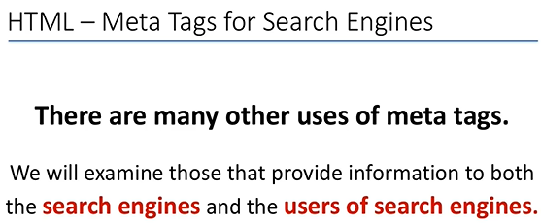
0408.1 Other Meta Tag Video
https://ucsc-extension.instructure.com/courses/3825/pages/1-dot-1-welcome?module_item_id=42202
0408.1 Other Meta Tag Video
This video (6:22) goes over the other key meta tags used for providing information to the Search Engines, such as description, robots and keywords. The lecture can help you better understand what these meta tags are use for and how they are applied in your web pages!

Slide 15
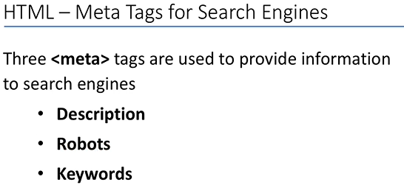
0408.1 Other Meta Tag Video
https://ucsc-extension.instructure.com/courses/3825/pages/1-dot-1-welcome?module_item_id=42202
0408.1 Other Meta Tag Video

Slide 16
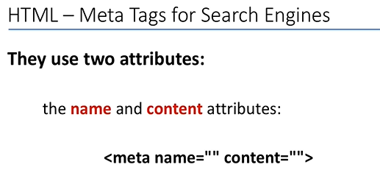
0408.1 Other Meta Tag Video
https://ucsc-extension.instructure.com/courses/3825/pages/1-dot-1-welcome?module_item_id=42202
0408.1 Other Meta Tag Video

Slide 17
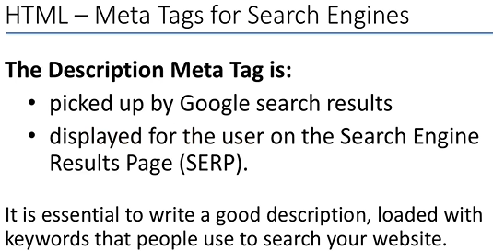
0408.1 Other Meta Tag Video
https://ucsc-extension.instructure.com/courses/3825/pages/1-dot-1-welcome?module_item_id=42202
0408.1 Other Meta Tag Video

Slide 18
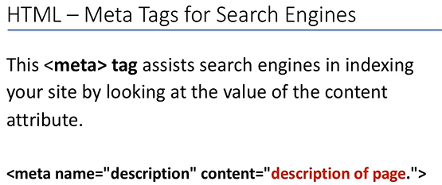
0408.1 Other Meta Tag Video
https://ucsc-extension.instructure.com/courses/3825/pages/1-dot-1-welcome?module_item_id=42202
0408.1 Other Meta Tag Video

Slide 19
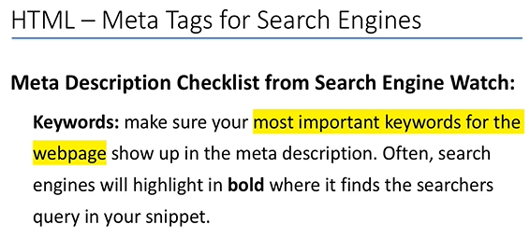
0408.1 Other Meta Tag Video
https://ucsc-extension.instructure.com/courses/3825/pages/1-dot-1-welcome?module_item_id=42202
0408.1 Other Meta Tag Video

Slide 20
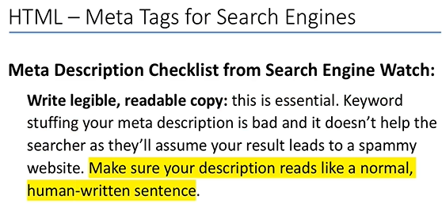
0408.1 Other Meta Tag Video
https://ucsc-extension.instructure.com/courses/3825/pages/1-dot-1-welcome?module_item_id=42202
0408.1 Other Meta Tag Video

Slide 21
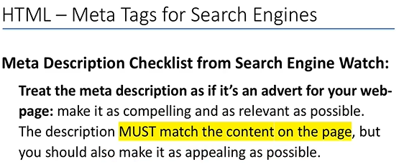
0408.1 Other Meta Tag Video
https://ucsc-extension.instructure.com/courses/3825/pages/1-dot-1-welcome?module_item_id=42202
0408.1 Other Meta Tag Video

Slide 22
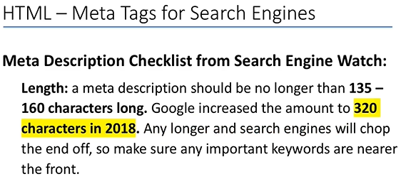
0408.1 Other Meta Tag Video
https://ucsc-extension.instructure.com/courses/3825/pages/1-dot-1-welcome?module_item_id=42202
0408.1 Other Meta Tag Video

Slide 23
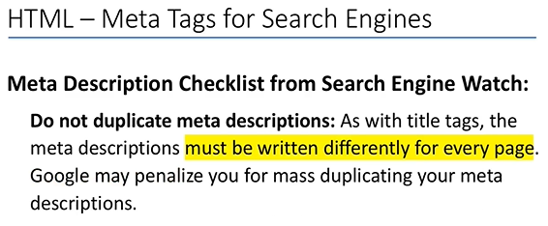
0408.1 Other Meta Tag Video
https://ucsc-extension.instructure.com/courses/3825/pages/1-dot-1-welcome?module_item_id=42202
0408.1 Other Meta Tag Video

Slide 24
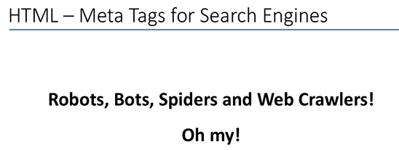
0408.1 Other Meta Tag Video
https://ucsc-extension.instructure.com/courses/3825/pages/1-dot-1-welcome?module_item_id=42202
0408.1 Other Meta Tag Video

Slide 25
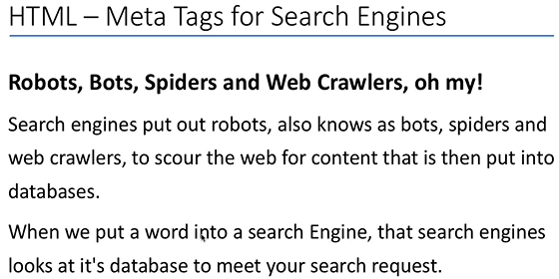
0408.1 Other Meta Tag Video
https://ucsc-extension.instructure.com/courses/3825/pages/1-dot-1-welcome?module_item_id=42202
0408.1 Other Meta Tag Video: Bot (Robot)

Slide 26
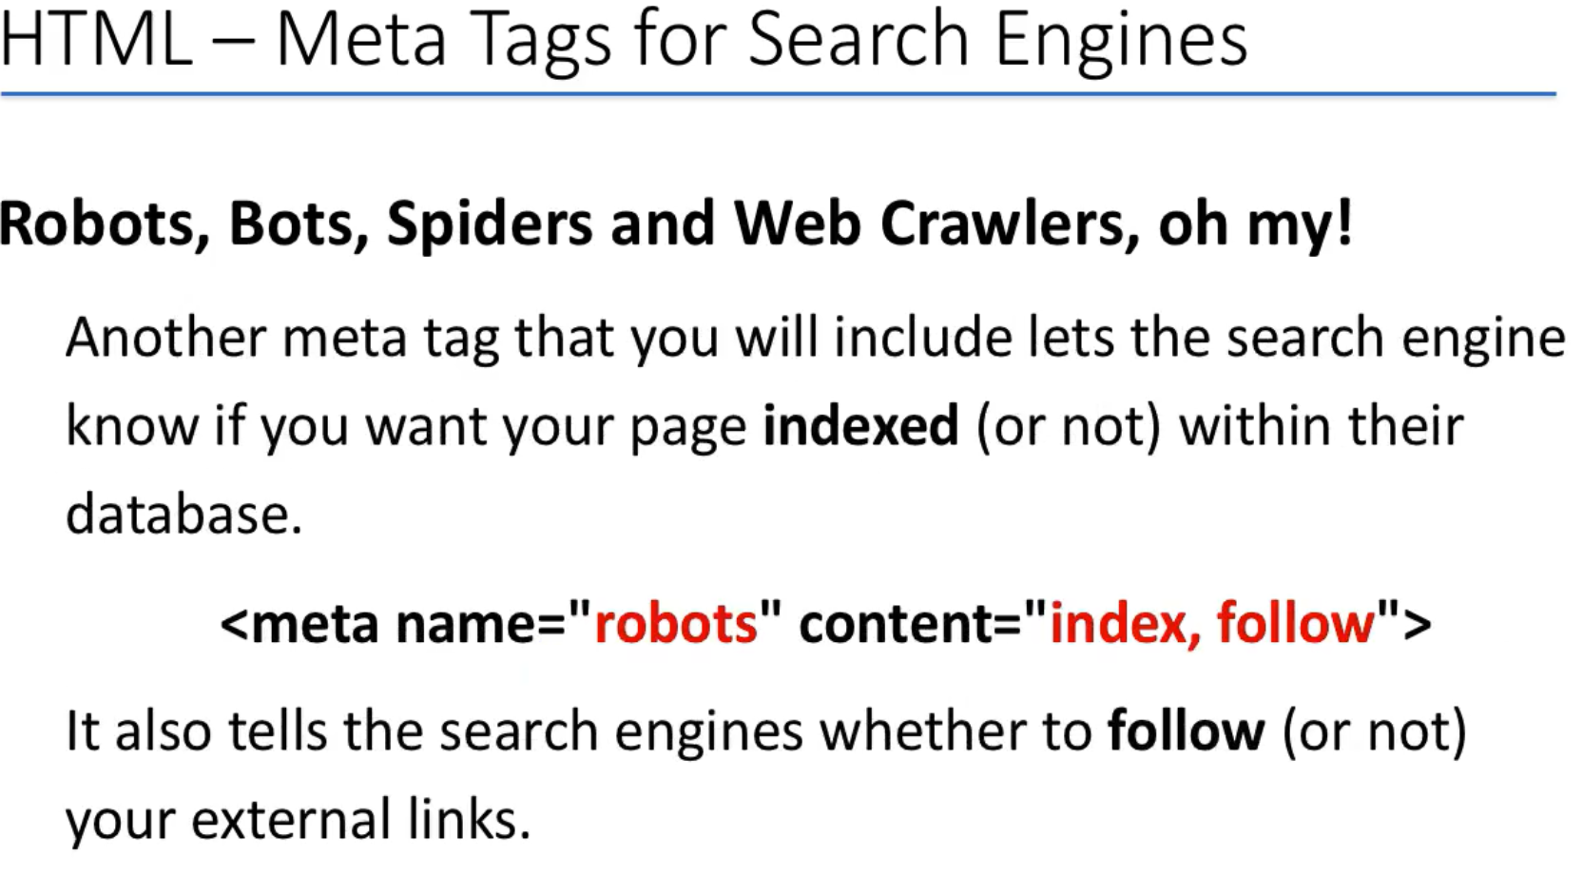
0408.1 Other Meta Tag Video
https://ucsc-extension.instructure.com/courses/3825/pages/1-dot-1-welcome?module_item_id=42202
0408.1 Other Meta Tag Video:

Slide 27
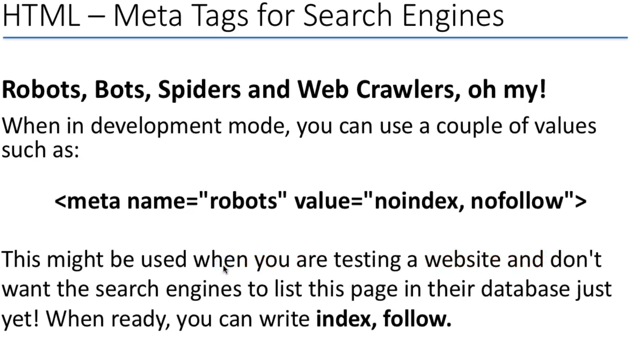
0408.1 Other Meta Tag Video
https://ucsc-extension.instructure.com/courses/3825/pages/1-dot-1-welcome?module_item_id=42202
0408.1 Other Meta Tag Video:

Slide 28
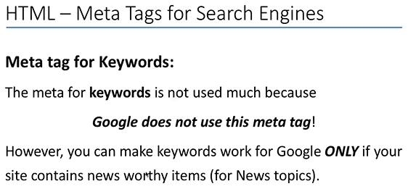
0408.1 Other Meta Tag Video
https://ucsc-extension.instructure.com/courses/3825/pages/1-dot-1-welcome?module_item_id=42202
0408.1 Other Meta Tag Video:

Slide 29
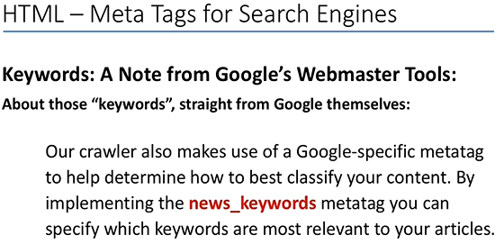
0408.1 Other Meta Tag Video
https://ucsc-extension.instructure.com/courses/3825/pages/1-dot-1-welcome?module_item_id=42202
0408.1 Other Meta Tag Video:

Slide 30
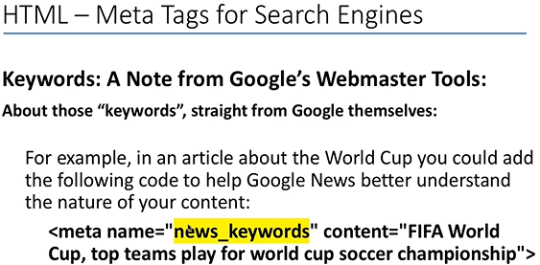
0408.1 Other Meta Tag Video
https://ucsc-extension.instructure.com/courses/3825/pages/1-dot-1-welcome?module_item_id=42202
0408.1 Other Meta Tag Video:

Slide 31

0408.1 Other Meta Tag Video
https://ucsc-extension.instructure.com/courses/3825/pages/1-dot-1-welcome?module_item_id=42202
0408.1 Other Meta Tag Video:

Slide 32
End of Chapter

