Slide 1

0409 Title Tag
Peter H. Chen

Slide 2
0409 Title Tag
https://ucsc-extension.instructure.com/courses/3825/pages/1-dot-1-welcome?module_item_id=42202
0409 Title Tag
The <title> Tag
The title tag goes between your opening <head> and closing </head>.
<title> This is the title of my page. </title>
Why is the title so important?
The title tag is important because: the text between the open and close <title> tags will be used by:
Browser Window Title Bar (see top of the browser window),
Search engine's looking for keywords to match a request and
the user when they Bookmarks/Favorites a site.

Slide 3
0409 Title Tag
https://ucsc-extension.instructure.com/courses/3825/pages/1-dot-1-welcome?module_item_id=42202
0409 Title Tag
Here are three tabs of three major newspapers.
You can see that SF Gate has a lot more words and they get cut off as seen by the ellipsis (three dots).

Slide 4
0409 Title Tag
https://ucsc-extension.instructure.com/courses/3825/pages/1-dot-1-welcome?module_item_id=42202
0409 Title Tag
Tips and Tricks - Best Practices:
With that in mind, you should keep these things in mind when writing a title for your web page (each web page gets a unique title):
Keep the <title> information short. Title information should not be more than 60 characters or 80 characters. This includes spaces, commas and carriage returns. Keep it short and sweet and use keywords that describe this site.
Keep the <title> meaningful. When coming up with a title, don’t say something like “Welcome to our site”. Give the name of the company or your name. “Ted’s Art Portfolio” is far better than “Welcome to Ted’s Site”, both for Search Engines but also for people who are going to bookmark your site.
It’s a required tag: HTML 4.01 specification states that all documents must contain a meaningful title within the <head> of the document. Titles should contain only ASCII characters (letters, numbers, base punctuation). Special characters such as “&” should be referred to by their character entities, in this case “&amp;”.

Slide 5
0409.1 Title Tag Video

Slide 6

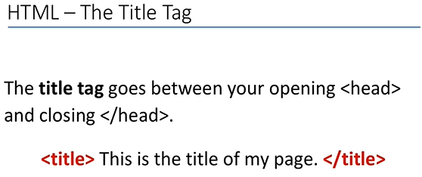
0409.1 Title Tag Video
https://ucsc-extension.instructure.com/courses/3825/pages/1-dot-1-welcome?module_item_id=42202
0409.1 Title Tag Video

Slide 7
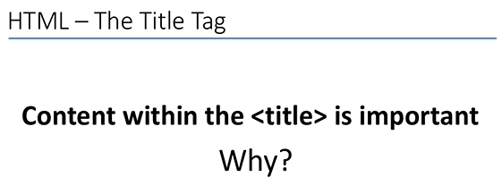
0409.1 Title Tag Video
https://ucsc-extension.instructure.com/courses/3825/pages/1-dot-1-welcome?module_item_id=42202
0409.1 Title Tag Video

Slide 8
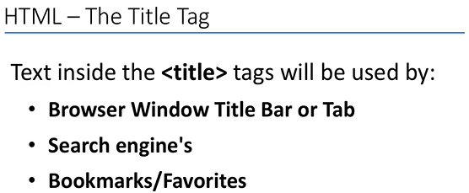
0409.1 Title Tag Video
https://ucsc-extension.instructure.com/courses/3825/pages/1-dot-1-welcome?module_item_id=42202
0409.1 Title Tag Video

Slide 9
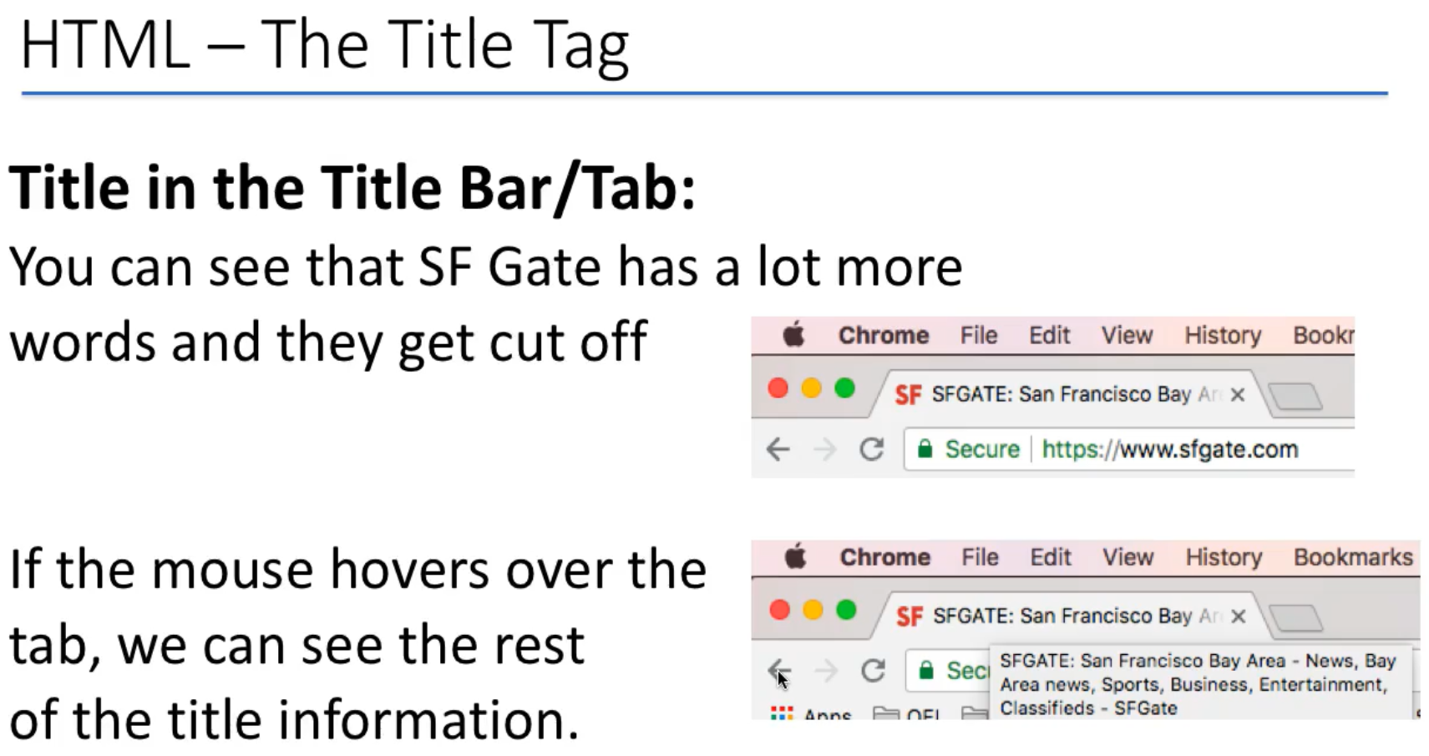
0409.1 Title Tag Video
https://ucsc-extension.instructure.com/courses/3825/pages/1-dot-1-welcome?module_item_id=42202
0409.1 Title Tag Video

Slide 10
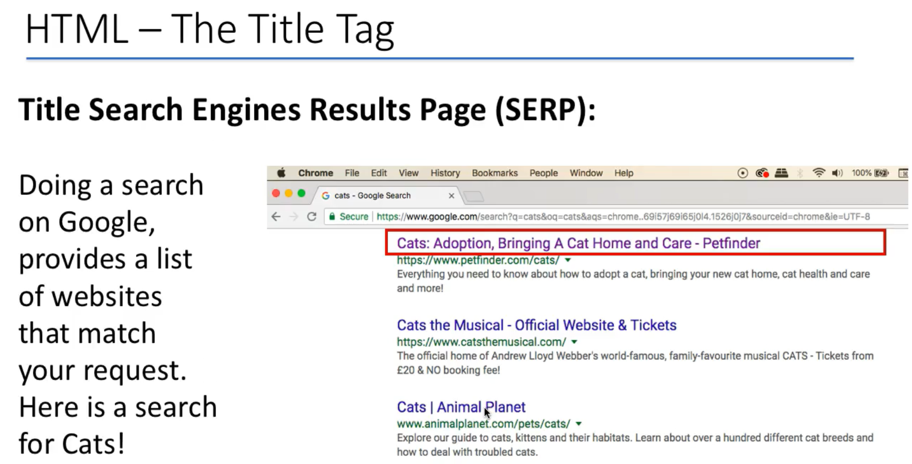
0409.1 Title Tag Video
https://ucsc-extension.instructure.com/courses/3825/pages/1-dot-1-welcome?module_item_id=42202
0409.1 Title Tag Video

Slide 11
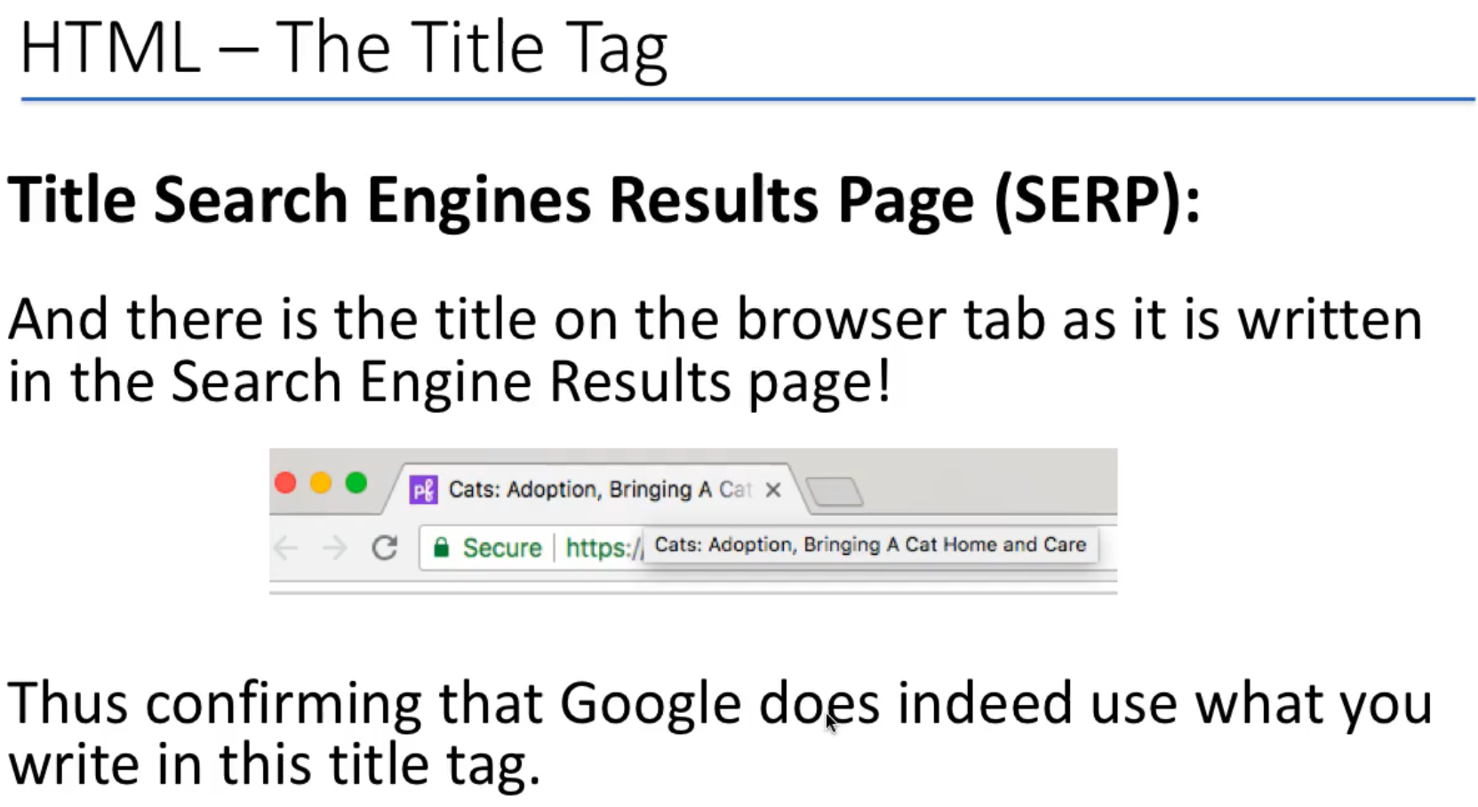
0409.1 Title Tag Video
https://ucsc-extension.instructure.com/courses/3825/pages/1-dot-1-welcome?module_item_id=42202
0409.1 Title Tag Video

Slide 12
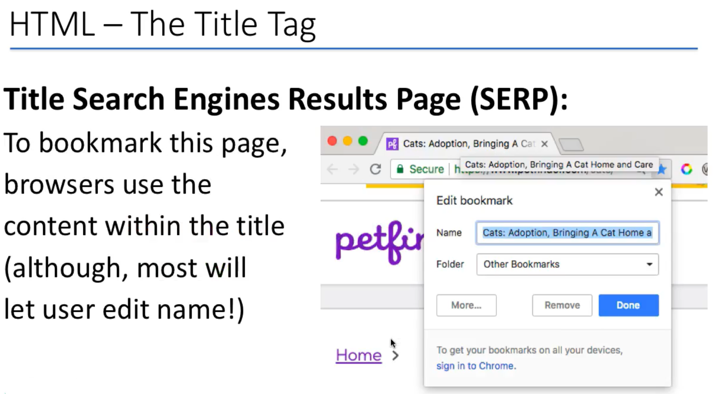
0409.1 Title Tag Video
https://ucsc-extension.instructure.com/courses/3825/pages/1-dot-1-welcome?module_item_id=42202
0409.1 Title Tag Video

Slide 13
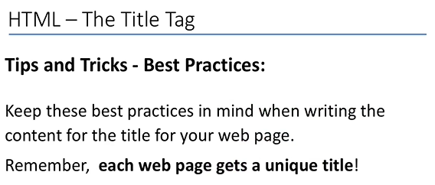
0409.1 Title Tag Video
https://ucsc-extension.instructure.com/courses/3825/pages/1-dot-1-welcome?module_item_id=42202
0409.1 Title Tag Video

Slide 14
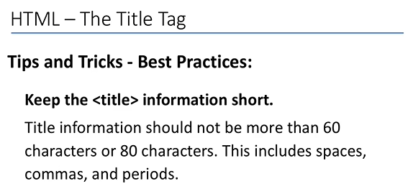
0409.1 Title Tag Video
https://ucsc-extension.instructure.com/courses/3825/pages/1-dot-1-welcome?module_item_id=42202
0409.1 Title Tag Video

Slide 15
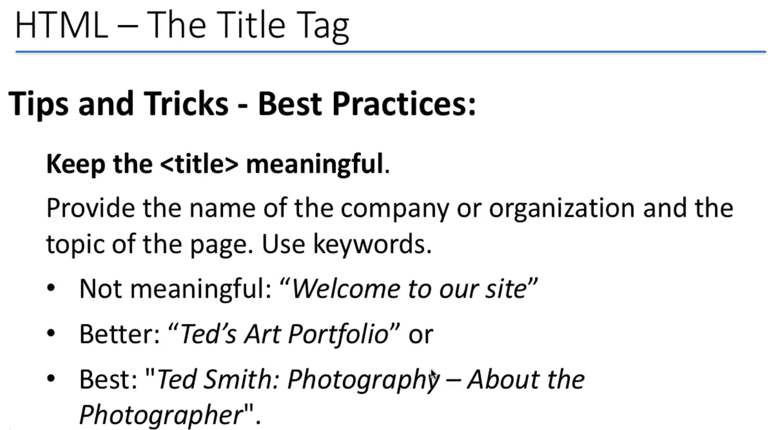
0409.1 Title Tag Video
https://ucsc-extension.instructure.com/courses/3825/pages/1-dot-1-welcome?module_item_id=42202
0409.1 Title Tag Video

Slide 16
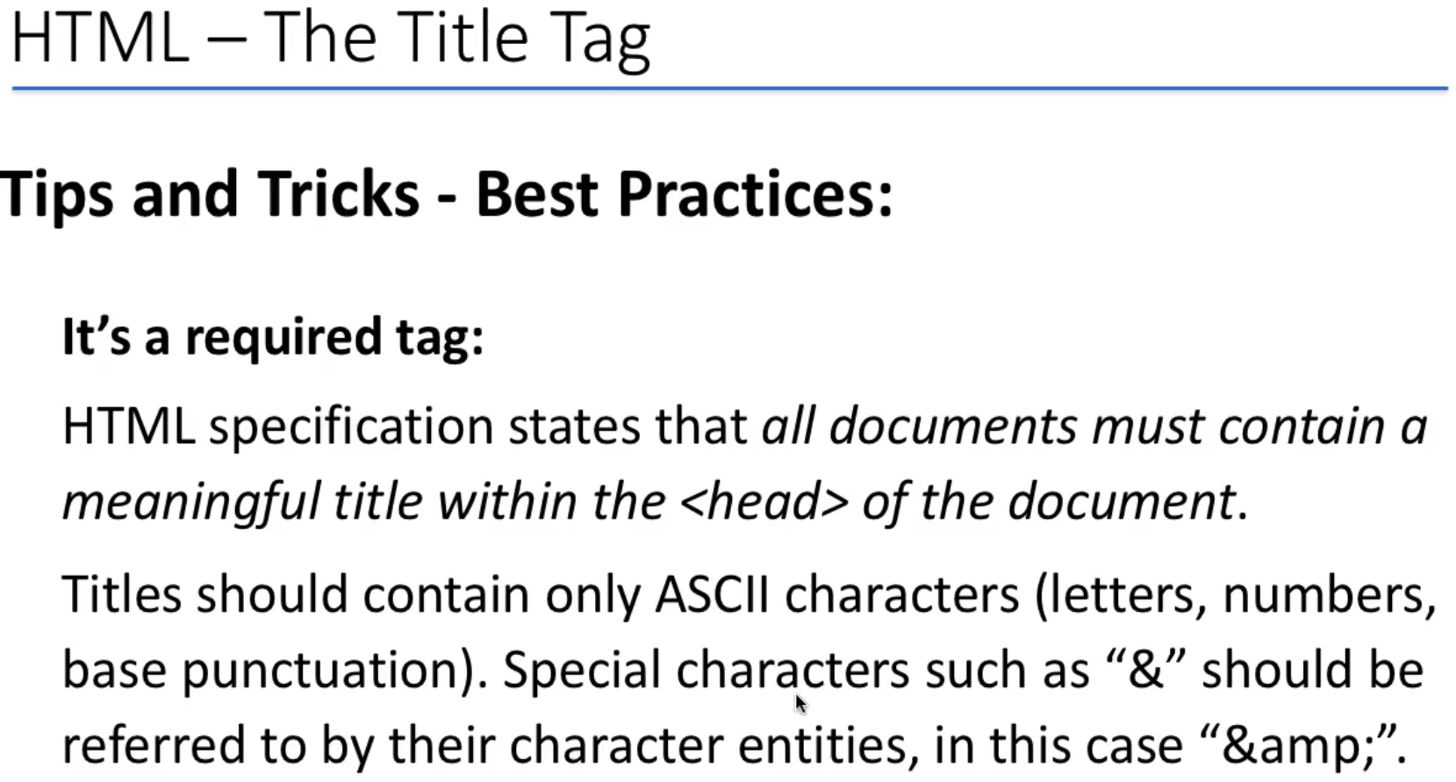
0409.1 Title Tag Video
https://ucsc-extension.instructure.com/courses/3825/pages/1-dot-1-welcome?module_item_id=42202
0409.1 Title Tag Video
& is HTML for "Start of a character reference".
&amp; is the character reference for "An ampersand".
&current; is not a standard character reference and so is an error (browsers may try to perform error recovery but you should not depend on this).
If you used a character reference for a real character (e.g. &trade;) then it (™) would appear in the URL instead of the string you wanted.
HTML doesn't recognize the & but it will recognize &amp; because it = & in html

Slide 17
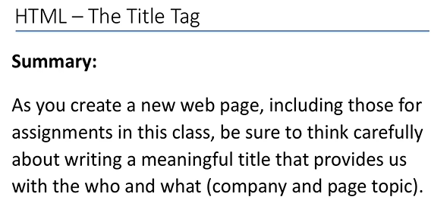
0409.1 Title Tag Video
https://ucsc-extension.instructure.com/courses/3825/pages/1-dot-1-welcome?module_item_id=42202
0409.1 Title Tag Video

Slide 18
End of Chapter

