Slide 1

0412 Heading Element
Peter H. Chen

Slide 2
0412 Heading Element
https://ucsc-extension.instructure.com/courses/3825/pages/1-dot-1-welcome?module_item_id=42202
0412 Heading Element
The Heading tag <h1>...</h1>, <h2>...</h2>, etc.
Headings are block level elements that are, by default, displayed in bold text with pre-determined space above and below.
There are 6 levels of headings <h1> to <h6>, with <h1> being the highest or top level heading and <h6> being the lowest or bottom-level element.
You will see that the browsers will display these as different 'sizes' based on the default browser display settings.
How to use these 6 levels of headings:
Think of “headings” to be used like headlines for newspapers or magazine covers.
The heading 1 is similar to the main headline of the day.
Other headlines are headlines for stories of different levels of importance or interest. Legal HTML syntax requires that headings appear in order.
For example, <h3> cannot precede <h2>.

Slide 3
0412 Heading Element
https://ucsc-extension.instructure.com/courses/3825/pages/1-dot-1-welcome?module_item_id=42202
0412 Heading Element
Do not skip heading levels (in other words do not go from h1 to h3).
Another way of thinking about how to apply heading elements is based on an "outline" of topics.
When writing an essay or research paper, you would begin by writing out an outline of the main topics covered.
The h1 represents the main topic (or, on a web page, the company or organization name) and the next level of headings would be subheadings of that main topic.
Heading 3 would be a subheading of any heading 2 topic and so on.

Slide 4
0412.1 Heading Element Video

Slide 5
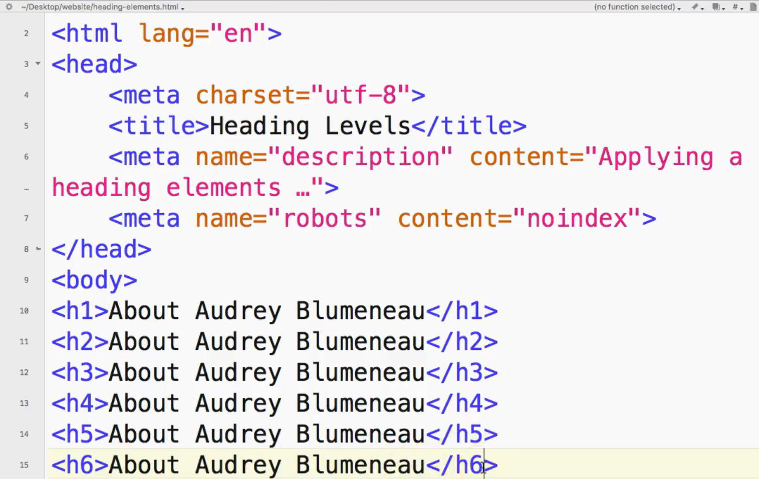
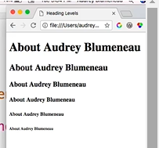
0412.1 Heading Element Video
https://ucsc-extension.instructure.com/courses/3825/pages/1-dot-1-welcome?module_item_id=42202
0412.1 Heading Element Video

Slide 6
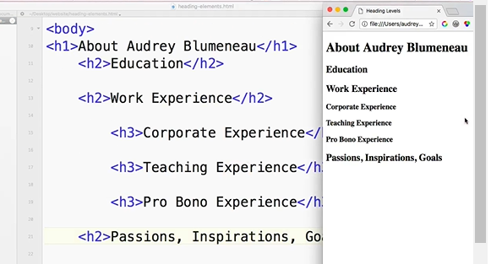
0412.1 Heading Element Video
https://ucsc-extension.instructure.com/courses/3825/pages/1-dot-1-welcome?module_item_id=42202
0412.1 Heading Element Video

Slide 7
0412.2 Heading and Assistive Technology

Slide 8
0412.2 Heading and Assistive Technology
https://ucsc-extension.instructure.com/courses/3825/pages/1-dot-1-welcome?module_item_id=42202
0412.2 Heading and Assistive Technology
Headings also help your page get properly indexed and help your page be readable for blind people who use screen readers.
Using JAWS, which is a commonly used screen reader for example, a user can hit the H key to jump from heading to heading, hit “2″ to go to the next <h2>, “3″ to go to the next <h3>, and so on.
View this YouTube video on the Importance of Headings for Accessibility for a blind person using a screen reader.

Slide 9
0412.2 Heading and Assistive Technology
https://ucsc-extension.instructure.com/courses/3825/pages/1-dot-1-welcome?module_item_id=42202
0412.2 Heading and Assistive Technology
Obsolete attributes (in other words: Do not use!):
I only show this so that you know that if you see this attribute you are looking at “old” code!
In regards to “presentation” of the heading tags, in the old days we could use an attribute for this tag to align the position of our headings. The “align” attribute is deprecated (meaning that it's obsolete, not used any more, not part of the HTML5 specifications) because alignment has to do with presentation and not structure.
This align attribute can only be used with a Transitional Doctype in order to validate.
A Strict or HTML5 Doctype will not validate with this attribute.

Slide 10
0412.2 Heading and Assistive Technology
https://ucsc-extension.instructure.com/courses/3825/pages/1-dot-1-welcome?module_item_id=42202
0412.2 Heading and Assistive Technology
You will still see align used by older or amateur websites. Again, I show it only to make sure you are aware of what this attribute is and why you would want to remove it should you see it being used. This no longer done, but just so you know how it was written, here is what it would look like:
align="center" or "left" or "right"
<h1 align="center">
This is a Heading Level 1 centered on the page.</h1>
We will not be covering CSS styles in this class but I will demonstrate a simple way to achieve the same concept from HTML to CSS. In the end, it’s best to not use any style attributes, as there is an even better way to do this – but that’s for the CSS class!

Slide 11
End of Chapter

