Slide 1

0413 Paragraph
Peter H. Chen

Slide 2
0413 Paragraph
https://ucsc-extension.instructure.com/courses/3825/pages/1-dot-1-welcome?module_item_id=42202
0413 Paragraph
The <p> Tag
A browser is clueless when you need to display paragraphs in your page unless you tell it that’s what you want.
You do this by using a paragraph: <p> tag.
Although technically the closing tag is optional, please get into the habit of closing this tag.
XHTML standards mandate this tag be closed. Plus, it just makes semantic sense that when paragraph ends that you tell the browser this is the end of this paragraph. How else would a browser know that?
As with the heading tags, we could use the align attribute within a <p> tag.
However, it has been deprecated and is no longer used by Strict or HTML5 doctypes, so my advice is, don’t ever use it!
<p>Here is some text in a paragraph of information.</p>
<p>And here is the next paragraph.</p>

Slide 3
0413.1 Paragraph Video

Slide 4
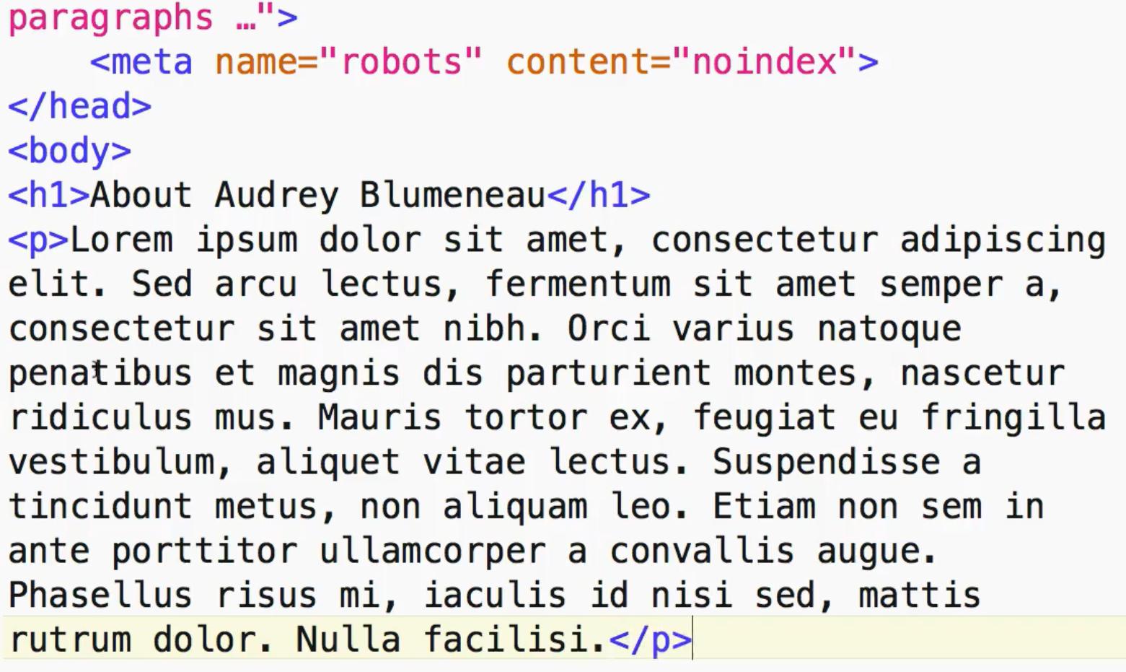
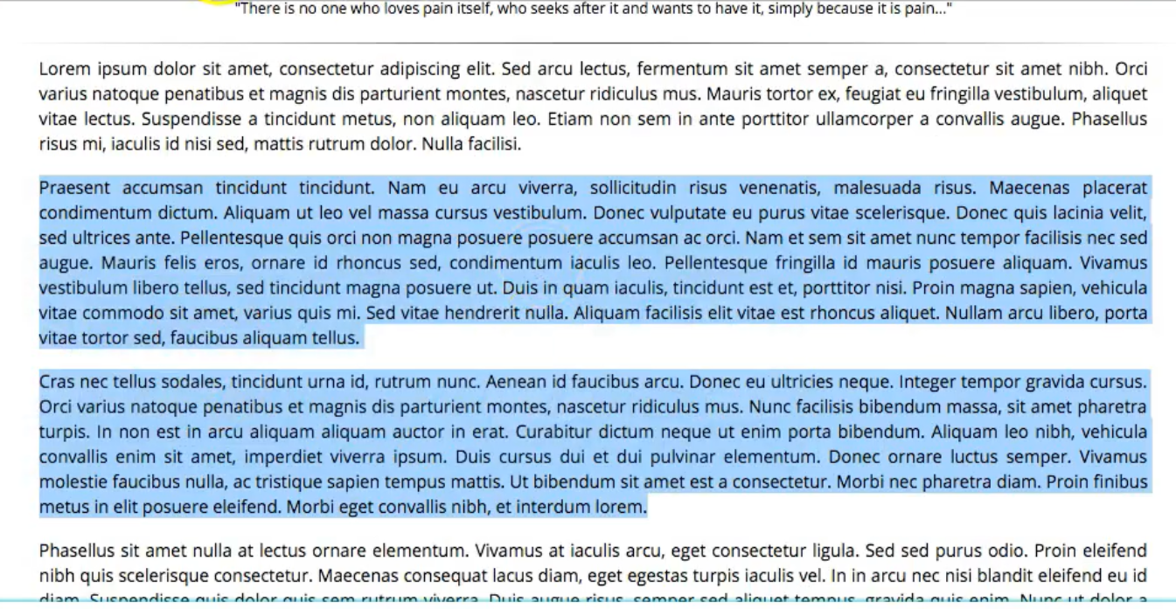
0413.1 Paragraph Video
https://ucsc-extension.instructure.com/courses/3825/pages/1-dot-1-welcome?module_item_id=42202
0413.1 Paragraph Video

Slide 5
0413.2 Heading and Assistive Technology

Slide 6
0413.2 Heading and Assistive Technology
https://ucsc-extension.instructure.com/courses/3825/pages/1-dot-1-welcome?module_item_id=42202
0413.2 Heading and Assistive Technology
Headings also help your page get properly indexed and help your page be readable for blind people who use screen readers.
Using JAWS, which is a commonly used screen reader for example, a user can hit the H key to jump from heading to heading, hit “2″ to go to the next <h2>, “3″ to go to the next <h3>, and so on.
View this YouTube video on the Importance of Headings for Accessibility for a blind person using a screen reader.

Slide 7
0412.2 Heading and Assistive Technology
https://ucsc-extension.instructure.com/courses/3825/pages/1-dot-1-welcome?module_item_id=42202
0413.2 Heading and Assistive Technology
Obsolete attributes (in other words: Do not use!):
I only show this so that you know that if you see this attribute you are looking at “old” code!
In regards to “presentation” of the heading tags, in the old days we could use an attribute for this tag to align the position of our headings. The “align” attribute is deprecated (meaning that it's obsolete, not used any more, not part of the HTML5 specifications) because alignment has to do with presentation and not structure.
This align attribute can only be used with a Transitional Doctype in order to validate.
A Strict or HTML5 Doctype will not validate with this attribute.

Slide 8
0413.2 Heading and Assistive Technology
https://ucsc-extension.instructure.com/courses/3825/pages/1-dot-1-welcome?module_item_id=42202
0413.2 Heading and Assistive Technology
You will still see align used by older or amateur websites. Again, I show it only to make sure you are aware of what this attribute is and why you would want to remove it should you see it being used. This no longer done, but just so you know how it was written, here is what it would look like:
align="center" or "left" or "right"
<h1 align="center">
This is a Heading Level 1 centered on the page.</h1>
We will not be covering CSS styles in this class but I will demonstrate a simple way to achieve the same concept from HTML to CSS. In the end, it’s best to not use any style attributes, as there is an even better way to do this – but that’s for the CSS class!

Slide 9
End of Chapter

