Slide 1

0414 Inline Element
Peter H. Chen

Slide 2
0414 Inline Element
https://ucsc-extension.instructure.com/courses/3825/pages/1-dot-1-welcome?module_item_id=42202
0414 Inline Element
Inline Elements
Inline elements are those elements that are placed “in the line” of that particular heading or paragraph. For instance, if we wanted to place emphasis on a word we would use the <em> element in front of the text we want to emphasize and close it </em> after the word or words we wanted to emphasize.
<p>Here is some text with some <em>emphasized</em> text.</p>
This would look like this on the browser:
Here is some text with some emphasized text.

Slide 3
0414.1 Paragraph Video

Slide 4
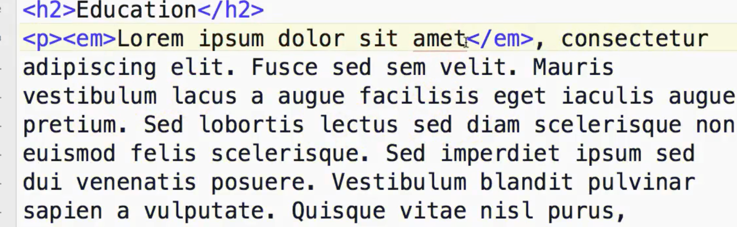
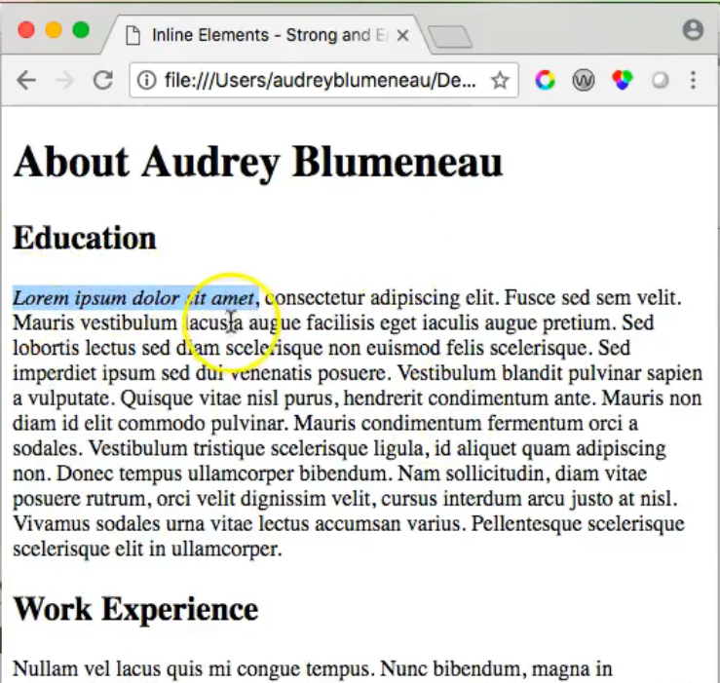
0414.1 Paragraph Video
https://ucsc-extension.instructure.com/courses/3825/pages/1-dot-1-welcome?module_item_id=42202
0413.1 Paragraph Video

Slide 5
End of Chapter

