Slide 1

0415 Validation
Peter H. Chen

Slide 2
0415 Validation
https://ucsc-extension.instructure.com/courses/3825/pages/1-dot-1-welcome?module_item_id=42202
0415 Validation
Validating your Web Page:
It is mandatory for web designers to write valid HTML/XHTML
Any web design firm will expect you to know and understand what it means to write “valid code”. So, before we move on with more tags, let’s look at what we have so far and make sure that it really is “valid”!
Think of validation like a spell check or grammar check in Microsoft Word. The validator will pick up all your typos and ‘punctuation’ to ensure that your tags are correctly written.

Slide 3
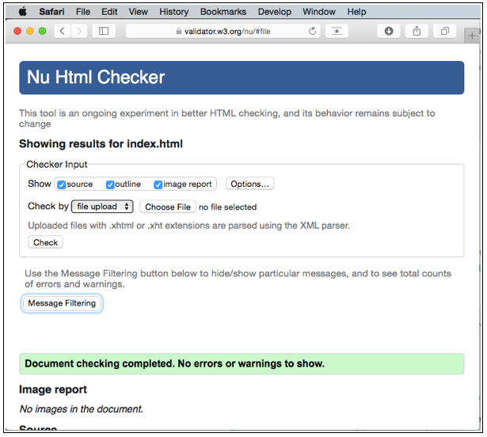
0415 Validation
https://ucsc-extension.instructure.com/courses/3825/pages/1-dot-1-welcome?module_item_id=42202
0415 Validation
W3C Validation Checker:
We will be using the W3C’s validation service although there are others.
For HTML5 Doctype use the “Nu” HTML Checker from the W3C

Slide 4
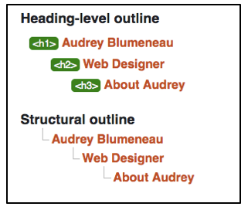
0415 Validation
https://ucsc-extension.instructure.com/courses/3825/pages/1-dot-1-welcome?module_item_id=42202
0415 Validation
Note: HTML5 does not have a “validation icon” as you have with HTML 4.01 or XHTML!
Make sure to check the checkboxes to "Show: source, outline, image report". Choose your file and click on the "Check" button. If all goes well, you will that "Green bar of success" that let's you know that there were no errors or warnings. That doesn't mean your code is perfect but as far as the specifications go, this is what you are aiming for!
When you check all the boxes for Show source, outline and image report, take a look at the results, scroll to bottom to see results.

Slide 5
0415.1 Validation Video

Slide 6
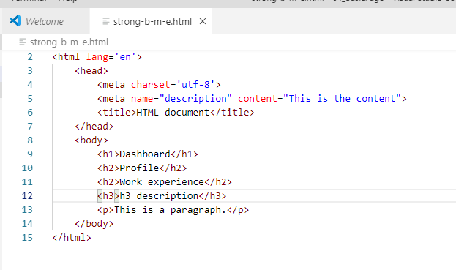
0415.1 Validation Video
https://ucsc-extension.instructure.com/courses/3825/pages/1-dot-1-welcome?module_item_id=42202
0415.1 Validation Video: Create a HTML file

Slide 7
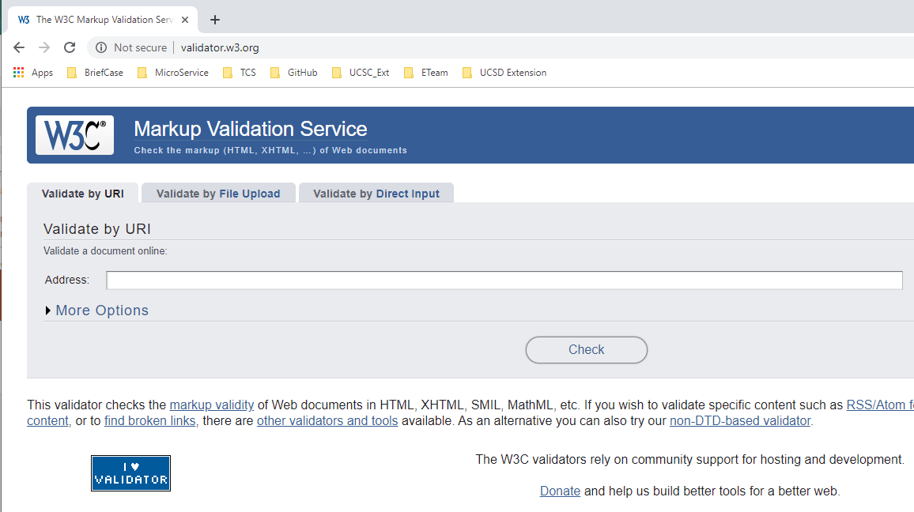
0415.1 Validation Video
https://ucsc-extension.instructure.com/courses/3825/pages/1-dot-1-welcome?module_item_id=42202
0415.1 Validation Video: validator.w3.org

Slide 8
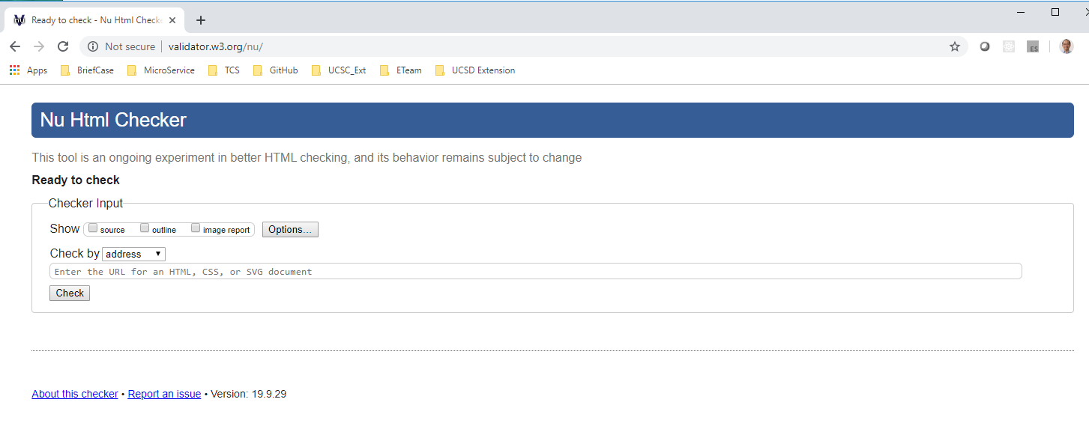
0415.1 Validation Video
https://ucsc-extension.instructure.com/courses/3825/pages/1-dot-1-welcome?module_item_id=42202
0415.1 Validation Video: validator.w3.org/nu

Slide 9
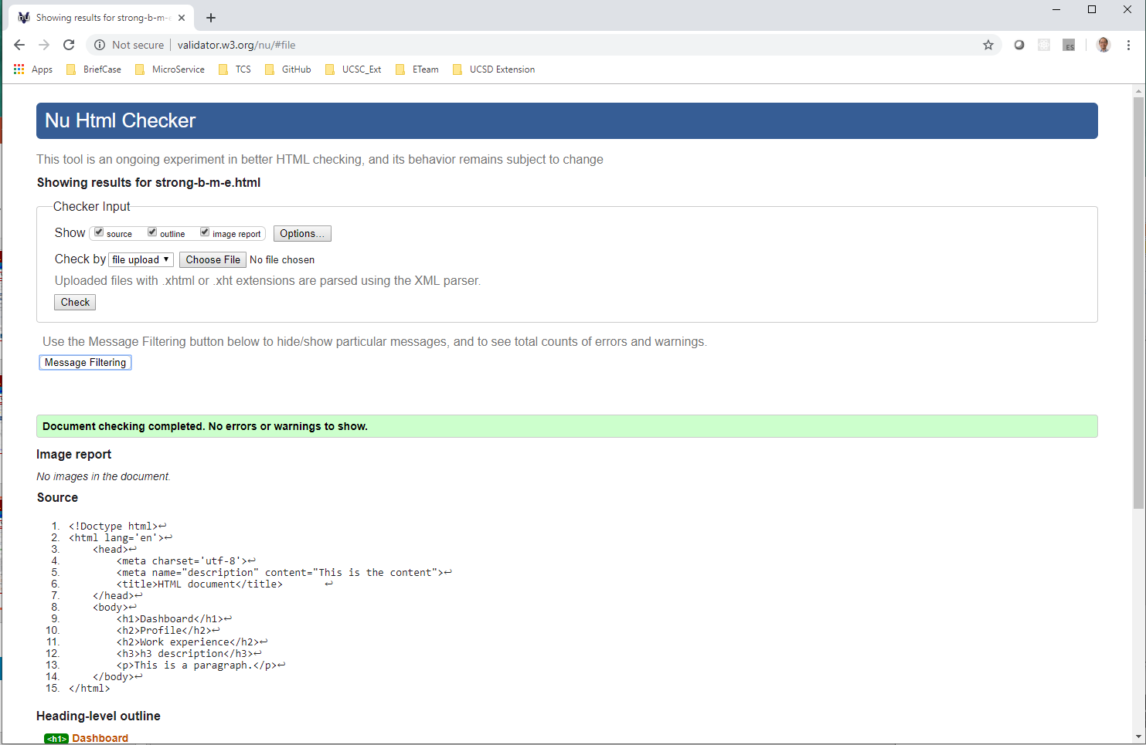
0415.1 Validation Video
https://ucsc-extension.instructure.com/courses/3825/pages/1-dot-1-welcome?module_item_id=42202
0415.1 Validation Video: validator.w3.org/nu

Slide 10
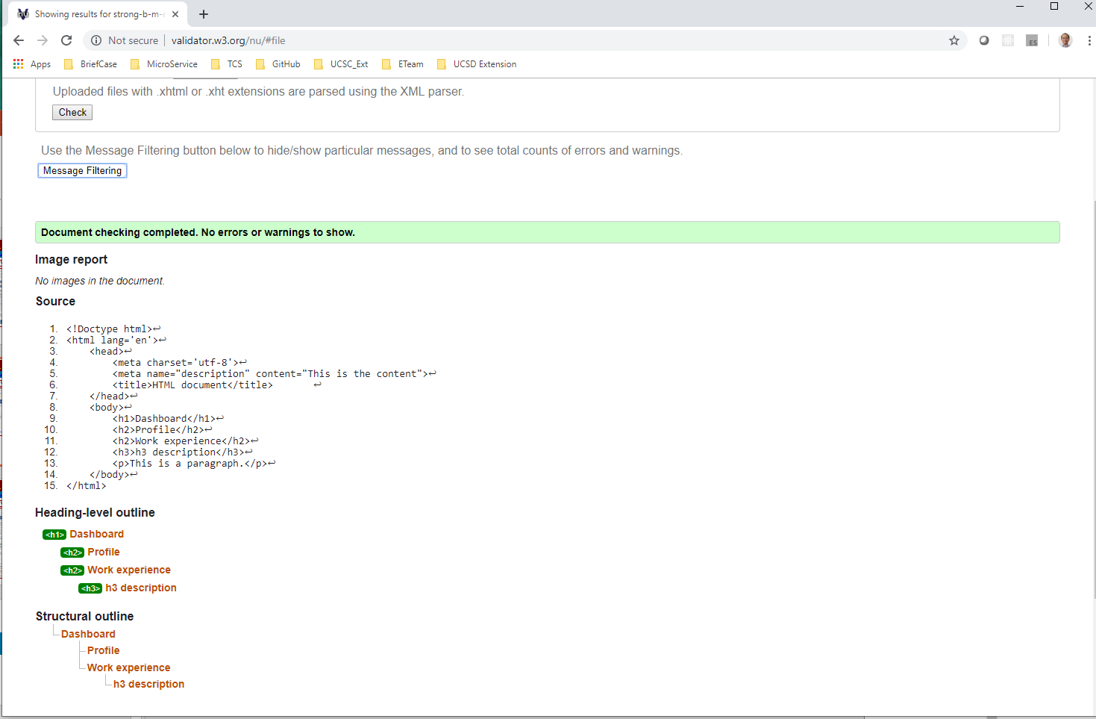
0415.1 Validation Video
https://ucsc-extension.instructure.com/courses/3825/pages/1-dot-1-welcome?module_item_id=42202
0415.1 Validation Video: validator.w3.org/nu

Slide 11
0415.2 Old Validation

Slide 12
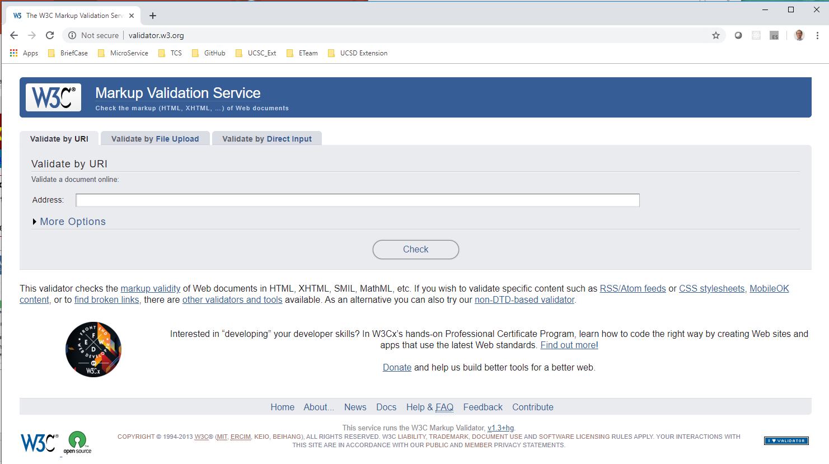
0415.2 Old Validation
https://ucsc-extension.instructure.com/courses/3825/pages/1-dot-1-welcome?module_item_id=42202
0415.2 Old Validation
For older websites (using HTML 4.01 or XHTML 1.0)
The W3C HTML Validator for web pages using the HTML 4.01 or XHTML 1.0 Doctypes is different from the one above, the Nu HTML Validator.

Slide 13

0415.2 Old Validation
https://ucsc-extension.instructure.com/courses/3825/pages/1-dot-1-welcome?module_item_id=42202
0415.2 Old Validation
For doctype HTML 4.01 or XHTML 1.0 go to the W3C – HTML Validator (Links to an external site.):
Select the tab: “Validate by File Upload”.
Click the “Browse” button and locate the HTML file you wish to validate.
If your page validates – you get green!
If your page does not validate (a red bar shows), make the corrections and validate until you get a message that your page validates. TIP: correct only the first listed problem; save your document and try again. Sometimes fixing the first problem fixes the rest of them.
For fun you could put a “Validate Icon” on your page ONLY FOR HTML 4.01 or XHTML 1.0.

Slide 14
0415.2 Old Validation
https://ucsc-extension.instructure.com/courses/3825/pages/1-dot-1-welcome?module_item_id=42202
0415.2 Old Validation
Do not get discouraged if you have a “ton” of errors!
The top mistakes are:
Typos – watch out for inverted letters in your tags (my personal most common error!)
Missing quotation marks (only the opening or the closing quote was placed).
Missing closing > angle brackets!
Missing equal sign (=) between attributes and values
Differentiate between colons ( : ) and semi-colons ( ; ) – They look the same, so sometimes I find that I need to zoom in to read my page better (poor eyesight…).
The DOCTYPE and the META tag for charset are often another area of problems…these two need to be written EXACTLY as shown – uppercase and lower case sensitivity included!
Watch out for extra “spaces” in your DOCTYPE or META tags – these will cause “warnings”.
Issue with block level and inline level element – remember that inline elements must be within a block level element.

Slide 15
End of Chapter

