Slide 1

0416 Phrase Element
Peter H. Chen

Slide 2
0416 Phrase Element
https://ucsc-extension.instructure.com/courses/3825/pages/1-dot-1-welcome?module_item_id=42202
0416 Phrase Element: <pre> Tag
Enhancing a simple page and Phrase Elements
We will explore a series of 'phrase' elements that are used to provide semantic meaning to your content.
In the case of the <pre>tag, (pre stands for pre-formatted). This will preserve space and line breaks and can be used around poetry or sample code.
The <pre> tag:
<pre> This is
preformatted text.It preserves both spaces
and line breaks.Great for poetry or
Or for computer code! </pre>

Slide 3
0416.1 Phrase Element Video

Slide 4
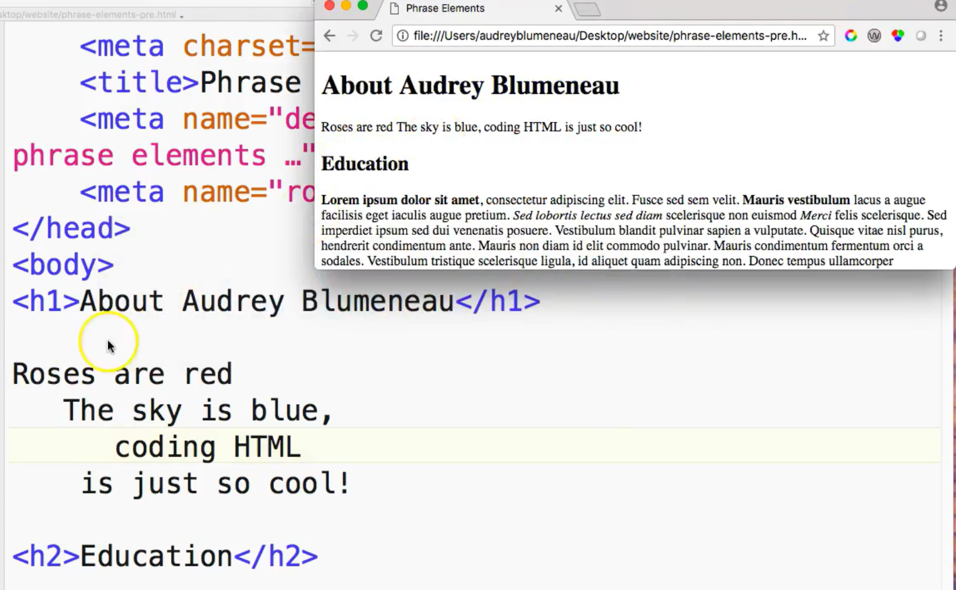
0416.1 Phrase Element Video
https://ucsc-extension.instructure.com/courses/3825/pages/1-dot-1-welcome?module_item_id=42202
0416.1 Phrase Element Video

Slide 5
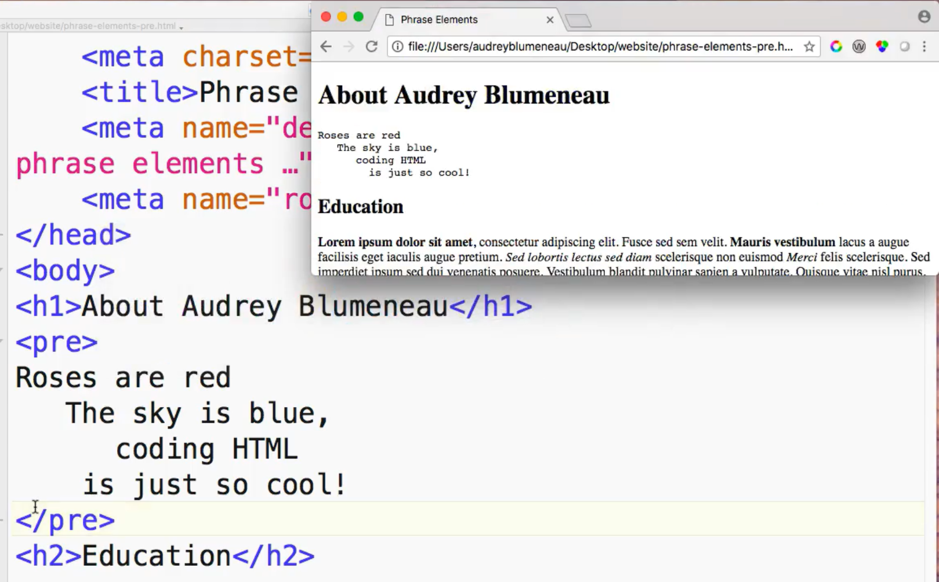
0416.1 Phrase Element Video
https://ucsc-extension.instructure.com/courses/3825/pages/1-dot-1-welcome?module_item_id=42202
0416.1 Phrase Element Video: Preserved the original spaces and line breaks.

Slide 6
End of Chapter

