Slide 1

0417 Strong vs. Emphasize
Peter H. Chen

Slide 2
0417 Strong vs. Emphasize
https://ucsc-extension.instructure.com/courses/3825/pages/1-dot-1-welcome?module_item_id=42202
0417 Strong and Emphasize
Strong, Bold, Italic, Emphasized...
To be Bold <b>...</b> or Strong <strong>...</strong> that is the question!

Slide 3
0417.1 Bold or Strong

Slide 4
0417.1 Bold or Strong
https://ucsc-extension.instructure.com/courses/3825/pages/1-dot-1-welcome?module_item_id=42202
0417.1 Bold or Strong
Yes, there are two tags that essentially appear visually to do the exact same thing!
They will both make the text display in bold.
The difference in the two tags has to do with semantics and how screen readers will interpret each tag.
For a screen reader, the <strong> tag has meaning – that the word or phrase will be strongly emphasized when it read out loud.
The <b> tag has no semantic meaning for a screen reader.
In HTML 4.01 and XHTML, the <b> tag was set to be deprecated due to the fact that it had no semantic meaning and was essentially about presentation – making the text look bold and stand out.
HTML5 has decided to give new life to the <b> tag by redefining what it means semantically!

Slide 5
0417.1 Bold or Strong
https://ucsc-extension.instructure.com/courses/3825/pages/1-dot-1-welcome?module_item_id=42202
0417.1 Bold or Strong
In the world of HTML5, the <b> tag represents a span of text that is stylistically offset text such as keywords and typographically emboldened text.
Still sounds like “presentation” to me but that is what the W3C is saying for now.
According the HTML5 specs (Links to an external site.):
“…the <b> element has now been given the specific semantic purpose of representing text “offset from its surrounding content without conveying any extra emphasis or importance, and for which the conventional typographic presentation is bold text; for example, keywords in a document abstract, or product names in a review”
The W3C goes on to state (Links to an external site.):
“The b element represents a span of text to which attention is being drawn for utilitarian purposes without conveying any extra importance and with no implication of an alternate voice or mood, such as key words in a document abstract, product names in a review, actionable words in interactive text-driven software, or an article lede.”

Slide 6
0417.1 Bold or Strong
https://ucsc-extension.instructure.com/courses/3825/pages/1-dot-1-welcome?module_item_id=42202
0417.1 Bold or Strong
The following example shows a use of the b element to highlight key words without marking them up as important:
<p>The <b>frobonitor</b> and <b>barbinator</b> components are fried.</p>
In the following example, objects in a text adventure are highlighted as being special by use of the b element.
<p>You enter a small room. Your <b>sword</b> glows brighter. A <b>rat</b> scurries past the corner wall.</p>

Slide 7
0417 Bold vs. Strong
https://ucsc-extension.instructure.com/courses/3825/pages/1-dot-1-welcome?module_item_id=42202
0417.1 Bold or Strong
The Strong Tag:
The <strong> tag was in the HTML 4.01 and XHTML used for stronger emphasis, now is used for “strong importance”.
The b element should be used as a last resort when no other element is more appropriate. In particular, headings should use the h1 to h6 elements, stress emphasis should use the em element, importance should be denoted with the strong element, and text marked or highlighted should use the mark element.
The following would be incorrect usage:
<p><b>WARNING!</b> Do not frob the barbinator!</p>
In the previous example, the correct element to use would have been <strong>, not <b>.

Slide 8
0417 Bold vs. Strong
https://ucsc-extension.instructure.com/courses/3825/pages/1-dot-1-welcome?module_item_id=42202
0417.1 Bold or Strong
The relative level of importance of a piece of content is given by its number of ancestor strong elements; each strong element increases the importance of its contents.
Changing the importance of a piece of text with the strong element does not change the meaning of the sentence.
Here is an example of a warning notice in a game, with the various parts marked up according to how important they are:
<p><strong>Warning.</strong> This dungeon is dangerous. <strong>Avoid the ducks.</strong> Take any gold you find. <strong><strong>Do not take any of the diamonds</strong>,they are explosive and <strong>will destroy anything within ten meters.</strong></strong> You have been warned.</p>
Another example from HTML5 Doctor (Links to an external site.):
Use the <b> element if you’d like to draw attention to the price without indicating that it’s more important.
Use <strong> if the price is important, such as the total price of an itemized receipt.

Slide 9
0417.2 Bold and Strong Video

Slide 10
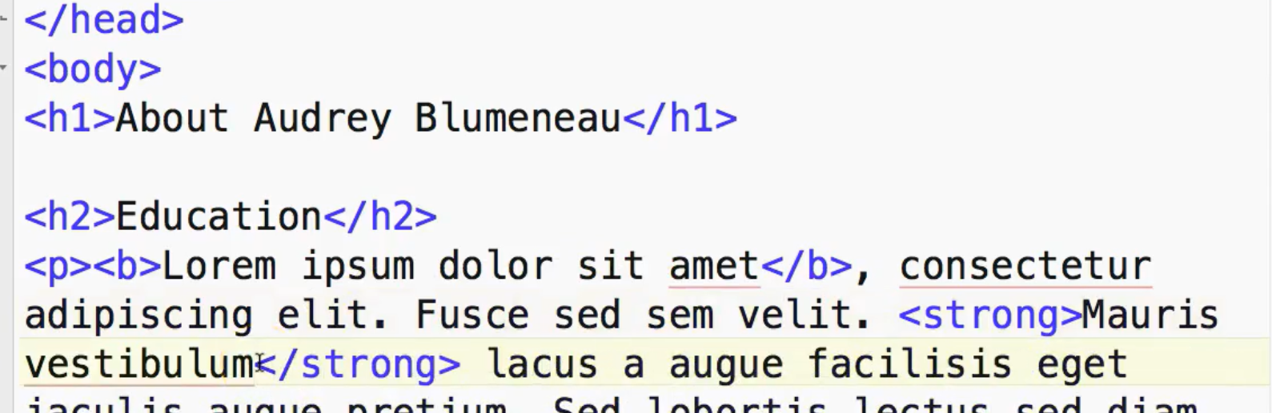
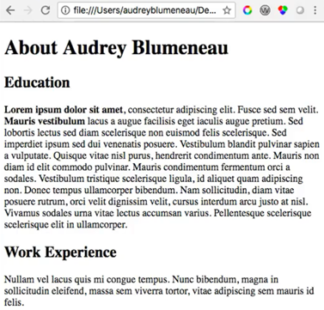
0417.2 Bold and Strong Video
https://ucsc-extension.instructure.com/courses/3825/pages/1-dot-1-welcome?module_item_id=42202
0417.2 Bold and Strong Video: Strong has semantic meaning than bold.

Slide 11
0417.3 Italic vs Emphasis

Slide 12
0417.3 Italic vs Emphasis
https://ucsc-extension.instructure.com/courses/3825/pages/1-dot-1-welcome?module_item_id=42202
0417.3 Italic vs Emphasize:
Italic <i>...</i> or Emphasis <em>...</em>
We have the same issue that we had with bold text, we also have with making text italic.
There are two tags that visually on the browsers do the same thing: italicize text. As with the b and strong elements we have an <i> and an <em> element. The <i> was being deprecated in HTML 4.01 and XHTML but brought back to life via HTML5.
In the past, the <i> tag was simply presentational and the <em> had semantic meaning for screen readers when the read text enclosed in the <em> tags it would read outloud that word or phrase with emphasis.
HTML5 has redefined both these tags.

Slide 13
0417.3 Italic vs Emphasis
https://ucsc-extension.instructure.com/courses/3825/pages/1-dot-1-welcome?module_item_id=42202
0417.3 Italic vs Emphasize:
<i> was italic but now it refers to text in an alternate voice such as transliterated foreign words, technical terms (some musical notation or in a screen play, the stage directions or handwritten text) and typographically emboldened text.
<em> was emphasis, is now for stress emphasis, meaning something you would pronounce differently!
For instance this sentence does not need a screen reader to read these words with emphasis but they are foreign words so:
We ate unagi, aburi-zake, and tako sushi last night, but the torosushi was all fished out.
Using <i lang="ja"> to indicate a transliterated word from a foreign language (with lang="ja-latn" indicating transliterated Japanese).
To check character sets use ISO 2 Letter Language Codes (Links to an external site.), SitePoint.

Slide 14
0417.3 Italic vs Emphasis
https://ucsc-extension.instructure.com/courses/3825/pages/1-dot-1-welcome?module_item_id=42202
0417.3 Italic vs Emphasize:
Same thing with taxonomy:
Nanotyrannus (“dwarf tyrant”) is a genus of tyrannosaurid dinosaur, and is possibly a juvenile specimen of Tyrannosaurus. It is based on CMN 7541, a skull collected in 1942 and described by Charles W. Gilmore described in 1946, who gave it the new species Gorgosaurus lancensis.
Using <i class="taxonomy"> for taxonomic names.

Slide 15
0417.4 Italic vs Emphasis Video

Slide 16
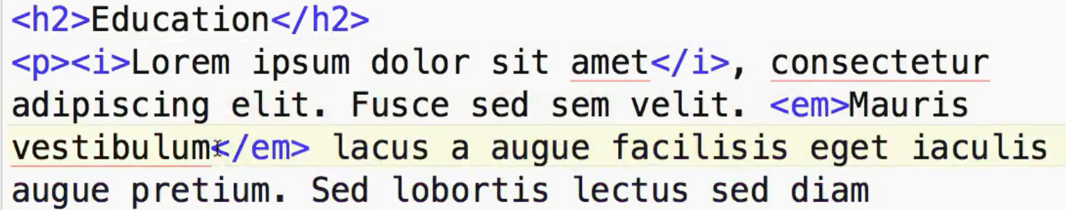
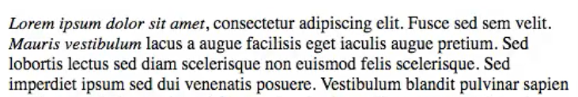
0417.4 Italic vs Emphasis Video
https://ucsc-extension.instructure.com/courses/3825/pages/1-dot-1-welcome?module_item_id=42202
0417.4 Italic vs Emphasize Video:

Slide 17
0417.5 Underline Element

Slide 18
0417.5 Underline Element
https://ucsc-extension.instructure.com/courses/3825/pages/1-dot-1-welcome?module_item_id=42202
0417.5 Underline Element
The Underline element: <u>…</u>
Enclosed text is rendered with an underline on the browser.
This is a tag that really should never be used. In the past it was considered deprecated as it was considered to a presentational tag.
However, HTML5 (for the time being) has kept it in the specs with this definition.
The idea is that sometimes it is semantically correct to underline text such as the formal name in Chinese or indicating a misspelled word after a spell check.
However, underlining text can be highly confusing to the user as it generally means that it’s a link.
People will move their cursor and try to click on the word and not get anything, except possible frustration due to confusion!
So, in other words, DO NOT USE this element!!

Slide 19
End of Chapter

