Slide 1

0419 Citation
Peter H. Chen

Slide 2
0419 Citation
  https://ucsc-extension.instructure.com/courses/3825/pages/1-dot-1-welcome?module_item_id=42202
0419 Citation
Citations, Quotations, and Definition Tags
These elements are meant to provide “meaning” to a page; they can be considered “logical” elements in that they give structure to the page by describing what they contain.

Slide 3
0419.1 <address> Tag

Slide 4
0419.1 <address> Tag
  https://ucsc-extension.instructure.com/courses/3825/pages/1-dot-1-welcome?module_item_id=42202
0419.1 The <address> tag:
The address represents the contact information for its enclosing section. If the <address> is a child of the body element than it applies to the document as a whole. The W3C states for HTML5:
  “The address element provides contact information for a document or part of a document. Information provided by address may include the names of the document’s maintainers, links to the maintainers’ Web pages, e-mail addresses for feedback, postal addresses, phone numbers, and so on. The address element is not appropriate for all postal and e-mail addresses; it should be reserved for providing such information about the contact people for the document.”

Slide 5
0419.1 <address> Tag
  https://ucsc-extension.instructure.com/courses/3825/pages/1-dot-1-welcome?module_item_id=42202
0419.1 The <address> tag:
You don't use the <address> tag just for any old address if it uses a postal address unless this information is relevant to the contact information for a document. You would typically use this in the footer of a document.
<address>
  Written by: Jim Jones<br>
  Visit us at: 222 Main Street<br>
  SomeCity, SomeState, USA<br>
</address>
This will render the text in italics in most browsers
  Written by: Jim Jones
  Visit us at: 222 Main Street
  SomeCity, SomeState, USA

Slide 6
0419.1 <address> Tag
  https://ucsc-extension.instructure.com/courses/3825/pages/1-dot-1-welcome?module_item_id=42202
0419.1 The <address> tag:
Another application, according to the W3C specifications would be to list a group of authors, volunteers etc.
<address>
Contributors include:
  <a href="#">Ann Jones</a>,
  <a href="#">Jim Smith</a>,
  <a href="#">Beth Jones</a>,
  <a href="#">Chris Smith</a>,
</address>
or:
<address>
  <a title="Posts by Ann Jones" href="#">Ann Jones</a>
</address>

Slide 7
0418.2 <address> Tag Video

Slide 8
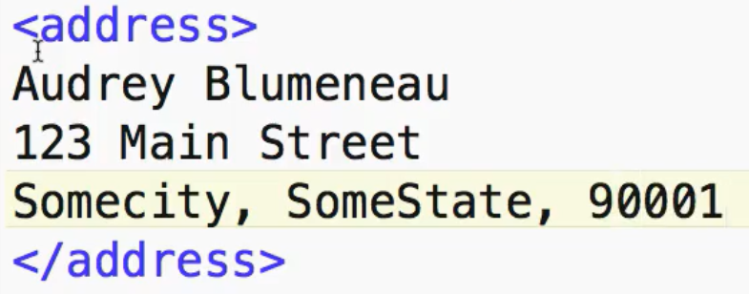

0418.2 <address> Tag Video
  https://ucsc-extension.instructure.com/courses/3825/pages/1-dot-1-welcome?module_item_id=42202
0418.2 <address> Tag Video

Slide 9
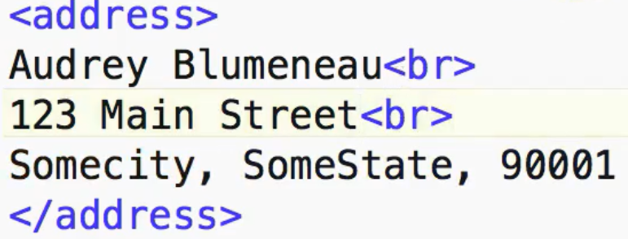
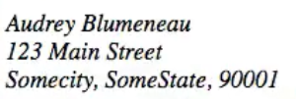
0418.2 <address> Tag Video
  https://ucsc-extension.instructure.com/courses/3825/pages/1-dot-1-welcome?module_item_id=42202
0418.2 <address> Tag Video

Slide 10
0418.3 <abbr> Tag

Slide 11
0418.3 <abbr> Tag
  https://ucsc-extension.instructure.com/courses/3825/pages/1-dot-1-welcome?module_item_id=42202
0418.3 <abbr> Tag
The <abbr> tag represents an abbreviation or an acronym.
The tag has an optional title attribute that will provide the user with an expansion of that abbreviation as a tool tip when the user moves their mouse over the word.
The title must contain an expansion of the abbreviation and nothing else!
This tag is an inline element so it would get used like this:
  <p> We live in <abbr title="California">CA</abbr>, the golden state</p>
Firefox and Opera will, by default, display a dotted border/underline so for other browsers such as IE8, Safari, and Chrome you would use a little CSS to indicate to a user that there is a tool tip for a particular abbreviation.
Back in the old days, when we had “browser wars”, we had both an <abbr> and an <acronym> tag as a result of Netscape introducing the <abbr> and Microsoft introducing the <acronym>.
HTML5 and the W3C decided to go with <abbr>.

Slide 12
0418.3 <abbr> Tag
  https://ucsc-extension.instructure.com/courses/3825/pages/1-dot-1-welcome?module_item_id=42202
0418.3 <abbr> Tag
As a result, we have browser compatibility issues, as IE6 and IE7 do not support <abbr>.
To get <abbr> working in IE6 and IE7, you need to create the element with JavaScript! How fun! You can copy and paste the following code and place it in the <head> </head> tags:
<!--[if lte IE 7]>
  <script type="text/javascript">document.createElement('abbr');</script>
<![endif]-->

Slide 13
0418.4 <abbr> Tag Video

Slide 14
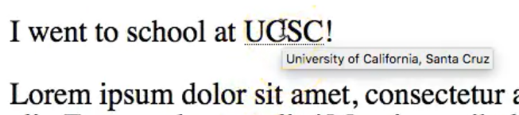
0418.4 <abbr> Tag Video
  https://ucsc-extension.instructure.com/courses/3825/pages/1-dot-1-welcome?module_item_id=42202
0418.4 <abbr> Tag Video

Slide 15
0418.5 Quotation

Slide 16
0418.5 Quotation
  https://ucsc-extension.instructure.com/courses/3825/pages/1-dot-1-welcome?module_item_id=42202
0418.5 Quotation
Long Quotation: This is how a long quotation is written in HTML:
  <blockquote cite="http://www.sfmoma.org/eliasson/data/index.html">
    I think the principle question about taking your time is also about generosity.<br>
    Olafur Elliasson.
  </blockquote>
The long quotation will look like this the browser:
  I think the principle question about taking your time is also about generosity.
  Olafur Elliasson.
You can use the cite attribute to cite where you got the quotation from. Notice that you won’t get the quotation marks using the <blockquote>.
Also note: You can add <p> tags within a <blockquote>, but don’t put a <blockquote> within <p> tags as this will not validate.

Slide 17
0418.5 Quotation
  https://ucsc-extension.instructure.com/courses/3825/pages/1-dot-1-welcome?module_item_id=42202
0418.5 Quotation
Short Quotation: This is how a short quotation is written in HTML:
  <q>I think the principle question about taking your time is also about generosity.</q><br>
  Olafur Elliasson
This is how the short quotation looks on the browser:
  “I think the principle question about taking your time is also about generosity.”
  Olafur Elliasson
With the <blockquote> element, the browser inserts line breaks and margins, but the <q> element does not render as anything special.
As <cite>Harry S. Truman</cite> said,<q lang="en-us">The buck stops here.</q>
For more about Phrase Elements see the W3C

Slide 18
End of Chapter

