Slide 1

0420 HR
Peter H. Chen

Slide 2
0420 HR
https://ucsc-extension.instructure.com/courses/3825/pages/1-dot-1-welcome?module_item_id=42202
0420 HR
The <hr> Tag (block-Level Element)
The <hr> tag is used to create a horizontal rule, or line on your page.
They are used for simple dividers, breaking an otherwise long document.
In most browsers, the default shows up as an “embossed” shaded rule that extends the width of the browser window.
Because it is a block-level element, a line break is created above and below the rule.
<hr>

Slide 3
0420.1 HR Video

Slide 4
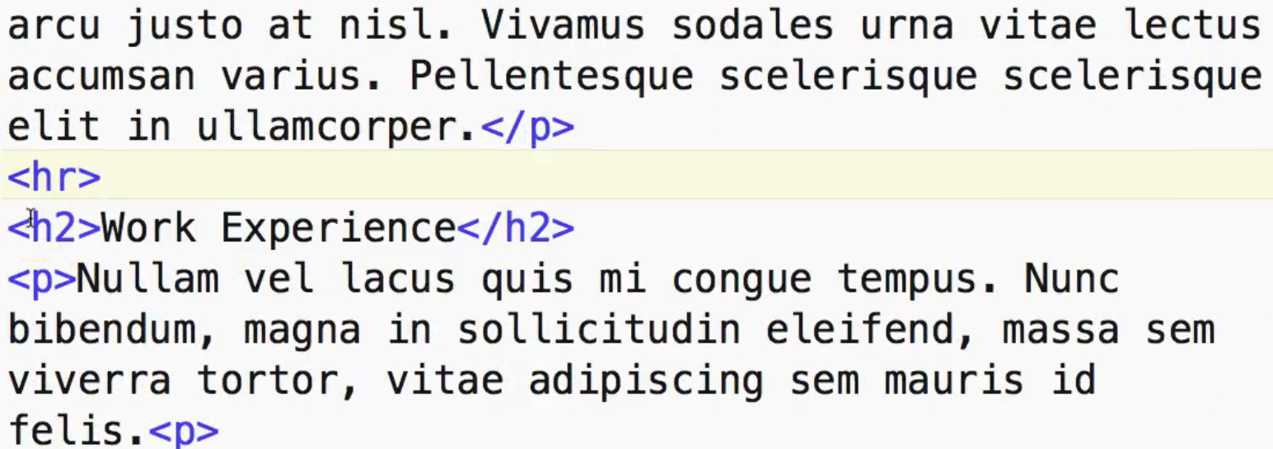
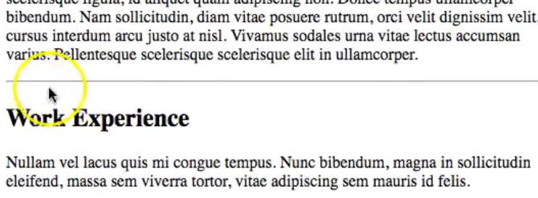
0420.1 HR Video
https://ucsc-extension.instructure.com/courses/3825/pages/1-dot-1-welcome?module_item_id=42202
0420.1 HR Video

Slide 5
0420.2 Old Code

Slide 6
0420.2 Old Code
https://ucsc-extension.instructure.com/courses/3825/pages/1-dot-1-welcome?module_item_id=42202
0420.2 Old Code (Do not use!)
Shown for historical purposes only and to make sure when you see this you know it's old!
The following attributes—ALL attributes have been DEPRECATED in HTML 4.01—were once used so, if you see these, you know you are looking at old code!
Thickness:
Use the “size” attribute to control the thickness or weight of the rule. Size is specified in pixels.
size="10“
Length:
The “width” attribute controls the length of the rule and can be set either by pixel length or by percentage.
width="500" This would set the width to 500 pixels.
width="50%" This would set the width to 50% of the browser window.

Slide 7
0420.2 Old Code
https://ucsc-extension.instructure.com/courses/3825/pages/1-dot-1-welcome?module_item_id=42202
0420.2 Old Code (Do not use!)
Alignment:
Can set the alignment to left, center or right.
align="center" Centers the line on the page (horizontally).
3D Shading:
The “noshade” attribute causes the rule to display as a solid black line.
noshade prevents the line from being shadowed.
Color: (never would VALIDATE!!!)
color="#FF0000" sets the color to red.
IE started this and other browsers’ now support it but it was never added to the W3C’s specifications and there fore will not validate.
I show it only because everyone always asks me about it!

Slide 8
End of Chapter

