Slide 1

0422 Character Entities
Peter H. Chen

Slide 2
0422 Character Entities
https://ucsc-extension.instructure.com/courses/3825/pages/1-dot-1-welcome?module_item_id=42202
0422 Character Entities
Character Entities (aka: Special Characters or Escape Characters)
What are Character entities?
Table of some common character entities
The non-breaking space
Hyphens, en dashes, em dashes
The Ellipsis…
More resources
Video Demo

Slide 3
0422 Character Entity
https://ucsc-extension.instructure.com/courses/3825/pages/1-dot-1-welcome?module_item_id=42202
0422 What is a character entity?
Characters not found in the normal alphanumeric character set, such as <, > and &, must be specified in HTML using character entities because the browser will mix them up for being code.
These characters can be referenced by names (&name;) or by numeric value (&#nnn;).
The browser interprets the string to display the proper character.
Named entities are easier to remember but browsers may not support all entity names so using numeric values can sometimes be better as support for numeric values is very good.
Here are some basic common ones.
Many more can be found at the web sites below or in any HTML book.

Slide 4
0422 Character Entity
https://ucsc-extension.instructure.com/courses/3825/pages/1-dot-1-welcome?module_item_id=42202
Common Character Entities, HTML code and shortcut keys
Character | Description | Name | Numeric | Mac | Win
 | Non-breaking space (ensure that a line doesn’t break between two words). | &nbsp; | &#160;
& | Ampersand | &amp; | &#038;
< | Less then sign | &lt; | &#060;
> | Greater then sign | &gt; | &#062;

Slide 5
0422 Character Entity
https://ucsc-extension.instructure.com/courses/3825/pages/1-dot-1-welcome?module_item_id=42202
Common Character Entities, HTML code and shortcut keys
Character | Description | Name | Numeric | Mac | Win
“ | Left Curly quotes | &ldquo; | &#8220; | Option [ | Alt 1047
” | Right Curly quotes | &rdquo; | &#8221; | Option Shift [ | Alt 0148
– | En Dash (indicate duration or replace “to”) | &ndash; | &#8211; | Option hyphen | Alt 0150

Slide 6
0422 Character Entity
https://ucsc-extension.instructure.com/courses/3825/pages/1-dot-1-welcome?module_item_id=42202
Common Character Entities, HTML code and shortcut keys
Character | Description | Name | Numeric | Mac | Win
— | Em Dash (used in place of colon or parenthesis; there should be no space before or after) | &mdash; | &#8212; | Opt Shift hyphen | Alt 0151
… | Horizontal Ellipsis (something omitted from text) | &hellip; | &#8230; | Option ; | Alt 0133

Slide 7
0422 Character Entity
https://ucsc-extension.instructure.com/courses/3825/pages/1-dot-1-welcome?module_item_id=42202
Common Character Entities, HTML code and shortcut keys
Character | Description | Name | Numeric | Mac | Win
© | Copyright Symbol | &copy; | &#169; | Option G | Alt 0169
® | Registered trademark | &reg; | &#174; | Option 2 | Alt 0153

Slide 8
0422.1 What is &nbsp;?

Slide 9
0422.1 What is &nbsp;?
https://ucsc-extension.instructure.com/courses/3825/pages/1-dot-1-welcome?module_item_id=42202
The non-breaking space character (&nbsp;) ensures that a line will not break between two words.
In the early days of web design, using &nbsp; was incorrectly used to add more space between words.
It was a truly terrible use of this character reference.
We use CSS for that purpose, but many old websites used this technique excessively (and even not so old websites!).

Slide 10
0422.2 Hyphens

Slide 11
0422.2 Hyphen
https://ucsc-extension.instructure.com/courses/3825/pages/1-dot-1-welcome?module_item_id=42202
Hyphens, En dashes, Em dashes and Ellipsis, oh my!
Hyphens –
Hyphens are used for hyphenating words or line breaks.
Example:
odd-looking animals
En Dash (short dash, &ndash;) –
An en dash is longer than a hyphen (the width of the letter “N”).
Used between words that indicate duration (time, months, years) or to replace the word “to”.
There is no space between on either side of an en dash.
Examples:
September­–December
6:15–9:00 P.M.
18–22 years of age

Slide 12
0422.2 Hyphen
https://ucsc-extension.instructure.com/courses/3825/pages/1-dot-1-welcome?module_item_id=42202
Em Dash (long dash, &mdash;) —
An em dash is twice as long as an en dash (~ the width of the letter “M”).
Used to indicate abrupt change of thought—something you would put in parenthesis. There is no space before or after an em dash although you can bump of the kerning if too close to letters.
Examples:
Grandma made some pies—yeah!
Warning—you’re about to enter into another world!
Ellipsis … why use character entity code or Mac/Win character key?
There are some additional reasons to using the correct character entities (and graphic designers may already be quite aware of this when working with InDesign for example).
The ellipsis is a character and not just three dots at the end of a thought…we use it to indicate to the reader that there is a pause. It can also indicate that a section of text is missing from a greater body of text, for example when we see Read More…

Slide 13
0422.2 Hyphen
https://ucsc-extension.instructure.com/courses/3825/pages/1-dot-1-welcome?module_item_id=42202
I am sure that many of you simply type out the three dot dot dot's versus using a shortcut key for the character. One indicates a series of full stops and one is a character that indicates text or a section of text is missing from a greater body of text.
A full stop is generally used to show that a sentence has ended, one is always enough, it makes no sense to end the sentence three times.
There is a weak argument that they look the same so there is no need to worry, O and 0 under some lights look the same, it doesn’t mean that they have anything to do with each other.
There are some accessibility implications that come along with using three full stops as opposed to the correct character, screen readers can be set to read out the character (in my experience calling it a ‘period’) obviously this isn’t right. For anyone using a screen-reader, the ellipsis, correctly entered as a character entity … represents a long pause in voicing. Otherwise, it gets read out loud as dot dot dot or period period period.

Slide 14
0422.2 Hyphen
https://ucsc-extension.instructure.com/courses/3825/pages/1-dot-1-welcome?module_item_id=42202
The short-cut key on the Mac is simply Cmd ; (semi-colon). Nice and simple and so important to your audience!
Again, coding web pages isn't just about visual presentation but also auditory presentation.
More Character Entity References resources!
The Non-Designer’s Design Book (4th Edition) by Robin Williams: pp. 158 and 159
W3C HTML5 Named Character Entities (Links to an external site.)
HTML XHTML Entities – from HTML Quick Start Guide (Links to an external site.)
Markup Specific Entities for HTML and XHTML (Links to an external site.)
Encode and Decode HTML Entities (Links to an external site.)
Copy Paste Character (Links to an external site.) (!) - an interesting website to get code for HTML
&what; (Links to an external site.) Discover your Character!

Slide 15
0422.3 Character Entities Video

Slide 16

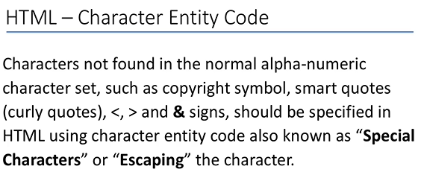
0422.3 Character Entities Video
https://ucsc-extension.instructure.com/courses/3825/pages/1-dot-1-welcome?module_item_id=42202
0422.3 Character Entities Video

Slide 17
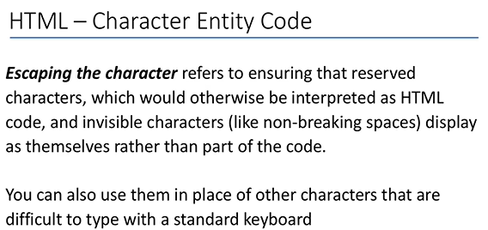
0422.3 Character Entities Video
https://ucsc-extension.instructure.com/courses/3825/pages/1-dot-1-welcome?module_item_id=42202
0422.3 Character Entities Video

Slide 18
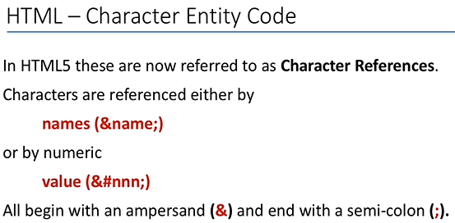
0422.3 Character Entities Video
https://ucsc-extension.instructure.com/courses/3825/pages/1-dot-1-welcome?module_item_id=42202
0422.3 Character Entities Video

Slide 19
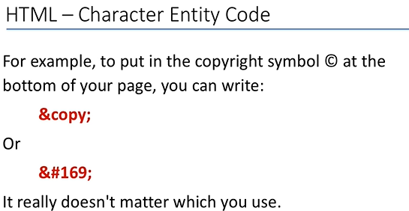
0422.3 Character Entities Video
https://ucsc-extension.instructure.com/courses/3825/pages/1-dot-1-welcome?module_item_id=42202
0422.3 Character Entities Video

Slide 20
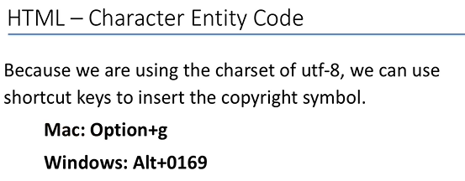
0422.3 Character Entities Video
https://ucsc-extension.instructure.com/courses/3825/pages/1-dot-1-welcome?module_item_id=42202
0422.3 Character Entities Video

Slide 21
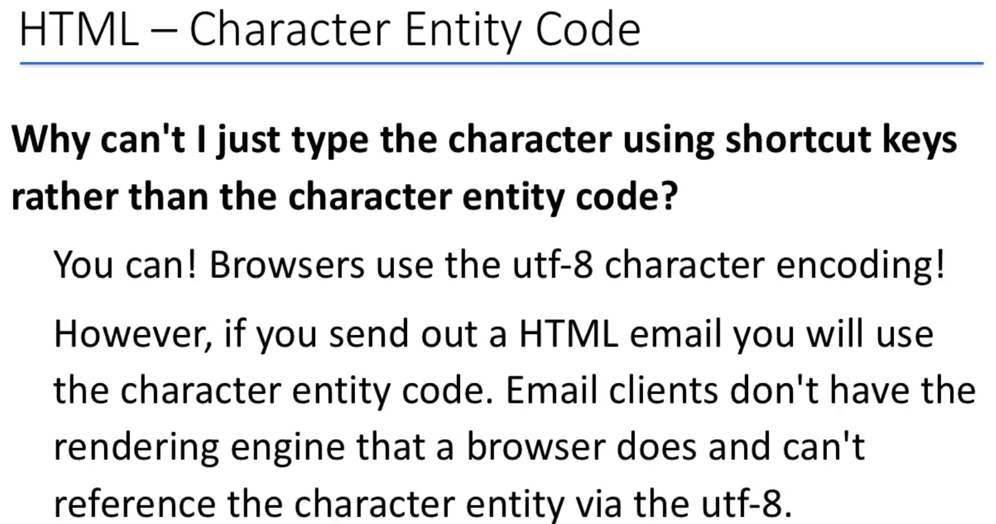
0422.3 Character Entities Video
https://ucsc-extension.instructure.com/courses/3825/pages/1-dot-1-welcome?module_item_id=42202
0422.3 Character Entities Video

Slide 22
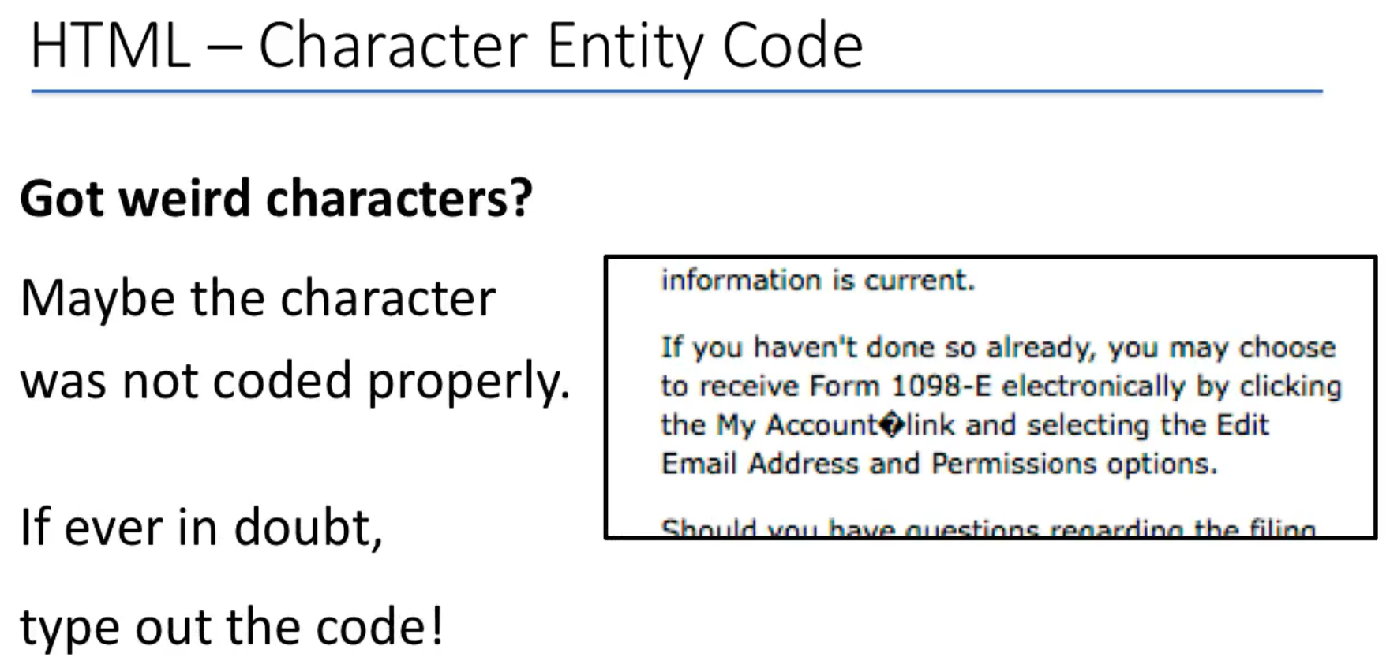
0422.3 Character Entities Video
https://ucsc-extension.instructure.com/courses/3825/pages/1-dot-1-welcome?module_item_id=42202
0422.3 Character Entities Video

Slide 23
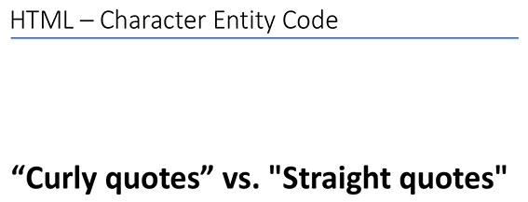
0422.3 Character Entities Video
https://ucsc-extension.instructure.com/courses/3825/pages/1-dot-1-welcome?module_item_id=42202
0422.3 Character Entities Video

Slide 24
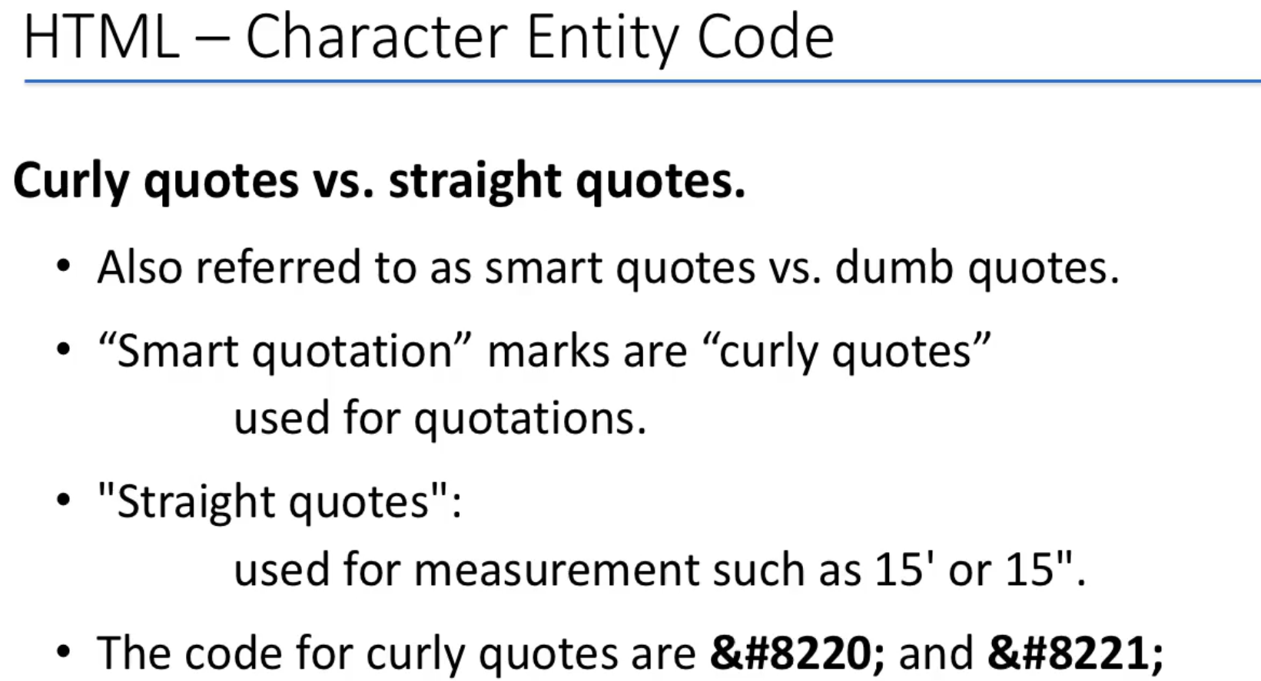
0422.3 Character Entities Video
https://ucsc-extension.instructure.com/courses/3825/pages/1-dot-1-welcome?module_item_id=42202
0422.3 Character Entities Video

Slide 25
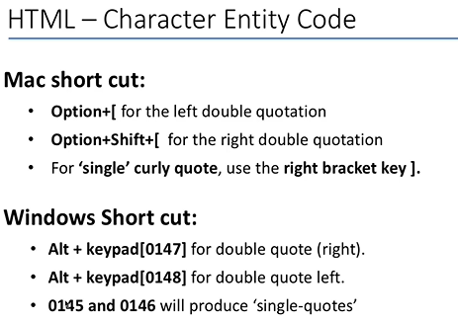
0422.3 Character Entities Video
https://ucsc-extension.instructure.com/courses/3825/pages/1-dot-1-welcome?module_item_id=42202
0422.3 Character Entities Video

Slide 26
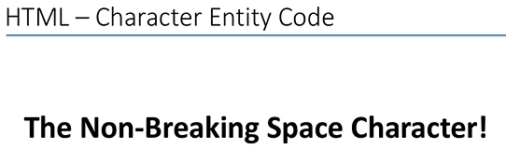
0422.3 Character Entities Video
https://ucsc-extension.instructure.com/courses/3825/pages/1-dot-1-welcome?module_item_id=42202
0422.3 Character Entities Video

Slide 27
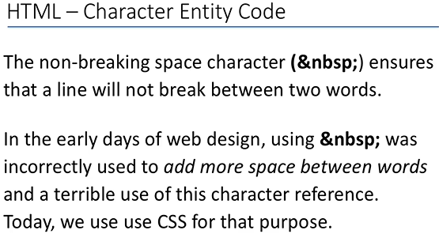
0422.3 Character Entities Video
https://ucsc-extension.instructure.com/courses/3825/pages/1-dot-1-welcome?module_item_id=42202
0422.3 Character Entities Video

Slide 28
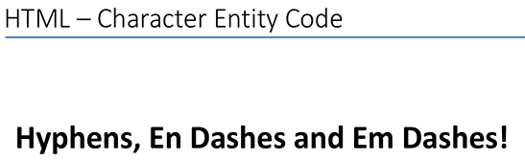
0422.3 Character Entities Video
https://ucsc-extension.instructure.com/courses/3825/pages/1-dot-1-welcome?module_item_id=42202
0422.3 Character Entities Video

Slide 29
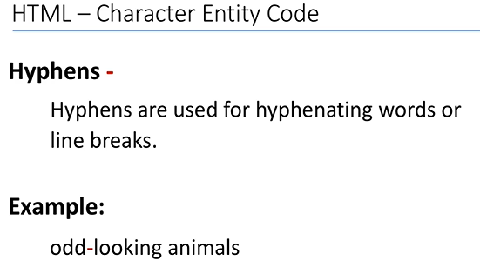
0422.3 Character Entities Video
https://ucsc-extension.instructure.com/courses/3825/pages/1-dot-1-welcome?module_item_id=42202
0422.3 Character Entities Video

Slide 30
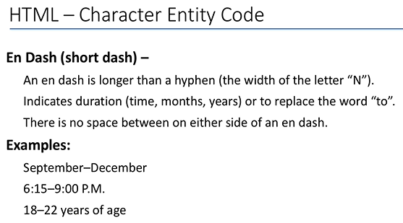
0422.3 Character Entities Video
https://ucsc-extension.instructure.com/courses/3825/pages/1-dot-1-welcome?module_item_id=42202
0422.3 Character Entities Video: &ndash;

Slide 31
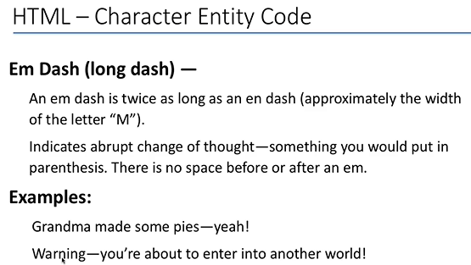
0422.3 Character Entities Video
https://ucsc-extension.instructure.com/courses/3825/pages/1-dot-1-welcome?module_item_id=42202
0422.3 Character Entities Video: &mdash;

Slide 32
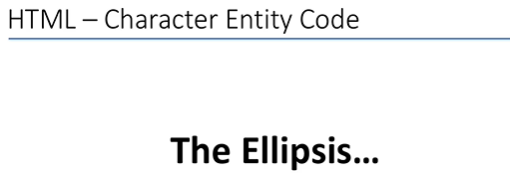
0422.3 Character Entities Video
https://ucsc-extension.instructure.com/courses/3825/pages/1-dot-1-welcome?module_item_id=42202
0422.3 Character Entities Video: Ellipsis (&hellip;)

Slide 33
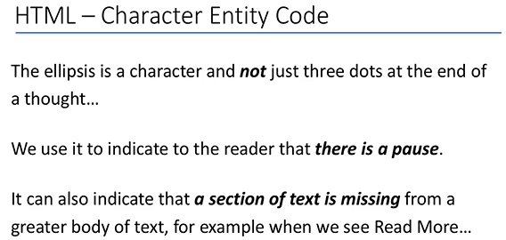
0422.3 Character Entities Video
https://ucsc-extension.instructure.com/courses/3825/pages/1-dot-1-welcome?module_item_id=42202
0422.3 Character Entities Video

Slide 34
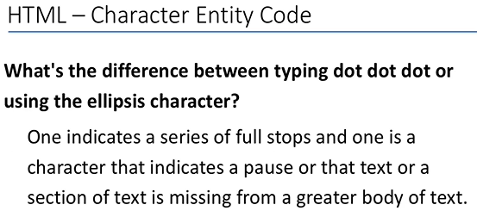
0422.3 Character Entities Video
https://ucsc-extension.instructure.com/courses/3825/pages/1-dot-1-welcome?module_item_id=42202
0422.3 Character Entities Video

Slide 35
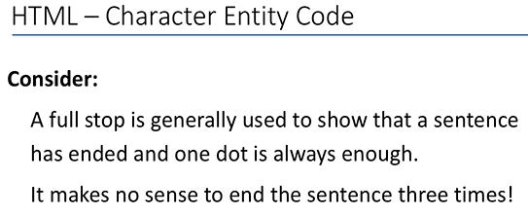
0422.3 Character Entities Video
https://ucsc-extension.instructure.com/courses/3825/pages/1-dot-1-welcome?module_item_id=42202
0422.3 Character Entities Video

Slide 36
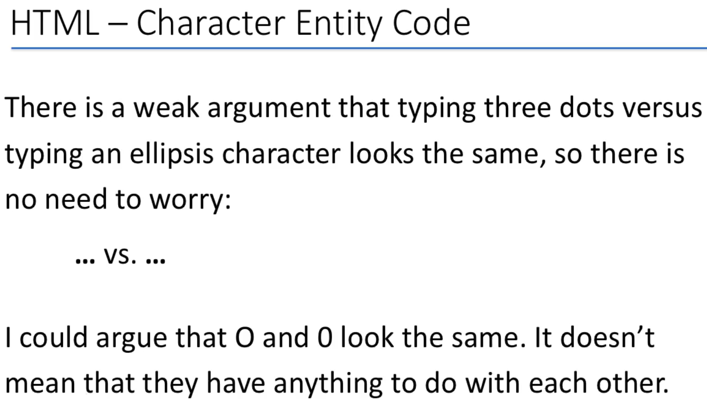
0422.3 Character Entities Video
https://ucsc-extension.instructure.com/courses/3825/pages/1-dot-1-welcome?module_item_id=42202
0422.3 Character Entities Video

Slide 37
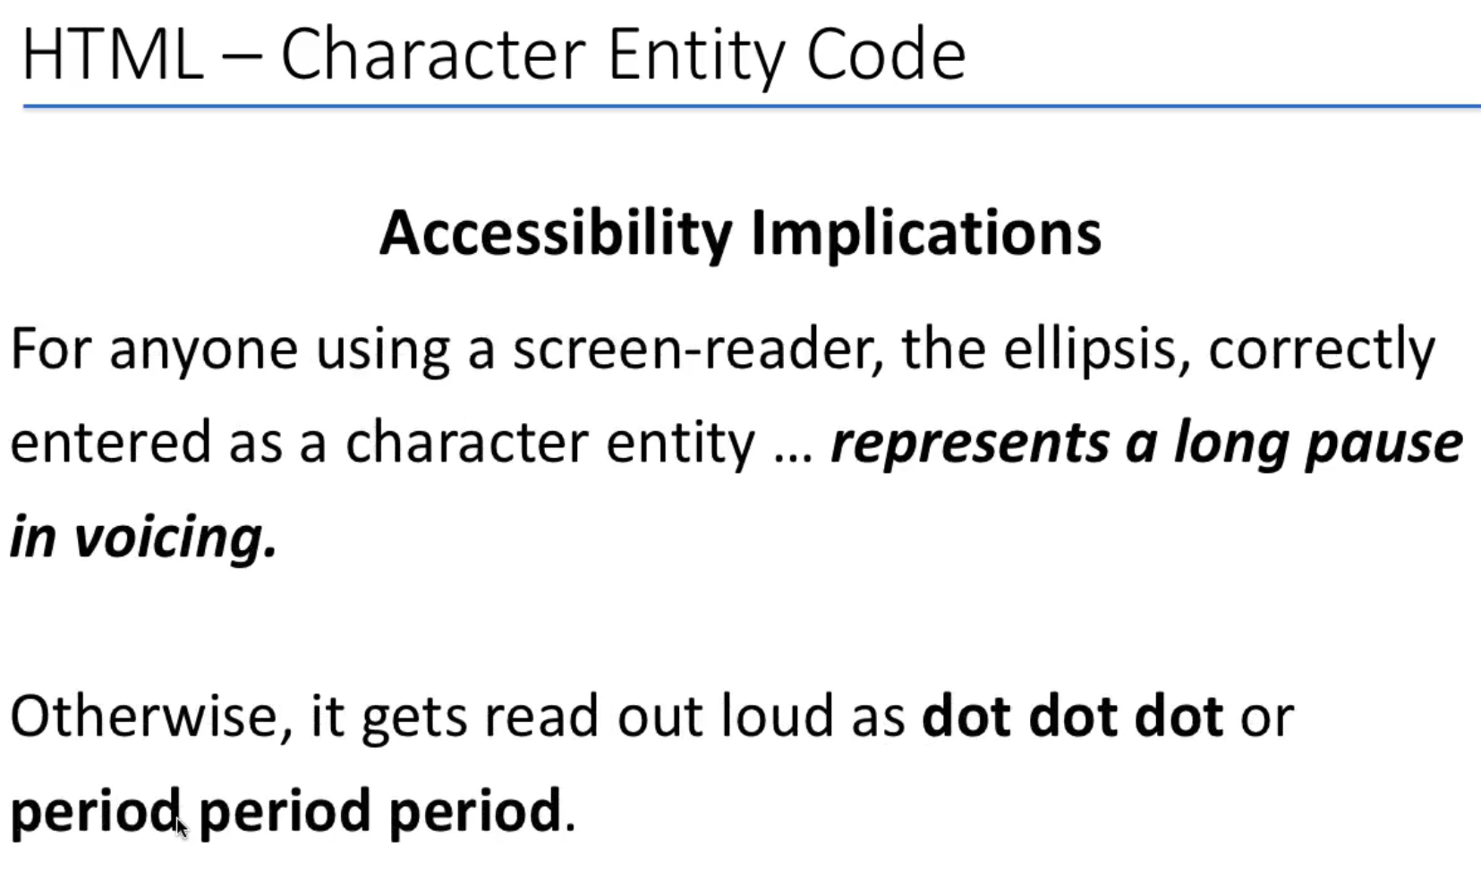
0422.3 Character Entities Video
https://ucsc-extension.instructure.com/courses/3825/pages/1-dot-1-welcome?module_item_id=42202
0422.3 Character Entities Video

Slide 38
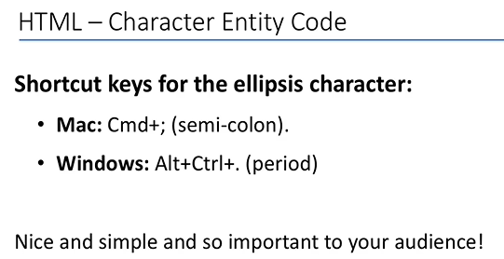
0422.3 Character Entities Video
https://ucsc-extension.instructure.com/courses/3825/pages/1-dot-1-welcome?module_item_id=42202
0422.3 Character Entities Video

Slide 39
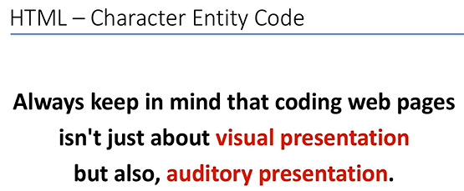
0422.3 Character Entities Video
https://ucsc-extension.instructure.com/courses/3825/pages/1-dot-1-welcome?module_item_id=42202
0422.3 Character Entities Video

Slide 40
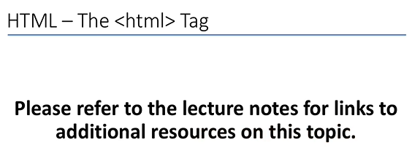
0422.3 Character Entities Video
https://ucsc-extension.instructure.com/courses/3825/pages/1-dot-1-welcome?module_item_id=42202
0422.3 Character Entities Video

Slide 41
End of Chapter

