Slide 1

1202 Final Quiz
Peter H. Chen

Slide 2
1202 Final Quiz
https://ucsc-extension.instructure.com/courses/3825/pages/1-dot-1-welcome?module_item_id=42202
1202 Final Quiz
Module 12 - HTML Final Quiz!
Due Dec 17 at 11:59pm Points 10 Questions 10
Available Sep 17 at 12am - Dec 17 at 11:59pm 3 months
Time Limit 30 Minutes Allowed Attempts 3
Instructions
Review of Concepts covered in Module 12 - Final
Objectives:
Students should be able to:
Define XHTML/HTML5 terminology
Identify correct XHTML/HTML5 usage

Slide 3
1202 Final Quiz
https://ucsc-extension.instructure.com/courses/3825/pages/1-dot-1-welcome?module_item_id=42202
1202 Final Quiz
About the Quiz:
This is a graded quiz
There are 10 questions for a total of 10 points.
You can take the quiz three times
Highest score is applied.
You will have 30 minutes to complete for each attempt.

Slide 4
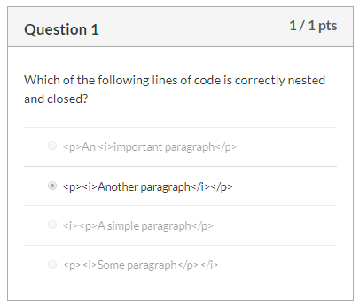
1202 Final Quiz
https://ucsc-extension.instructure.com/courses/3825/pages/1-dot-1-welcome?module_item_id=42202
1202 Final Quiz

Slide 5
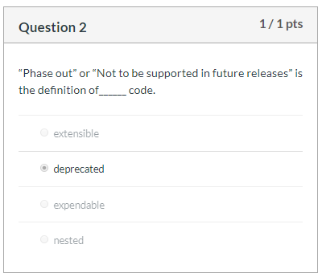
1202 Final Quiz
https://ucsc-extension.instructure.com/courses/3825/pages/1-dot-1-welcome?module_item_id=42202
1202 Final Quiz

Slide 6
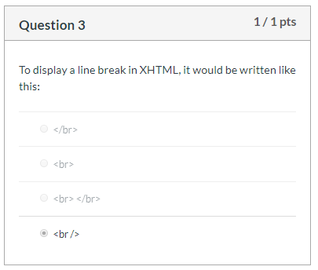
1202 Final Quiz
https://ucsc-extension.instructure.com/courses/3825/pages/1-dot-1-welcome?module_item_id=42202
1202 Final Quiz

Slide 7
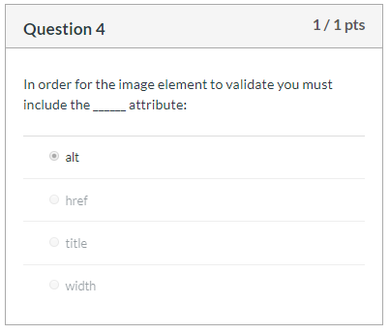
1202 Final Quiz
https://ucsc-extension.instructure.com/courses/3825/pages/1-dot-1-welcome?module_item_id=42202
1202 Final Quiz

Slide 8
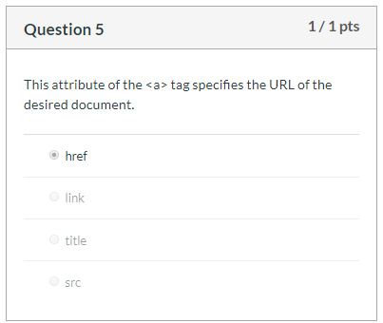
1202 Final Quiz
https://ucsc-extension.instructure.com/courses/3825/pages/1-dot-1-welcome?module_item_id=42202
1202 Final Quiz

Slide 9
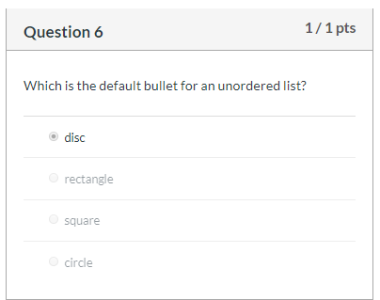
1202 Final Quiz
https://ucsc-extension.instructure.com/courses/3825/pages/1-dot-1-welcome?module_item_id=42202
1202 Final Quiz

Slide 10
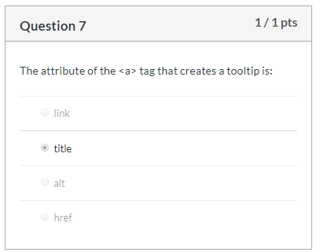
1202 Final Quiz
https://ucsc-extension.instructure.com/courses/3825/pages/1-dot-1-welcome?module_item_id=42202
1202 Final Quiz

Slide 11
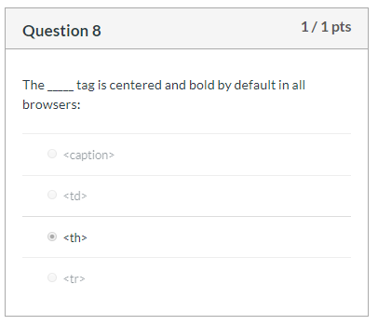
1202 Final Quiz
https://ucsc-extension.instructure.com/courses/3825/pages/1-dot-1-welcome?module_item_id=42202
1202 Final Quiz

Slide 12
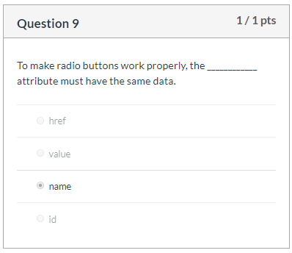
1202 Final Quiz
https://ucsc-extension.instructure.com/courses/3825/pages/1-dot-1-welcome?module_item_id=42202
1202 Final Quiz

Slide 13
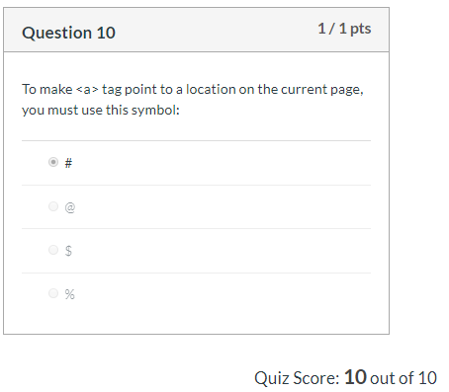
1202 Final Quiz
https://ucsc-extension.instructure.com/courses/3825/pages/1-dot-1-welcome?module_item_id=42202
1202 Final Quiz

Slide 14
End of Chapter

