Slide 1

0601 Web Image
Peter H. Chen

Slide 2
0601 Web Image
https://ucsc-extension.instructure.com/courses/3825/pages/1-dot-1-welcome?module_item_id=42202
0601 Web Image
Using Images for your web pages:
There are three file formats that are supported by all browsers on all platforms on all devices. These include:
.gif
.jpg
.png
There are others, but these are the essential “web” graphic formats you must use for the web.

Slide 3
0601 Web Image
https://ucsc-extension.instructure.com/courses/3825/pages/1-dot-1-welcome?module_item_id=42202
0601 Web Image
GIF or .gif (Graphics Interchange Format)
are file formats used for images using solid colors, line art and supports up to 8 bits per pixel, which allows for the use of 256 colors total.
The compression algorithm reduces colors and therefore is considered a “lossless” compression.
This format allows you to do two things .jpg and .png formats cannot do.
Pixels are either 100% on or 100% off, meaning that you can apply transparency (100% off to a particular color) and
GIF is a multi-image format, which means you can create animation.

Slide 4
0601 Web Image
https://ucsc-extension.instructure.com/courses/3825/pages/1-dot-1-welcome?module_item_id=42202
0601 Web Image
JPEG or .jpg (Joint Photographic Experts Group)
is a file format that works well for photographic material. An image that contains smooth variations of colors is also a good for .jpg file format.
A .jpg is a lossy compression format which means that the encoding process discards some of it’s data each time you compress the file, which is why you will see an image deteriorate over time if you save a .jpg file over and over again.
It’s best to use a .psd or .tiff format and then save out to the .jpg format.

Slide 5
0601 Web Image
https://ucsc-extension.instructure.com/courses/3825/pages/1-dot-1-welcome?module_item_id=42202
0601 Web Image
PNG or .png (Portable Network Graphics)
uses something called the DEFLATE compression method (similar to .zip compression algorithm).
It is, like .gif compression, a lossless compression.
Like .jpg, it is a single image format so it does not support animation like .gif compression allows.
However, unlike .jpg and .gif, it can support alpha transparency meaning it has the ability to hold 50% transparent (gif only does 100% transparency).
It has only been recently that all of today’s browsers support .png (especially transparency, which IE6 did not support).
There is a png-8 and png-24.
PNG-8 is essentially the same as .gif in terms of color limitations (256 colors) but allows for alpha transparency.
PNG-24 allows for a much broader range of colors.

Slide 6
0601.1 Web Image Video

Slide 7

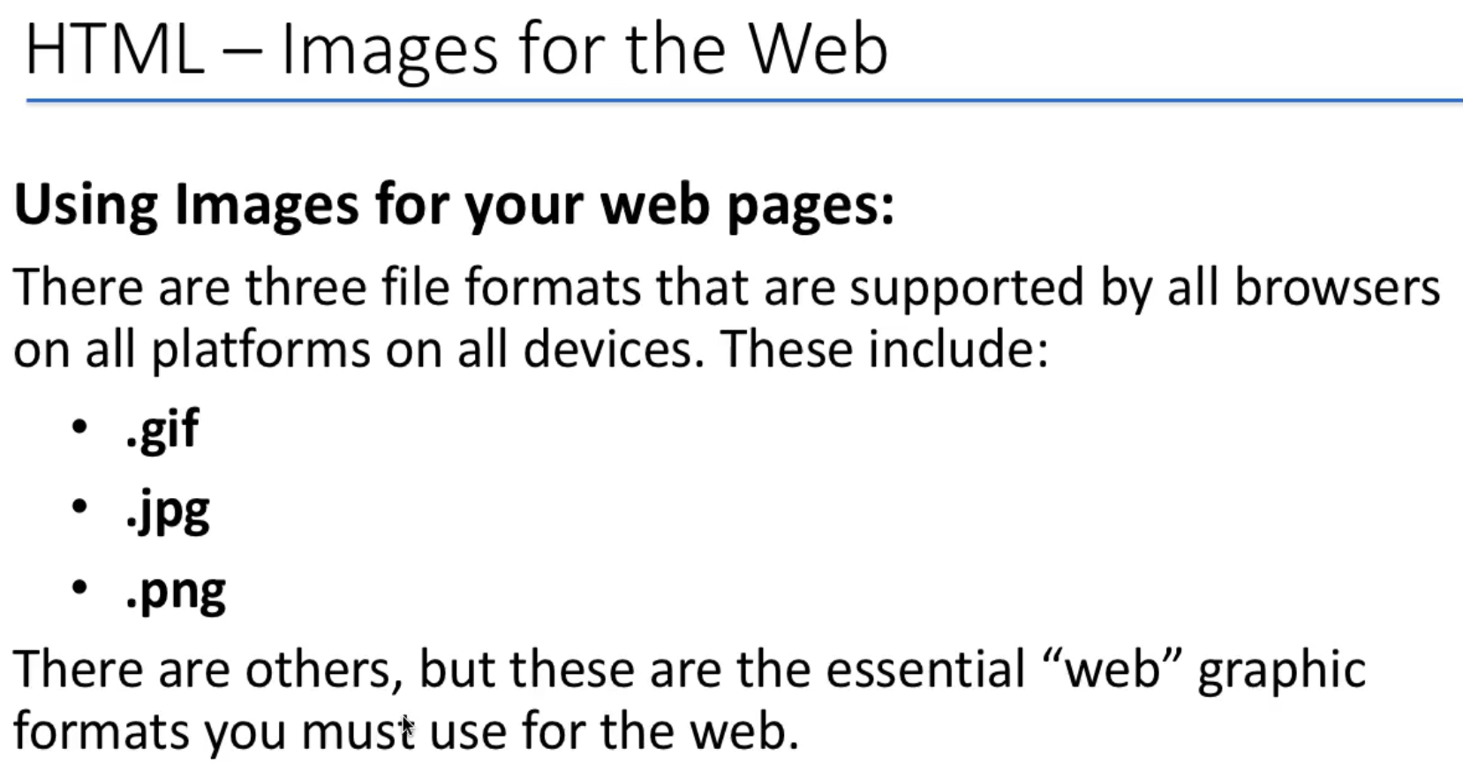
0601.1 Web Image Video
https://ucsc-extension.instructure.com/courses/3825/pages/1-dot-1-welcome?module_item_id=42202
0601.1 Web Image Video

Slide 8
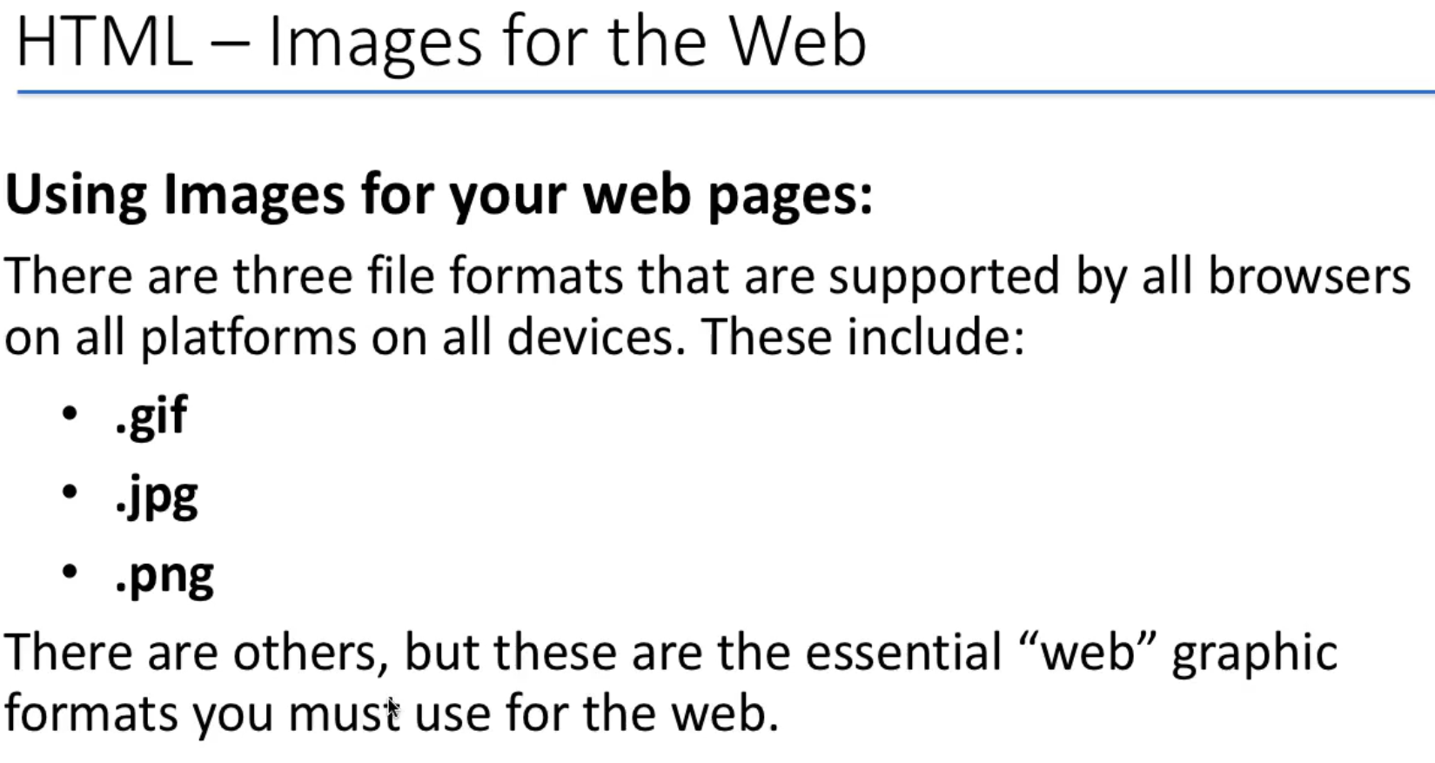
0601.1 Web Image Video
https://ucsc-extension.instructure.com/courses/3825/pages/1-dot-1-welcome?module_item_id=42202
0601.1 Web Image Video

Slide 9
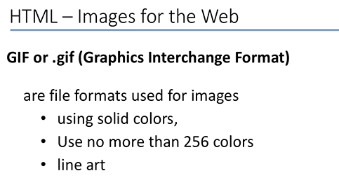
0601.1 Web Image Video
https://ucsc-extension.instructure.com/courses/3825/pages/1-dot-1-welcome?module_item_id=42202
0601.1 Web Image Video

Slide 10
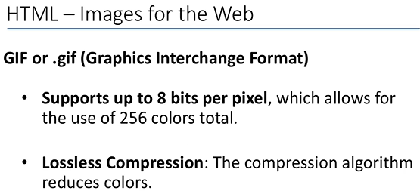
0601.1 Web Image Video
https://ucsc-extension.instructure.com/courses/3825/pages/1-dot-1-welcome?module_item_id=42202
0601.1 Web Image Video

Slide 11
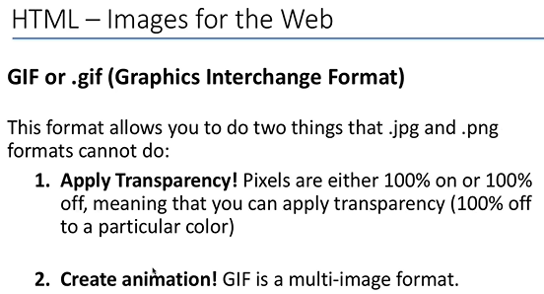
0601.1 Web Image Video
https://ucsc-extension.instructure.com/courses/3825/pages/1-dot-1-welcome?module_item_id=42202
0601.1 Web Image Video

Slide 12
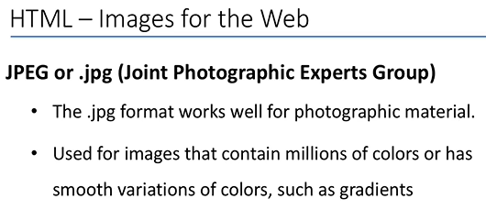
0601.1 Web Image Video
https://ucsc-extension.instructure.com/courses/3825/pages/1-dot-1-welcome?module_item_id=42202
0601.1 Web Image Video

Slide 13
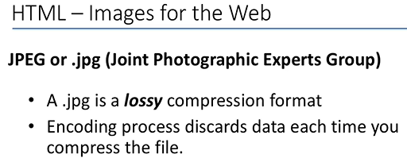
0601.1 Web Image Video
https://ucsc-extension.instructure.com/courses/3825/pages/1-dot-1-welcome?module_item_id=42202
0601.1 Web Image Video

Slide 14
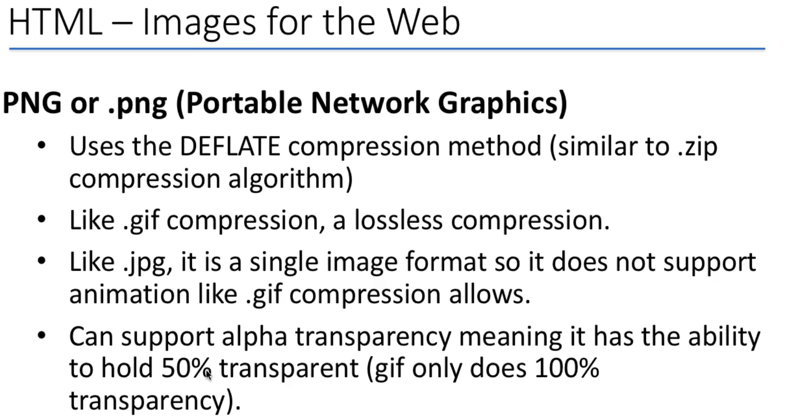
0601.1 Web Image Video
https://ucsc-extension.instructure.com/courses/3825/pages/1-dot-1-welcome?module_item_id=42202
0601.1 Web Image Video

Slide 15
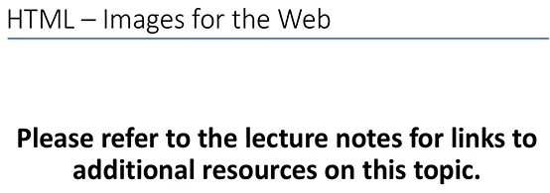
0601.1 Web Image Video
https://ucsc-extension.instructure.com/courses/3825/pages/1-dot-1-welcome?module_item_id=42202
0601.1 Web Image Video

Slide 16
End of Chapter

