Slide 1

0605 Path, Height, and Width
Peter H. Chen

Slide 2
0605 Path, Height, and Width
https://ucsc-extension.instructure.com/courses/3825/pages/1-dot-1-welcome?module_item_id=42202
0605 Path, Height, and Width
Optional Attributes of the <img> tag:
height="60" sets the height of the graphic to 60 pixels.
width="468" sets the width of the graphic to 468 pixels
It’s a good idea to specify both the width and height attributes for images.
If width and height are set, the space required for the image is reserved when the page is loaded.
However, without these attributes, the browser does not know the size of the image, and cannot reserve the appropriate space to it.
The effect will be that the page layout will change during loading (while the images load).
The browser won’t have to spend time setting up the space and it will display the image more quickly.

Slide 3
0605 Path, Height, and Width
https://ucsc-extension.instructure.com/courses/3825/pages/1-dot-1-welcome?module_item_id=42202
0605 Path, Height, and Width
Also don’t downsize an image simply by changing the width and height numbers – resize it in an image-editing program. Otherwise you force a user to download a large image even though it “looks” small.

Slide 4
0605.1 Path, Height, and Width Video

Slide 5
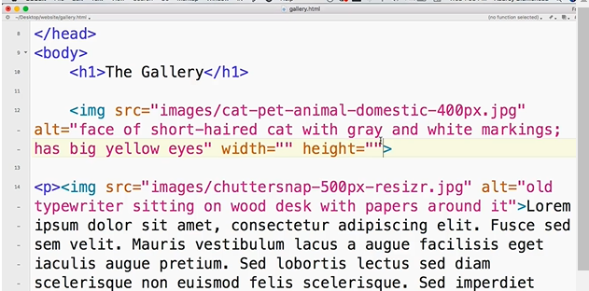
0605.1 Path, Height, and Width Video
https://ucsc-extension.instructure.com/courses/3825/pages/1-dot-1-welcome?module_item_id=42202
0605.1 Path, Height, and Width Video

Slide 6
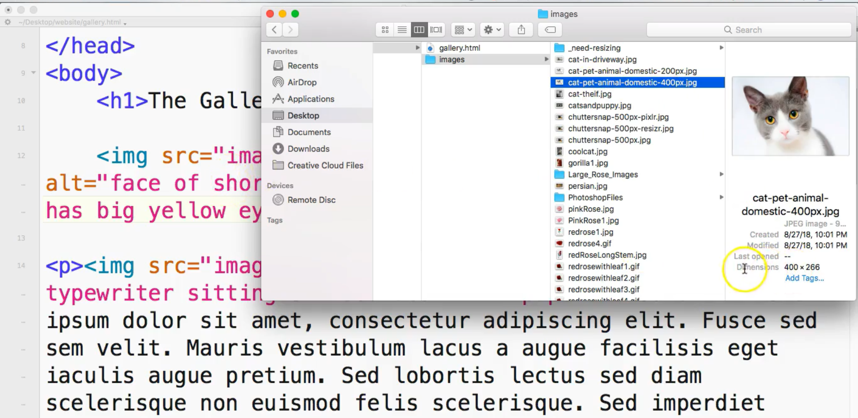
0605.1 Path, Height, and Width Video
https://ucsc-extension.instructure.com/courses/3825/pages/1-dot-1-welcome?module_item_id=42202
0605.1 Path, Height, and Width Video
Without specify the Width and Height, the actual size is 400x266

Slide 7
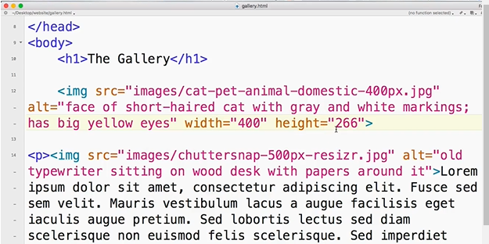
0605.1 Path, Height, and Width Video
https://ucsc-extension.instructure.com/courses/3825/pages/1-dot-1-welcome?module_item_id=42202
0605.1 Path, Height, and Width Video
Specify Width=“400” and Height =“266”

Slide 8
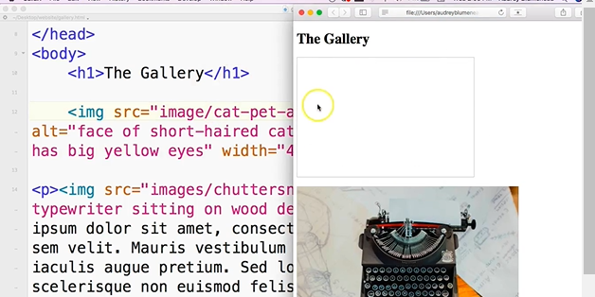
0605.1 Path, Height, and Width Video
https://ucsc-extension.instructure.com/courses/3825/pages/1-dot-1-welcome?module_item_id=42202
0605.1 Path, Height, and Width Video
Specify Width=“400” and Height =“266”. Change folder “images” to “image”.
On Chrome, the image is empty with size 400 x 266.

Slide 9
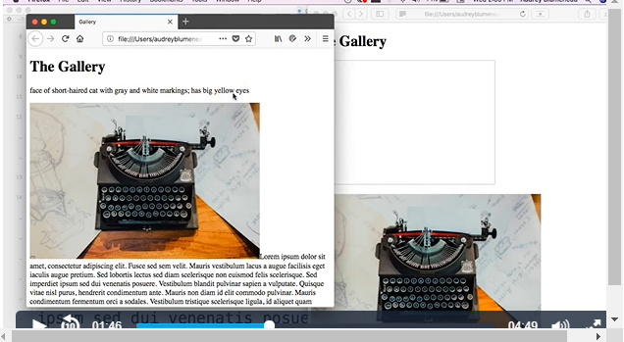
0605.1 Path, Height, and Width Video
https://ucsc-extension.instructure.com/courses/3825/pages/1-dot-1-welcome?module_item_id=42202
0605.1 Path, Height, and Width Video
Left hand side: Firefox. Right hand size: Chrome

Slide 10
0605.1 Path, Height, and Width Video
https://ucsc-extension.instructure.com/courses/3825/pages/1-dot-1-welcome?module_item_id=42202
0605.1 Path, Height, and Width Video
Do not change size of Height and Width, just use the image size.

Slide 11
End of Chapter

