Slide 1

0607 Images Assignment
Peter H. Chen

Slide 2
0607 Images Assignment
https://ucsc-extension.instructure.com/courses/3825/pages/1-dot-1-welcome?module_item_id=42202
0607 Images Assignment
Due Dec 17 by 11:59pm Points 10 Submitting a file upload
Available Sep 17 at 12am - Dec 17 at 11:59pm 3 months
Assignment: Images!
Objective:
By the end of this unit, you should be able to
locate Creative Commons or properly licensed images for a web project
perform basic optimization of images for optimal size for use on the web
write code that meets accessibility mandates for images
write code that meets and passes W3C Validation standards

Slide 3
0607 Images Assignment
https://ucsc-extension.instructure.com/courses/3825/pages/1-dot-1-welcome?module_item_id=42202
0607 Images Assignment
What you will do:
Create a folder for this assignment. Name this folder: YourlLastName-module06-images.
You will create a folder within this folder called images (keep the names lower-case letters)

Slide 4
0607 Images Assignment
https://ucsc-extension.instructure.com/courses/3825/pages/1-dot-1-welcome?module_item_id=42202
0607 Images Assignment
Get some images (at least three of a topic of your choice!) and put into a folder called "images".
You can use your own images, find properly licensed images on the web or the ones in the instructor provided images folder.
If using your own images, be sure to optimize/resize so that they are under 100kb
If you use images from the Web, be sure to check license for reuse and check size. Resize (keep under 100kb) if necessary.
Be sure to cite where you got your images. This can be done either in the footer of your web page (remember we have a tag for this!). Place at the bottom of page: “Images were obtained from....” or, in the code via a comment tag.
Remember, no spaces in your file names!

Slide 5
0607 Images Assignment
https://ucsc-extension.instructure.com/courses/3825/pages/1-dot-1-welcome?module_item_id=42202
0607 Images Assignment
Create a new .html file and insert at minimum three images into a web page.
Save this file as yourlastname-06-images.html
Be sure to include good alt content (imagine telling someone what the image is on the telephone).
As always, make sure to keep a <title> that is good for search engines / bookmarking, write meta tags that have good descriptions (lots of keywords and key phrases relative to your content. That means if your images are all about cats doing silly things, than your title and your meta tag for the description will talk about “We have some photos of the silly things cats do. Does your cat do this? [list silly things cats do...]” or something like that. In other words, do not write “Assignment 6, images; inserting images for assignment 6”. )

Slide 6
0607 Images Assignment
https://ucsc-extension.instructure.com/courses/3825/pages/1-dot-1-welcome?module_item_id=42202
0607 Images Assignment
Validate your code per the W3C standards:
Use this validator for the HTML5 doctype:
https://validator.w3.org/nu/ (https://validator.w3.org/nu/) (check all the boxes for source, outline and image report).
When you submit this assignment, you zip your folder so you an submit all files as a "package"! Windows, Right-click the folder, go to Send To > Compressed (zipped) folder").
Mac: Right-click on the folder and choose "Compress".

Slide 7
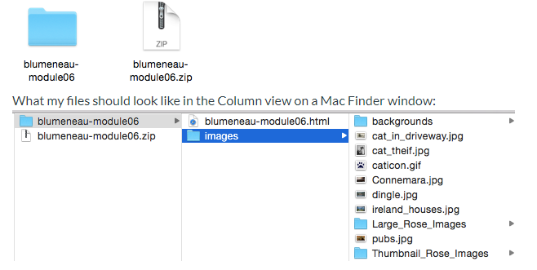
0607 Images Assignment
https://ucsc-extension.instructure.com/courses/3825/pages/1-dot-1-welcome?module_item_id=42202
0607 Images Assignment
This will create a .zip file and this is the file you will submit to me.

Slide 8
0607 Images Assignment
https://ucsc-extension.instructure.com/courses/3825/pages/1-dot-1-welcome?module_item_id=42202
0607 Images Assignment
NOTE:
Use the HTML5 doctype and meta tag for this exercise. That does mean you will not apply any deprecated attributes (there are a few deprecated attribute in this module, which I only showcase so you are aware of what they are and what they did, so you can recognize old code from what is currently acceptable. In other words, you shouldn't use these attributes!
The HTML code here is exactly the same whether we use HTML 4.01 Transitional/Strict, XHTML 1.0 Transitional/Strict or HTML5 minus those deprecated attributes!

Slide 9
0607 Images Assignment
https://ucsc-extension.instructure.com/courses/3825/pages/1-dot-1-welcome?module_item_id=42202
0607 Images Assignment
What to Submit:
Check Rubric (see below) to ensure you have met all the criteria.
Submit your .zip folder here!

Slide 10
0607 Images Assignment
https://ucsc-extension.instructure.com/courses/3825/pages/1-dot-1-welcome?module_item_id=42202
0607 Images Assignment
HTML Images (1)
Criteria | Ratings | Pts
Validated HTML code (no errors or warnings) |  | 2.0 pts
Images display on the browser window. Image file size is under 100kb; minimum of three images, cited and licensed for reuse. |  | 3.0 pts
Content for alt attribute describes the image and/or function clearly and effectively |  | 3.0 pts
Content for title and meta description are appropriate for the content of the page; application of other elements such as headings, paragraphs are well placed for semantic and structural integrity |  | 2.0 pts
Total Points: 10.0

Slide 11
End of Chapter

