Slide 1

0608 Images Quiz
Peter H. Chen

Slide 2
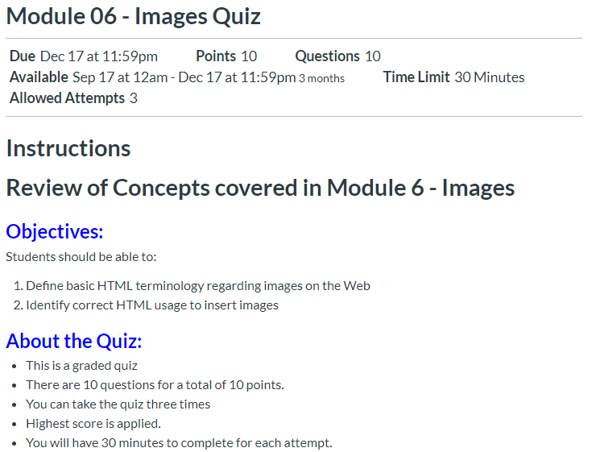
0608 Images Quiz
https://ucsc-extension.instructure.com/courses/3825/pages/1-dot-1-welcome?module_item_id=42202
0608 Images Quiz

Slide 3
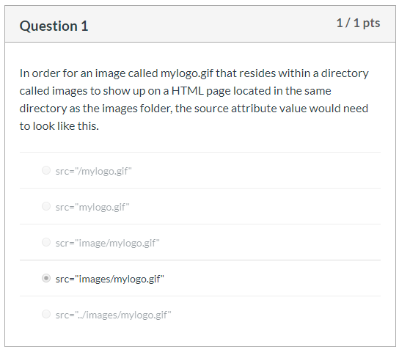
0608 Images Quiz
https://ucsc-extension.instructure.com/courses/3825/pages/1-dot-1-welcome?module_item_id=42202
0608 Images Quiz

Slide 4
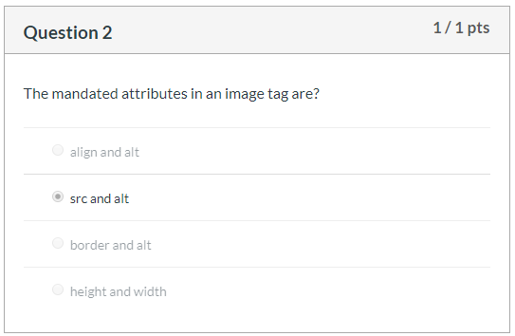
0608 Images Quiz
https://ucsc-extension.instructure.com/courses/3825/pages/1-dot-1-welcome?module_item_id=42202
0608 Images Quiz

Slide 5
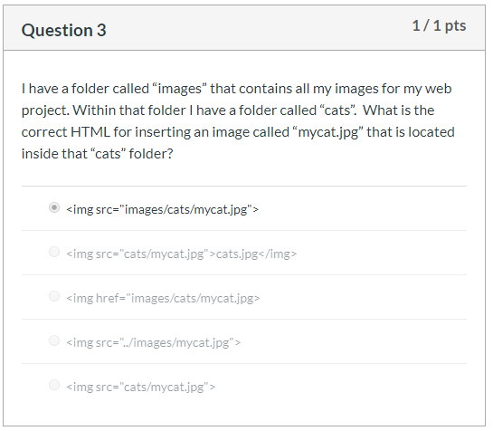
0608 Images Quiz
https://ucsc-extension.instructure.com/courses/3825/pages/1-dot-1-welcome?module_item_id=42202
0608 Images Quiz

Slide 6
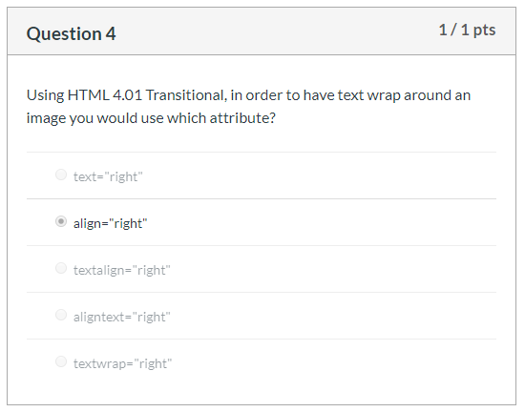
0608 Images Quiz
https://ucsc-extension.instructure.com/courses/3825/pages/1-dot-1-welcome?module_item_id=42202
0608 Images Quiz

Slide 7
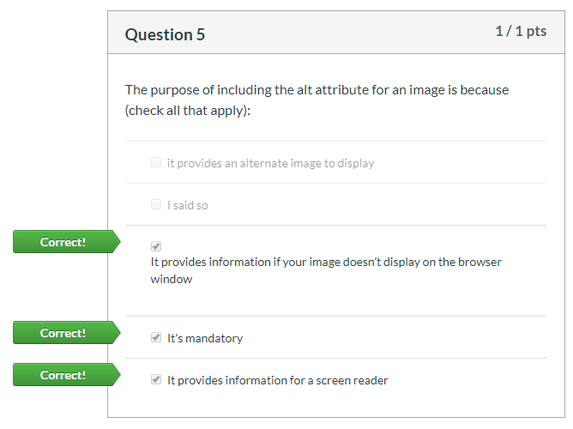
0608 Images Quiz
https://ucsc-extension.instructure.com/courses/3825/pages/1-dot-1-welcome?module_item_id=42202
0608 Images Quiz

Slide 8
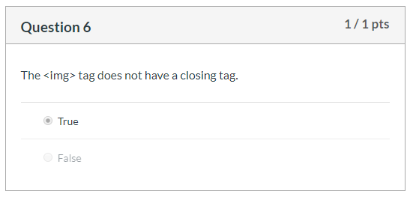
0608 Images Quiz
https://ucsc-extension.instructure.com/courses/3825/pages/1-dot-1-welcome?module_item_id=42202
0608 Images Quiz

Slide 9
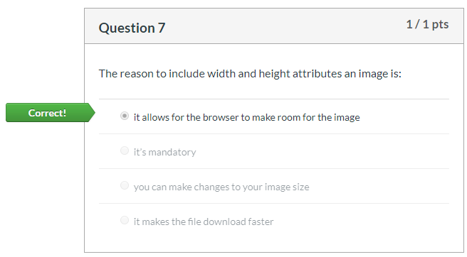
0608 Images Quiz
https://ucsc-extension.instructure.com/courses/3825/pages/1-dot-1-welcome?module_item_id=42202
0608 Images Quiz

Slide 10
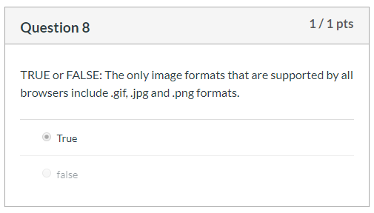
0608 Images Quiz
https://ucsc-extension.instructure.com/courses/3825/pages/1-dot-1-welcome?module_item_id=42202
0608 Images Quiz

Slide 11
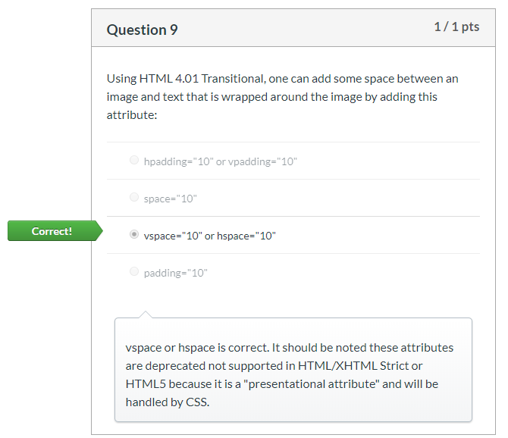
0608 Images Quiz
https://ucsc-extension.instructure.com/courses/3825/pages/1-dot-1-welcome?module_item_id=42202
0608 Images Quiz

Slide 12
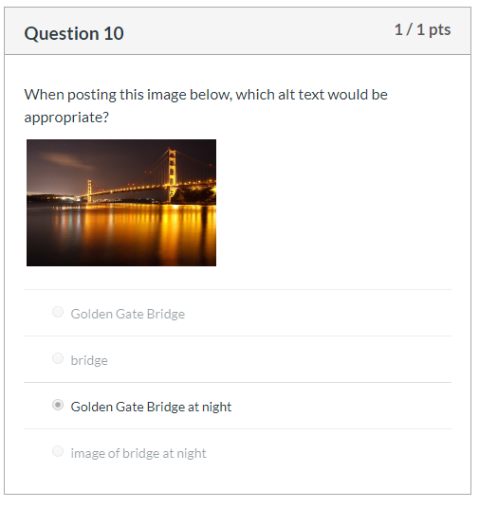
0608 Images Quiz
https://ucsc-extension.instructure.com/courses/3825/pages/1-dot-1-welcome?module_item_id=42202
0608 Images Quiz

Slide 13
End of Chapter

