Slide 1

0423 Basic Page Assignment
Peter H. Chen

Slide 2
0423 Basic Page Assignment
https://ucsc-extension.instructure.com/courses/3825/pages/1-dot-1-welcome?module_item_id=42202
Module 04 - Basic Page Assignment
Due Dec 17 by 11:59pm Points 10 Submitting a file upload
Available Sep 17 at 12am - Dec 17 at 11:59pm 3 months
Assignment - Basic HTML Code
Objective:
Be able to hand-code a simple web page using the basic structural, block-level, inline-level and phrase HTML elements covered in class.
Includes code specifically for the browsers and search engines that will enhance search engine optimization and proper browser display.
Be able to write code that meets/passes W3C code specifications by achieving W3C Validation.

Slide 3
0423 Basic Page Assignment
https://ucsc-extension.instructure.com/courses/3825/pages/1-dot-1-welcome?module_item_id=42202
How you will do this:
Open the text editor of your choice (Notepad++, BBEdit, Sublime, etc.) to create a HTML document.
Save this file as "YourLastName-04-basic.html". Remember: No spaces. (Your last name, module number: i.e. blumeneau-04-basic.html)
Contents (see Rubric below for additional guidance):
Apply the HTML5 doctype
Apply appropriate meta tags (for the charset, use the newest one which is also the shortest one!).
This <title> must indicate the topic for this page. For example, it should say something like "John Doe - About Me".
Make sure your full name is displayed on the page (for example in the title and heading tag).
Include block level elements (at least two headings and two paragraphs, hr, blockquote).

Slide 4
0423 Basic Page Assignment
https://ucsc-extension.instructure.com/courses/3825/pages/1-dot-1-welcome?module_item_id=42202
Ideas for content could be:
Information about you (e.g.: a synopsis of your education, jobs, travels, (think of these as possible 'headings') etc.).
What are your personal goals (i.e. a degree in what? Dream job doing what?).
Add inline elements (i, b, sub, sup, br, or q for favorite quotation for example).
Add phrase elements (apply to an abbreviation (abbr) em, strong, cite, etc , for example).
Validate your code per the W3C standards:
Use the HTML5 doctype and meta tag for this assignment as shown in the Lecture notes and do not use any of the deprecated attributes!
Use the Nu HTML Validator (Links to an external site.) for the HTML5 doctype (note that there is a different validator if you used doctype for HTML 4.01 but best to use HTML5 doctype!) and check all the boxes for source, outline and image report.

Slide 5
0423 Basic Page Assignment
https://ucsc-extension.instructure.com/courses/3825/pages/1-dot-1-welcome?module_item_id=42202
If you had used the HTML 4.01 Transitional or Strict doctype, you would have to use the older HTML 4.01 validator (Links to an external site.). In other words, there are two different validators, one for HTML5 (nu) and one for older docytpes!
Also be aware that the HTML5 validator does NOT include a validation icon, so don't try to put one in. If you had used the HTML 4.01 doctype and validation, then you could have placed the icon on your web page.

Slide 6
0423 Basic Page Assignment
https://ucsc-extension.instructure.com/courses/3825/pages/1-dot-1-welcome?module_item_id=42202
What to Submit:
Double check the Rubric below to ensure you met all the criteria
Submit your .html file here (click on Submit Button at upper-right corner)!
First time submitting an assignment? Need Help?
If this is the first time submitting an assignment and you are unfamiliar with how to do so, you can watch this short video on Assignment Submissions in Canvas (Links to an external site.). This video covers all types of assignment submissions.

Slide 7
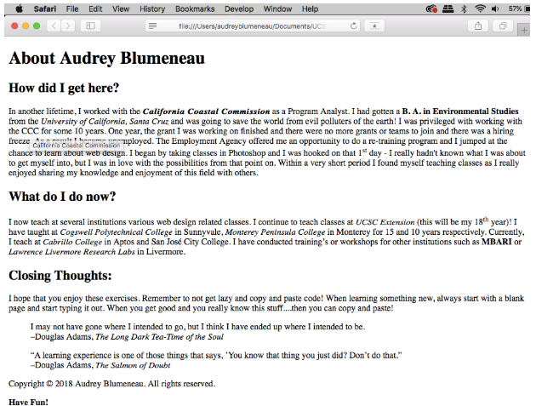
0423 Basic Page Assignment
https://ucsc-extension.instructure.com/courses/3825/pages/1-dot-1-welcome?module_item_id=42202
Example:
Here is a screen-shot example of what your page might look like. Notice the tool tip that is displayed as a result of the <abbr> element applied to the CCC abbreviation.
Can you guess which elements I used for this page content?

Slide 8
0423 Basic Page Assignment
https://ucsc-extension.instructure.com/courses/3825/pages/1-dot-1-welcome?module_item_id=42202
Module 4: Basic HTML (1):
Module 4: Basic HTML (1)
Criteria | Ratings | Pts
This criterion is linked to a Learning OutcomeHTML passed validation (no warnings or errors). |  | 1.0 pts
This criterion is linked to a Learning OutcomeContent for <title> and meta tag for description is meaningful and keyword rich. |  | 2.0 pts
This criterion is linked to a Learning OutcomeProper semantic application of block level elements (heading, paragraph, blockquote, pre, hr etc.) at least four (4) different element examples (or more!). |  | 2.0 pts
This criterion is linked to a Learning OutcomeProper semantic application of phrase elements (for example: sub, sup, i, em, b, strong, br, q, cite, etc) at least eight (8) different element examples of phrase elements (or more!). |  | 4.0 pts
This criterion is linked to a Learning OutcomeDemonstrated application of character entities (example: copyright, curly quotation marks etc.). |  | 1.0 pts

Slide 9
End of Chapter

