Slide 1

0424 Quiz
Peter H. Chen

Slide 2
0424 Basic HTML Quiz
https://ucsc-extension.instructure.com/courses/3825/pages/1-dot-1-welcome?module_item_id=42202
Due Dec 17 at 11:59pm Points 10 Questions 10
Available Sep 17 at 12am - Dec 17 at 11:59pm 3 months
Time Limit 30 Minutes Allowed Attempts 3
Instructions
Review of Concepts covered in Module 4 - Basic HTML
Objectives:
Students should be able to:
Define basic HTML terminology
Identify correct HTML usage
About the Quiz:
This is a graded quiz
There are 10 questions for a total of 10 points.
You can take the quiz three times
Highest score is applied.
You will have 30 minutes to complete for each attempt.

Slide 3
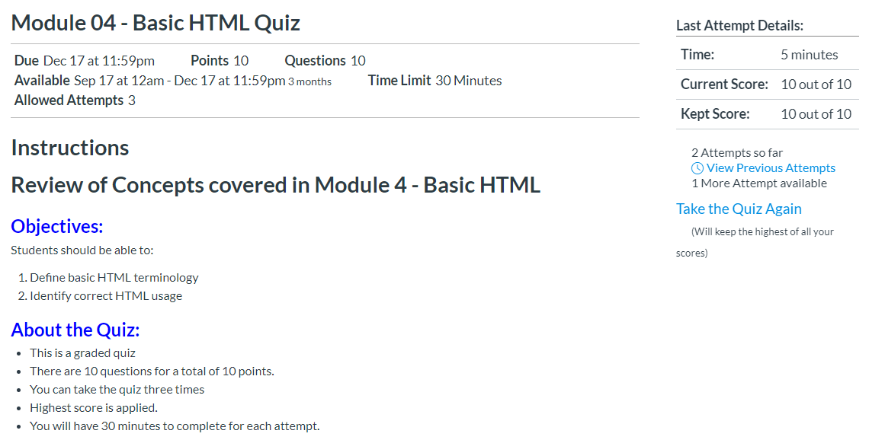
0424 Basic HTML Quiz
https://ucsc-extension.instructure.com/courses/3825/pages/1-dot-1-welcome?module_item_id=42202
Quiz:

Slide 4
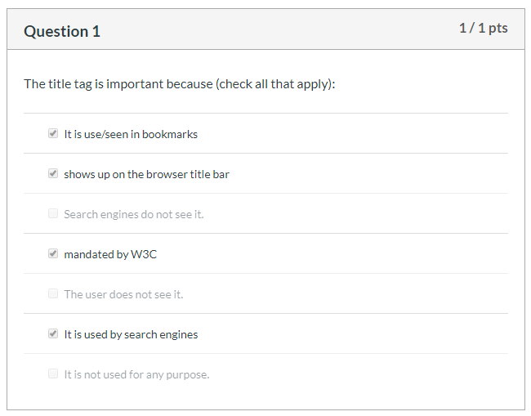
0424 Basic HTML Quiz
https://ucsc-extension.instructure.com/courses/3825/pages/1-dot-1-welcome?module_item_id=42202
Question 1:

Slide 5
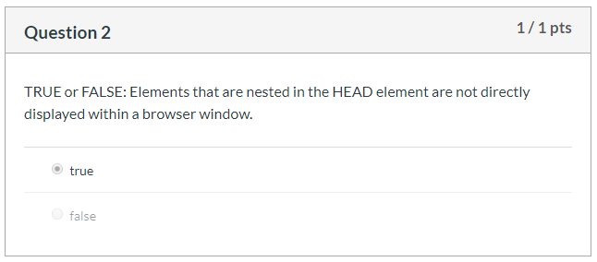
0424 Basic HTML Quiz
https://ucsc-extension.instructure.com/courses/3825/pages/1-dot-1-welcome?module_item_id=42202
Question 2:

Slide 6
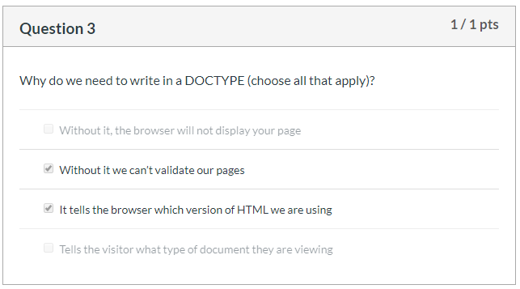
0424 Basic HTML Quiz
https://ucsc-extension.instructure.com/courses/3825/pages/1-dot-1-welcome?module_item_id=42202
Question 3:

Slide 7
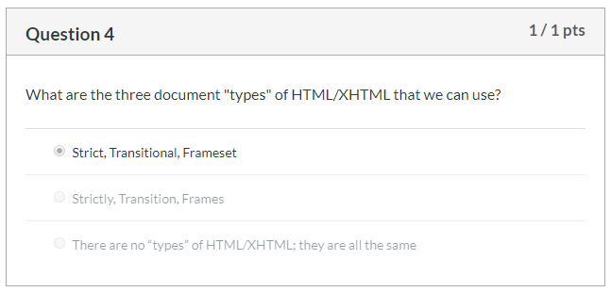
0424 Basic HTML Quiz
https://ucsc-extension.instructure.com/courses/3825/pages/1-dot-1-welcome?module_item_id=42202
Question 4:

Slide 8
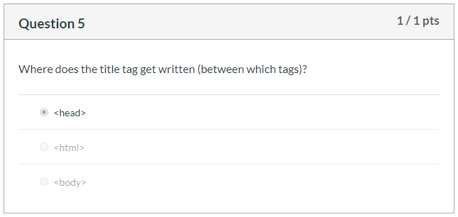
0424 Basic HTML Quiz
https://ucsc-extension.instructure.com/courses/3825/pages/1-dot-1-welcome?module_item_id=42202
Question 5:

Slide 9
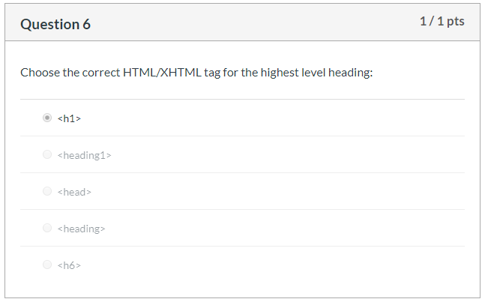
0424 Basic HTML Quiz
https://ucsc-extension.instructure.com/courses/3825/pages/1-dot-1-welcome?module_item_id=42202
Question 6:

Slide 10
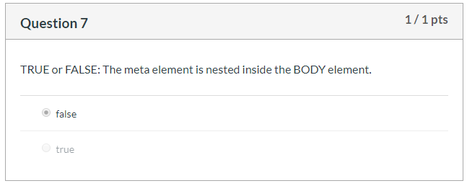
0424 Basic HTML Quiz
https://ucsc-extension.instructure.com/courses/3825/pages/1-dot-1-welcome?module_item_id=42202
Question 7:

Slide 11
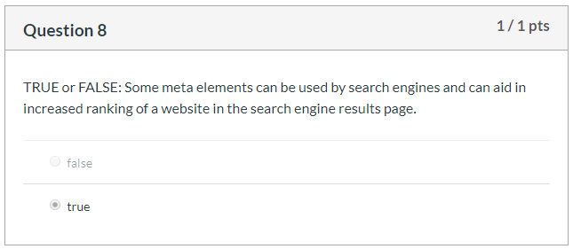
0424 Basic HTML Quiz
https://ucsc-extension.instructure.com/courses/3825/pages/1-dot-1-welcome?module_item_id=42202
Question 8:

Slide 12
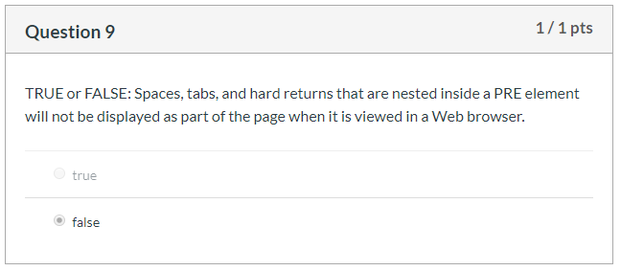
0424 Basic HTML Quiz
https://ucsc-extension.instructure.com/courses/3825/pages/1-dot-1-welcome?module_item_id=42202
Question 9:

Slide 13
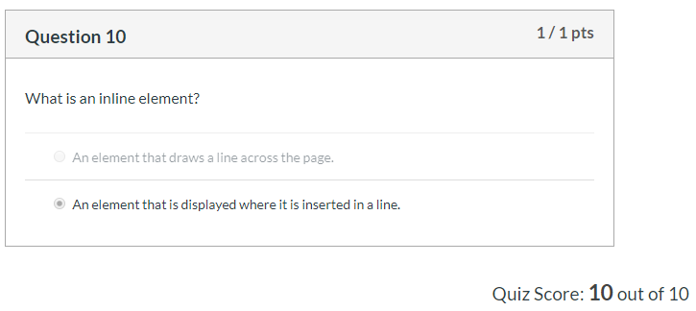
0424 Basic HTML Quiz
https://ucsc-extension.instructure.com/courses/3825/pages/1-dot-1-welcome?module_item_id=42202
Question 10:

Slide 14
End of Chapter

