Slide 1

0502 Unordered List
Peter H. Chen

Slide 2
0502 Unordered List
https://ucsc-extension.instructure.com/courses/3825/pages/1-dot-1-welcome?module_item_id=42202
0502 Unordered List
The Unordered List: <ul> </ul> Tag
The <ul> and <li> tags are used to create unordered lists (the <li> stands for List Item).
Unordered simply means there is no numbering scheme involved, instead you will get different types of bullets.
<ul>
<li> This is item number 1</li>
<li> This is item number 2</li>
</ul>

Slide 3
0502 Unordered List
https://ucsc-extension.instructure.com/courses/3825/pages/1-dot-1-welcome?module_item_id=42202
0502 Unordered List
Older code (using HTML 4.01 or XHTML 1.0)
You can change the “type” of the bullets for the whole list by using the “type” attribute within the <ul> tag but ONLY if you are using HTML 4.01 or XHTML 1.0.
This allows you to specify one of three types: disc (the default), circle, or square.
<ul type="circle">
<ul type="square">
You can also put this attribute within the <li type="square"> tag.
Note: the type attribute used for the <ul> has been deprecated in favor of using CSS so it won’t validate when using HTML5 doctype.

Slide 4
0502 Unordered List
https://ucsc-extension.instructure.com/courses/3825/pages/1-dot-1-welcome?module_item_id=42202
0502 Unordered List
Validation issues that may arise:
Putting a list inside a paragraph doesn't validate.
<p>Here is a list of fruit:
<ul>
<li>Apple</li>
<li>Banana</li>
<li>Watermelon</li>
</ul>
</p>

Slide 5
0502 Unordered List
https://ucsc-extension.instructure.com/courses/3825/pages/1-dot-1-welcome?module_item_id=42202
0502 Unordered List
It will validate if you move the list outside of the paragraph:
<p> Here is a list of fruit:</p>
<ul>
<li>Apple</li>
<li>Banana</li>
<li>Watermelon</li>
</ul>

Slide 6
0502.1 Unordered List Video

Slide 7
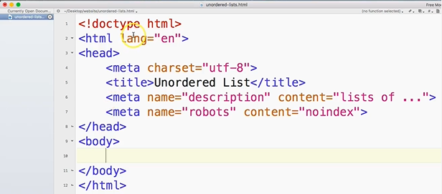
0502.1 Unordered List Video
https://ucsc-extension.instructure.com/courses/3825/pages/1-dot-1-welcome?module_item_id=42202
0502.1 Unordered List Video

Slide 8
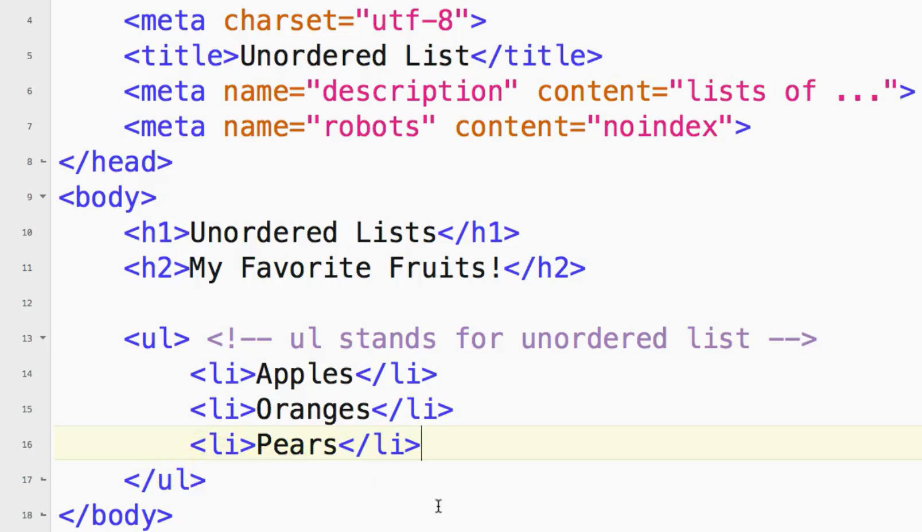
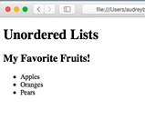
0502.1 Unordered List Video
https://ucsc-extension.instructure.com/courses/3825/pages/1-dot-1-welcome?module_item_id=42202
0502.1 Unordered List Video

Slide 9
End of Chapter

