Slide 1

0503 Ordered List
Peter H. Chen

Slide 2
0503 Ordered List
https://ucsc-extension.instructure.com/courses/3825/pages/1-dot-1-welcome?module_item_id=42202
0503 Ordered List
The Ordered List: <ol> </ol> Tag
The <ol> and <li> tags are used to create ordered lists. Ordered simply means there is a numbering scheme involved.
<ol>
<li> This is item number 1</li>
<li> This is item number 2</li>
</ol>

Slide 3
0503 Ordered List
https://ucsc-extension.instructure.com/courses/3825/pages/1-dot-1-welcome?module_item_id=42202
0503 Ordered List
The Type Attribute:
The “type” attribute can be used within ordered lists to specify the style of numbering.
There are five possible values: 1) 1 - numbers, 2) uppercase letters, 3) lowercase letters, 4) uppercase Roman numeral, and 5) lowercase Roman numeral.
Unlike the type attribute for the <ul> the type attribute in the <ol> will validate when using HTML5 DOCTYPE.
<ol type="A">
<ol type="a">
<ol type="I">
<ol type="i">

Slide 4
0503 Ordered List
https://ucsc-extension.instructure.com/courses/3825/pages/1-dot-1-welcome?module_item_id=42202
0503 Ordered List
You can also put this attribute in the <li> tag. If you want to start your list with a certain number or letter value, use the “start” attribute.
<ol start="23">
Note: the “start” attribute requires a numeric value even if the list type is not numeric. So you might have something that looks like this:
<ol type="a" start="4">

Slide 5
0502.1 Unordered List Video

Slide 6
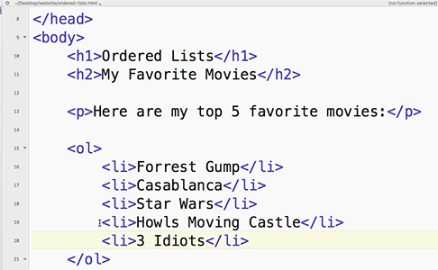
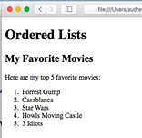
0503.1 Unordered List Video
https://ucsc-extension.instructure.com/courses/3825/pages/1-dot-1-welcome?module_item_id=42202
0503.1 Ordered List Video

Slide 7
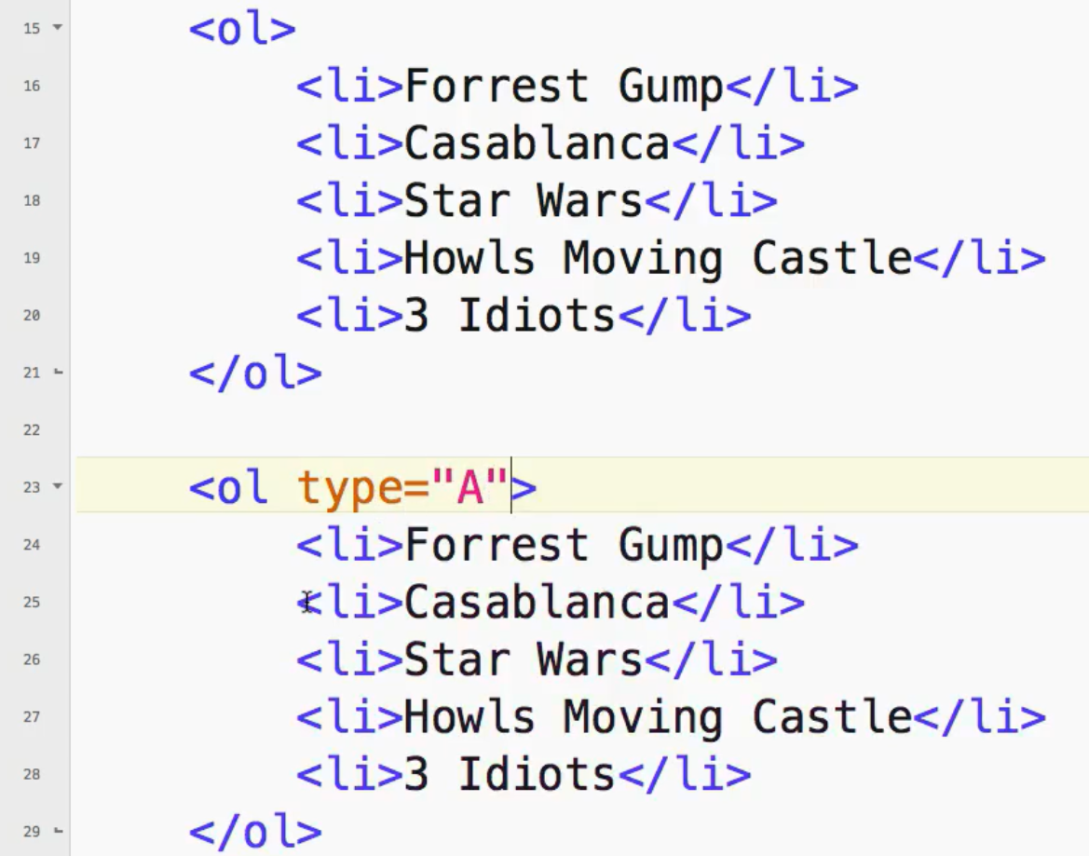
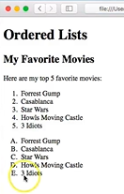
0503.1 Unordered List Video
https://ucsc-extension.instructure.com/courses/3825/pages/1-dot-1-welcome?module_item_id=42202
0503.1 Ordered List Video

Slide 8
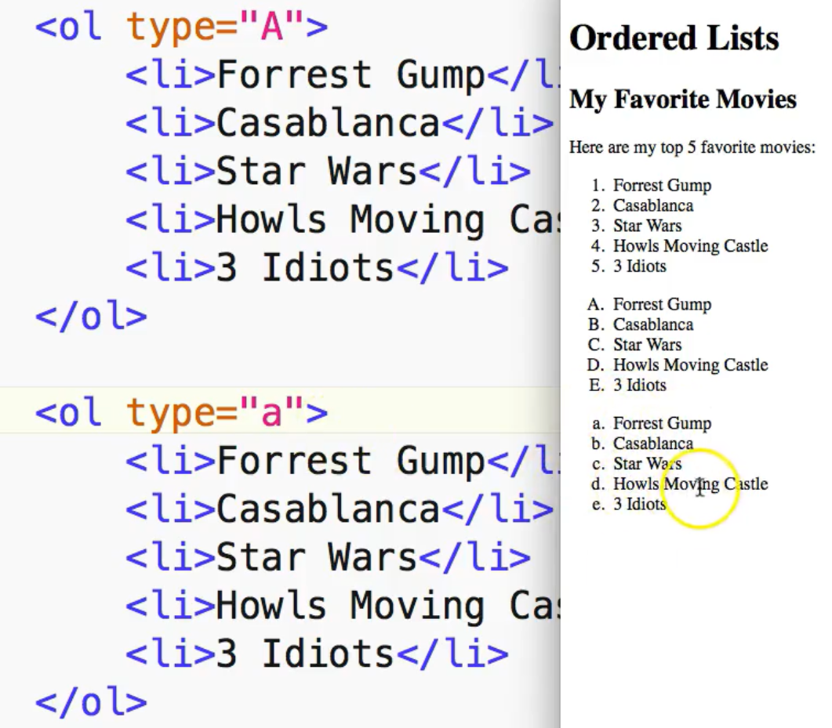
0503.1 Unordered List Video
https://ucsc-extension.instructure.com/courses/3825/pages/1-dot-1-welcome?module_item_id=42202
0503.1 Ordered List Video

Slide 9
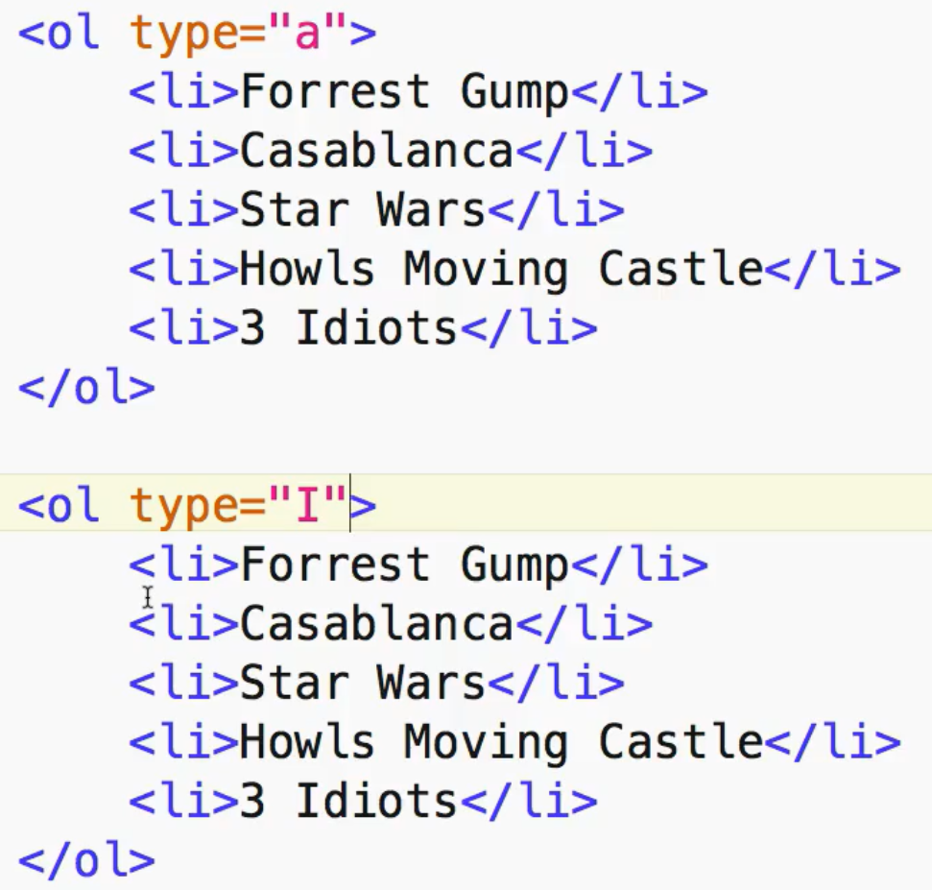
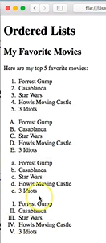
0503.1 Unordered List Video
https://ucsc-extension.instructure.com/courses/3825/pages/1-dot-1-welcome?module_item_id=42202
0503.1 Ordered List Video

Slide 10
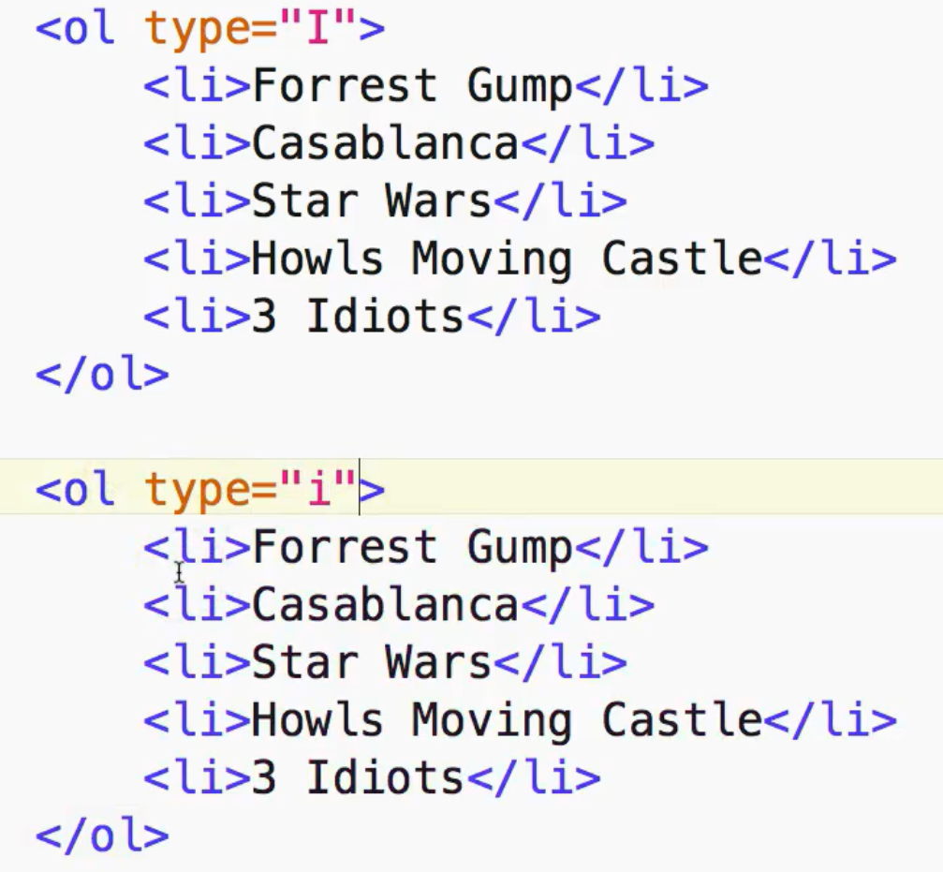
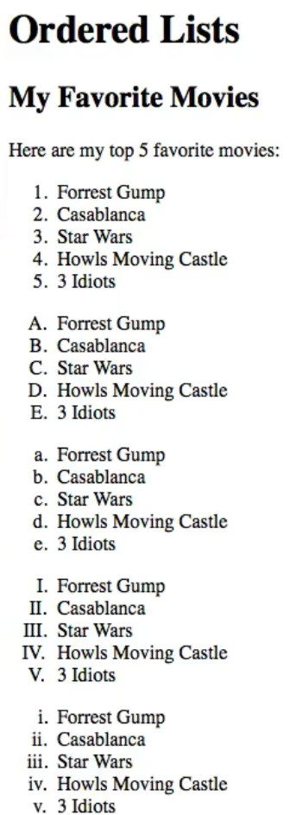
0503.1 Unordered List Video
https://ucsc-extension.instructure.com/courses/3825/pages/1-dot-1-welcome?module_item_id=42202
0503.1 Ordered List Video

Slide 11
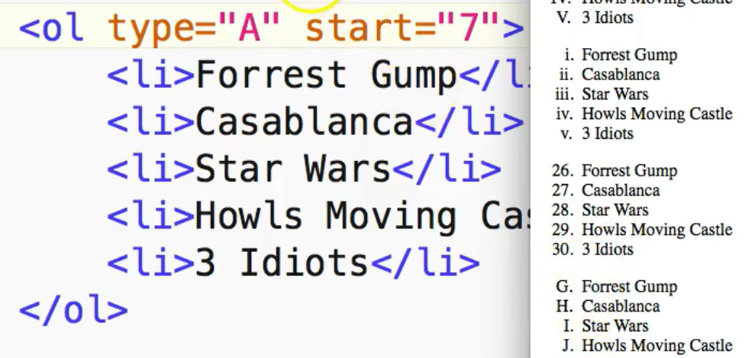
0503.1 Unordered List Video
https://ucsc-extension.instructure.com/courses/3825/pages/1-dot-1-welcome?module_item_id=42202
0503.1 Ordered List Video: Start at 26

Slide 12
End of Chapter

