Slide 1

0800 Overview
Peter H. Chen

Slide 2
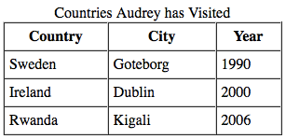
0800 Overview
https://ucsc-extension.instructure.com/courses/3825/pages/1-dot-1-welcome?module_item_id=42202
0800 Overview
This module covers the various elements and attributes used to code a table to display data on a web page.

Slide 3
0800 Overview
https://ucsc-extension.instructure.com/courses/3825/pages/1-dot-1-welcome?module_item_id=42202
0800 Overview
By the end of the module, you will be able to:
Identify different elements and attributes used in coding a table in HTML
Apply correct elements and attributes to construct a data table
Code a semantic, well-structured data table that meets coding standards
Write code to enhance accessibility and search engine optimization
What you will do:
Complete the following activities and assessments:
Read through the module materials
Watch video lecture and demonstrations
Complete the Assignment
Complete the Quiz

Slide 4
End of Chapter

