Slide 1

0801 Create Table
Peter H. Chen

Slide 2

0801 Create Table
https://ucsc-extension.instructure.com/courses/3825/pages/1-dot-1-welcome?module_item_id=42202
0801 Creating a Simple Table
HTML tags for creating tables were originally used for tabular data.
In the 1990’s, designers began using table for controlling layout of web pages.
This no longer done today because it causes serious accessibility issues for anyone using a screen reader.
Today, tables should be used for data only and are frowned upon when used for text alignment, page layout and multi-part image containers as was done in the past, again, due to how assistive technology reads the content.
The first tag that defines a table is the <table> opening tag.
All <table> tags must be closed with a </table>.

Slide 3
0801 Create Table
https://ucsc-extension.instructure.com/courses/3825/pages/1-dot-1-welcome?module_item_id=42202
0801 Creating a Simple Table
Table Rows <tr>…</tr>
The <tr> tag defines a row of cells within a table.
A table row as delimited by <tr> tags does not contain any content other than the table cell <td> tags.
Most of the attributes used in the <table> tag, are can be used in the <tr> tag.
Table data cells <td>…</td>
The <td> tag defines the table data cell.
A table cell can contain any information including another <table> which we call “nesting a table inside another table”.

Slide 4
0801 Create Table
https://ucsc-extension.instructure.com/courses/3825/pages/1-dot-1-welcome?module_item_id=42202
0801 Creating a Simple Table
Putting it all together:
Any <table> must contain at least one <tr>…</tr> and <td>…</td> set, such as,
<table>
<tr>
<td>
Here is some text in a cell
</td>
</tr>
</table>

Slide 5
0801.1 Create Table Video

Slide 6
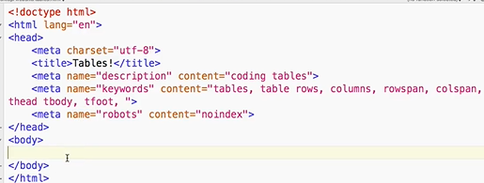
0801.1 Create Table Video
https://ucsc-extension.instructure.com/courses/3825/pages/1-dot-1-welcome?module_item_id=42202
0801.1 Creating a Simple Table Video:
Table is used for data only.
Table is not used for Layout.

Slide 7
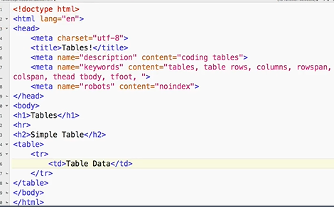
0801.1 Create Table Video
https://ucsc-extension.instructure.com/courses/3825/pages/1-dot-1-welcome?module_item_id=42202
0801.1 Creating a Simple Table Video:
<tr>: table row.
<td>: table data. Content of data.

Slide 8
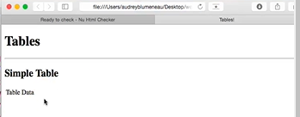
0801.1 Create Table Video
https://ucsc-extension.instructure.com/courses/3825/pages/1-dot-1-welcome?module_item_id=42202
0801.1 Creating a Simple Table Video:
<tr>: table row.
<td>: table data. Content of data.

Slide 9
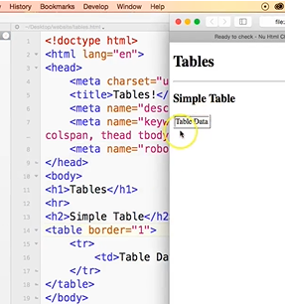
0801.1 Create Table Video
https://ucsc-extension.instructure.com/courses/3825/pages/1-dot-1-welcome?module_item_id=42202
0801.1 Creating a Simple Table Video:
<table border=“1”> Add border.

Slide 10
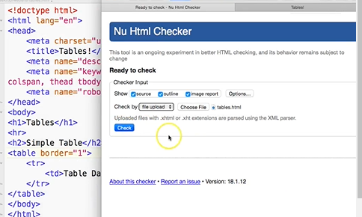
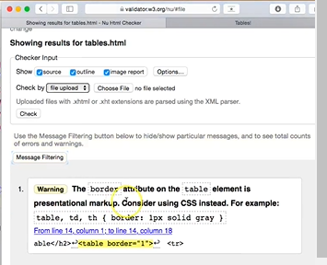
0801.1 Create Table Video
https://ucsc-extension.instructure.com/courses/3825/pages/1-dot-1-welcome?module_item_id=42202
0801.1 Creating a Simple Table Video:
Use Validator.w3.org/nu to check the error:
Warning: Table border use CSS. CSS is a little bit complex than HTML.

Slide 11
End of Chapter

