Slide 1

0802 Table Row/Column
Peter H. Chen

Slide 2
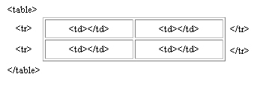
0802 Table Row/Column
https://ucsc-extension.instructure.com/courses/3825/pages/1-dot-1-welcome?module_item_id=42202
0802 Table Row/Column
Two Row, Two Column Table:
To create a two-row, two-column table it would look like this:
<table width="200" border="1">
<tr>
<td>Cell 1</td>
<td>Cell 2</td>
</tr>
<tr>
<td> Cell 3</td>
<td> Cell 4</td>
</tr>
</table>
The table would like this:

Slide 3
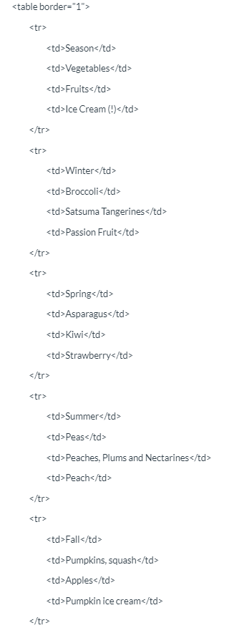
0802 Table Row/Column
https://ucsc-extension.instructure.com/courses/3825/pages/1-dot-1-welcome?module_item_id=42202
0802 Table Row/Column
Applying this to some real content:
A useful example would be:

Slide 4
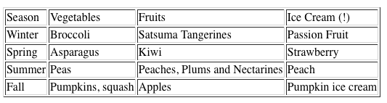
0802 Table Row/Column
https://ucsc-extension.instructure.com/courses/3825/pages/1-dot-1-welcome?module_item_id=42202
0802 Table Row/Column
The result of the code above on the browser window would be:

Slide 5
0802.1 Table Row/Column Video

Slide 6
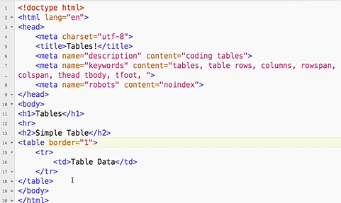
0802.1 Table Row/Column Video
https://ucsc-extension.instructure.com/courses/3825/pages/1-dot-1-welcome?module_item_id=42202
0802.1 Table Row/Column Video: Simple Table

Slide 7
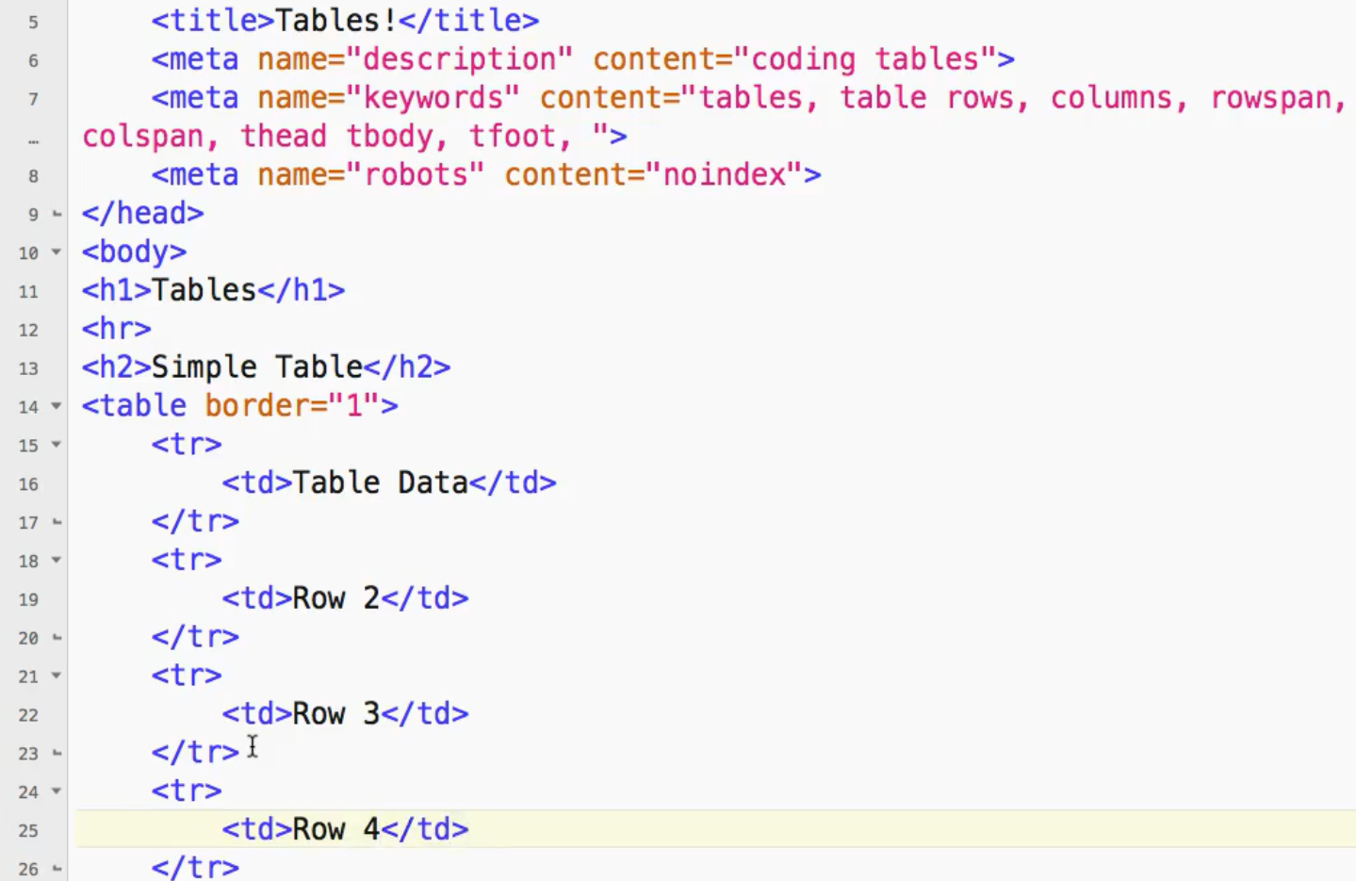
0802.1 Table Row/Column Video
https://ucsc-extension.instructure.com/courses/3825/pages/1-dot-1-welcome?module_item_id=42202
0802.1 Table Row/Column Video: Row 2, 3, 4

Slide 8

0802.1 Table Row/Column Video
https://ucsc-extension.instructure.com/courses/3825/pages/1-dot-1-welcome?module_item_id=42202
0802.1 Table Row/Column Video: Row 2, 3, 4

Slide 9
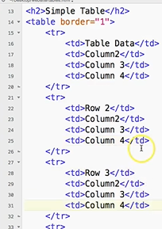
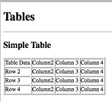
0802.1 Table Row/Column Video
https://ucsc-extension.instructure.com/courses/3825/pages/1-dot-1-welcome?module_item_id=42202
0802.1 Table Row/Column Video: Row 2, 3, 4

Slide 10
End of Chapter

