Slide 1

0803 Table Header
Peter H. Chen

Slide 2
0803 Table Header
https://ucsc-extension.instructure.com/courses/3825/pages/1-dot-1-welcome?module_item_id=42202
0803 Table Header
Table Headers <th>…</th>
Table headers <th> cells function the same as table data cells <td> however, they do provide very important information to both search engines and assistive technology users. In fact, applying table headers is essential for designing a user-friendly web page for anyone using a screen reader to access the content of the page.
Browsers display content in the <th> as bold text and center.
<th>Table Header</th>
So, for example, we can apply a table header to indicate the contents of a particular column or row.

Slide 3

0803 Table Header
https://ucsc-extension.instructure.com/courses/3825/pages/1-dot-1-welcome?module_item_id=42202
0803 Table Header
Below is a very simplistic table:
<table border="1">
<tr>
<th>Header- bold and centered!</th>
</tr>
<tr>
<td>info is left aligned and not centered</td>
</tr>
<tr>
<td>info</td>
</tr>
</table>

Slide 4
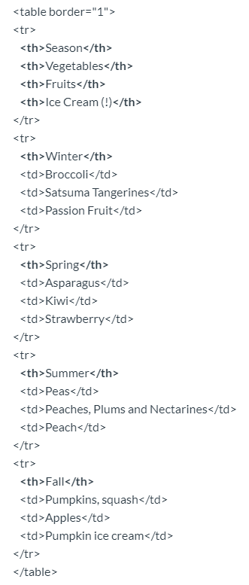
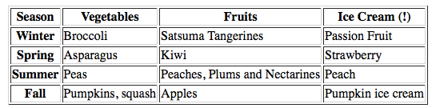
0803 Table Header
https://ucsc-extension.instructure.com/courses/3825/pages/1-dot-1-welcome?module_item_id=42202
0803 Table Header
Another Example:
A more useful example would be:
This would present like this

Slide 5
0803.1 Table Header Video

Slide 6
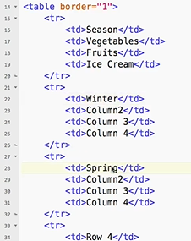
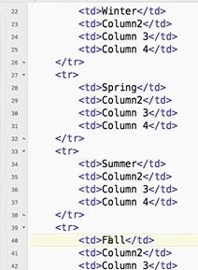
0803.1 Table Header Video
https://ucsc-extension.instructure.com/courses/3825/pages/1-dot-1-welcome?module_item_id=42202
0803.1 Table Header Video: Header and season row.

Slide 7
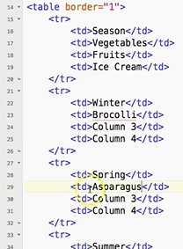
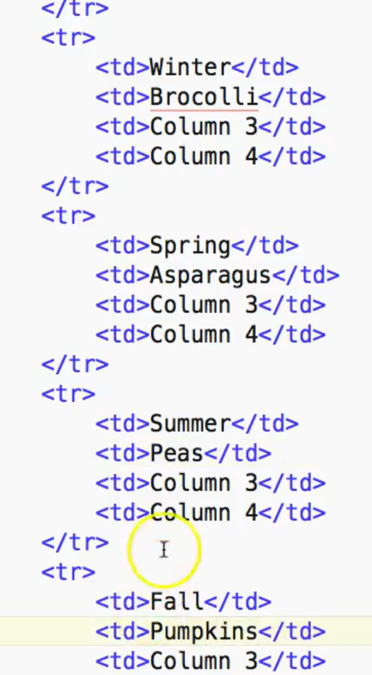
0803.1 Table Header Video
https://ucsc-extension.instructure.com/courses/3825/pages/1-dot-1-welcome?module_item_id=42202
0803.1 Table Header Video: Vegetable column

Slide 8
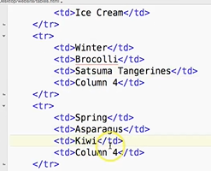
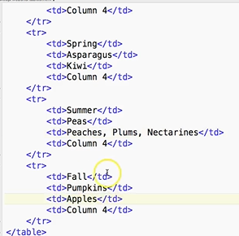
0803.1 Table Header Video
https://ucsc-extension.instructure.com/courses/3825/pages/1-dot-1-welcome?module_item_id=42202
0803.1 Table Header Video: Fruit Column

Slide 9
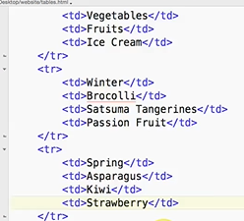
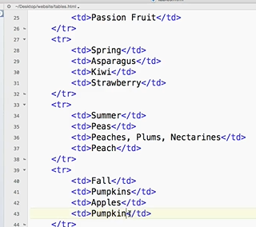
0803.1 Table Header Video
https://ucsc-extension.instructure.com/courses/3825/pages/1-dot-1-welcome?module_item_id=42202
0803.1 Table Header Video: Ice Scream Column

Slide 10
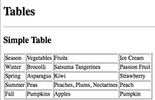
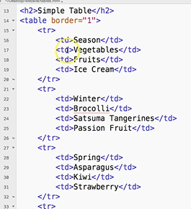
0803.1 Table Header Video
https://ucsc-extension.instructure.com/courses/3825/pages/1-dot-1-welcome?module_item_id=42202
0803.1 Table Header Video:
So far, we do not have any heading.

Slide 11
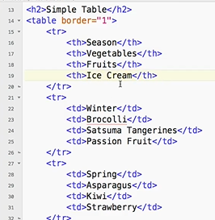
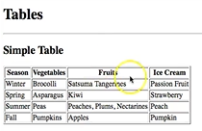
0803.1 Table Header Video
https://ucsc-extension.instructure.com/courses/3825/pages/1-dot-1-welcome?module_item_id=42202
0803.1 Table Header Video:
Change <td> (table data) to <th> (table header).
Table header is always bold.

Slide 12
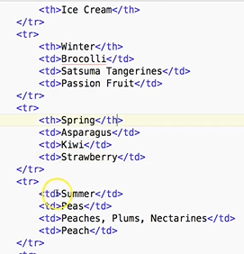
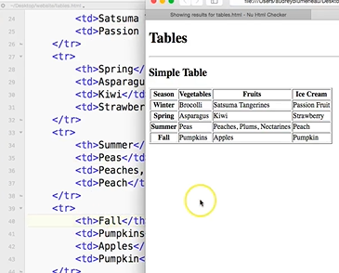
0803.1 Table Header Video
https://ucsc-extension.instructure.com/courses/3825/pages/1-dot-1-welcome?module_item_id=42202
0803.1 Table Header Video:
Change <td> (table data) to <th> (table header) for the season column.

Slide 13
0803.1 Table Header Video
https://ucsc-extension.instructure.com/courses/3825/pages/1-dot-1-welcome?module_item_id=42202
0803.1 Table Header Video:
Change <td> (table data) to <th> (table header) for the season column.

Slide 14
End of Chapter

