Slide 1

0804 Table Merge Column
Peter H. Chen

Slide 2
0804 Table Merge Column
https://ucsc-extension.instructure.com/courses/3825/pages/1-dot-1-welcome?module_item_id=42202
0804 Table Merge Column
Spanning Columns:
The <td colspan="2"> tells the browser to make “cell 1” occupy the same horizontal space as two cells (“span” over two columns).
It is 'merging' the columns or 'spanning' the columns.
<table border="1">
<tr>
<td colspan="2"> Cell 1 & 2 combined </td>
</tr>
<tr>
<td>Cell 3</td>
<td>Cell 4</td>
</tr>
</table>

Slide 3
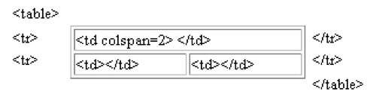
0804 Table Merge Column
https://ucsc-extension.instructure.com/courses/3825/pages/1-dot-1-welcome?module_item_id=42202
0804 Table Merge Column
This is a table with colspan="2":

Slide 4
0804 Table Merge Column
https://ucsc-extension.instructure.com/courses/3825/pages/1-dot-1-welcome?module_item_id=42202
0804 Table Merge Column
Applying colspan to the previous table header example, it could look like this (I am using "4" because this table contains 4 columns or <th>/<td> in each row):
<table border="1">
<tr>
<th colspan="4">Important Information</th>
</tr>
<tr>
<th>Season</th>
<th>Vegetables</th>
<th>Fruits</th>
<th>Ice Cream (!)</th>
</tr>....
</table>

Slide 5
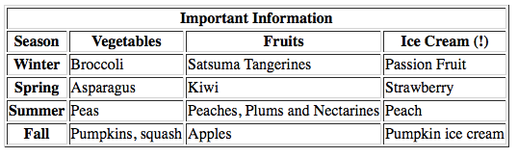
0804 Table Merge Column
https://ucsc-extension.instructure.com/courses/3825/pages/1-dot-1-welcome?module_item_id=42202
0804 Table Merge Column
This results in this display as shown below:

Slide 6
0804.1 Table Merge Column Video

Slide 7
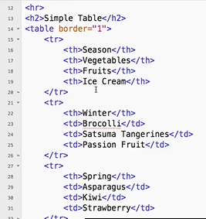
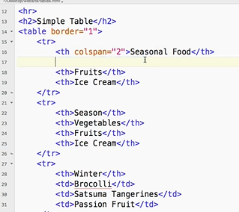
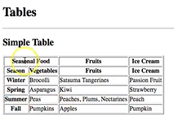
0804.1 Table Merge Column Video
https://ucsc-extension.instructure.com/courses/3825/pages/1-dot-1-welcome?module_item_id=42202
0804.1 Table Merge Column Video: Merge two columns

Slide 8
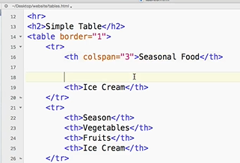
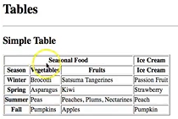
0804.1 Table Merge Column Video
https://ucsc-extension.instructure.com/courses/3825/pages/1-dot-1-welcome?module_item_id=42202
0804.1 Table Merge Column Video: Merge 3 columns

Slide 9
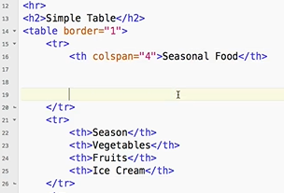
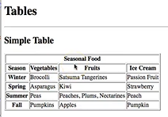
0804.1 Table Merge Column Video
https://ucsc-extension.instructure.com/courses/3825/pages/1-dot-1-welcome?module_item_id=42202
0804.1 Table Merge Column Video

Slide 10
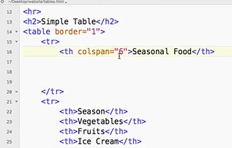
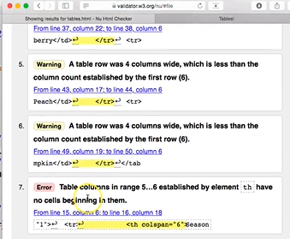
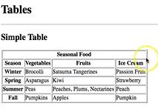
0804.1 Table Merge Column Video
https://ucsc-extension.instructure.com/courses/3825/pages/1-dot-1-welcome?module_item_id=42202
0804.1 Table Merge Column Video: If colspan =“6” which is more than 4 columns od cell data, there will be a lot of warning and error in validation.

Slide 11
End of Chapter

