Slide 1

0805 Table Merge Row
Peter H. Chen

Slide 2
0805 Table Merge Row
https://ucsc-extension.instructure.com/courses/3825/pages/1-dot-1-welcome?module_item_id=42202
0805 Table Merge Row
Spanning Rows:
The “rowspan” attribute stretches a cell to occupy the space of cells in rows.
<table border="1">
<tr>
<td rowspan="2">Cell 1 and 3 combined </td>
<td> Cell 2 </td>
</tr>
<tr>
<td> Cell 4 </td>
</tr>
</table>
Cell 1,3
Cell 2
Cell 4

Slide 3

0805 Table Merge Row
https://ucsc-extension.instructure.com/courses/3825/pages/1-dot-1-welcome?module_item_id=42202
0805 Table Merge Row
Here is an example of what that would look like:

Slide 4
0805.1 Table Merge Column Video

Slide 5
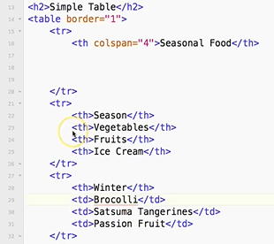
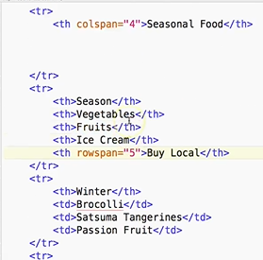
0805.1 Table Merge Row Video
https://ucsc-extension.instructure.com/courses/3825/pages/1-dot-1-welcome?module_item_id=42202
0805.1 Table Merge Row Video: rowspan=“5”

Slide 6
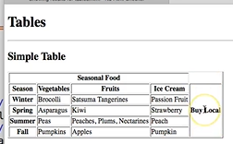
0805.1 Table Merge Row Video
https://ucsc-extension.instructure.com/courses/3825/pages/1-dot-1-welcome?module_item_id=42202
0805.1 Table Merge Row Video: rowspan=“5”

Slide 7
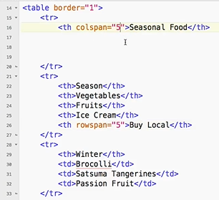
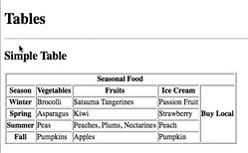
0805.1 Table Merge Row Video
https://ucsc-extension.instructure.com/courses/3825/pages/1-dot-1-welcome?module_item_id=42202
0805.1 Table Merge Row Video: colspan=“5”

Slide 8
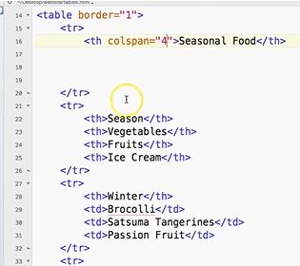
0805.1 Table Merge Row Video
https://ucsc-extension.instructure.com/courses/3825/pages/1-dot-1-welcome?module_item_id=42202
0805.1 Table Merge Row Video: colspan=“5”

Slide 9
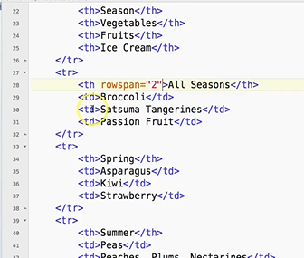
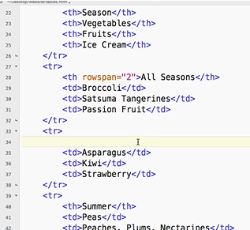
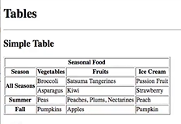
0805.1 Table Merge Row Video
https://ucsc-extension.instructure.com/courses/3825/pages/1-dot-1-welcome?module_item_id=42202
0805.1 Table Merge Row Video: colspan=“5”

Slide 10
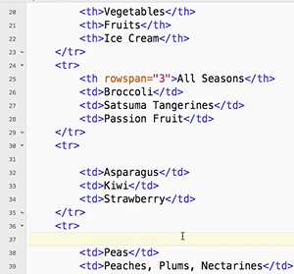
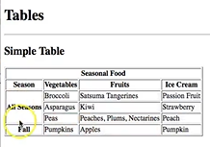
0805.1 Table Merge Row Video
https://ucsc-extension.instructure.com/courses/3825/pages/1-dot-1-welcome?module_item_id=42202
0805.1 Table Merge Row Video: rowspan=“3”

Slide 11
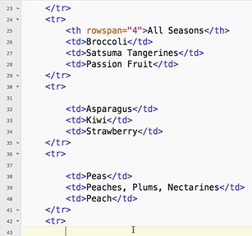
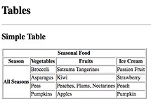
0805.1 Table Merge Row Video
https://ucsc-extension.instructure.com/courses/3825/pages/1-dot-1-welcome?module_item_id=42202
0805.1 Table Merge Row Video: rowspan=“3”

Slide 12
End of Chapter

