Slide 1

0806 Table Caption
Peter H. Chen

Slide 2
0806 Table Caption
https://ucsc-extension.instructure.com/courses/3825/pages/1-dot-1-welcome?module_item_id=42202
0806 Table Caption
Captions
The caption element is used to provide caption (!) for your table!
It’s a way to give your table a title and for accessibility purposes, this will be very important.

Slide 3
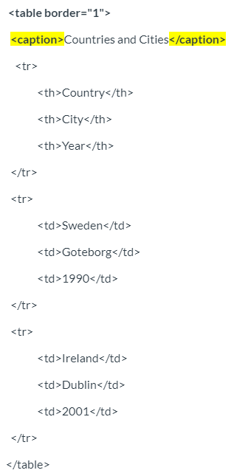
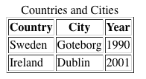
0806 Table Caption
https://ucsc-extension.instructure.com/courses/3825/pages/1-dot-1-welcome?module_item_id=42202
0806 Table Caption
The caption element is added immediately after the opening table tag.
Here is what this code would look like on a browser window:

Slide 4
0806.1 Table Caption Video

Slide 5
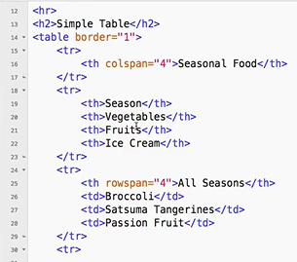
0806.1 Table Caption Video
https://ucsc-extension.instructure.com/courses/3825/pages/1-dot-1-welcome?module_item_id=42202
0806.1 Table Caption Video:

Slide 6
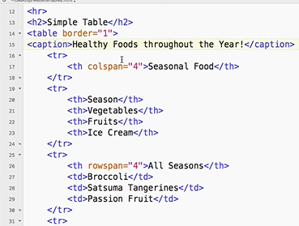
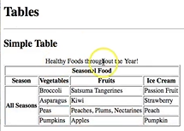
0806.1 Table Caption Video
https://ucsc-extension.instructure.com/courses/3825/pages/1-dot-1-welcome?module_item_id=42202
0806.1 Table Caption Video:
Caption is displayed outside the table.
Caption is controlled by Cascade Style Sheet (CSS)

Slide 7
End of Chapter

