Slide 1

0807 Table Element
Peter H. Chen

Slide 2
0807 Table Element
https://ucsc-extension.instructure.com/courses/3825/pages/1-dot-1-welcome?module_item_id=42202
0807 Table Element
Additional table elements: thead, tfoot and tbody:
Table rows <tr> can be grouped into a table head (thead), a table footer (tfoot) and one or more table bodies (tbody).
If a table has a head section it must appear before the tbody section.
If no thead or tfoot is used then there is no need for a tbody.
What is the purpose of these elements?
Browsers can use these elements to enable scrolling of the table body independently of the header and footer.
Also, when printing a large table that spans multiple pages, these elements can enable the table header and footer to be printed at the top and bottom of each page.
Another benefit of row grouping are that it makes it easy to style head, foot and body sections of a table independently of each other without adding classes.

Slide 3
0807 Table Element
https://ucsc-extension.instructure.com/courses/3825/pages/1-dot-1-welcome?module_item_id=42202
0807 Table Element
Please note a change in coding practice:
It's important to understand that when using HTML 4.01, the tfoot MUST go BEFORE the tbody!
Now, we are mostly going to be working in HTML5 doctype and as of 2017, this rule got changed and the tfoot now comes AFTER the tbody.
Please note that this is very new and many websites and books will still tell you to write things as I have explained above.

Slide 4
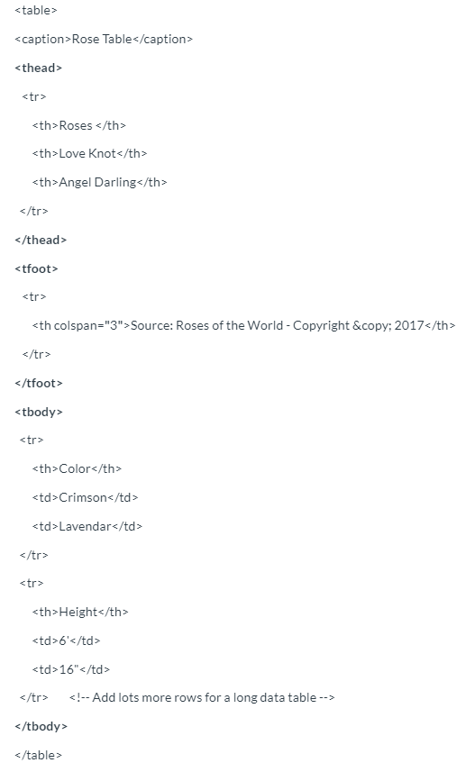
0807 Table Element
https://ucsc-extension.instructure.com/courses/3825/pages/1-dot-1-welcome?module_item_id=42202
0807 Table Element
HTML 4.01 or XHTML 1.0
Here is how a typical HTML 4.01 table may look:

Slide 5
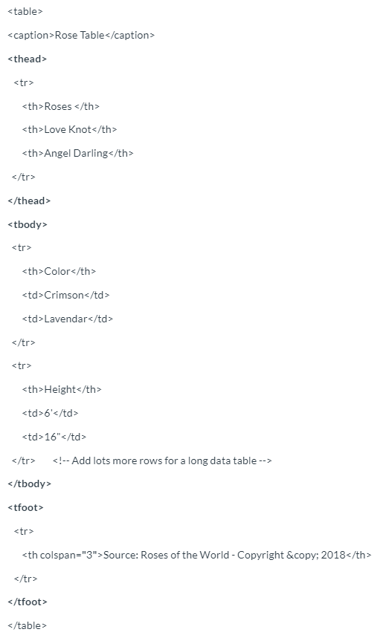
0807 Table Element
https://ucsc-extension.instructure.com/courses/3825/pages/1-dot-1-welcome?module_item_id=42202
0807 Table Element
HTML5:
Here is how a typical HTML5 table may look:

Slide 6
0807 Table Element
https://ucsc-extension.instructure.com/courses/3825/pages/1-dot-1-welcome?module_item_id=42202
0807 Table Element
There is no difference between HTML4.01, XHTML 1.0 and HTML5 except for the <tfoot> element placement when using the HTML5 doctype.

Slide 7
0807.1 Table Element Video

Slide 8
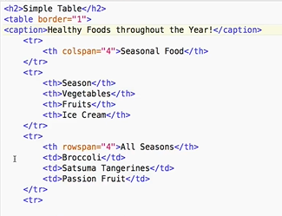
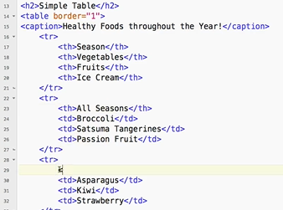
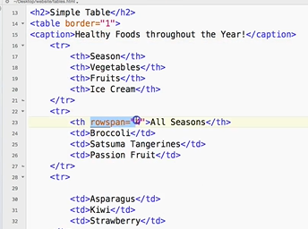
0807.1 Table Element Video
https://ucsc-extension.instructure.com/courses/3825/pages/1-dot-1-welcome?module_item_id=42202
0807.1 Table Element Video:

Slide 9
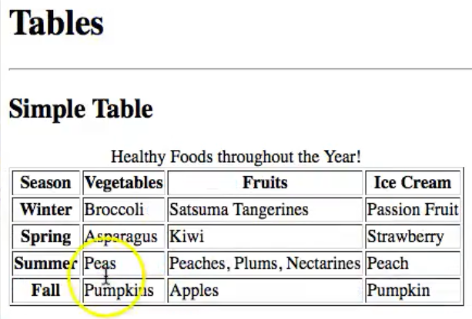
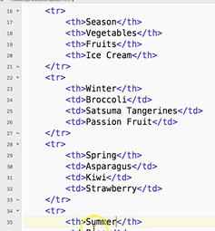
0807.1 Table Element Video
https://ucsc-extension.instructure.com/courses/3825/pages/1-dot-1-welcome?module_item_id=42202
0807.1 Table Element Video: <th> Winter</th>, <th>Spring</th>

Slide 10
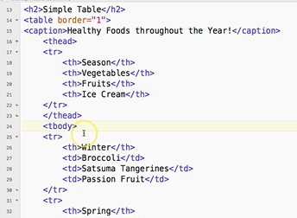
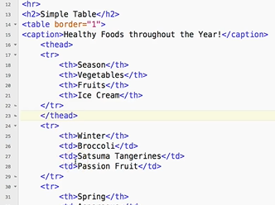
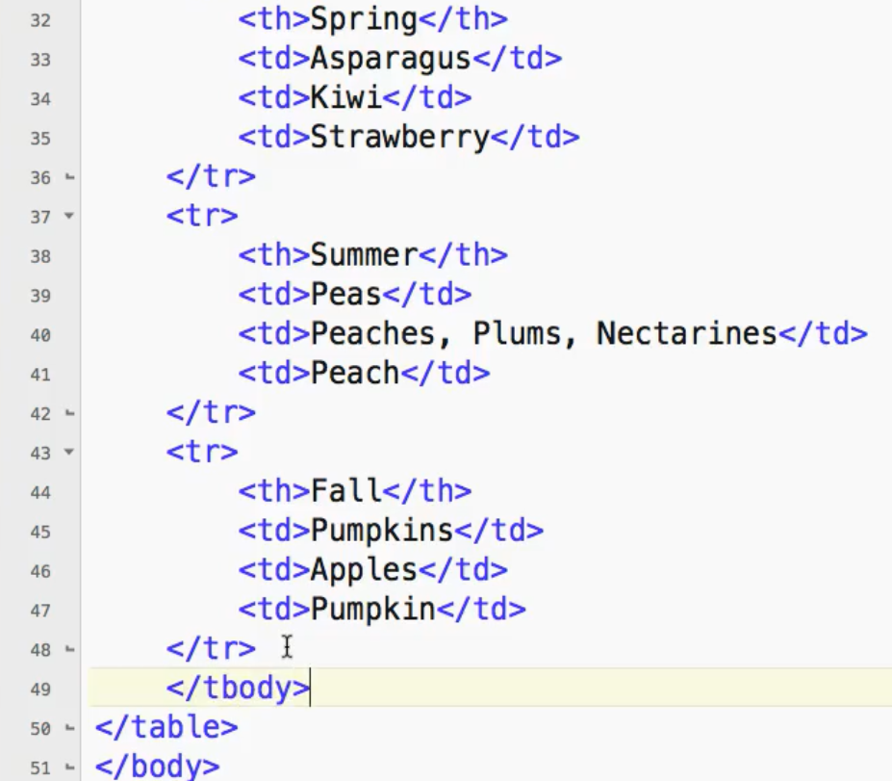
0807.1 Table Element Video
https://ucsc-extension.instructure.com/courses/3825/pages/1-dot-1-welcome?module_item_id=42202
0807.1 Table Element Video:
<thead> … </thead>
<tbody> … </tbody>

Slide 11
0807.1 Table Element Video
https://ucsc-extension.instructure.com/courses/3825/pages/1-dot-1-welcome?module_item_id=42202
0807.1 Table Element Video:
<thead> … </thead>
<tbody> … </tbody>

Slide 12
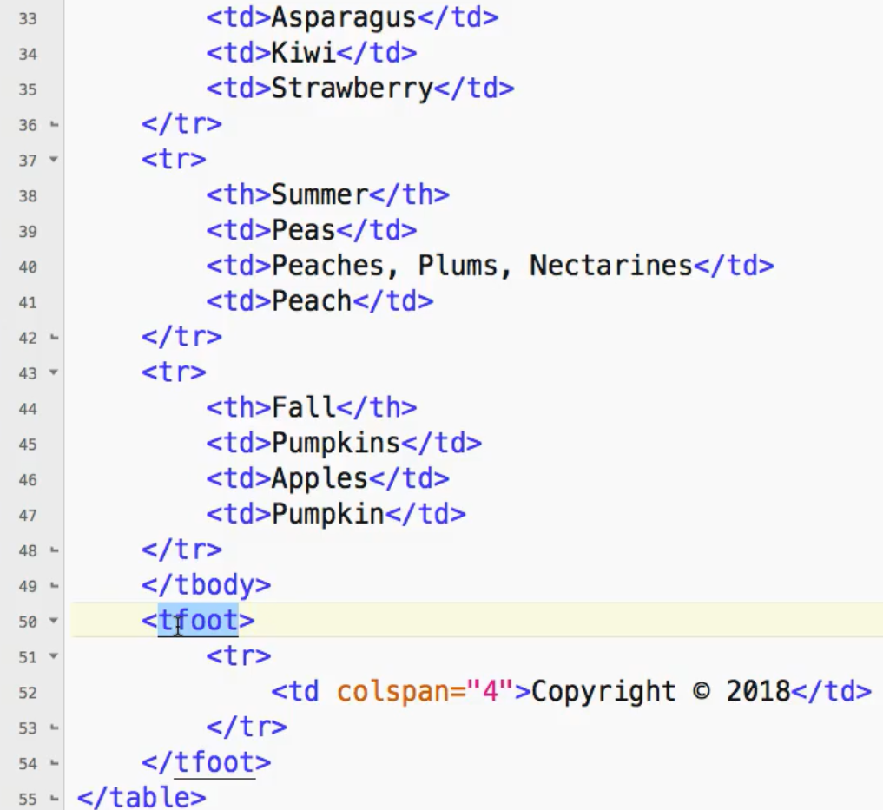
0807.1 Table Element Video
https://ucsc-extension.instructure.com/courses/3825/pages/1-dot-1-welcome?module_item_id=42202
0807.1 Table Element Video:
<tfoot>
<tr>
<td colspan=“4”>Copyright © (alt+0169) 2019</td>
</tr>s
</tfoot>

Slide 13
End of Chapter

