Slide 1

0808 Obsolete Attribute
Peter H. Chen

Slide 2
0808 Obsolete Attribute
https://ucsc-extension.instructure.com/courses/3825/pages/1-dot-1-welcome?module_item_id=42202
0808 Obsolete Attribute
The <table> tag has attributes as follows: [note: this is not a complete list of all the attributes used for tables and all are deprecated or obsolete as we will use CSS instead (in the CSS class!). Note that HTML5 will not validate with the use of any of these attributes!]:
bgcolor="#FF0000". This sets the table background color to red. Color settings in the <tr> override settings in the <table> and settings in the <td> override settings in the <tr> settings. (Deprecated and will not validate when using HTML5 doctype).
align="center". This centers the table to the center of the browser window. You can also set align =”left” or “right”. (Deprecated and will not validate when using HTML5 doctype).
cellpadding="20". This will specify the space (in pixels or percent) between the cell walls and contents. (Deprecated and will not validate when using HTML5 doctype).

Slide 3
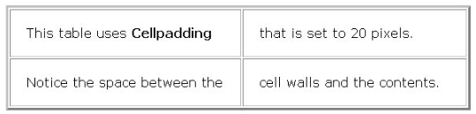
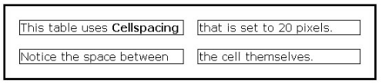
0808 Obsolete Attribute
https://ucsc-extension.instructure.com/courses/3825/pages/1-dot-1-welcome?module_item_id=42202
0808 Obsolete Attribute
cellspacing="20". This will specify the space (in pixels or percent) between cells

Slide 4
0808 Obsolete Attribute
https://ucsc-extension.instructure.com/courses/3825/pages/1-dot-1-welcome?module_item_id=42202
0808 Obsolete Attribute
border="1". Creates a 1-pixel thick border around each cell and the entire table. “0” means no border. “15” adds a thicker beveled border around the outside of the table edges (the inside stays at the default of 2 pixels). If you simply write <table border> you will get a 1-pixel border around and between cells. This attribute is temporarily allowed in HTML5 but will generate a ‘warning’ that you should update your presentational code to CSS.
width="550" sets the overall width of the table to 550 pixels. (You can also use percentages such as width="90%") Pixels create a fixed or absolute table size and % creates a liquid or relative table size (meaning that it will always be that percentage of the width of the browser window). (Deprecated and will not validate when using HTML5 doctype).

Slide 5
0808 Obsolete Attribute
https://ucsc-extension.instructure.com/courses/3825/pages/1-dot-1-welcome?module_item_id=42202
0808 Obsolete Attribute
So an opening <table> tag could look something like this:
Old code (using HTML 4.0 Transitional Doctype):
<table border="5" bgcolor="#FFFF66" cellspacing="20" width="355" align="center">
Again, I show this code only to ensure that if you come across an ‘older’ website (and I do all the time), you will know what this all means and also know that it is “old”!

Slide 6
0808.1 Obsolete Attribute Video

Slide 7
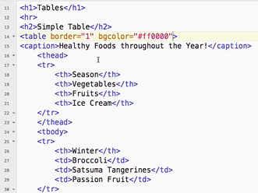
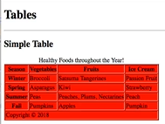
0808.1 Obsolete Attribute Video
https://ucsc-extension.instructure.com/courses/3825/pages/1-dot-1-welcome?module_item_id=42202
0808.1 Obsolete Attribute Video: Obsolete attribute will not be validate in HTML 5.
Set color for entire table.

Slide 8
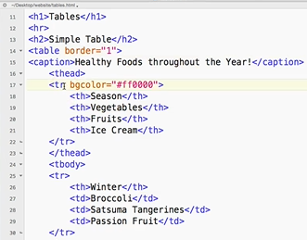
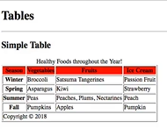
0808.1 Obsolete Attribute Video
https://ucsc-extension.instructure.com/courses/3825/pages/1-dot-1-welcome?module_item_id=42202
0808.1 Obsolete Attribute Video: Set color for particular row (<tr>).

Slide 9
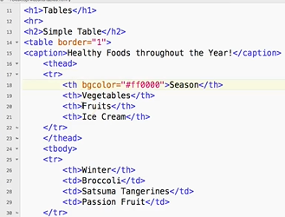
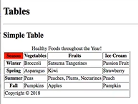
0808.1 Obsolete Attribute Video
https://ucsc-extension.instructure.com/courses/3825/pages/1-dot-1-welcome?module_item_id=42202
0808.1 Obsolete Attribute Video: Set color for header.

Slide 10
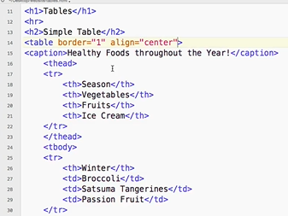
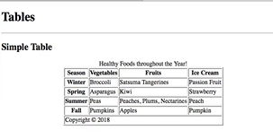
0808.1 Obsolete Attribute Video
https://ucsc-extension.instructure.com/courses/3825/pages/1-dot-1-welcome?module_item_id=42202
0808.1 Obsolete Attribute Video: Set table align=“center”

Slide 11
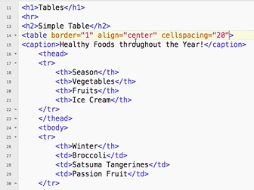
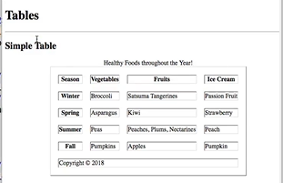
0808.1 Obsolete Attribute Video
https://ucsc-extension.instructure.com/courses/3825/pages/1-dot-1-welcome?module_item_id=42202
0808.1 Obsolete Attribute Video: Set table cellspacing=“20”

Slide 12
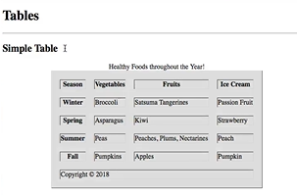
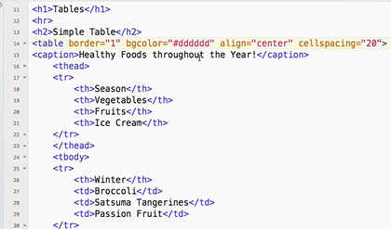
0808.1 Obsolete Attribute Video
https://ucsc-extension.instructure.com/courses/3825/pages/1-dot-1-welcome?module_item_id=42202
0808.1 Obsolete Attribute Video: Set table color=“#dddddd”

Slide 13
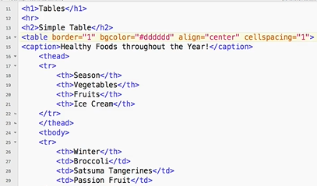
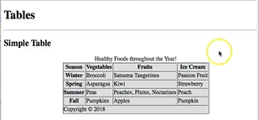
0808.1 Obsolete Attribute Video
https://ucsc-extension.instructure.com/courses/3825/pages/1-dot-1-welcome?module_item_id=42202
0808.1 Obsolete Attribute Video: Set table cellspacing=“1”

Slide 14
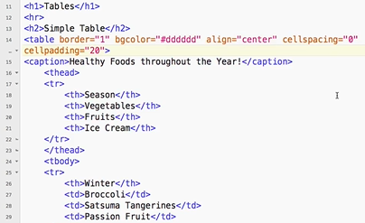
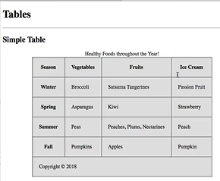
0808.1 Obsolete Attribute Video
https://ucsc-extension.instructure.com/courses/3825/pages/1-dot-1-welcome?module_item_id=42202
0808.1 Obsolete Attribute Video: Set table cellspadding=“20”

Slide 15
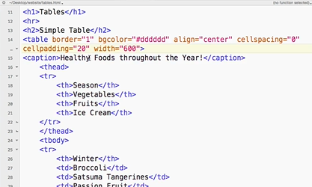
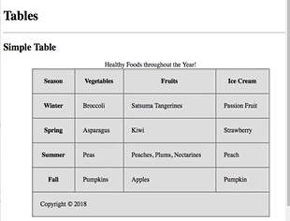
0808.1 Obsolete Attribute Video
https://ucsc-extension.instructure.com/courses/3825/pages/1-dot-1-welcome?module_item_id=42202
0808.1 Obsolete Attribute Video: Set table width=“600” (600 pixel).

Slide 16
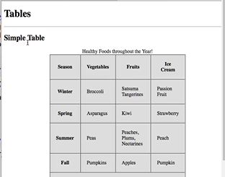
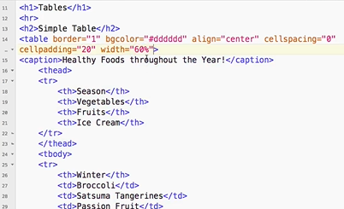
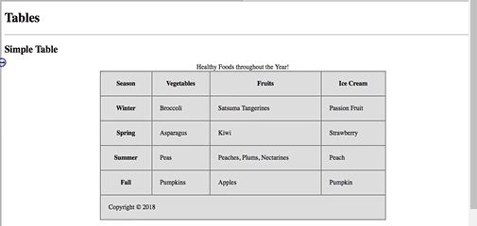
0808.1 Obsolete Attribute Video
https://ucsc-extension.instructure.com/courses/3825/pages/1-dot-1-welcome?module_item_id=42202
0808.1 Obsolete Attribute Video: Set table width=“60%”

Slide 17
End of Chapter

