Slide 1

0809 Table Assignment
Peter H. Chen

Slide 2
0809 Table Assignment
https://ucsc-extension.instructure.com/courses/3825/pages/1-dot-1-welcome?module_item_id=42202
0809 Table Assignment
Due Dec 17 by 11:59pm Points 10 Submitting a file upload
Available Sep 17 at 12am - Dec 17 at 11:59pm 3 months
Assignment - Tables!
Objective:
Be able to hand-code a validated data table (as shown below) to showcase ability to render rows, columns, merged columns and rows and captions.

Slide 3
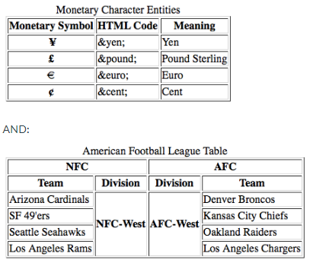
0809 Table Assignment
https://ucsc-extension.instructure.com/courses/3825/pages/1-dot-1-welcome?module_item_id=42202
0809 Table Assignment
Create a new HTML file and save this file as: "YourLastName-08-tables.html".
Recreate the following two tables (note that the border="1" is the only attribute used here):

Slide 4
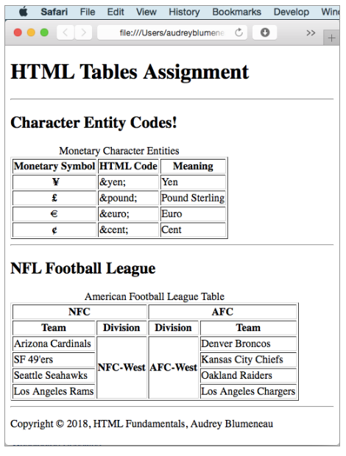
0809 Table Assignment
https://ucsc-extension.instructure.com/courses/3825/pages/1-dot-1-welcome?module_item_id=42202
0809 Table Assignment
Your web page will look like this (note: you can add images and absolute links if you want to practice your coding skills but I am looking for these two specific tables with this specific content!):

Slide 5
0809 Table Assignment
https://ucsc-extension.instructure.com/courses/3825/pages/1-dot-1-welcome?module_item_id=42202
0809 Table Assignment
You will notice that I do “show” borders on this example.
Remember, if you are using the HTML5 doctype you will get a “warning” when you validate that you should use CSS.
This is the one time I allow for a validation “warning” for these tables (in other words you will get two warnings, 1 for each table).
For this class and this assignment, that will be okay.
In the CSS class I would have you remove this attribute!
Validate your code per the W3C standards: Use this validator for the HTML5 doctype: https://validator.w3.org/nu/ (Links to an external site.) (check all the boxes for source, outline and image report).

Slide 6
0809 Table Assignment
https://ucsc-extension.instructure.com/courses/3825/pages/1-dot-1-welcome?module_item_id=42202
0809 Table Assignment
NOTE:
You will use the HTML5 doctype and meta tag for this exercise.
Do not use any deprecated attributes (there are a few deprecated attributes, besides the border in this module).
I only showcase these so you are aware of what they are and what they did, so you can recognize old code from what is currently acceptable.
In other words, you shouldn't use these attributes! The exception in this one assignment is the border attribute!
The HTML code here is exactly the same whether we use HTML 4.01 Transitional / Strict, XHTML 1.0 Transitional/Strict or HTML5 minus those deprecated attributes!

Slide 7
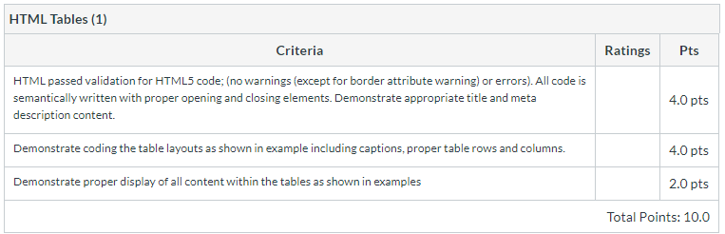
0809 Table Assignment
https://ucsc-extension.instructure.com/courses/3825/pages/1-dot-1-welcome?module_item_id=42202
0809 Table Assignment
What to Submit:
Check the Rubric below to ensure you meet specific criteria
Submit your .html file here

Slide 8
End of Chapter

