Slide 1

1003 XHTML Quiz
Peter H. Chen

Slide 2
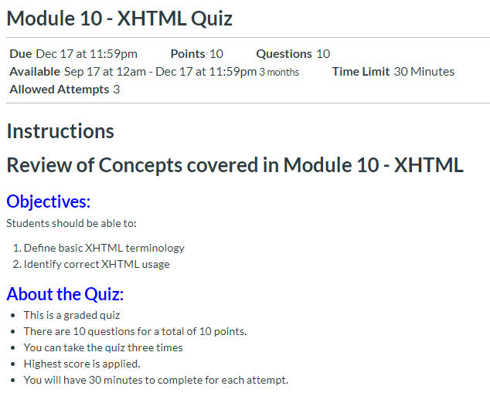
1002 XHTML Assignment
https://ucsc-extension.instructure.com/courses/3825/pages/1-dot-1-welcome?module_item_id=42202
1003 XHTML Quiz

Slide 3
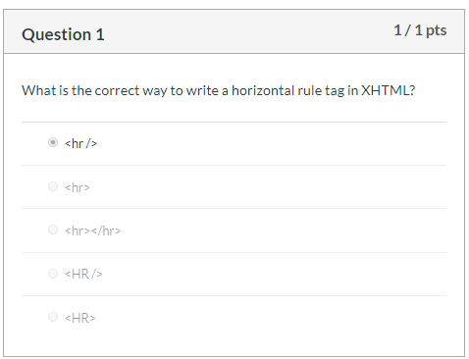
1002 XHTML Assignment
https://ucsc-extension.instructure.com/courses/3825/pages/1-dot-1-welcome?module_item_id=42202
1003 XHTML Quiz

Slide 4
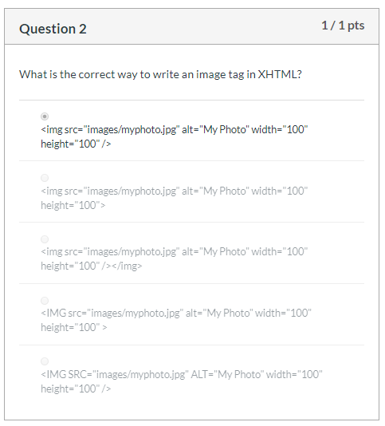
1002 XHTML Assignment
https://ucsc-extension.instructure.com/courses/3825/pages/1-dot-1-welcome?module_item_id=42202
1003 XHTML Quiz

Slide 5
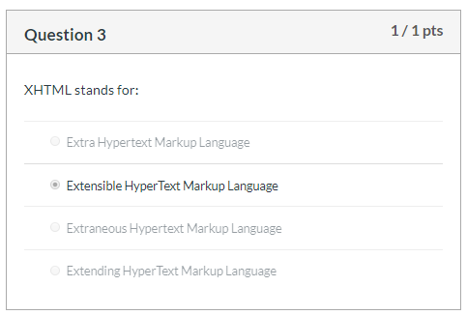
1002 XHTML Assignment
https://ucsc-extension.instructure.com/courses/3825/pages/1-dot-1-welcome?module_item_id=42202
1003 XHTML Quiz

Slide 6
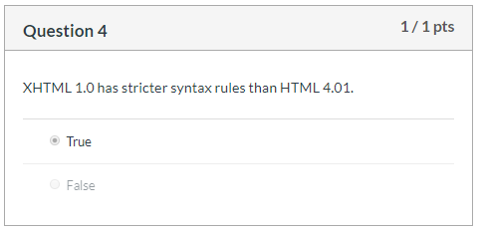
1002 XHTML Assignment
https://ucsc-extension.instructure.com/courses/3825/pages/1-dot-1-welcome?module_item_id=42202
1003 XHTML Quiz

Slide 7
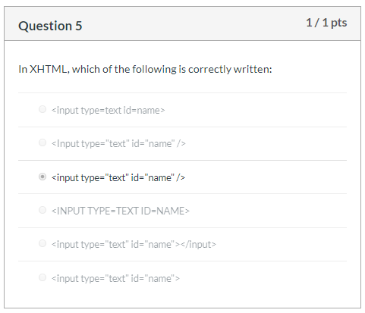
1002 XHTML Assignment
https://ucsc-extension.instructure.com/courses/3825/pages/1-dot-1-welcome?module_item_id=42202
1003 XHTML Quiz

Slide 8
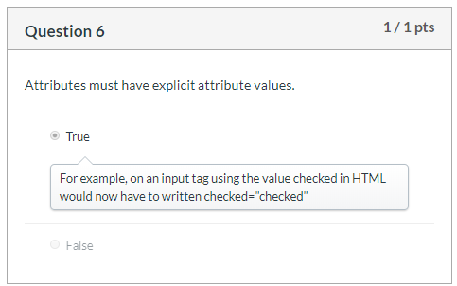
1002 XHTML Assignment
https://ucsc-extension.instructure.com/courses/3825/pages/1-dot-1-welcome?module_item_id=42202
1003 XHTML Quiz

Slide 9
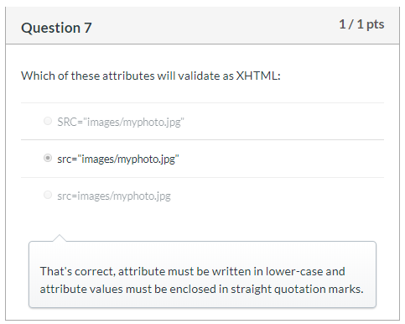
1002 XHTML Assignment
https://ucsc-extension.instructure.com/courses/3825/pages/1-dot-1-welcome?module_item_id=42202
1003 XHTML Quiz

Slide 10
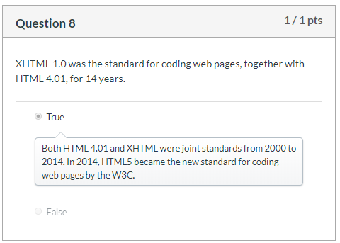
1002 XHTML Assignment
https://ucsc-extension.instructure.com/courses/3825/pages/1-dot-1-welcome?module_item_id=42202
1003 XHTML Quiz

Slide 11
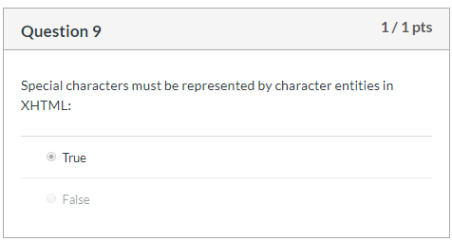
1002 XHTML Assignment
https://ucsc-extension.instructure.com/courses/3825/pages/1-dot-1-welcome?module_item_id=42202
1003 XHTML Quiz

Slide 12
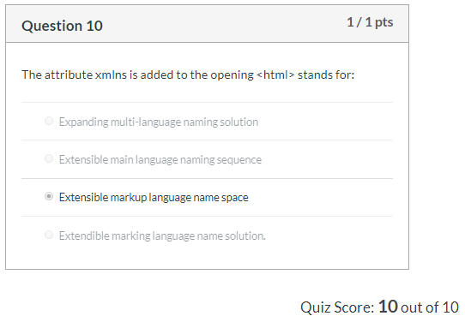
1002 XHTML Assignment
https://ucsc-extension.instructure.com/courses/3825/pages/1-dot-1-welcome?module_item_id=42202
1003 XHTML Quiz

Slide 13
End of Chapter

