Slide 1

0202 Web History
Peter H. Chen

Slide 2

0202 Web History
https://ucsc-extension.instructure.com/courses/3825/pages/1-dot-1-welcome?module_item_id=42202
2.2 - History of the World Wide Web (in a nutshell!)
The World Wide Web (WWW)
The World Wide Web (or “the Web” or “WWW”) is defined as being a collection of documents (text, graphics, animations, sounds or video’s) that we can access via a protocol.
The Web has its own protocol called Hyper Text Transfer Protocol or HTTP.
What makes the Web unique is that you can link (via hypertext) one document to many other documents, thereby forming a “web” of information.

Slide 3
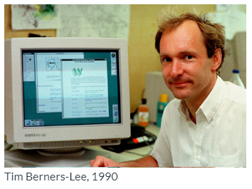
0202 Web History
https://ucsc-extension.instructure.com/courses/3825/pages/1-dot-1-welcome?module_item_id=42202
The Beginnings:
The WWW began as a networked information project at CERN (European Organization for Nuclear Research also known as the European Particle Physics Laboratory) in Switzerland in 1989/1990 (see links below)!
A computer specialist, Tim Berners-Lee, first proposed a system of information management that used the hypertext process to link documents over a network.
Tim Berners-Lee wrote, in 1990, the first WWW client (a browser-editor running under NeXTStep), and called it "WorldWideWeb".
It ran on a NeXT computer along with the first WWW server along with most of the communications software, defining URLs, HTTP, and HTML.
For the first few years, web pages were text based only.

Slide 4
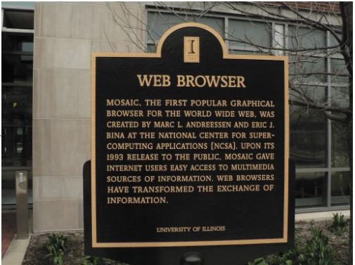
0202 Web History
https://ucsc-extension.instructure.com/courses/3825/pages/1-dot-1-welcome?module_item_id=42202
Development of Browsers:
In 1993, team members of National Center for Supercomputing Applications (NCSA) along with graduate students from University of Illinois, Champagne-Urbana, created the first graphical browser called NCSA Mosaic.

Slide 5


0202 Web History
https://ucsc-extension.instructure.com/courses/3825/pages/1-dot-1-welcome?module_item_id=42202
Browser Companies: Netscape:
Among the programmers was a graduate student by the name of Marc Andreeson. After graduating he moved out to Silicon Valley and together with a partner, started a company called Mosaic.
They later changed its name to Netscape Communications Corp. in November 1994.
This changed forever the way we view information on the web.

Slide 6
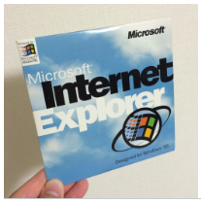
0202 Web History
https://ucsc-extension.instructure.com/courses/3825/pages/1-dot-1-welcome?module_item_id=42202
Browser Companies: Internet Explorer:
Version 1.0 of Microsoft Corp.'s Internet Explorer browser was announced in 1995 after Bill Gates took notice of Netscape’s success.
Microsoft’s browser competed with Netscape's browser, and each evolved its own HTML features, which provided us with what is now termed as the “browser wars”!

Slide 7

0202 Web History
https://ucsc-extension.instructure.com/courses/3825/pages/1-dot-1-welcome?module_item_id=42202
The World Wide Web Consortium:
The browser wars are what sparked Tim Berners-Lee to set up the World Wide Web Consortium (W3C), which he continues to this day to lead as acting director.
The W3C mission is to set the standards by which browsers are to interpret HTML and all other languages.
W3C Mission Statement:
Today the W3C’s mission statement (Links to an external site.) includes:
Open Standards Principles
Design Principles
Web for all
Web on everything
Vision
Web for rich interaction,
Web of data and
Services and web of trust.

Slide 8
0202.2 Video

Slide 9
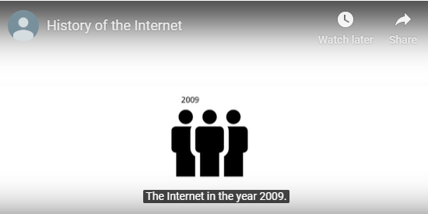
0202.2 Video
https://ucsc-extension.instructure.com/courses/3825/pages/1-dot-1-welcome?module_item_id=42202
View Videos on the History of the Internet and World Wide Web.
A more detailed history via this animated YouTube Video (8 minutes):

Slide 10
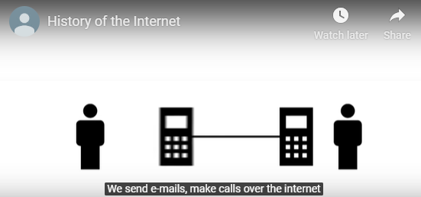
0202.2 Video
https://ucsc-extension.instructure.com/courses/3825/pages/1-dot-1-welcome?module_item_id=42202
View Videos on the History of the Internet and World Wide Web.
A more detailed history via this animated YouTube Video (8 minutes):

Slide 11
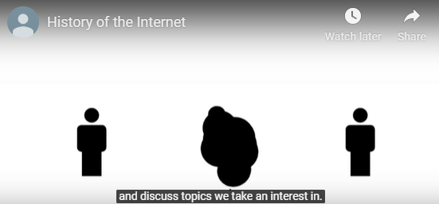
0202.2 Video
https://ucsc-extension.instructure.com/courses/3825/pages/1-dot-1-welcome?module_item_id=42202
View Videos on the History of the Internet and World Wide Web.
A more detailed history via this animated YouTube Video (8 minutes):

Slide 12
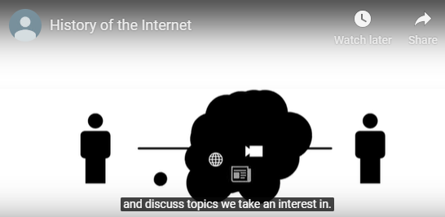
0202.2 Video
https://ucsc-extension.instructure.com/courses/3825/pages/1-dot-1-welcome?module_item_id=42202
View Videos on the History of the Internet and World Wide Web.
A more detailed history via this animated YouTube Video (8 minutes):

Slide 13
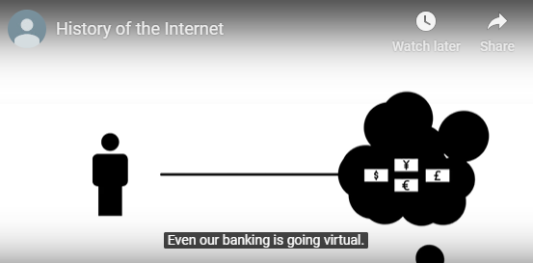
0202.2 Video
https://ucsc-extension.instructure.com/courses/3825/pages/1-dot-1-welcome?module_item_id=42202
View Videos on the History of the Internet and World Wide Web.
A more detailed history via this animated YouTube Video (8 minutes):

Slide 14
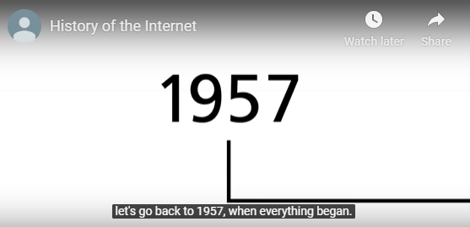
0202.2 Video
https://ucsc-extension.instructure.com/courses/3825/pages/1-dot-1-welcome?module_item_id=42202
View Videos on the History of the Internet and World Wide Web.
A more detailed history via this animated YouTube Video (8 minutes):

Slide 15
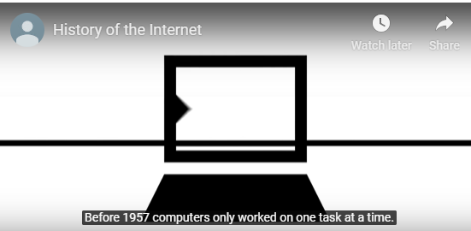
0202.2 Video
https://ucsc-extension.instructure.com/courses/3825/pages/1-dot-1-welcome?module_item_id=42202
View Videos on the History of the Internet and World Wide Web.
A more detailed history via this animated YouTube Video (8 minutes):

Slide 16
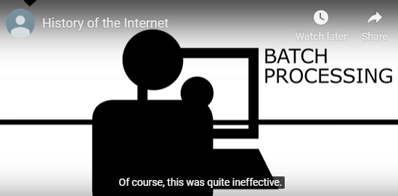
0202.2 Video
https://ucsc-extension.instructure.com/courses/3825/pages/1-dot-1-welcome?module_item_id=42202
View Videos on the History of the Internet and World Wide Web.
A more detailed history via this animated YouTube Video (8 minutes):

Slide 17
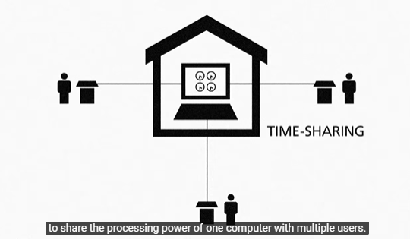
0202.2 Video
https://ucsc-extension.instructure.com/courses/3825/pages/1-dot-1-welcome?module_item_id=42202
View Videos on the History of the Internet and World Wide Web.
A more detailed history via this animated YouTube Video (8 minutes):

Slide 18
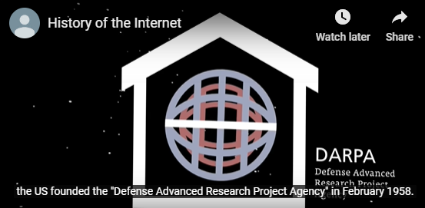
0202.2 Video
https://ucsc-extension.instructure.com/courses/3825/pages/1-dot-1-welcome?module_item_id=42202
View Videos on the History of the Internet and World Wide Web.
A more detailed history via this animated YouTube Video (8 minutes):

Slide 19
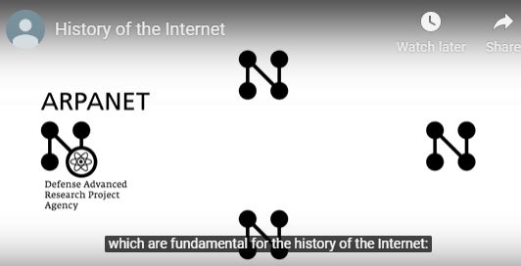
0202.2 Video
https://ucsc-extension.instructure.com/courses/3825/pages/1-dot-1-welcome?module_item_id=42202
View Videos on the History of the Internet and World Wide Web.
A more detailed history via this animated YouTube Video (8 minutes):

Slide 20
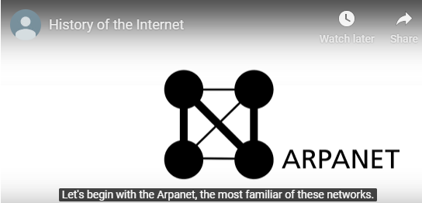
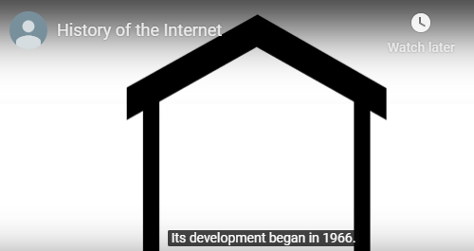
0202.2 Video
https://ucsc-extension.instructure.com/courses/3825/pages/1-dot-1-welcome?module_item_id=42202
View Videos on the History of the Internet and World Wide Web.
A more detailed history via this animated YouTube Video (8 minutes):

Slide 21
0202.3 Web Video

Slide 22
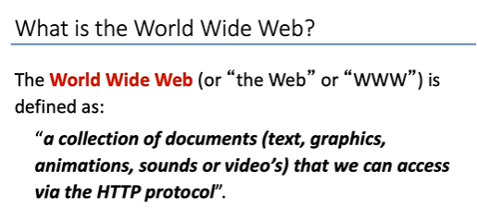
0202.3 Web Video
https://ucsc-extension.instructure.com/courses/3825/pages/1-dot-1-welcome?module_item_id=42202
What is World Wide Web?

Slide 23
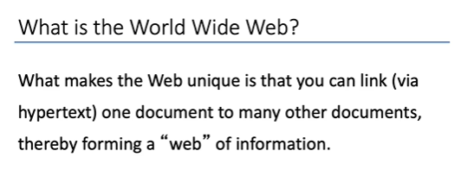
0202.3 Web Video
https://ucsc-extension.instructure.com/courses/3825/pages/1-dot-1-welcome?module_item_id=42202
What is World Wide Web?

Slide 24
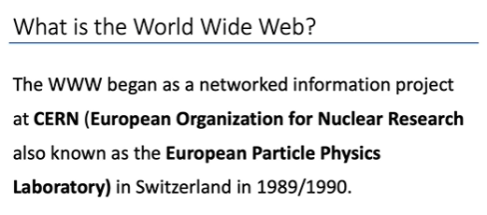
0202.3 Web Video
https://ucsc-extension.instructure.com/courses/3825/pages/1-dot-1-welcome?module_item_id=42202
What is World Wide Web?

Slide 25
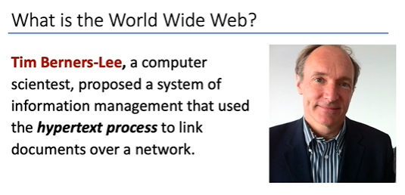
0202.3 Web Video
https://ucsc-extension.instructure.com/courses/3825/pages/1-dot-1-welcome?module_item_id=42202
What is World Wide Web?

Slide 26
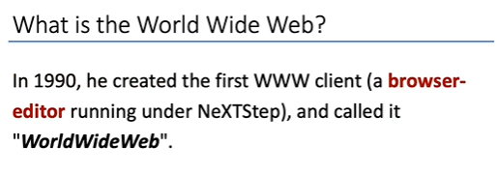
0202.3 Web Video
https://ucsc-extension.instructure.com/courses/3825/pages/1-dot-1-welcome?module_item_id=42202
What is World Wide Web?

Slide 27
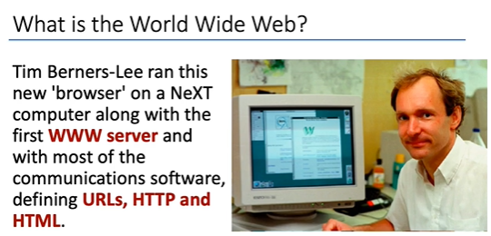
0202.3 Web Video
https://ucsc-extension.instructure.com/courses/3825/pages/1-dot-1-welcome?module_item_id=42202
What is World Wide Web?

Slide 28
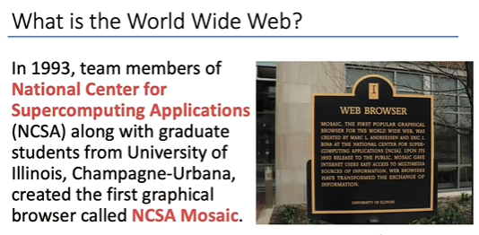
0202.3 Web Video
https://ucsc-extension.instructure.com/courses/3825/pages/1-dot-1-welcome?module_item_id=42202
What is World Wide Web?

Slide 29
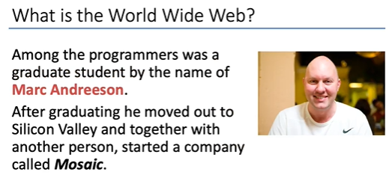
0202.3 Web Video
https://ucsc-extension.instructure.com/courses/3825/pages/1-dot-1-welcome?module_item_id=42202
What is World Wide Web?

Slide 30
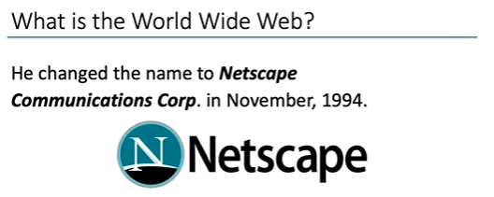
0202.3 Web Video
https://ucsc-extension.instructure.com/courses/3825/pages/1-dot-1-welcome?module_item_id=42202
What is World Wide Web?

Slide 31
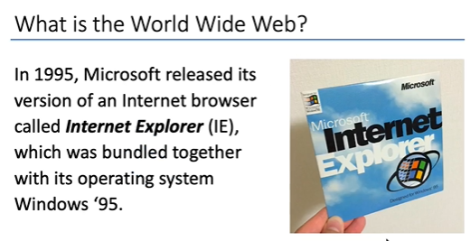
0202.3 Web Video
https://ucsc-extension.instructure.com/courses/3825/pages/1-dot-1-welcome?module_item_id=42202
What is World Wide Web?

Slide 32
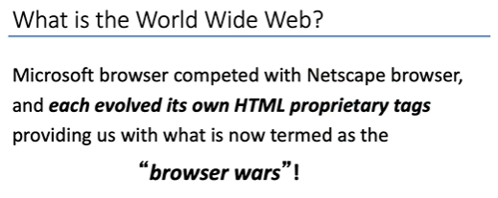
0202.3 Web Video
https://ucsc-extension.instructure.com/courses/3825/pages/1-dot-1-welcome?module_item_id=42202
What is World Wide Web?

Slide 33
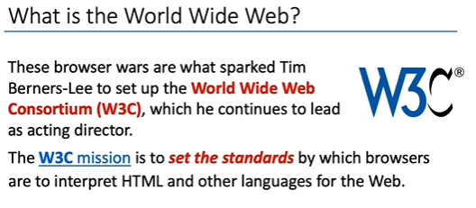
0202.3 Web Video
https://ucsc-extension.instructure.com/courses/3825/pages/1-dot-1-welcome?module_item_id=42202
What is World Wide Web?

Slide 34
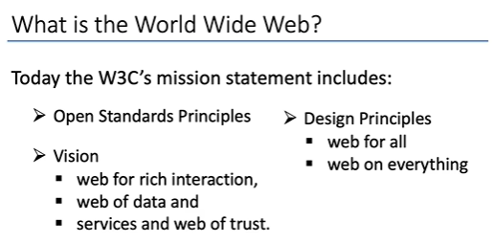
0202.3 Web Video
https://ucsc-extension.instructure.com/courses/3825/pages/1-dot-1-welcome?module_item_id=42202
What is World Wide Web?

Slide 35
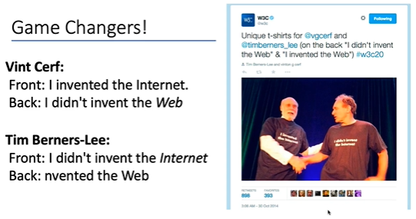
0202 Web History
https://ucsc-extension.instructure.com/courses/3825/pages/1-dot-1-welcome?module_item_id=42202
What is World Wide Web?

Slide 36
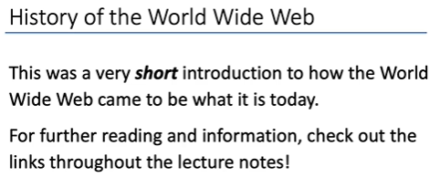
0202 Web History
https://ucsc-extension.instructure.com/courses/3825/pages/1-dot-1-welcome?module_item_id=42202
What is World Wide Web?

Slide 37
End of Chapter

