Slide 1

0203 HTML
Peter H. Chen

Slide 2
0203 HTML
https://ucsc-extension.instructure.com/courses/3825/pages/1-dot-1-welcome?module_item_id=42202
0203 HTML
What does HTML stand for and what is it?
Hypertext Markup Language - HTML only marks up or describes data.
HTML provides a few attributes so that additional information can be provided to either the browser or to other languages such as CSS or JavaScript.
As such, writing HTML code is not writing a programming language.
HTML provides the semantic structure of the content of a document.

Slide 3
0203 HTML
https://ucsc-extension.instructure.com/courses/3825/pages/1-dot-1-welcome?module_item_id=42202
0203 HTML
The Evolution of HTML:
Read: Chapter 2: A History of HTML (Links to an external site.)
Since it’s inception back in the early 1990’s, we now have many versions of HTML:
HTML1.0 – the first release of HTML. Very, very basic (no images!).
HTML2.0 – July 1994 version 2.0 was released. It was the standard until about 1997.

Slide 4
0203 HTML
https://ucsc-extension.instructure.com/courses/3825/pages/1-dot-1-welcome?module_item_id=42202
0203 HTML
The Evolution of HTML:
HTML3.0 – In 1995 this version was suppose to appease the cries of “designers” who wanted more control over the look of a web site. Netscape was creating what was called Netscape Extension tags, but when other browsers tried to emulate, they didn’t work the same and designers got frustrated. Dave Ragget came up with a solution by introducing HTML 3.0, which included many new tags, but browsers were slow to implement them. It was not successful.
HTML3.2 – In 1997 the World Wide Consortium endorsed HTML version 3.2 which did not include many of these Netscape extension tags. Instead, this version became the standard by which the browsers and designers would start to implement.

Slide 5
0203 HTML
https://ucsc-extension.instructure.com/courses/3825/pages/1-dot-1-welcome?module_item_id=42202
0203 HTML
The Evolution of HTML:
TML4.0 - HTML 4.0 was recommended by the W3C in December 1997 and became the official standard in April 1998. Microsoft undertook browser support surprisingly earnestly with Internet Explorer and the market-leading IE5 had good support for almost all of the new tags and attributes. In comparison, Netscape’s terribly flawed Navigator 4.7 was terrible when using HTML 4.0 and basic CSS. Navigator 6 was a vast improvement.
HTML 4.01 - Once HTML4.0 had been out for a little while, the documentation was revised and corrected in a few minor ways and was entitled HTML 4.01; this version of HTML has been the standard ever since 1999 and is the foundation for HTML5.

Slide 6
0203 HTML
https://ucsc-extension.instructure.com/courses/3825/pages/1-dot-1-welcome?module_item_id=42202
0203 HTML
The Evolution of HTML:
XML – XML (eXtensible Markup Language) is a generic markup language specified by the W3C. The information technology (IT) industry uses many languages based on XML as data-description languages. XML tags resemble HTML tags, but XML is much more flexible because it lets users define their own tags. In this way XML acts like a meta-language—that is, it can be used to define other languages, such as RSS (Links to an external site.). Moreover, HTML is a presentation language, whereas XML is a data-description language. This means that XML has far broader applications than just the Web. For example, Web services can use XML to exchange requests and responses. (Source: https://developer.mozilla.org/en-US/docs/Glossary/XML (Links to an external site.)

Slide 7
0203 HTML
https://ucsc-extension.instructure.com/courses/3825/pages/1-dot-1-welcome?module_item_id=42202
0203 HTML
The Evolution of HTML:
XHTML1.0 – W3C issued their specifications of XHTML 1.0 January 26, 2000 as joint-standard with HTML 4.01. XHTML is an application of XML and because it is more restrictive language documents need to be well formed so they can be parsed using XML parsers. There isn’t much difference between HTML and XHTML elements or attributes. It’s mainly just a new set of coding rules. The W3C was working on XHTML 2.0 but officially closed all work on this version in early 2009 in response to the next version of HTML – see next item!
HTML 5.0 – This version was made an official standard as of October 28, 2014. The W3C states that: “HTML 5 defines the fifth major revision of the core language of the World Wide Web, HTML”. Browsers generally support the new elements of HTML5 however, IE8 did not and IE9 had a little bit better support. http://www.w3.org/TR/html5/ (Links to an external site.)

Slide 8
0203 HTML
https://ucsc-extension.instructure.com/courses/3825/pages/1-dot-1-welcome?module_item_id=42202
0203 HTML
The Evolution of HTML:
HTML 5.1 – The latest and newest version of HTML. It was made an official standard as of November 1, 2016. It makes some corrections and tweaks some code.
HTML 5.2 – HTML5.2 (Links to an external site.) is now the current version of HTML. It was made an official standard as of December 14, 2017. As with HTML5.1, it has made some corrections and tweaking of the code.
.

Slide 9
0203.01 HTML Video
Peter H. Chen

Slide 10
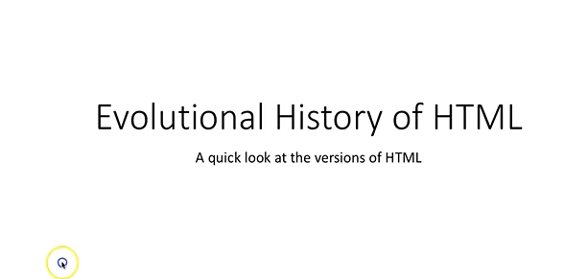
0203.01 HTML Video
https://ucsc-extension.instructure.com/courses/3825/pages/1-dot-1-welcome?module_item_id=42202
0203.01 HTML Video .

Slide 11
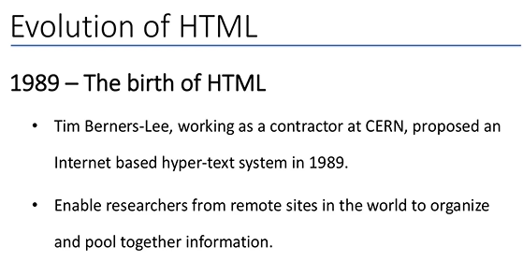
0203.01 HTML Video
https://ucsc-extension.instructure.com/courses/3825/pages/1-dot-1-welcome?module_item_id=42202
0203.01 HTML Video .

Slide 12
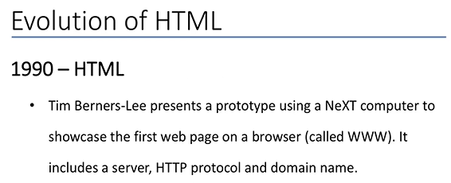
0203.01 HTML Video
https://ucsc-extension.instructure.com/courses/3825/pages/1-dot-1-welcome?module_item_id=42202
0203.01 HTML Video .

Slide 13
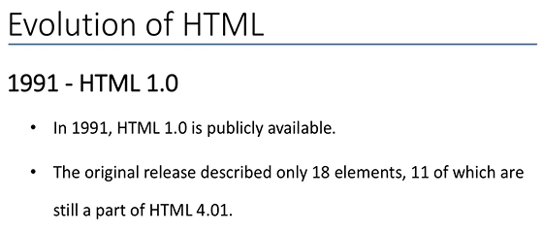
0203.01 HTML Video
https://ucsc-extension.instructure.com/courses/3825/pages/1-dot-1-welcome?module_item_id=42202
0203.01 HTML Video .

Slide 14
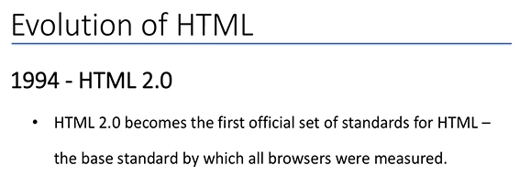
0203.01 HTML Video
https://ucsc-extension.instructure.com/courses/3825/pages/1-dot-1-welcome?module_item_id=42202
0203.01 HTML Video .

Slide 15
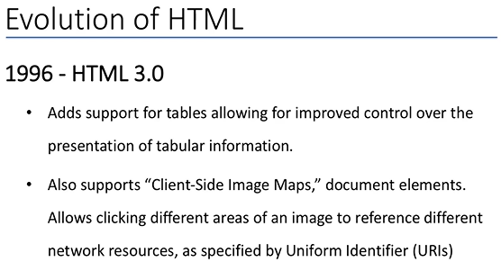
0203.01 HTML Video
https://ucsc-extension.instructure.com/courses/3825/pages/1-dot-1-welcome?module_item_id=42202
0203.01 HTML Video .

Slide 16
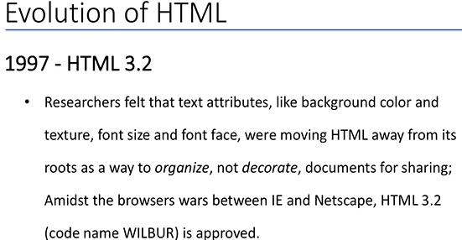
0203.01 HTML Video
https://ucsc-extension.instructure.com/courses/3825/pages/1-dot-1-welcome?module_item_id=42202
0203.01 HTML Video .

Slide 17
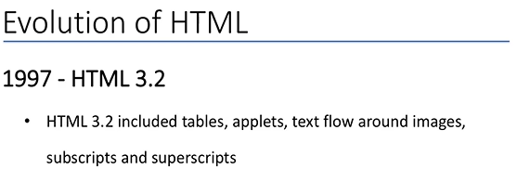
0203.01 HTML Video
https://ucsc-extension.instructure.com/courses/3825/pages/1-dot-1-welcome?module_item_id=42202
0203.01 HTML Video .

Slide 18
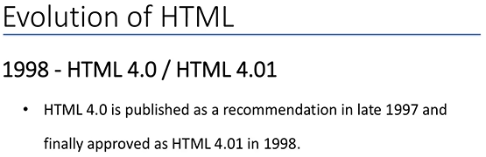
0203.01 HTML Video
https://ucsc-extension.instructure.com/courses/3825/pages/1-dot-1-welcome?module_item_id=42202
0203.01 HTML Video .

Slide 19
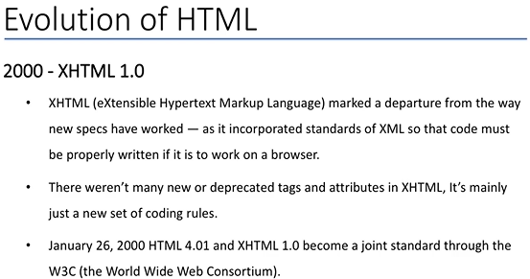
0203.01 HTML Video
https://ucsc-extension.instructure.com/courses/3825/pages/1-dot-1-welcome?module_item_id=42202
0203.01 HTML Video .

Slide 20
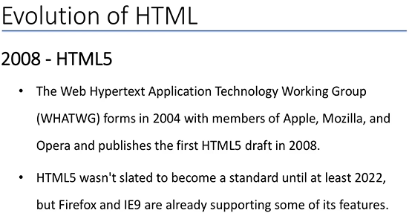
0203.01 HTML Video
https://ucsc-extension.instructure.com/courses/3825/pages/1-dot-1-welcome?module_item_id=42202
0203.01 HTML Video .

Slide 21
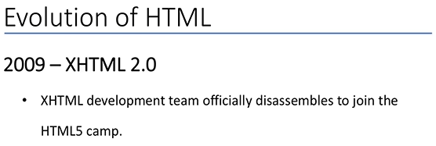
0203.01 HTML Video
https://ucsc-extension.instructure.com/courses/3825/pages/1-dot-1-welcome?module_item_id=42202
0203.01 HTML Video .

Slide 22
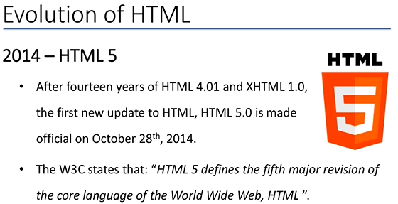
0203.01 HTML Video
https://ucsc-extension.instructure.com/courses/3825/pages/1-dot-1-welcome?module_item_id=42202
0203.01 HTML Video .

Slide 23
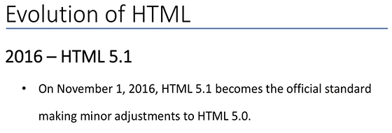
0203.01 HTML Video
https://ucsc-extension.instructure.com/courses/3825/pages/1-dot-1-welcome?module_item_id=42202
0203.01 HTML Video .

Slide 24
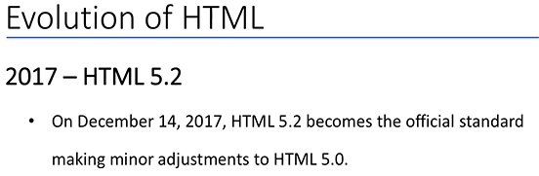
0203.01 HTML Video
https://ucsc-extension.instructure.com/courses/3825/pages/1-dot-1-welcome?module_item_id=42202
0203.01 HTML Video .

Slide 25
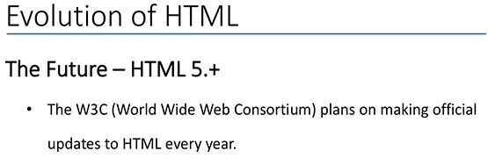
0203.01 HTML Video
https://ucsc-extension.instructure.com/courses/3825/pages/1-dot-1-welcome?module_item_id=42202
0203.01 HTML Video .

Slide 26
End of Chapter

