Slide 1

0302 BBEditor
Peter H. Chen

Slide 2

0302 BBEditor
https://ucsc-extension.instructure.com/courses/3825/pages/1-dot-1-welcome?module_item_id=42202
0302 BBEditor for Mac
Important: BBEdit 12 requires macOS 10.11.6 or later, and will not run on any earlier version of macOS. (as of May 22, 2018).

Slide 3
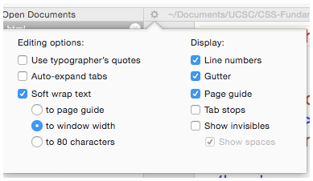
0302 BBEditor
https://ucsc-extension.instructure.com/courses/3825/pages/1-dot-1-welcome?module_item_id=42202
0302 BBEditor for Mac
Although all looks good when you first open and start typing, there are a few preferences I will set up from the beginning including the Word Wrap and the Text Size.
You can set wrap text for one document—choose the small “gear” icon shown at top-left corner of document and choose “Soft wrap text” and choose “to window width”.

Slide 4
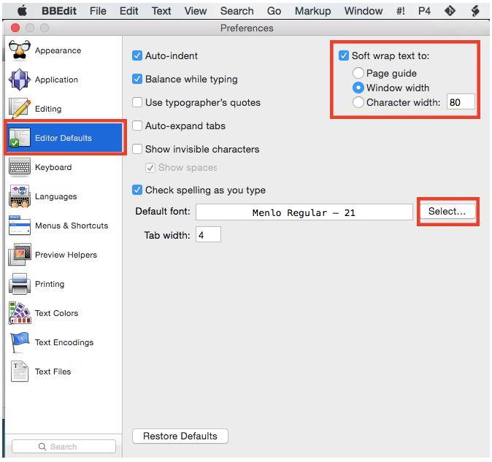
0302 BBEditor
https://ucsc-extension.instructure.com/courses/3825/pages/1-dot-1-welcome?module_item_id=42202
0302 BBEditor for Mac
This is better done via the Preferences so all documents have this set up.
To increase the font size and text wrap: go to BBEdit > Preferences;
Choose: Editor Default and Select Default Font button. That way you can increase the font size to a more comfortable setting.

Slide 5
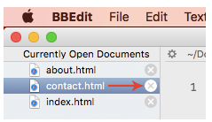
0302 BBEditor
https://ucsc-extension.instructure.com/courses/3825/pages/1-dot-1-welcome?module_item_id=42202
0302 BBEditor for Mac
How to View your HTML document on the Browser from BBEdit?
When you want to view your .html file in a browser window you can simply drag the icon of your file directly into the browser icon or browser window of your choice.
If you do not see the side-panel as shown below, be sure to go to the menu and click on View > Show Sidebar (Cmd+0 (zero))
How to Save your in BBEdit?
Have you Saved your File?
The color of these icons tells you that you saved your file, so you see your changes in the browser (white).

Slide 6
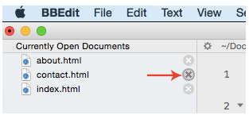
0302 BBEditor
https://ucsc-extension.instructure.com/courses/3825/pages/1-dot-1-welcome?module_item_id=42202
0302 BBEditor for Mac
Otherwise they look dark gray indicating that you need to save the file (Cmd+S (Mac).
If this is a new file use Shift+Cmd+S

Slide 7
End of Chapter

