Slide 1

0303 Notepad++
Peter H. Chen

Slide 2

0303 Notepad++
https://ucsc-extension.instructure.com/courses/3825/pages/1-dot-1-welcome?module_item_id=42202
0303 Notepad++ for Windows
When you go to the website, click “Download” menu option on left and then choose:

Slide 3
0303 Notepad++
https://ucsc-extension.instructure.com/courses/3825/pages/1-dot-1-welcome?module_item_id=42202
0303 Notepad++ for Windows
Notepad++ now offers a version for 32bit and also 64bit - so you have to know what your computer is running before making that decision.
If you are running Windows 7 or 8 check this website about how to find out:
https://support.microsoft.com/en-us/kb/827218 (Links to an external site.).

Slide 4
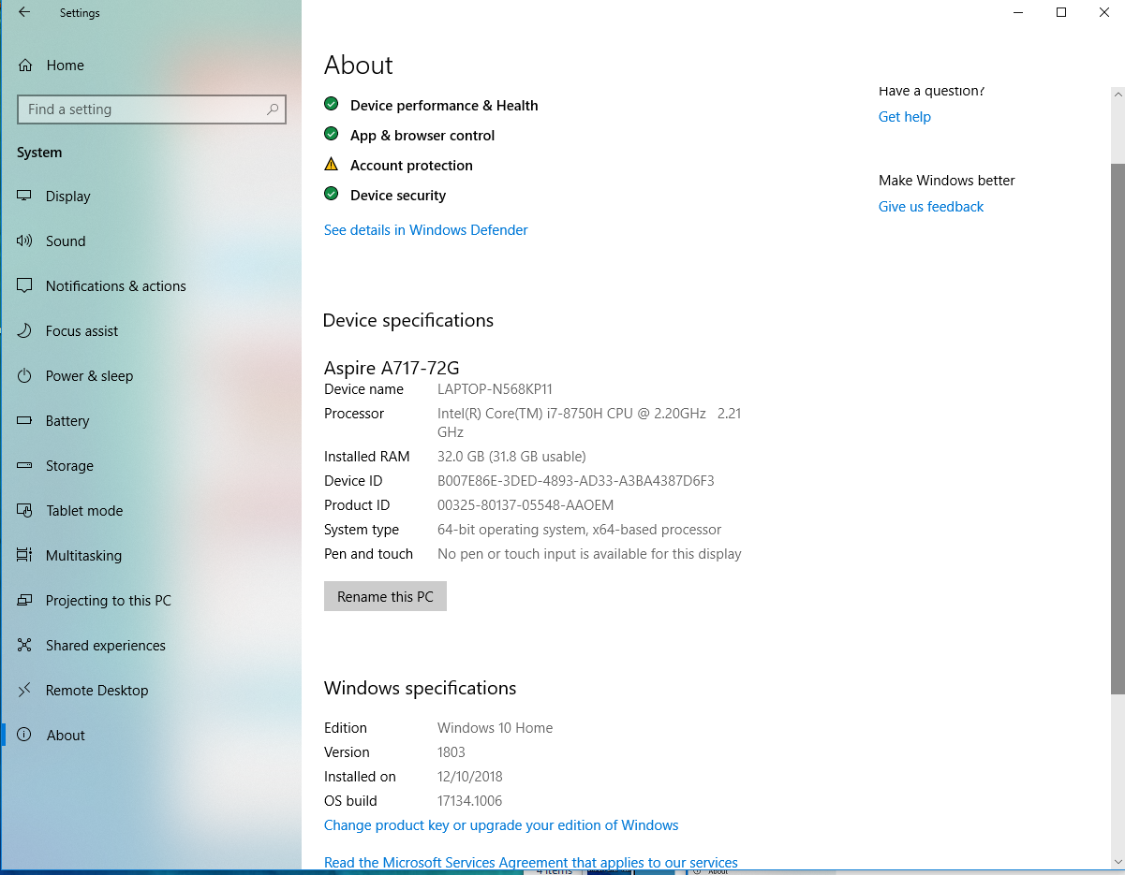
0303 Notepad++
https://ucsc-extension.instructure.com/courses/3825/pages/1-dot-1-welcome?module_item_id=42202
0303 Notepad++ for Windows
If you are using Windows 10, right-click on the Start button, then click on "Settings".
You should be able to see whether your computer is using 32bit or 64bit under the System > About > System Type. This video from HP (!) does a nice job of showing how/where:
https://www.youtube.com/watch?v=6Fc3WSZalYo

Slide 5
0303 Notepad++
https://ucsc-extension.instructure.com/courses/3825/pages/1-dot-1-welcome?module_item_id=42202
0303 Notepad++ for Windows
Set up Word Wrap and Font Size:
Once downloaded and installed, this free application has some similar settings as BBEdit, in terms of preferences before starting.
Set Word Wrap with icon on far right (under the word Window on the menu).
To increase/decrease the font size, Notepad++ has a nifty shortcut key: hold down the Ctrl key and roll your mouse wheel to change the text size to the size you wish to use. Otherwise, use the magnify class icon with the plus sign to increase the font size.

Slide 6
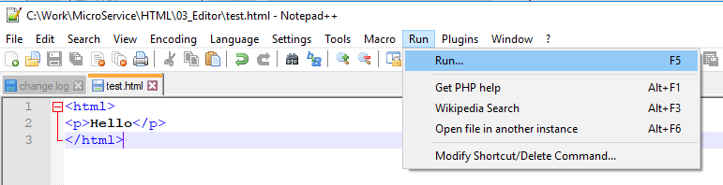
0303 Notepad++
https://ucsc-extension.instructure.com/courses/3825/pages/1-dot-1-welcome?module_item_id=42202
0303 Notepad++ for Windows
Viewing your HTML on a Browser:
To “see” your code render on a browser window, click on “Run” menu and choose which browser to test. Make sure your files are saved before you choose:
“Run > …

Slide 7
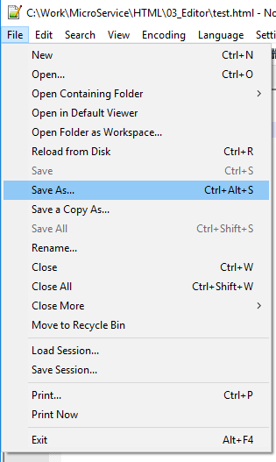
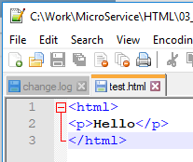
0303 Notepad++
https://ucsc-extension.instructure.com/courses/3825/pages/1-dot-1-welcome?module_item_id=42202
0303 Notepad++ for Windows
Saving your files as your work:
You know your file is saved when the icon is “blue”.

Slide 8
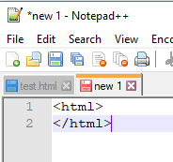
0303 Notepad++
https://ucsc-extension.instructure.com/courses/3825/pages/1-dot-1-welcome?module_item_id=42202
0303 Notepad++ for Windows
And “red” if you have not saved the file!.
To Save a file: Ctrl + S
To Save As: Ctrl + Alt + S

Slide 9
0303 Notepad++
https://ucsc-extension.instructure.com/courses/3825/pages/1-dot-1-welcome?module_item_id=42202
0303 Notepad++ for Windows
Turn off Autocompletion!
I have also found that while “learning” how to code, the Auto-Completion is not helpful (brains get lazy!).
If you really want to learn how to code, turn off all the auto completion settings (uncheck all the boxes).
When you can code in your sleep, you can turn this back on but meantime… let your brain learn how this all works without help!

Slide 10
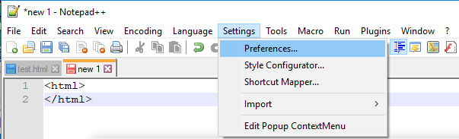
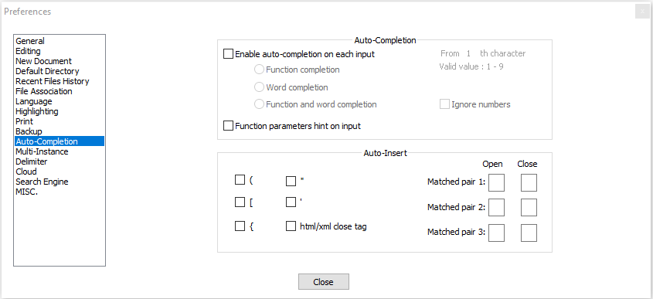
0303 Notepad++
https://ucsc-extension.instructure.com/courses/3825/pages/1-dot-1-welcome?module_item_id=42202
0303 Notepad++ for Windows
Settings > Preferences > Auto Completion
Whichever text editor you choose, I highly encourage you to increase the font size as this will make it much easier to spot mistakes which can be very small – as in the difference between : and ; which can be all the difference in the world!
Don’t strain your eyes more than you have to!

Slide 11
0303 Notepad++
https://ucsc-extension.instructure.com/courses/3825/pages/1-dot-1-welcome?module_item_id=42202
0303 Notepad++ for Windows
Videos for the class may be recorded on a Windows environment, I will be using Notepad++ or BBEdit on the Mac, and it will not make a difference, as HTML is HTML no matter which application you are using.
I work on both all the time and have access to all of these applications at all times.

Slide 12
0303.1 Video of Notepad++

Slide 13
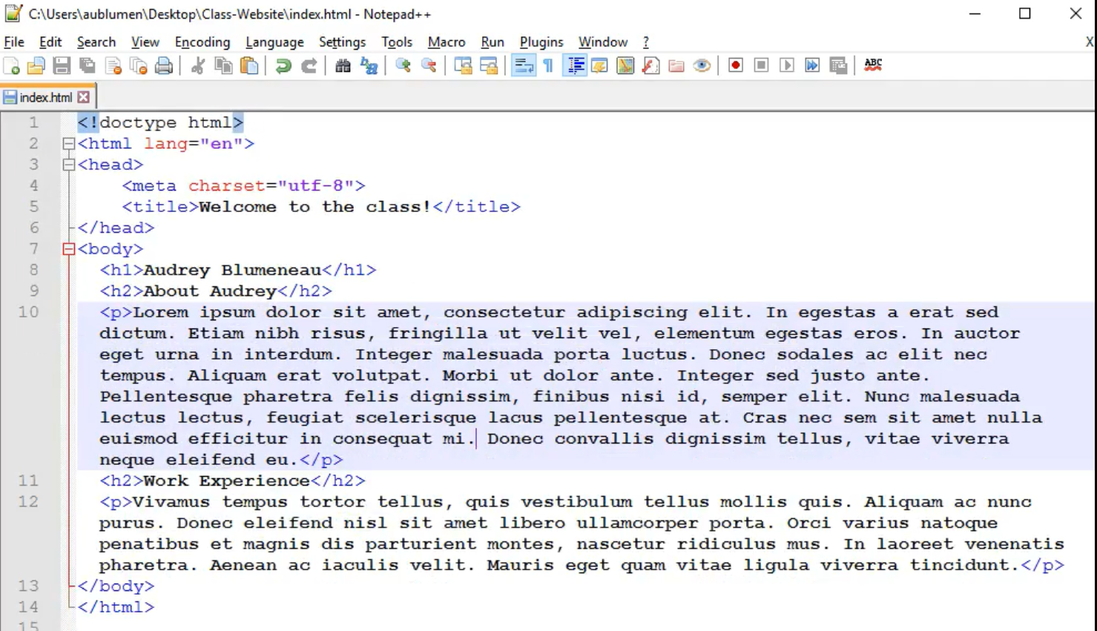
0303.1 Video of Notepad++
https://ucsc-extension.instructure.com/courses/3825/pages/1-dot-1-welcome?module_item_id=42202
0303.1 Video of Notepad++
Middle mouse for increase/decrease size.

Slide 14
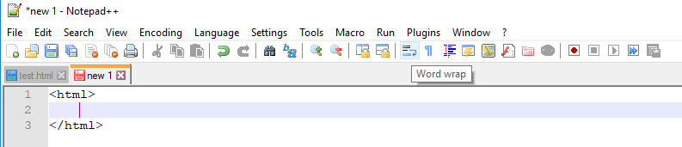
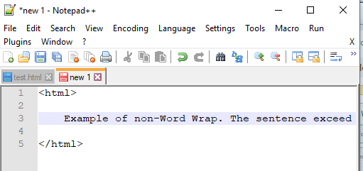
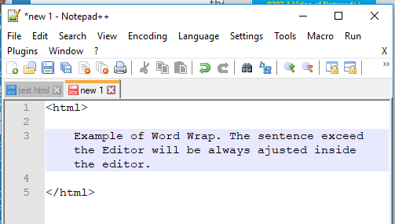
0303.1 Video of Notepad++
https://ucsc-extension.instructure.com/courses/3825/pages/1-dot-1-welcome?module_item_id=42202
0303.1 Video of Notepad++
Word wrap:

Slide 15
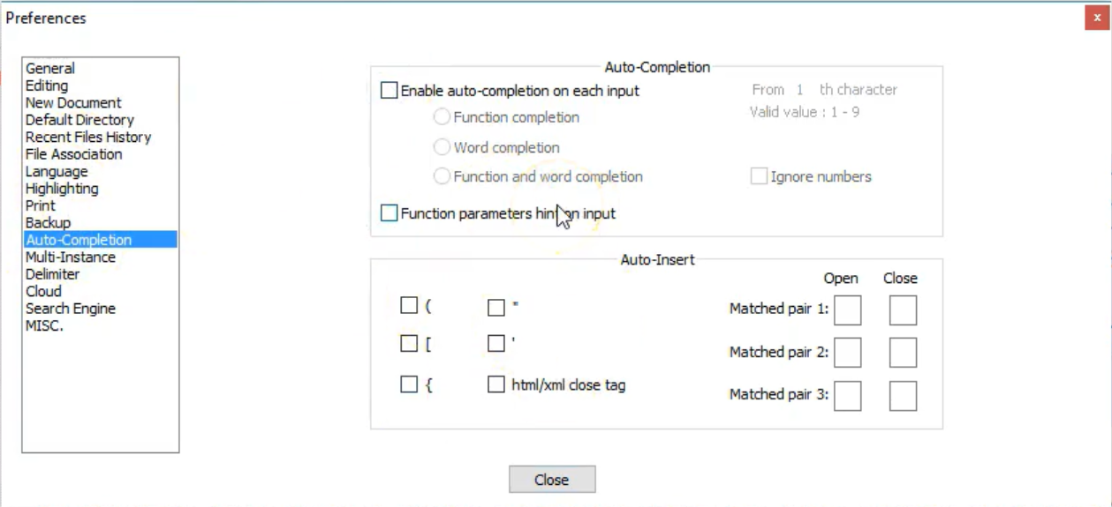
0303.1 Video of Notepad++
https://ucsc-extension.instructure.com/courses/3825/pages/1-dot-1-welcome?module_item_id=42202
0303.1 Video of Notepad++
Turn-off Auto-completion:

Slide 16
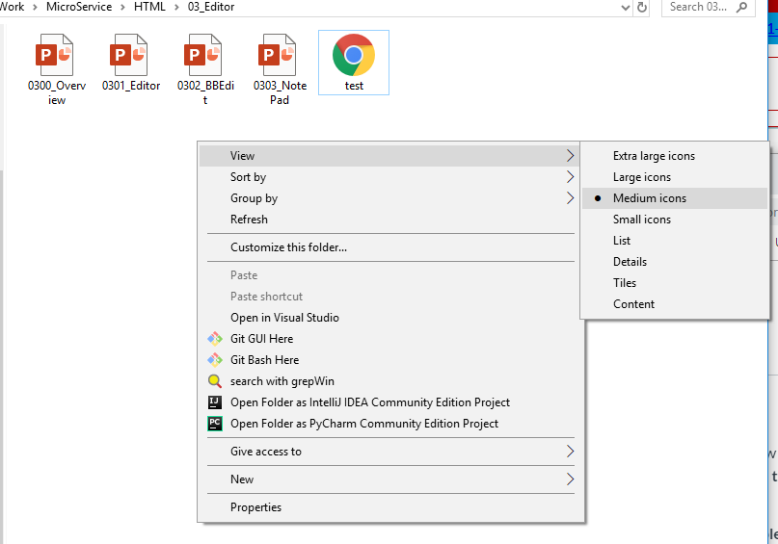
0303.1 Video of Notepad++
https://ucsc-extension.instructure.com/courses/3825/pages/1-dot-1-welcome?module_item_id=42202
0303.1 Video of Notepad++
Saved file with HTML icon.

Slide 17
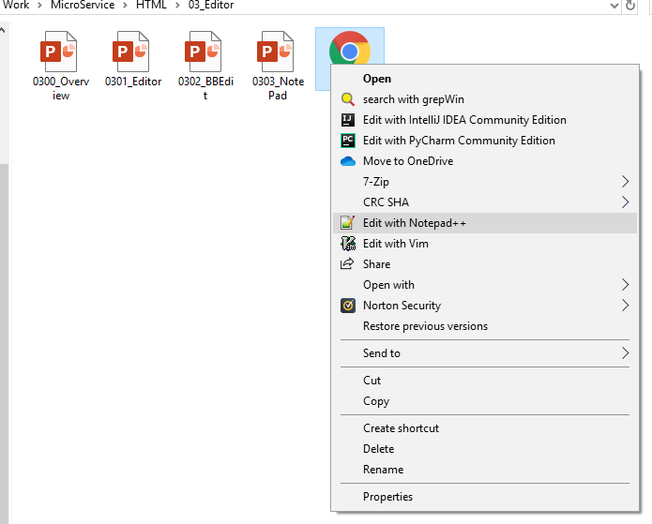
0303.1 Video of Notepad++
https://ucsc-extension.instructure.com/courses/3825/pages/1-dot-1-welcome?module_item_id=42202
0303.1 Video of Notepad++
Open with Notepad++.

Slide 18
End of Chapter

