Slide 1

0304 Text Editor
Peter H. Chen

Slide 2
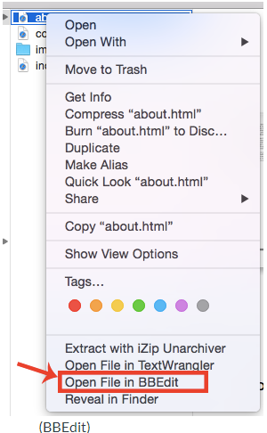
0304 Text Editor
https://ucsc-extension.instructure.com/courses/3825/pages/1-dot-1-welcome?module_item_id=42202
0304 Open HTML with Text Editor
Opening an existing HTML file:
When you want to open an existing HTML file to edit the code (myfile.html) you can:
“Right-click” on the file and choose from the menu:
“Open File in BBEdit” or “Edit with Notepad++”.

Slide 3
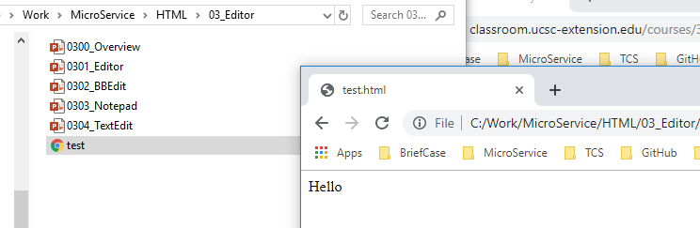
0304 Text Editor
https://ucsc-extension.instructure.com/courses/3825/pages/1-dot-1-welcome?module_item_id=42202
0304 Open HTML with Text Editor
Or
Open the application and choose “File > Open” and look for your file that way.
To view the html page in a browser simply double click the file or drag to browser window

Slide 4
End of Chapter

