Slide 1
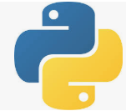
0401 Dictionary
Peter H. Chen

Slide 2
0401 Dictionary
https://www.ucsc-extension.edu/certificate-program/offering/python-programmers
Topics:
Importing with from
Dictionaries

Slide 3
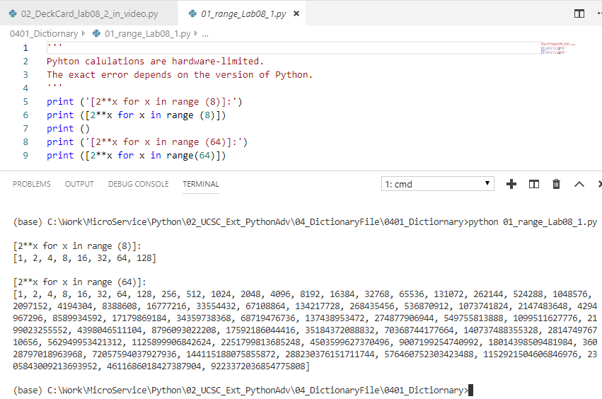
0401 Dictionary
https://www.ucsc-extension.edu/certificate-program/offering/python-programmers
> print ([2 ** x for x in range(8)])

Slide 4
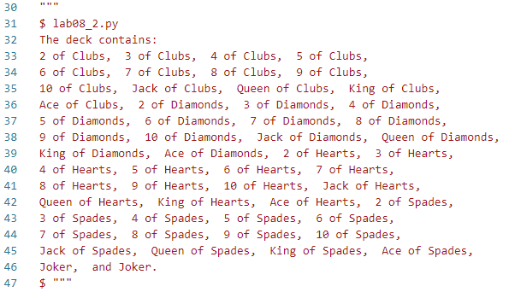
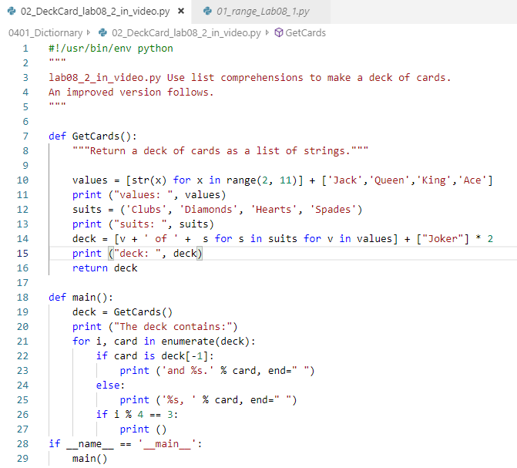
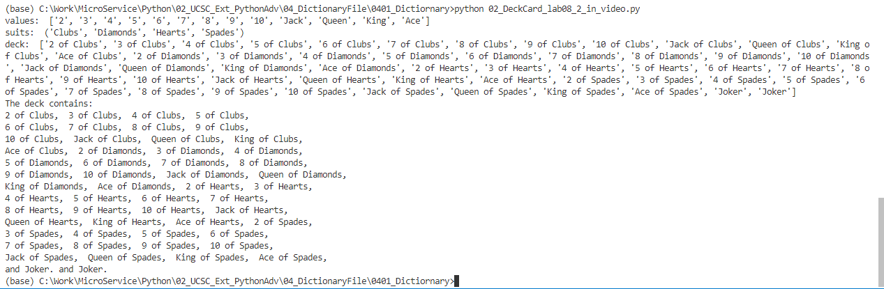
0401 Dictionary
https://www.ucsc-extension.edu/certificate-program/offering/python-programmers
Deck of Cards:

Slide 5
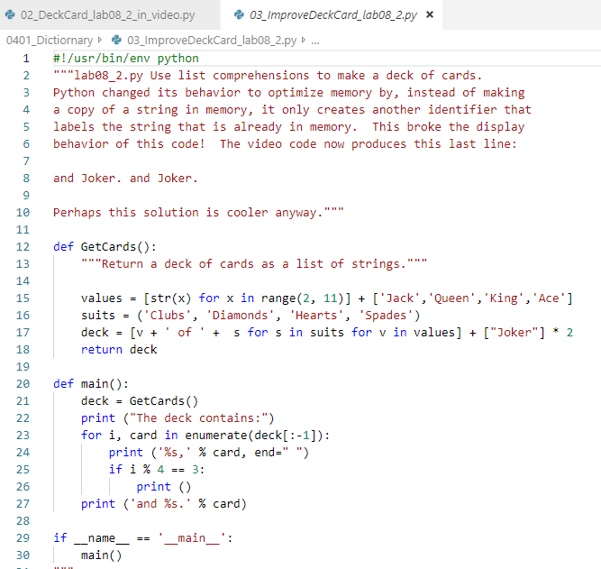
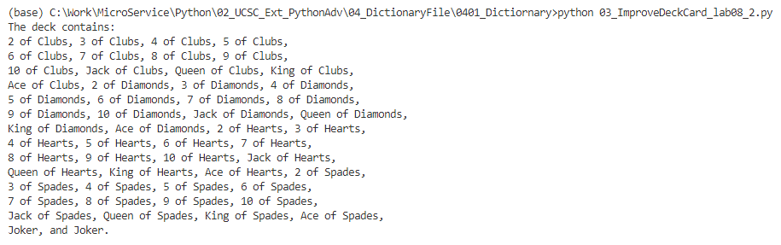
0401 Dictionary
https://www.ucsc-extension.edu/certificate-program/offering/python-programmers
Improve Deck of Cards:

Slide 6
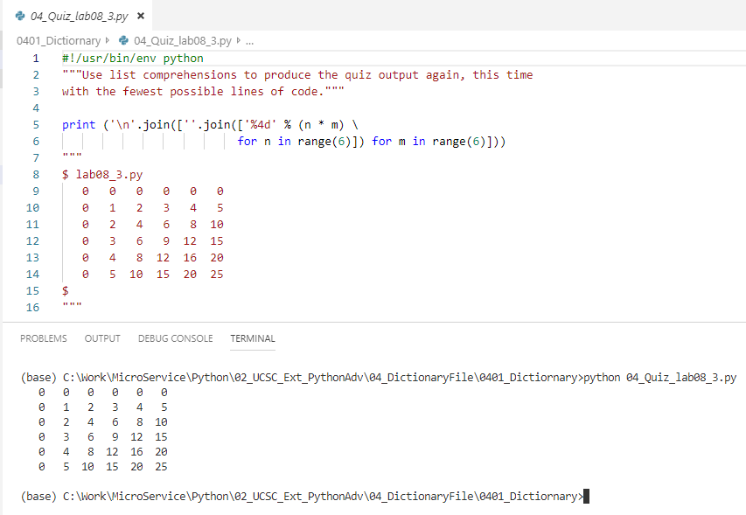
0401 Dictionary
https://www.ucsc-extension.edu/certificate-program/offering/python-programmers
Quiz: One line of print.

Slide 7
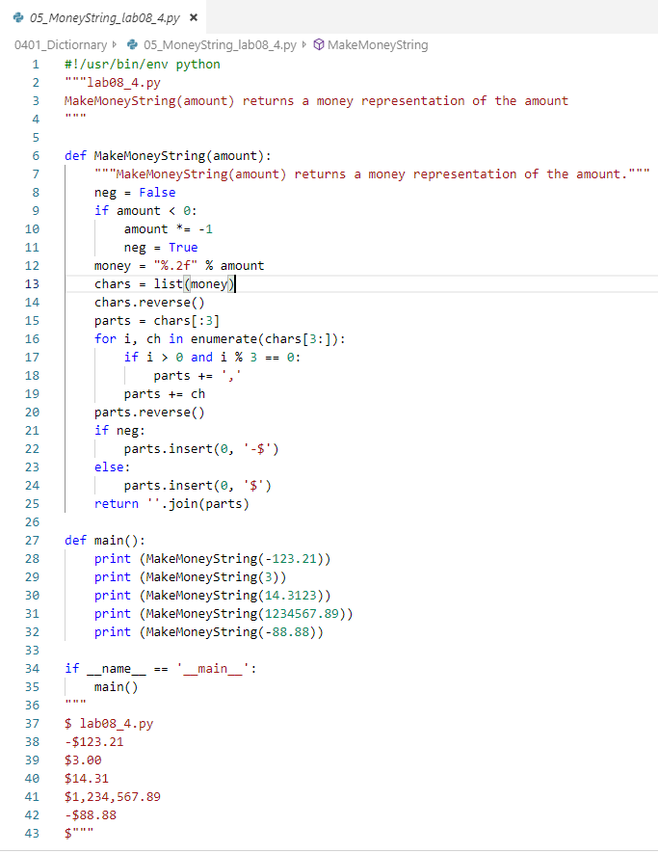
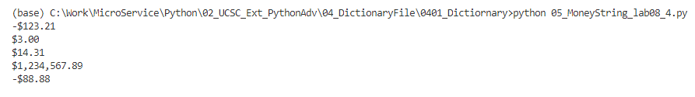
0401 Dictionary
https://www.ucsc-extension.edu/certificate-program/offering/python-programmers
Dollar String: nothing new to look at.

Slide 8
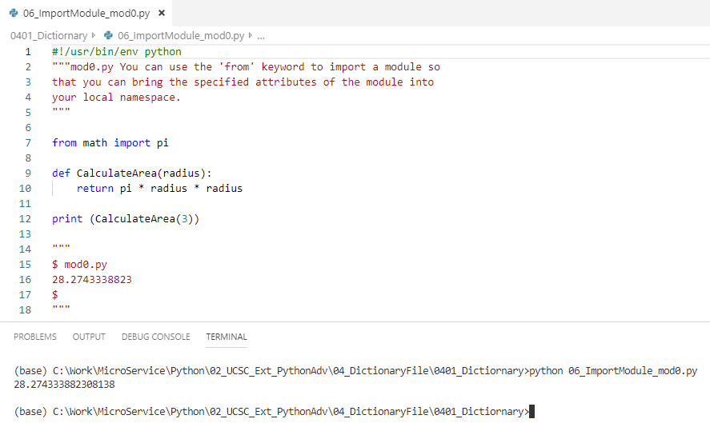
0401 Dictionary
https://www.ucsc-extension.edu/certificate-program/offering/python-programmers
Calculate Area: Use ‘from’ key word to import pi. ‘from math import pi’ means only the constant pi in the math module will be imported.
The constant pi is available in the math

Slide 9
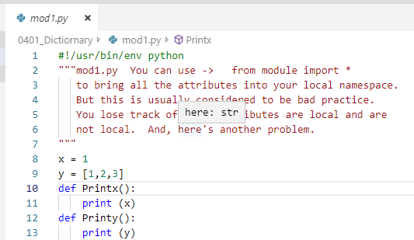
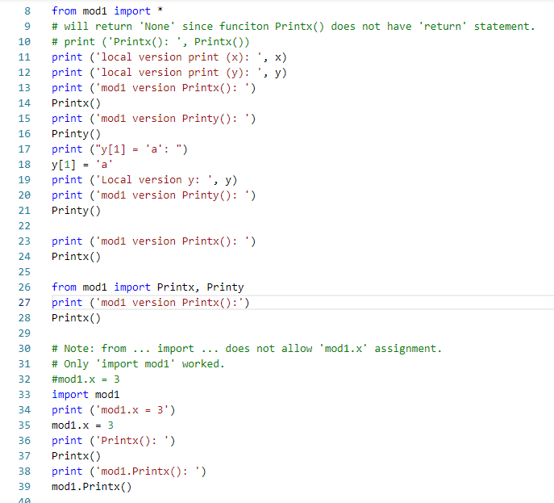
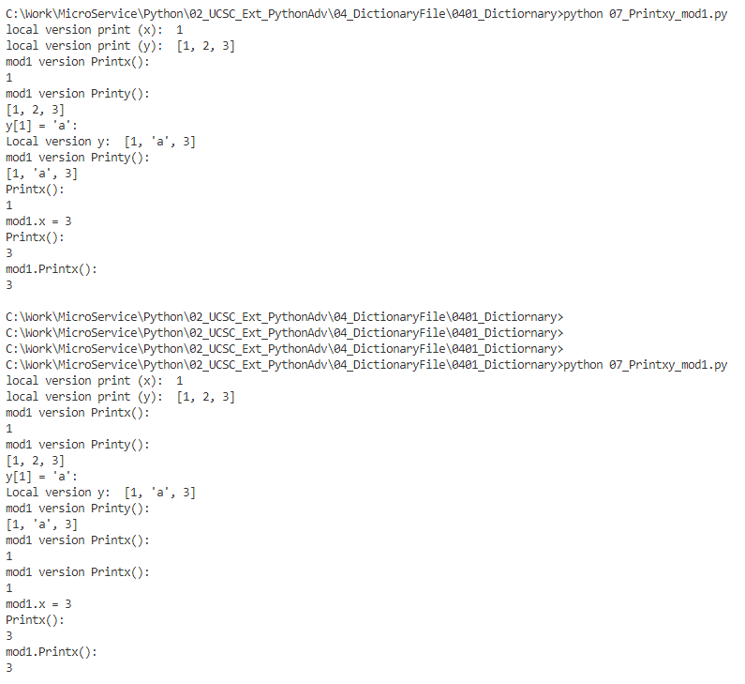
0401 Dictionary
https://www.ucsc-extension.edu/certificate-program/offering/python-programmers
Note: ‘from mod1 import *’ does not allowed the mod.x assignment.

Slide 10
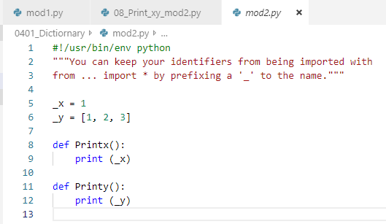
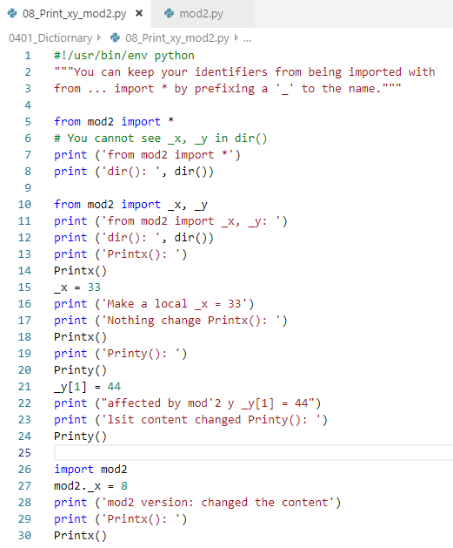
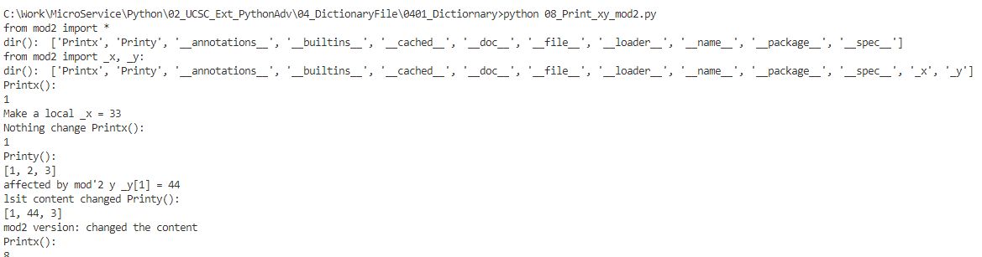
0401 Dictionary
https://www.ucsc-extension.edu/certificate-program/offering/python-programmers
You can keep your identifier from being imported with “from module import *” by prefixing _ (e.g., _x, or _y). You cannot see _x, _y in dir().

Slide 11
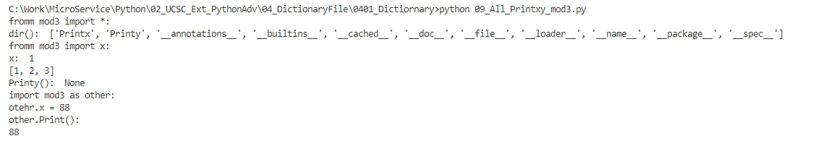
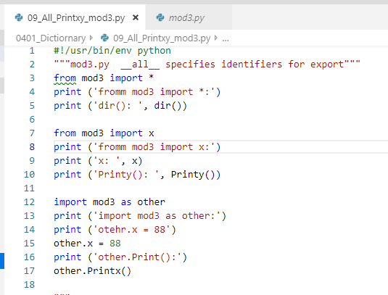
0401 Dictionary
https://www.ucsc-extension.edu/certificate-program/offering/python-programmers
You can keep your identifier from being imported with “from module import *” by prefixing _ (e.g., _x, or _y). You cannot see _x, _y in dir().

Slide 12
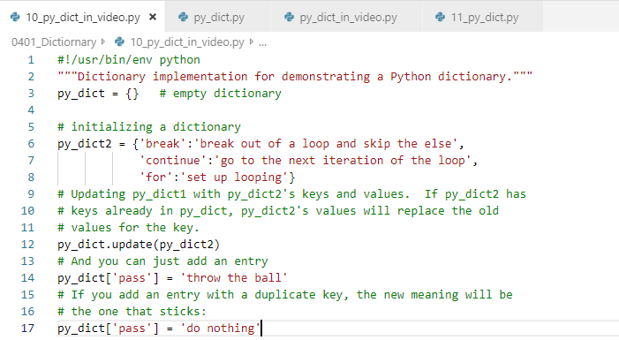
0401 Dictionary
https://www.ucsc-extension.edu/certificate-program/offering/python-programmers
py_dict_in_video.py:
Two dictionaries: py_list = {} and py_dict2 = { ‘key’: ‘value’}

Slide 13
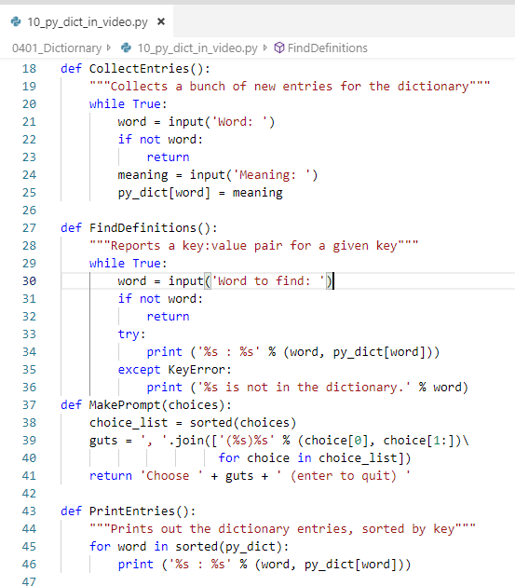
0401 Dictionary
https://www.ucsc-extension.edu/certificate-program/offering/python-programmers
py_dict_in_video.py:
CollectEntries(): Collect the entries
FindDefinition():
MakePrompt():
PrintEntries():

Slide 14
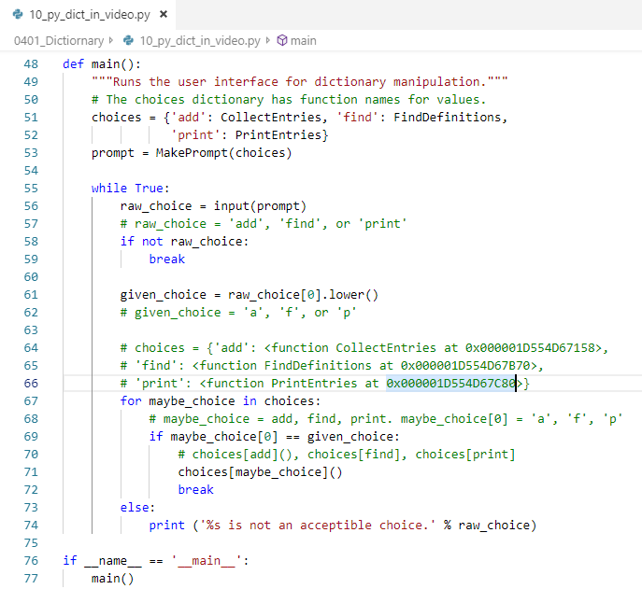
0401 Dictionary
https://www.ucsc-extension.edu/certificate-program/offering/python-programmers
py_dict_in_video.py:
Main():
Get the choice: ‘add’, ‘find’, ‘print’
Pick up the first character: ‘a’, ‘f’, ‘p’
Loop for choices’ key: ‘add’, ‘find’, print’.
Match the user input with key.
Select choices function with key. Call the function with associated value.

Slide 15
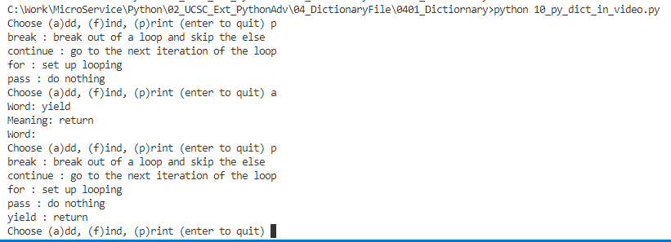
0401 Dictionary
https://www.ucsc-extension.edu/certificate-program/offering/python-programmers
py_dict_in_video.py:
Execution

Slide 16
End of Chapter

