Slide 1

01 Assignment: Lab 04
Peter H. Chen

Slide 2
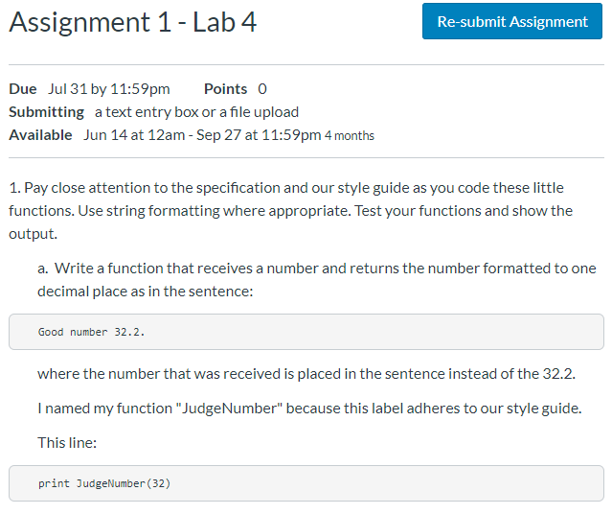
01 Assignment: Lab 04
https://www.ucsc-extension.edu/certificate-program/offering/python-programmers
Assignment 1: Lab 04 (1)

Slide 3
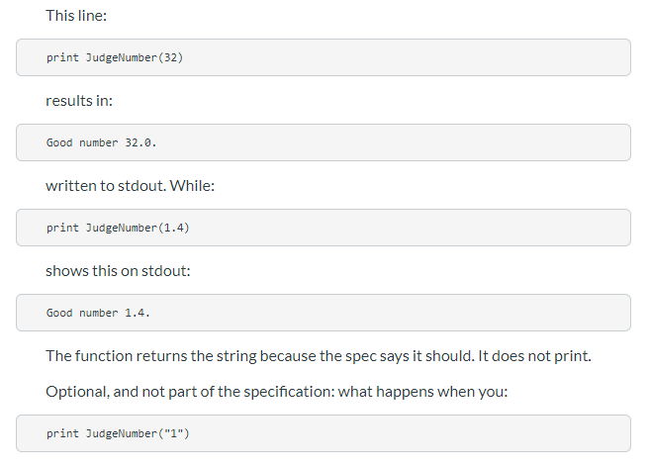
01 Assignment: Lab 04
https://www.ucsc-extension.edu/certificate-program/offering/python-programmers
Assignment 1: Lab 04 (2)

Slide 4
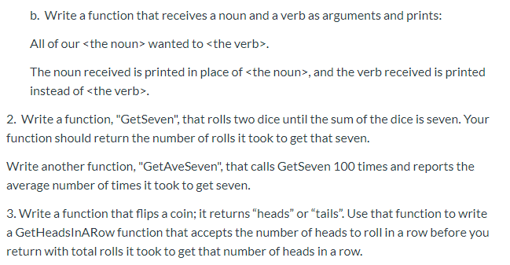
01 Assignment: Lab 04
https://www.ucsc-extension.edu/certificate-program/offering/python-programmers
Assignment 1: Lab 04 (3)

Slide 5
01.01 Lab 04 Solution
Peter H. Chen

Slide 6
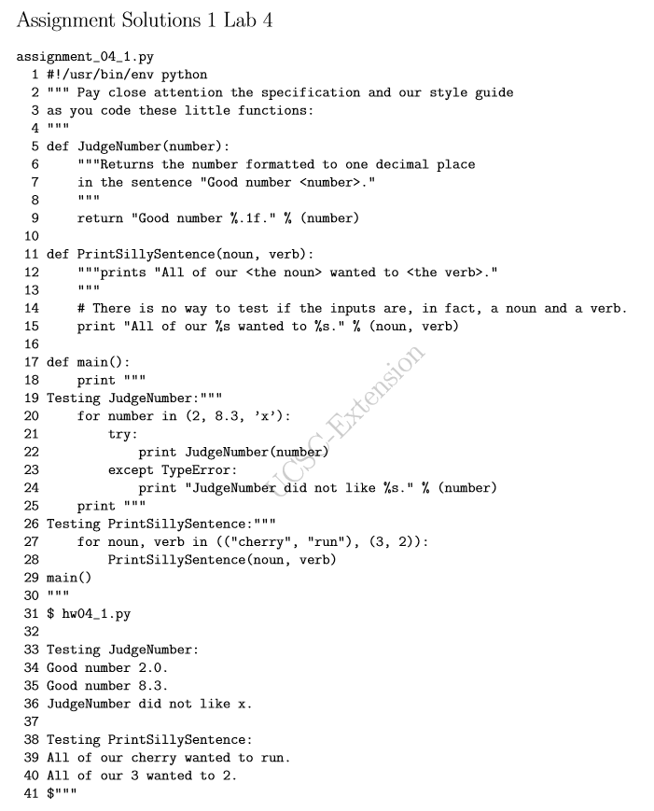
01.01 Lab 04 Solution
https://www.ucsc-extension.edu/certificate-program/offering/python-programmers
Assignment 1: Lab 04 Solution (1)

Slide 7
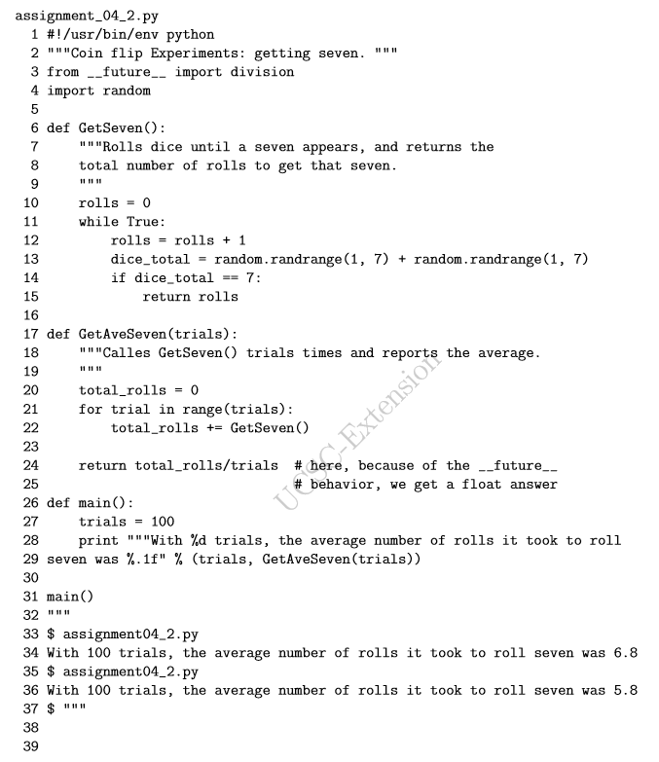
01.01 Lab 04 Solution
https://www.ucsc-extension.edu/certificate-program/offering/python-programmers
Assignment 1: Lab 04 Solution (2)

Slide 8
End of Chapter

