Slide 1

02 Assignment: Lab 07
Peter H. Chen

Slide 2
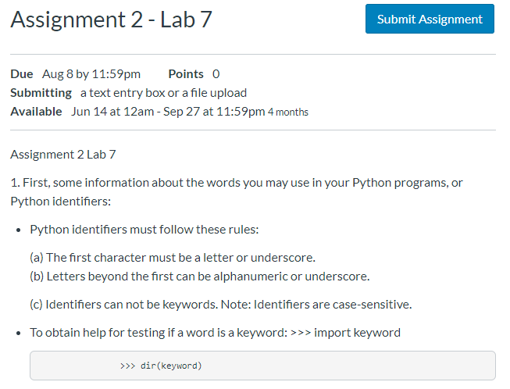
02 Assignment: Lab 07
https://www.ucsc-extension.edu/certificate-program/offering/python-programmers
Assignment 2: Lab 07 (1)

Slide 3
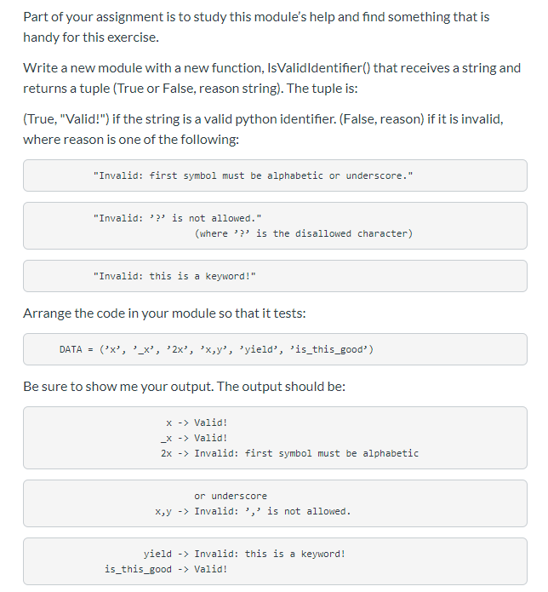
02 Assignment: Lab 07
https://www.ucsc-extension.edu/certificate-program/offering/python-programmers
Assignment 2: Lab 07 (2)

Slide 4
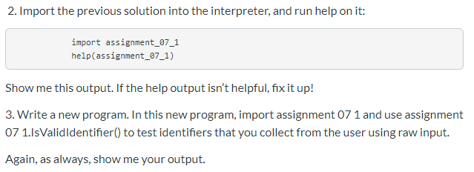
02 Assignment: Lab 07
https://www.ucsc-extension.edu/certificate-program/offering/python-programmers
Assignment 2: Lab 07 (3)

Slide 5
02.01 Lab 07 Solution
Peter H. Chen

Slide 6
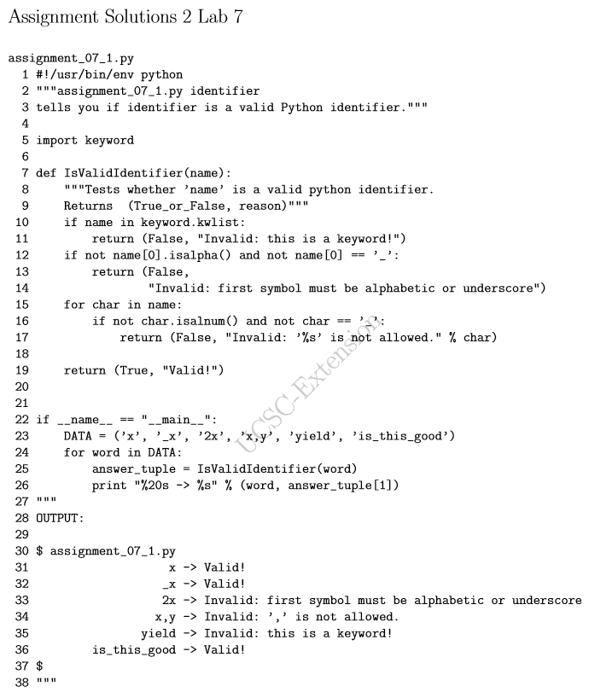
02.01 Lab 07 Solution
https://www.ucsc-extension.edu/certificate-program/offering/python-programmers
Assignment 2: Lab 07 Solution (1)

Slide 7
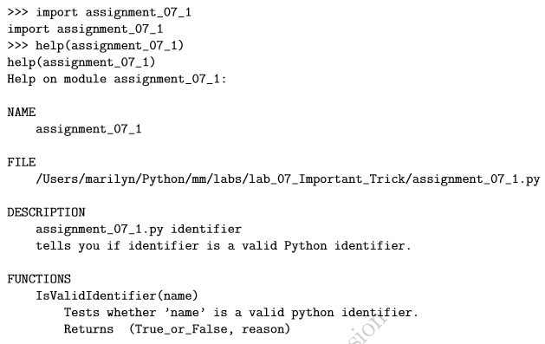
02.01 Lab 07 Solution
https://www.ucsc-extension.edu/certificate-program/offering/python-programmers
Assignment 2: Lab 07 Solution (2)

Slide 8
End of Chapter

