Slide 1

03 Assignment: Lab 11
Peter H. Chen

Slide 2
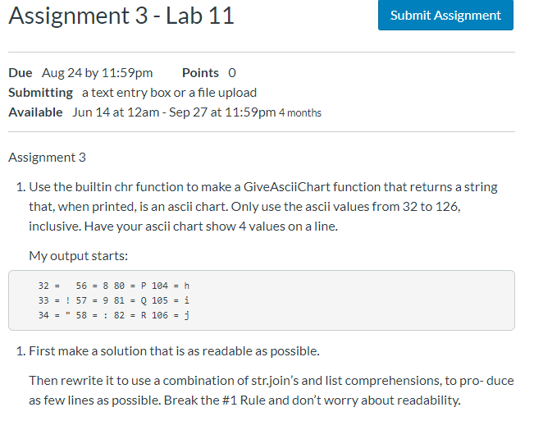
03 Assignment: Lab 11
https://www.ucsc-extension.edu/certificate-program/offering/python-programmers
Assignment 3: Lab 11 (1)

Slide 3
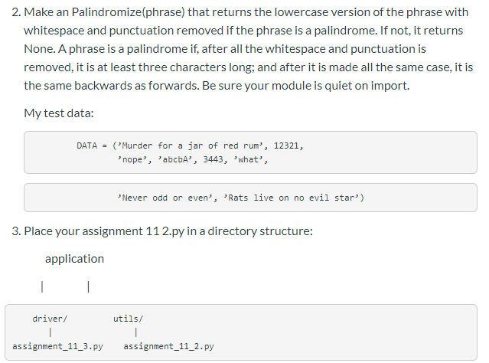
03 Assignment: Lab 11
https://www.ucsc-extension.edu/certificate-program/offering/python-programmers
Assignment 3: Lab 11 (2)

Slide 4
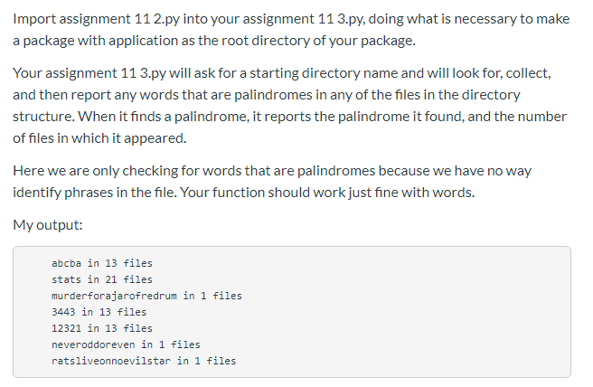
03 Assignment: Lab 11
https://www.ucsc-extension.edu/certificate-program/offering/python-programmers
Assignment 3: Lab 11 (3)

Slide 5
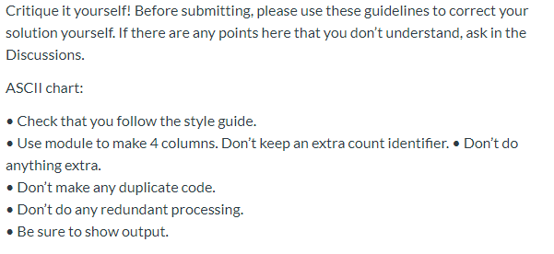
03 Assignment: Lab 11
https://www.ucsc-extension.edu/certificate-program/offering/python-programmers
Assignment 3: Lab 11 (4)

Slide 6
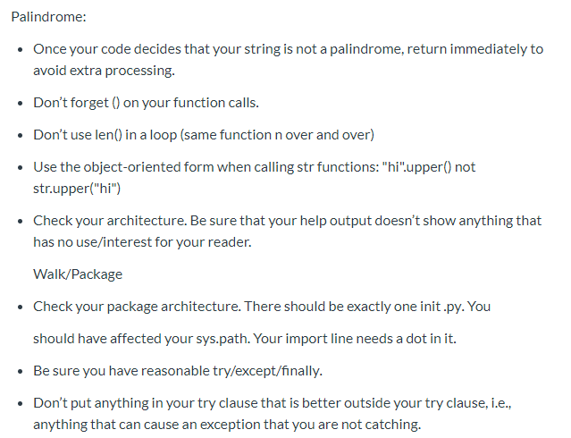
03 Assignment: Lab 11
https://www.ucsc-extension.edu/certificate-program/offering/python-programmers
Assignment 3: Lab 11 (5)

Slide 7
03.01 Lab 11 Solution
Peter H. Chen

Slide 8
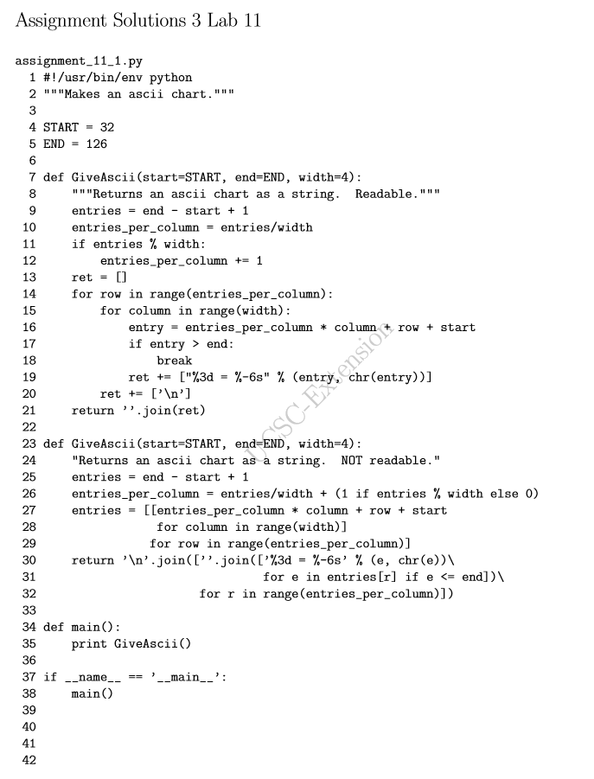
03.01 Lab 11 Solution
https://www.ucsc-extension.edu/certificate-program/offering/python-programmers
Lab 11 Solution (1):

Slide 9
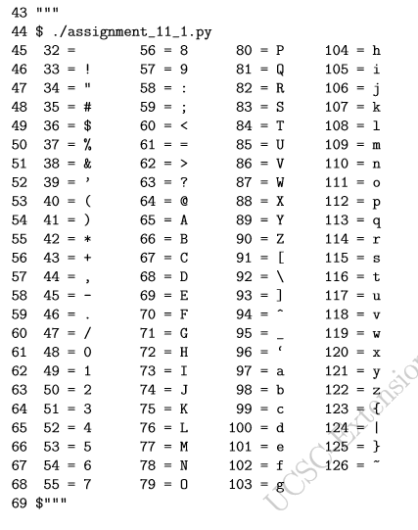
03.01 Lab 11 Solution
https://www.ucsc-extension.edu/certificate-program/offering/python-programmers
Lab 11 Solution (2):

Slide 10
End of Chapter

