Slide 1

04 Assignment: Lab 17
Peter H. Chen

Slide 2
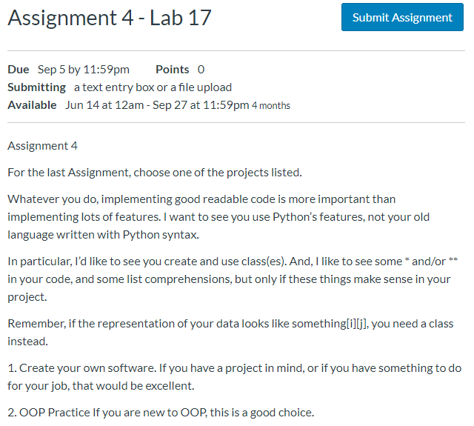
04 Assignment: Lab 17
https://www.ucsc-extension.edu/certificate-program/offering/python-programmers
Assignment 4: Lab 17 (1)

Slide 3
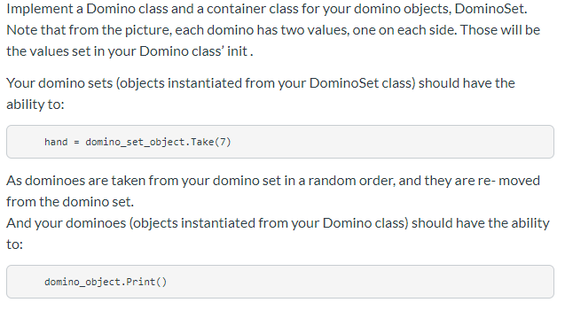
04 Assignment: Lab 17
https://www.ucsc-extension.edu/certificate-program/offering/python-programmers
Assignment 4: Lab 17 (2)

Slide 4
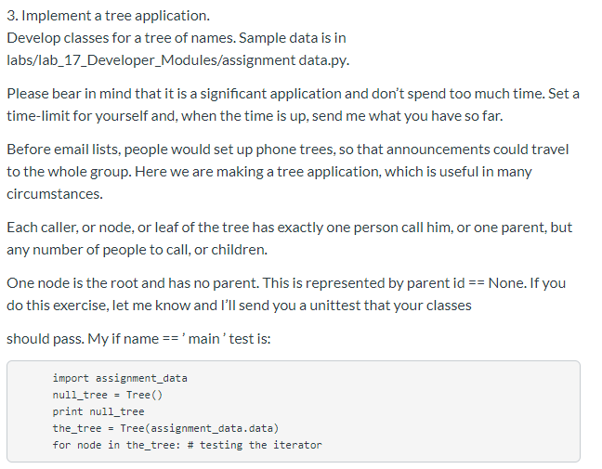
04 Assignment: Lab 17
https://www.ucsc-extension.edu/certificate-program/offering/python-programmers
Assignment 4: Lab 17 (3)

Slide 5
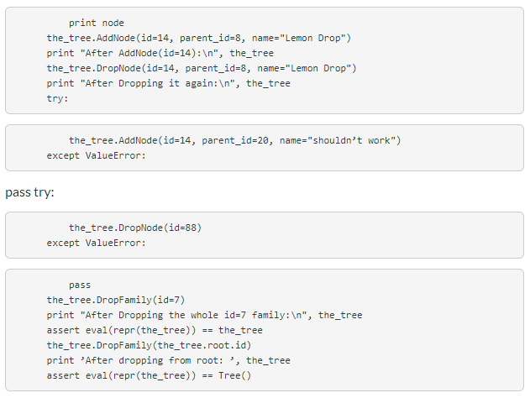
04 Assignment: Lab 17
https://www.ucsc-extension.edu/certificate-program/offering/python-programmers
Assignment 4: Lab 17 (4)

Slide 6
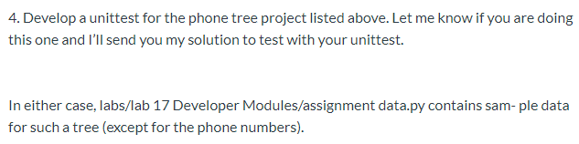
04 Assignment: Lab 17
https://www.ucsc-extension.edu/certificate-program/offering/python-programmers
Assignment 4: Lab 17 (5)

Slide 7
04.01 Lab 17 Solution

Slide 8
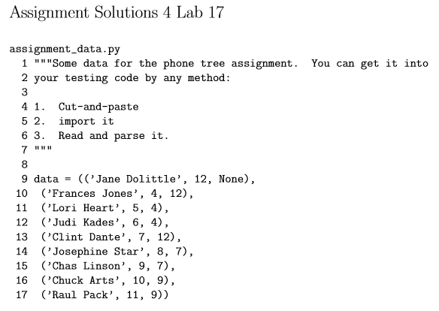
04.01 Lab 17 Solutions
https://www.ucsc-extension.edu/certificate-program/offering/python-programmers
Assignment 4: Lab 17 Solution (1)

Slide 9
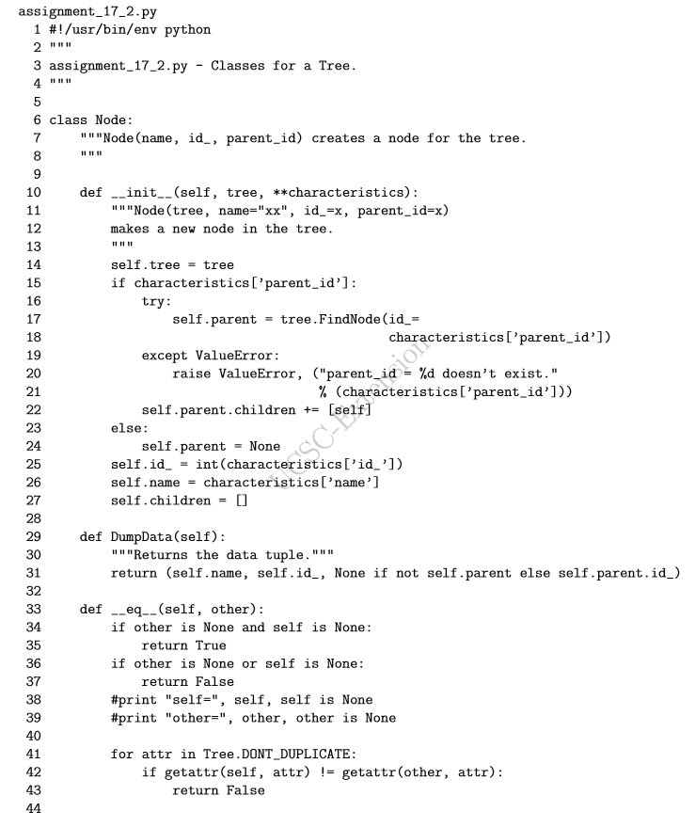
04.01 Lab 17 Solutions
https://www.ucsc-extension.edu/certificate-program/offering/python-programmers
Assignment 4: Lab 17 Solution (2)

Slide 10
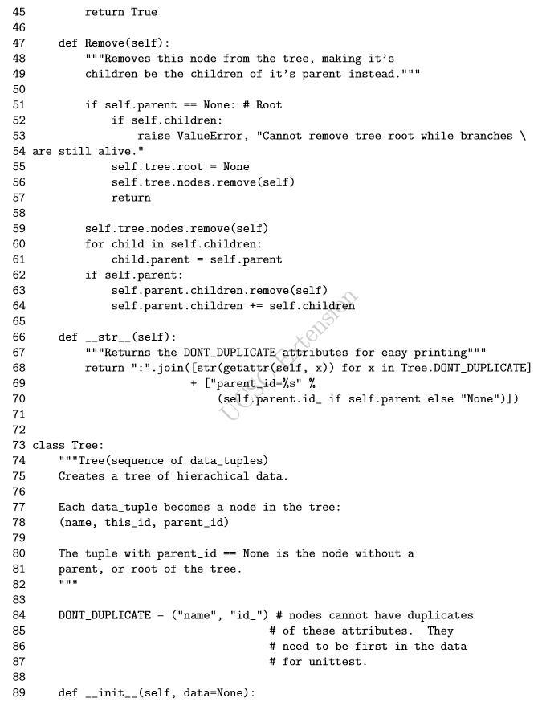
04.01 Lab 17 Solutions
https://www.ucsc-extension.edu/certificate-program/offering/python-programmers
Assignment 4: Lab 17 Solution (3)

Slide 11
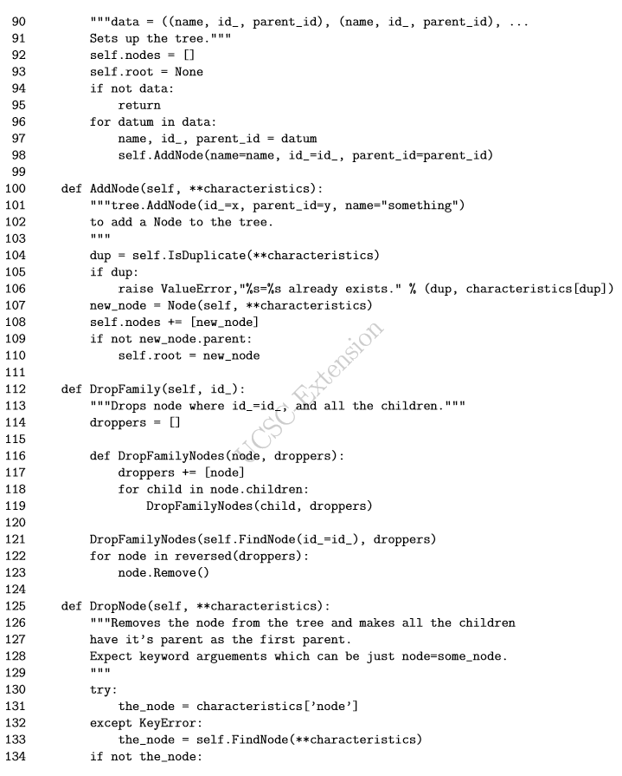
04.01 Lab 17 Solutions
https://www.ucsc-extension.edu/certificate-program/offering/python-programmers
Assignment 4: Lab 17 Solution (4)

Slide 12
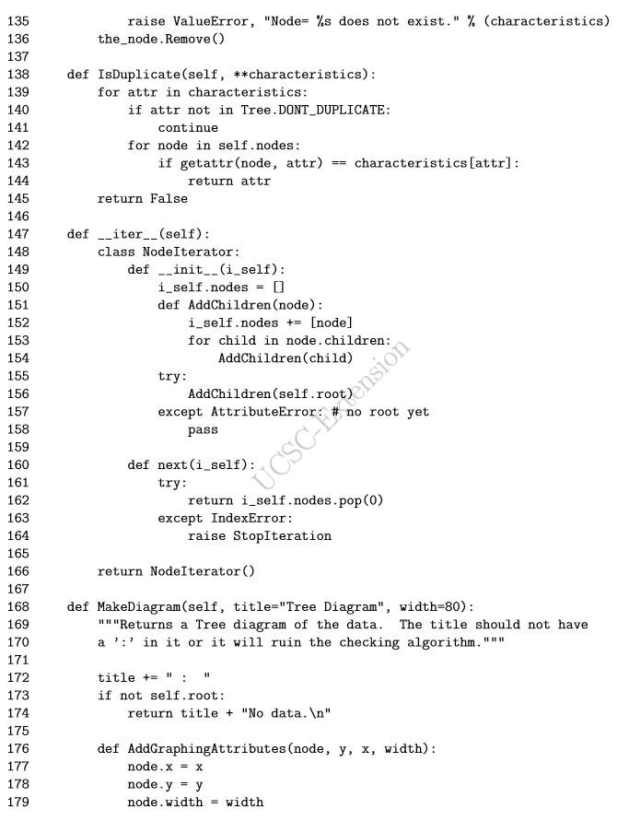
04.01 Lab 17 Solutions
https://www.ucsc-extension.edu/certificate-program/offering/python-programmers
Assignment 4: Lab 17 Solution (5)

Slide 13
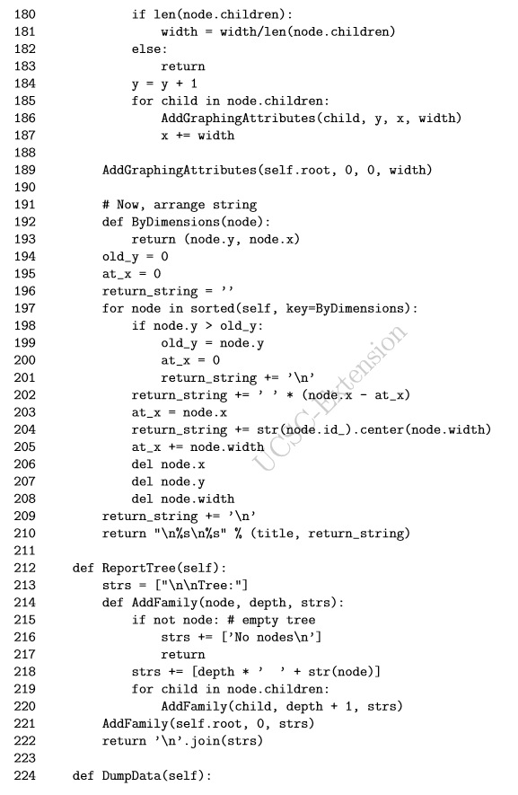
04.01 Lab 17 Solutions
https://www.ucsc-extension.edu/certificate-program/offering/python-programmers
Assignment 4: Lab 17 Solution (6)

Slide 14
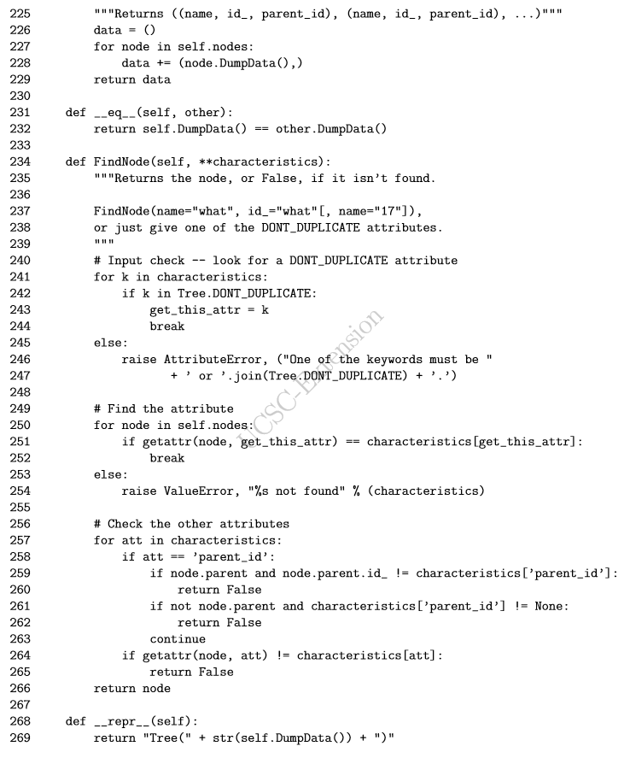
04.01 Lab 17 Solutions
https://www.ucsc-extension.edu/certificate-program/offering/python-programmers
Assignment 4: Lab 17 Solution (8)

Slide 15
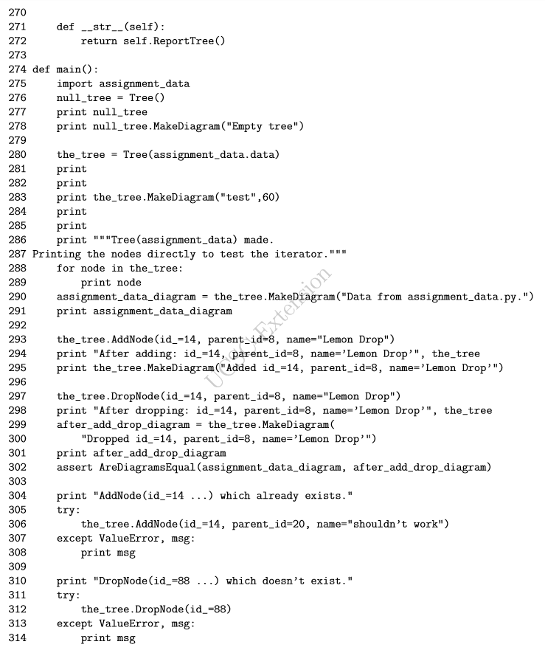
04.01 Lab 17 Solutions
https://www.ucsc-extension.edu/certificate-program/offering/python-programmers
Assignment 4: Lab 17 Solution (9)

Slide 16
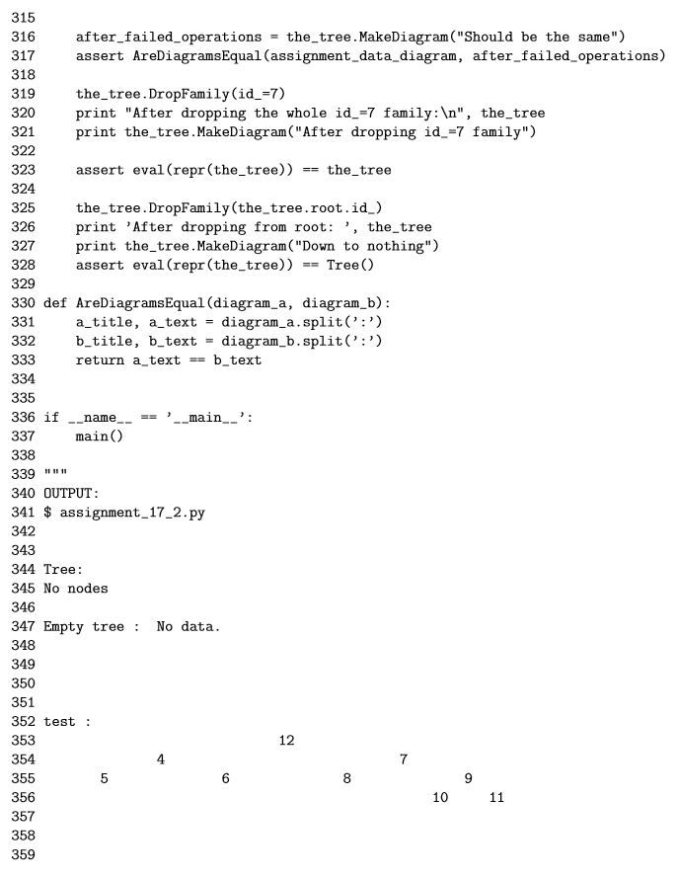
04.01 Lab 17 Solutions
https://www.ucsc-extension.edu/certificate-program/offering/python-programmers
Assignment 4: Lab 17 Solution (10)

Slide 17
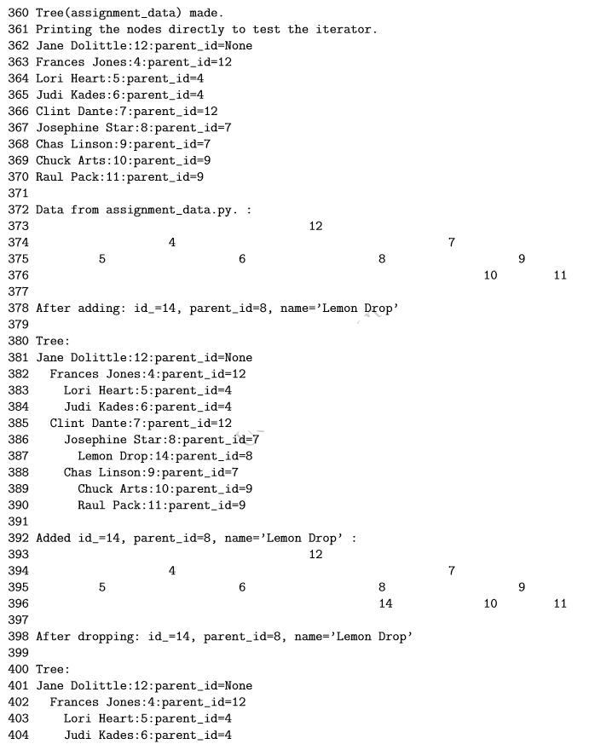
04.01 Lab 17 Solutions
https://www.ucsc-extension.edu/certificate-program/offering/python-programmers
Assignment 4: Lab 17 Solution (11)

Slide 18
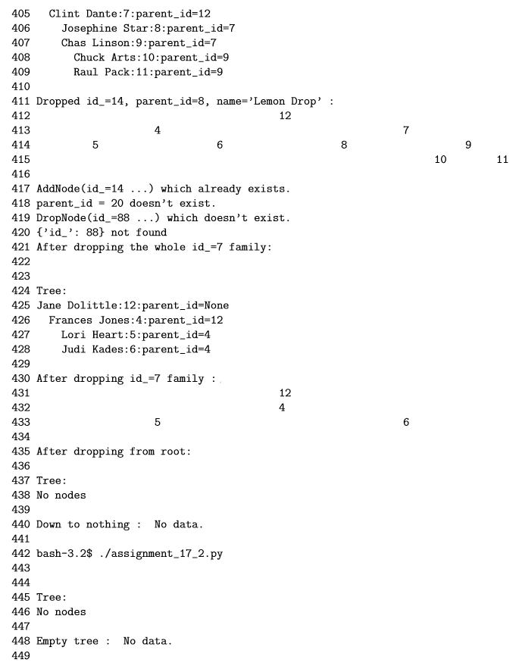
04.01 Lab 17 Solutions
https://www.ucsc-extension.edu/certificate-program/offering/python-programmers
Assignment 4: Lab 17 Solution (12)

Slide 19
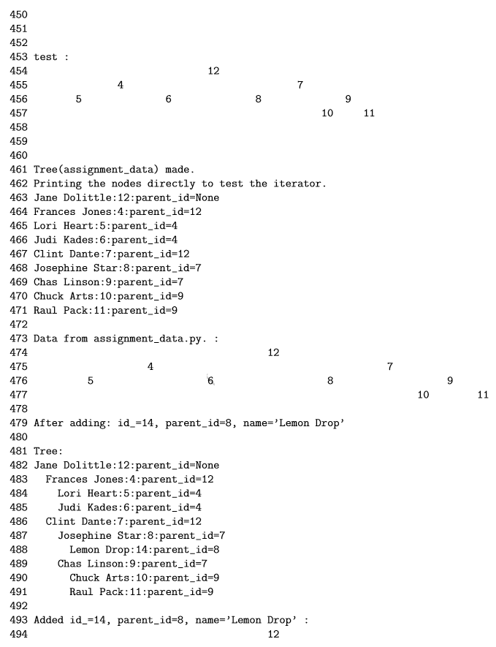
04.01 Lab 17 Solutions
https://www.ucsc-extension.edu/certificate-program/offering/python-programmers
Assignment 4: Lab 17 Solution (13)

Slide 20
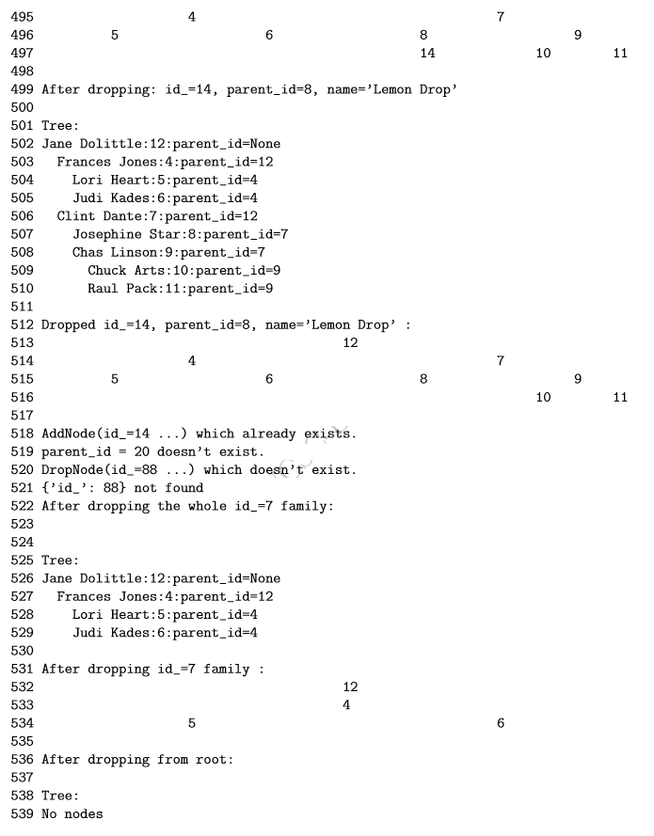
04.01 Lab 17 Solutions
https://www.ucsc-extension.edu/certificate-program/offering/python-programmers
Assignment 4: Lab 17 Solution (14)

Slide 21
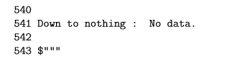
04.01 Lab 17 Solutions
https://www.ucsc-extension.edu/certificate-program/offering/python-programmers
Assignment 4: Lab 17 Solution (15)

Slide 22
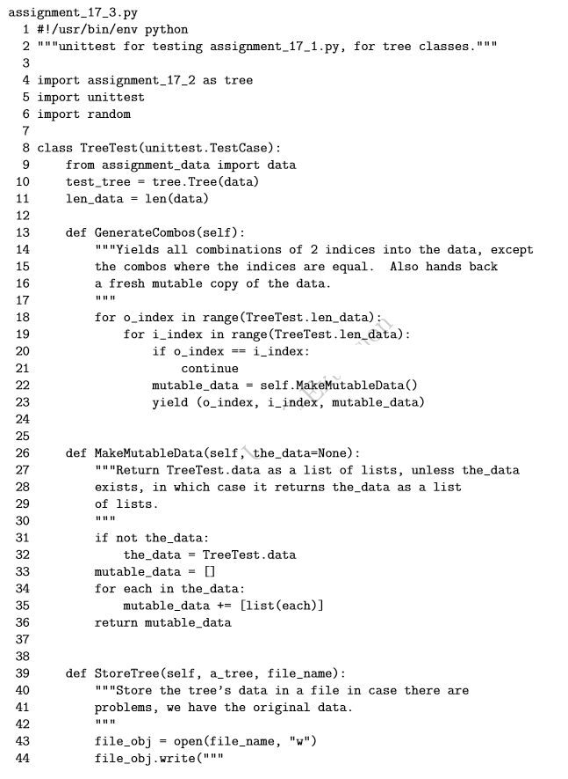
04.01 Lab 17 Solutions
https://www.ucsc-extension.edu/certificate-program/offering/python-programmers
Assignment 4: Lab 17 Solution (16)

Slide 23
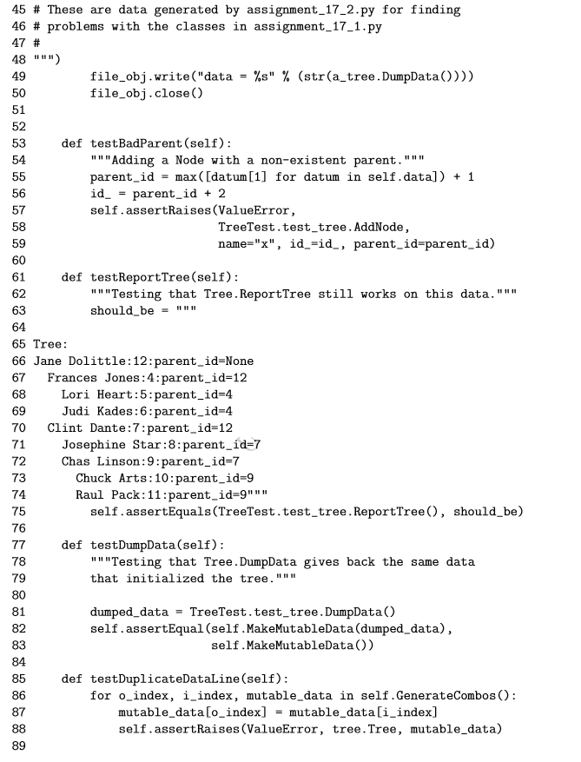
04.01 Lab 17 Solutions
https://www.ucsc-extension.edu/certificate-program/offering/python-programmers
Assignment 4: Lab 17 Solution (17)

Slide 24
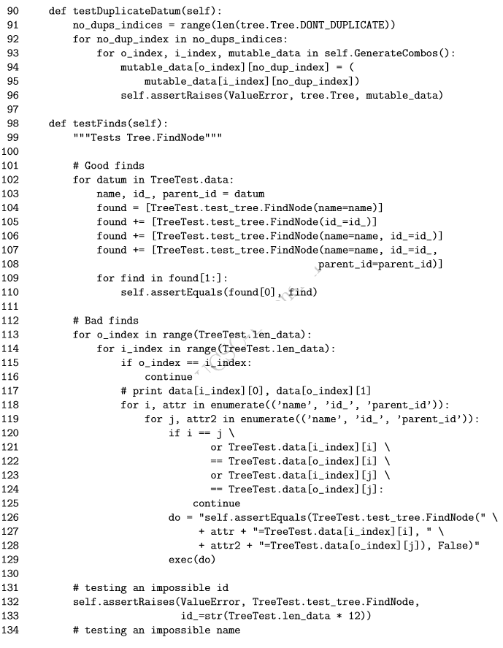
04.01 Lab 17 Solutions
https://www.ucsc-extension.edu/certificate-program/offering/python-programmers
Assignment 4: Lab 17 Solution (18)

Slide 25
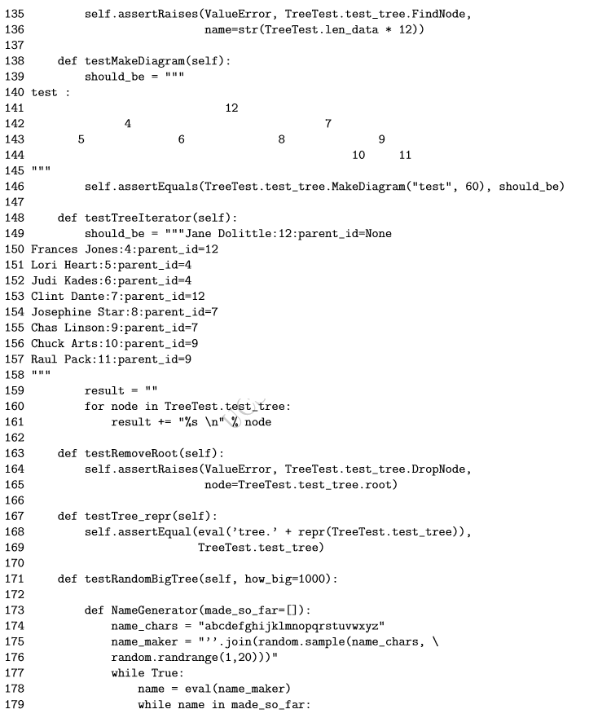
04.01 Lab 17 Solutions
https://www.ucsc-extension.edu/certificate-program/offering/python-programmers
Assignment 4: Lab 17 Solution (19)

Slide 26
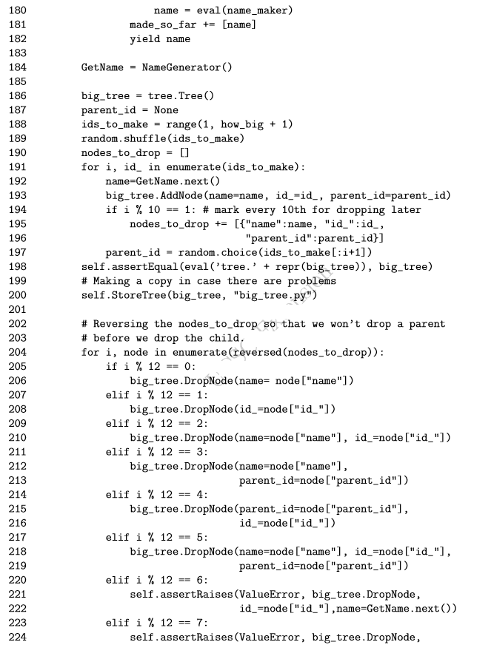
04.01 Lab 17 Solutions
https://www.ucsc-extension.edu/certificate-program/offering/python-programmers
Assignment 4: Lab 17 Solution (20)

Slide 27
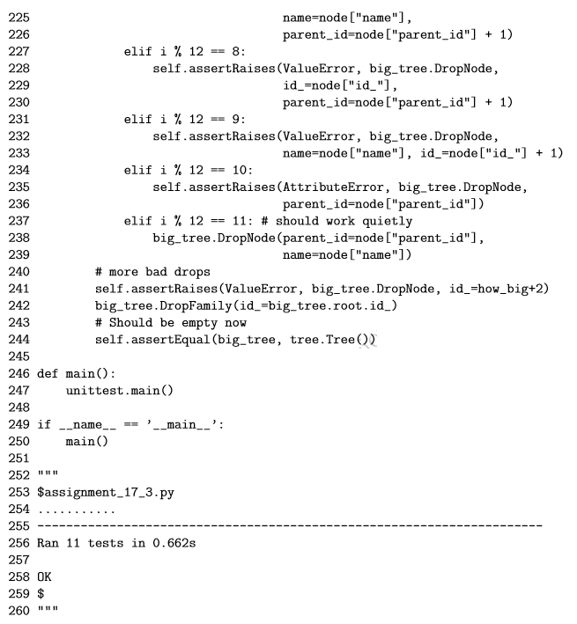
04.01 Lab 17 Solutions
https://www.ucsc-extension.edu/certificate-program/offering/python-programmers
Assignment 4: Lab 17 Solution (21)

Slide 28
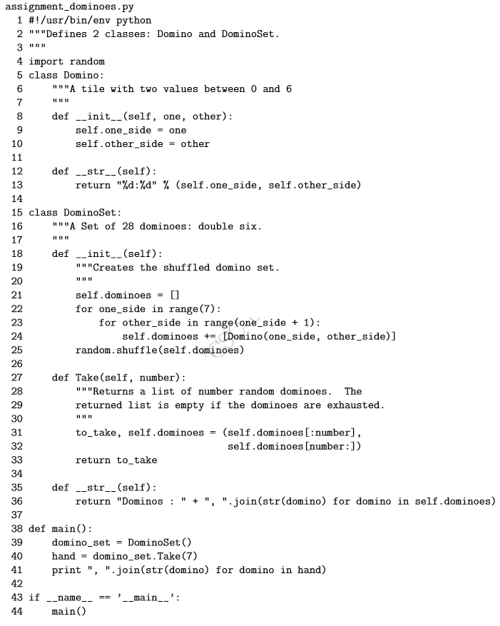
04.01 Lab 17 Solutions
https://www.ucsc-extension.edu/certificate-program/offering/python-programmers
Assignment 4: Lab 17 Solution (22)

Slide 29
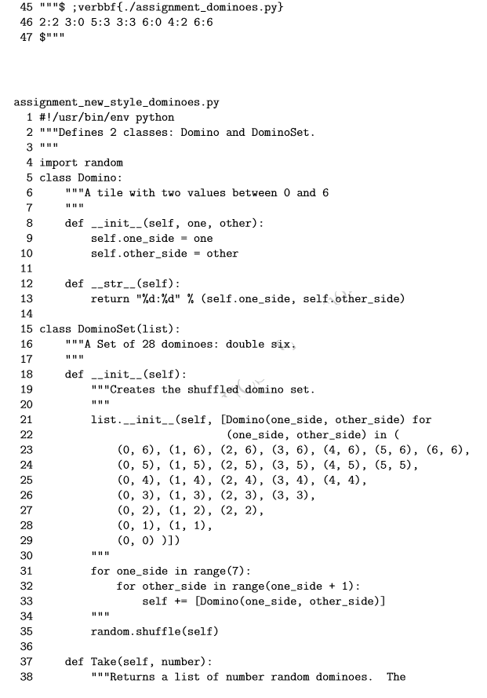
04.01 Lab 17 Solutions
https://www.ucsc-extension.edu/certificate-program/offering/python-programmers
Assignment 4: Lab 17 Solution (23)

Slide 30
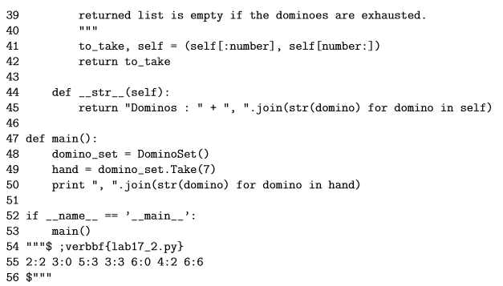
04.01 Lab 17 Solutions
https://www.ucsc-extension.edu/certificate-program/offering/python-programmers
Assignment 4: Lab 17 Solution (24)

Slide 31
End of Chapter

