Slide 1

0101 Output
Peter H. Chen

Slide 2
0101 Output
https://www.ucsc-extension.edu/certificate-program/offering/python-programmers
Topic:
Execute a Python Program
Syntax: code block, colons
If, elif, and else
While and another else
Write to stdout
Relational and logical operator

Slide 3
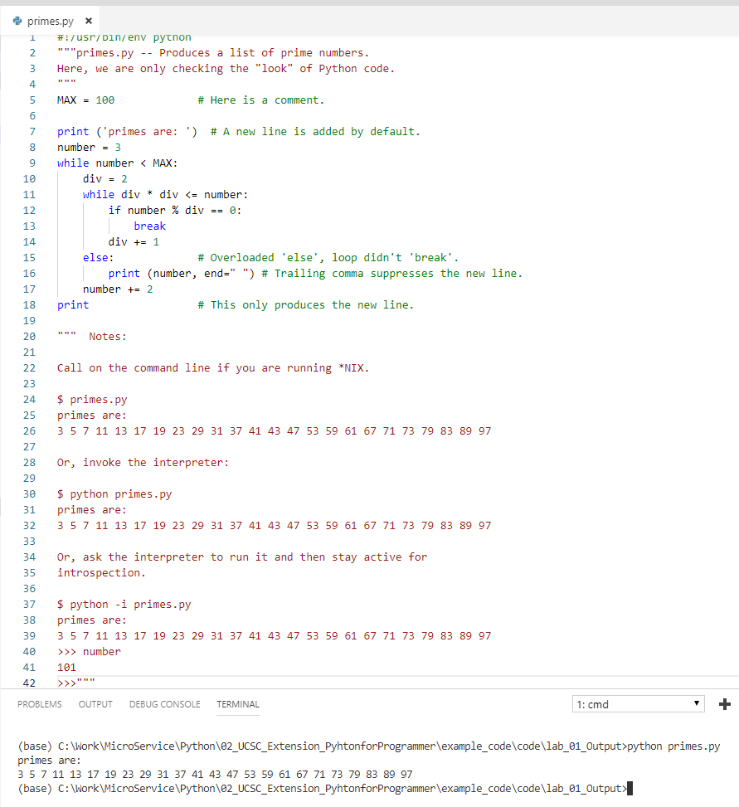
0101 Output
https://www.ucsc-extension.edu/certificate-program/offering/python-programmers
Primes.py

Slide 4
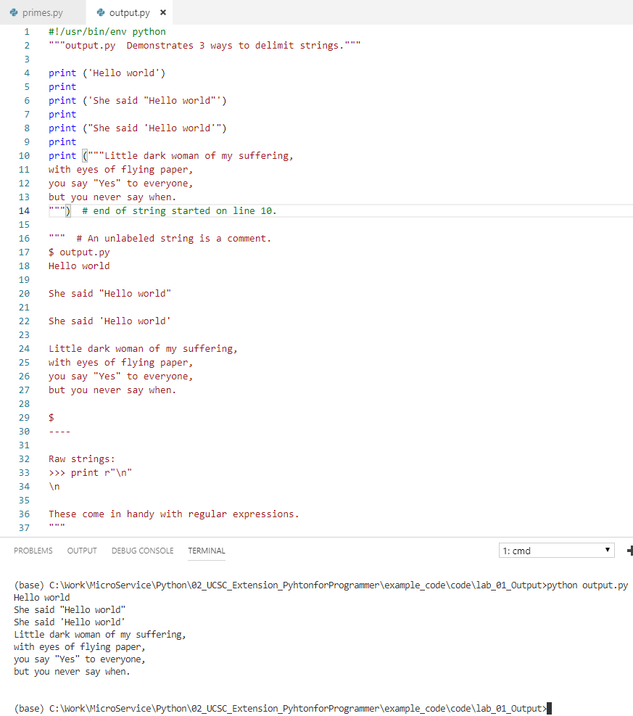
0101 Output
https://www.ucsc-extension.edu/certificate-program/offering/python-programmers
Output.py

Slide 5
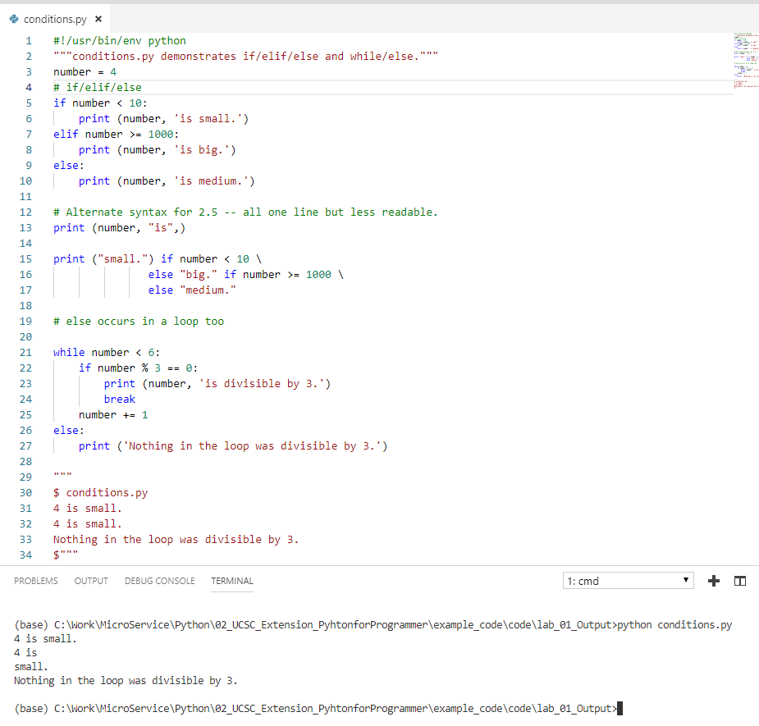
0101 Output
https://www.ucsc-extension.edu/certificate-program/offering/python-programmers
Condiotns.py

Slide 6
End of Chapter

