Slide 1

0102 Input
Peter H. Chen

Slide 2
0102 Input
https://www.ucsc-extension.edu/certificate-program/offering/python-programmers
Topics:
Input from stdin
Factory Function
Catching an Exception
Yet another else
Formatted strings
Integer division issue

Slide 3
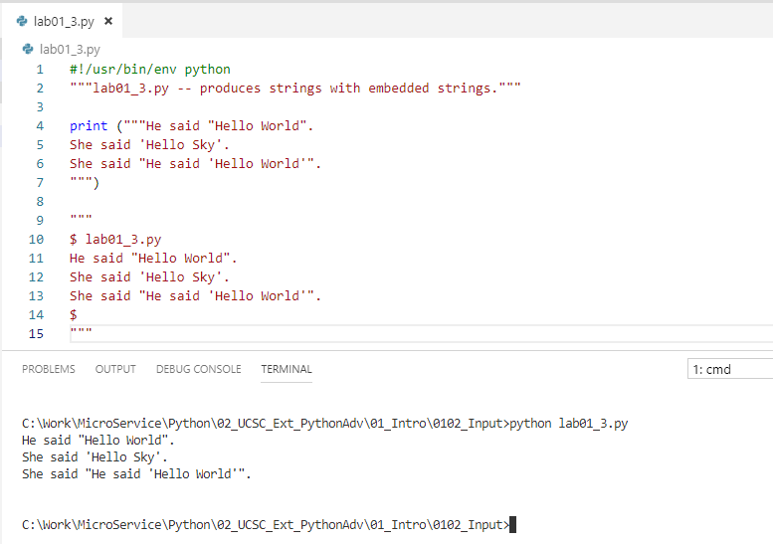
0102 Input
https://www.ucsc-extension.edu/certificate-program/offering/python-programmers
Lab01_3.py:

Slide 4
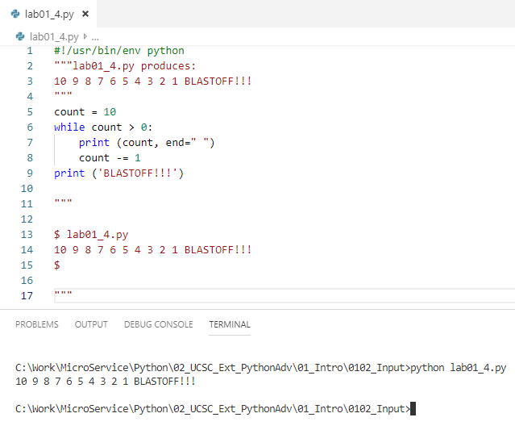
0102 Input
https://www.ucsc-extension.edu/certificate-program/offering/python-programmers
Lab01_4.py:

Slide 5
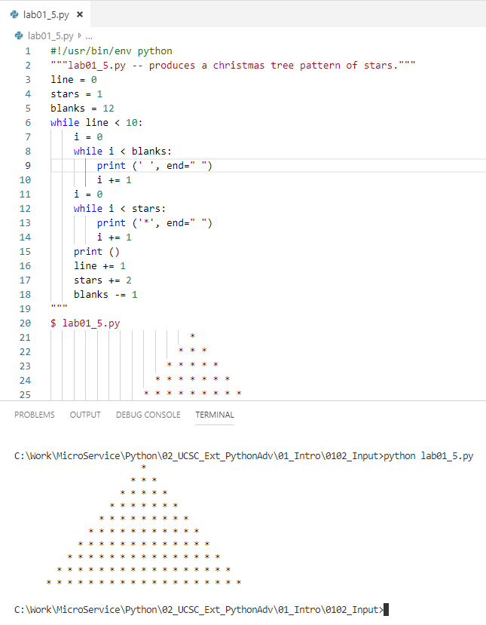
0102 Input
https://www.ucsc-extension.edu/certificate-program/offering/python-programmers
Lab01_5.py:

Slide 6
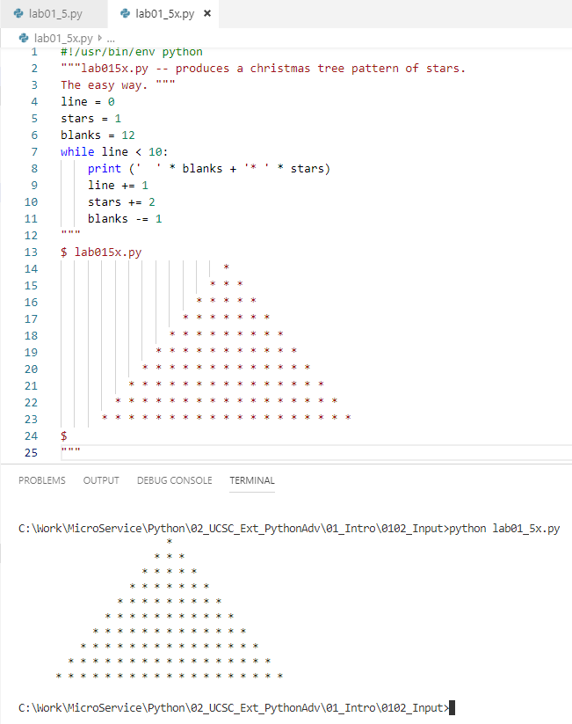
0102 Input
https://www.ucsc-extension.edu/certificate-program/offering/python-programmers
Lab01_5x.py:

Slide 7
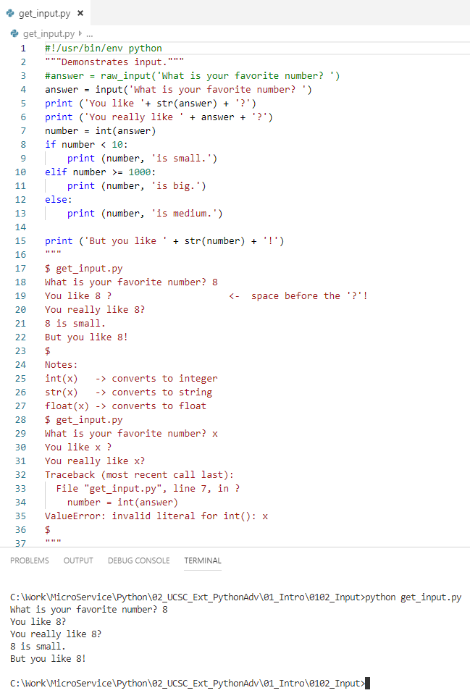
0102 Input
https://www.ucsc-extension.edu/certificate-program/offering/python-programmers
input06.py:

Slide 8
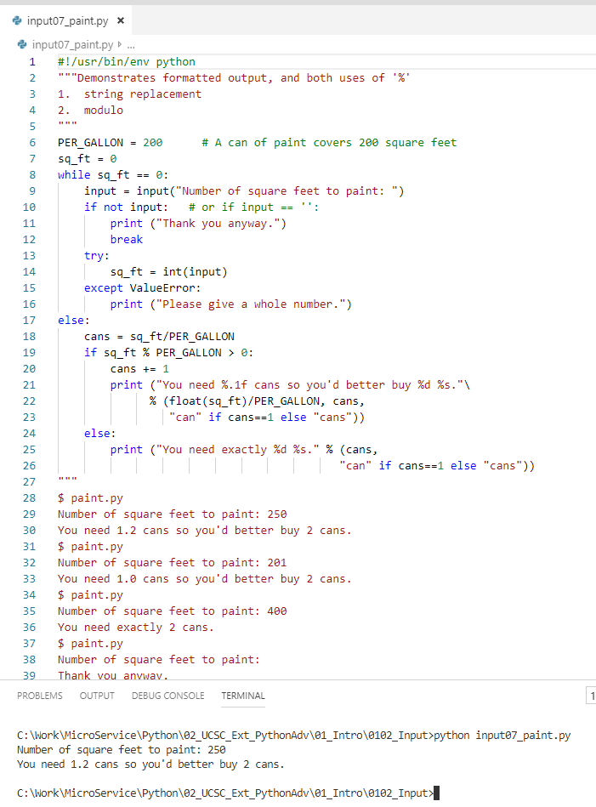
0102 Input
https://www.ucsc-extension.edu/certificate-program/offering/python-programmers
input07.py:

Slide 9
End of Chapter

