Slide 1

0103 for range
Peter H. Chen

Slide 2
0103 for range
https://www.ucsc-extension.edu/certificate-program/offering/python-programmers
Topics:
Range operator
For loop
tuples

Slide 3
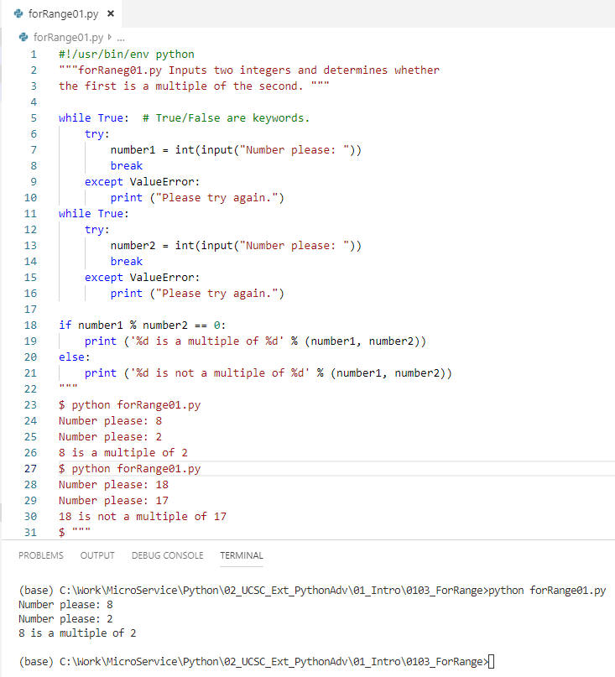
0103 for range
https://www.ucsc-extension.edu/certificate-program/offering/python-programmers
forRange01.py.

Slide 4
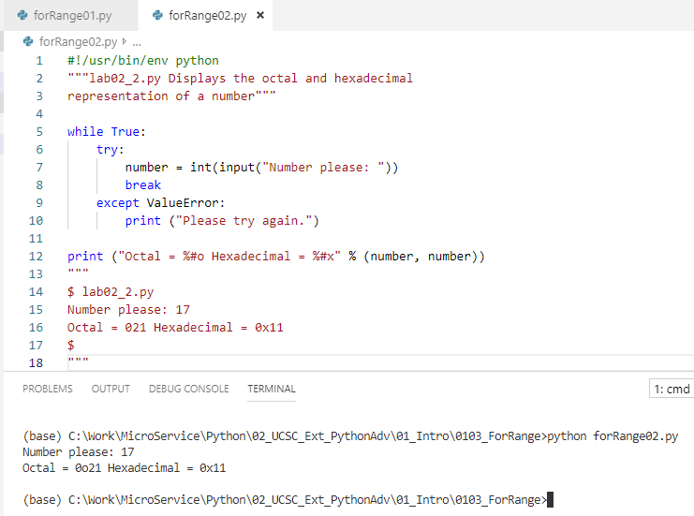
0103 for range
https://www.ucsc-extension.edu/certificate-program/offering/python-programmers
forRange02.py.

Slide 5
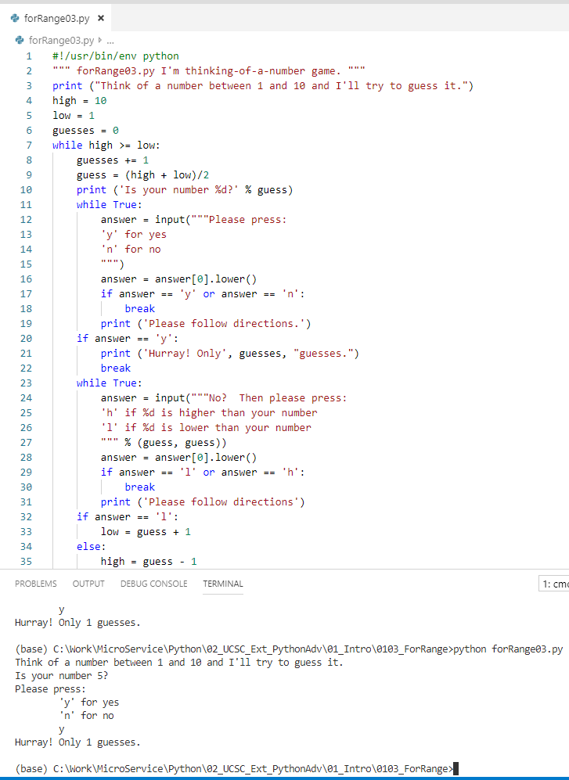
0103 for range
https://www.ucsc-extension.edu/certificate-program/offering/python-programmers
forRange03.py.

Slide 6
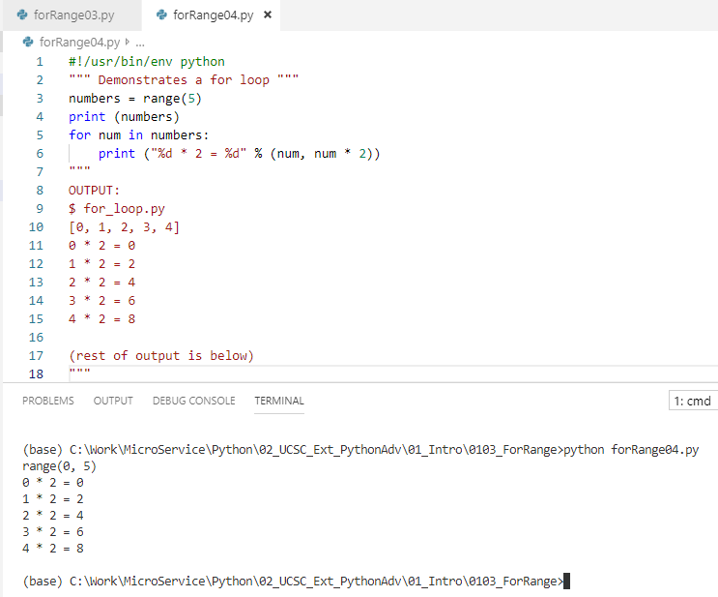
0103 for range
https://www.ucsc-extension.edu/certificate-program/offering/python-programmers
forRange04.py.

Slide 7
End of Chapter

