Slide 1

01 Quiz
Peter H. Chen

Slide 2
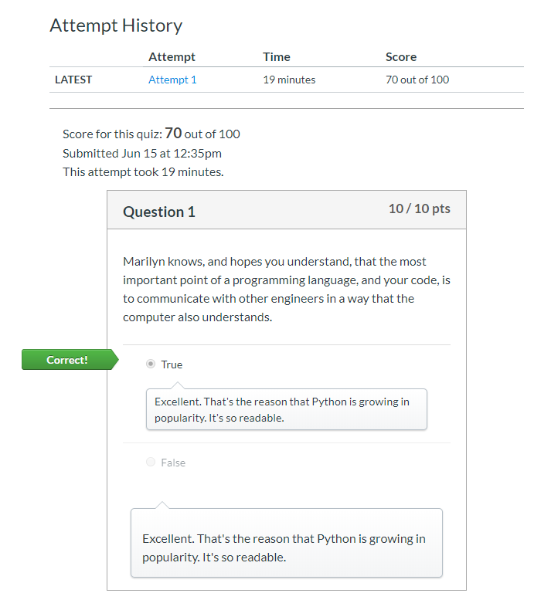
01 Quiz
https://www.ucsc-extension.edu/certificate-program/offering/python-programmers
Quiz:

Slide 3
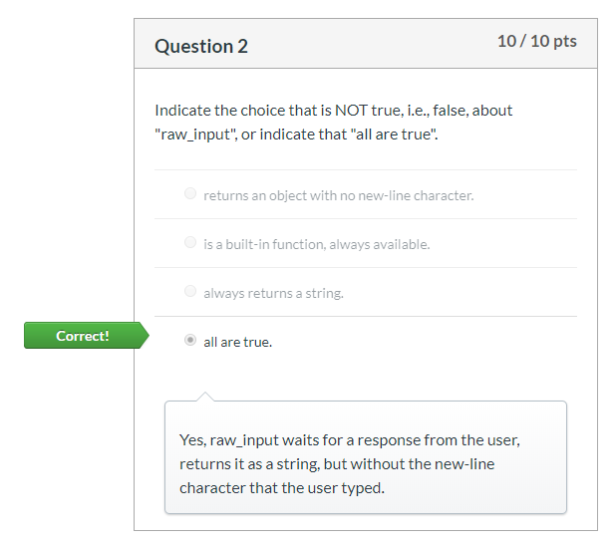
01 Quiz
https://www.ucsc-extension.edu/certificate-program/offering/python-programmers
Quiz:

Slide 4
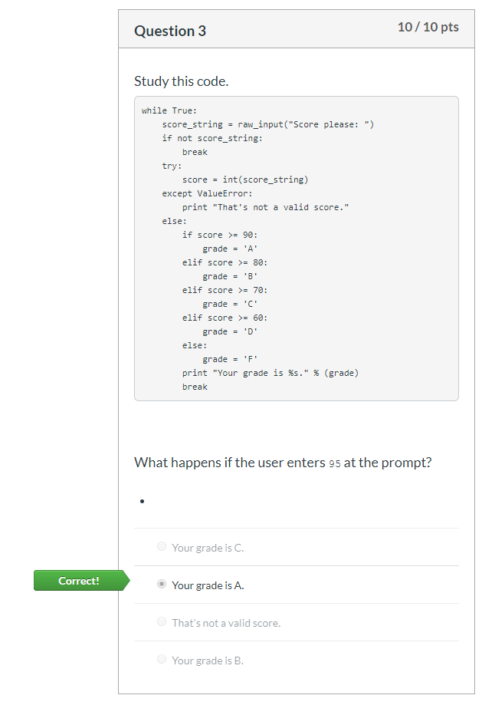
01 Quiz
https://www.ucsc-extension.edu/certificate-program/offering/python-programmers
Quiz:

Slide 5
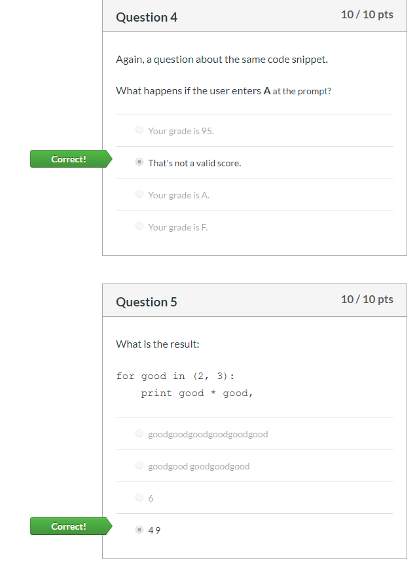
01 Quiz
https://www.ucsc-extension.edu/certificate-program/offering/python-programmers
Quiz:

Slide 6
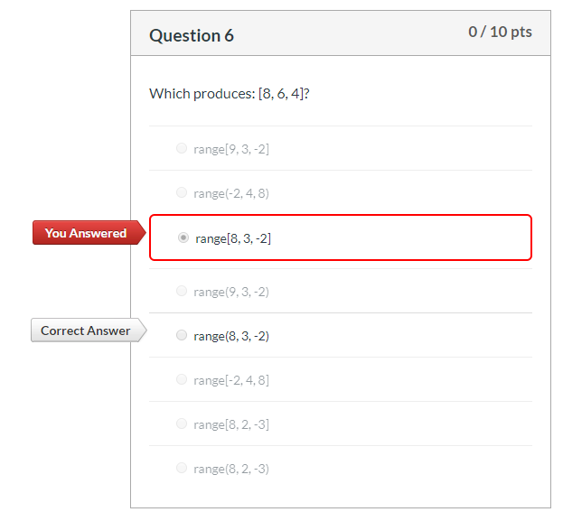
01 Quiz
https://www.ucsc-extension.edu/certificate-program/offering/python-programmers
Quiz:

Slide 7
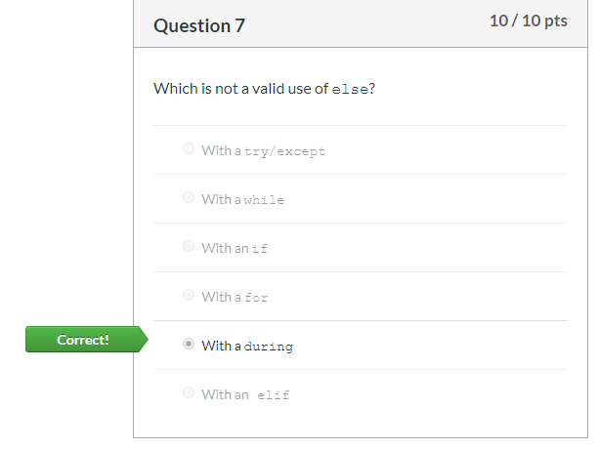
01 Quiz
https://www.ucsc-extension.edu/certificate-program/offering/python-programmers
Quiz:

Slide 8
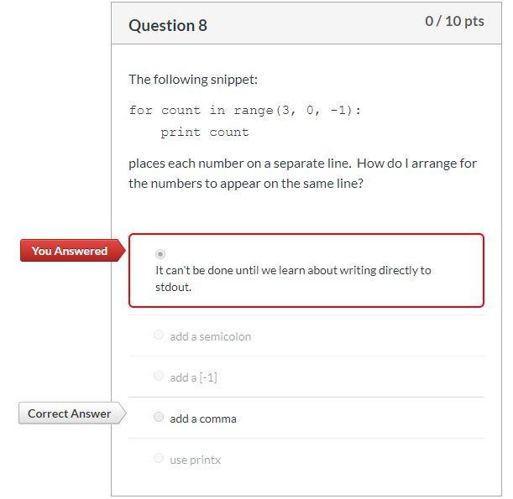
01 Quiz
https://www.ucsc-extension.edu/certificate-program/offering/python-programmers
Quiz:

Slide 9
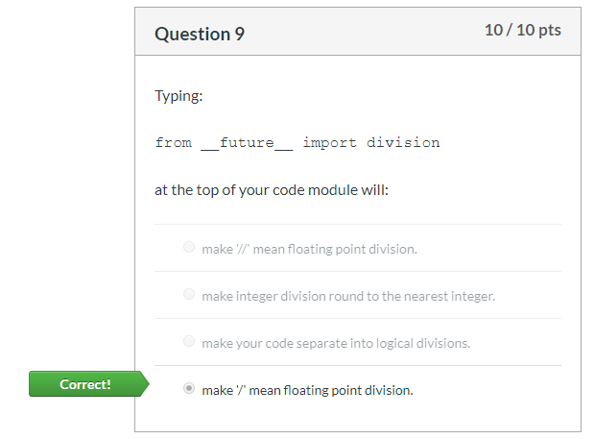
01 Quiz
https://www.ucsc-extension.edu/certificate-program/offering/python-programmers
Quiz:

Slide 10
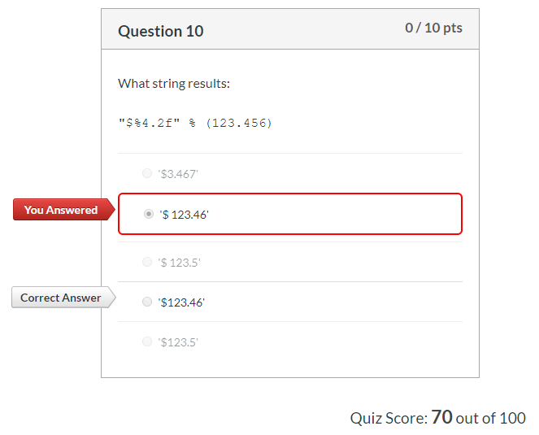
01 Quiz
https://www.ucsc-extension.edu/certificate-program/offering/python-programmers
Quiz:

Slide 11
End of Chapter

