Slide 1

0201 Function
Peter H. Chen

Slide 2
0201 Function
https://www.ucsc-extension.edu/certificate-program/offering/python-programmers
Topics:
Function protocols
None and import
Module: random
Introspection

Slide 3
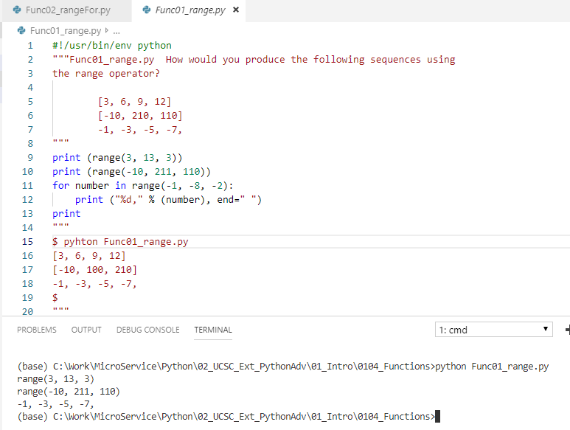
0201 Function
https://www.ucsc-extension.edu/certificate-program/offering/python-programmers
Func01_range.py

Slide 4
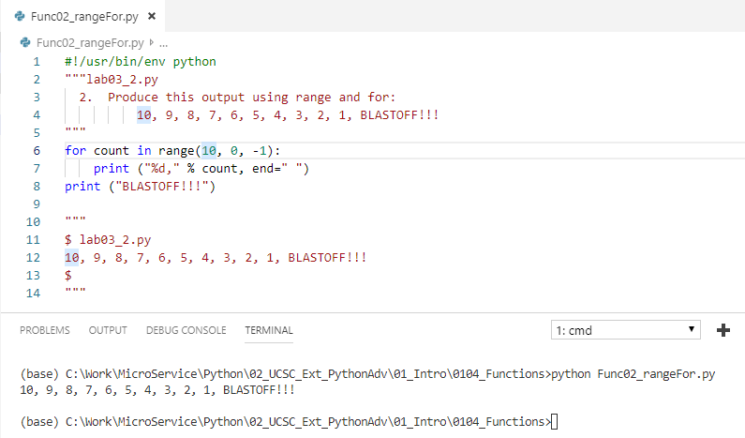
0201 Function
https://www.ucsc-extension.edu/certificate-program/offering/python-programmers
Func02_rangefor.py

Slide 5
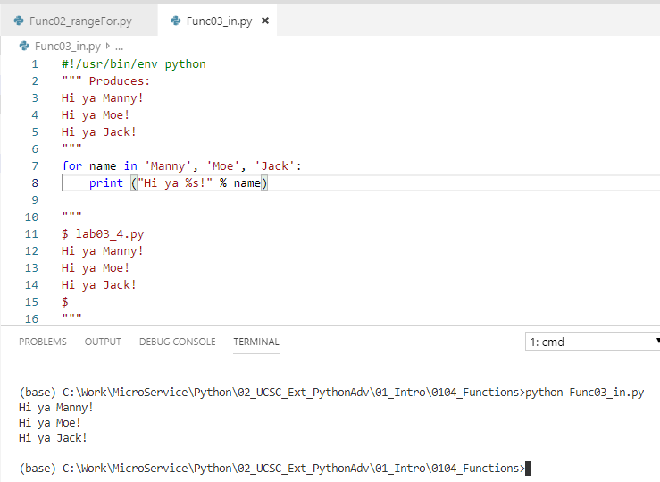
0201 Function
https://www.ucsc-extension.edu/certificate-program/offering/python-programmers
Func03_in.py

Slide 6
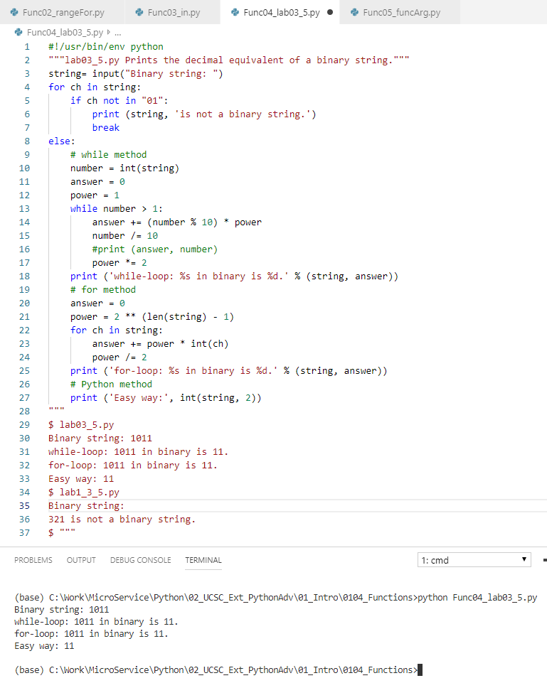
0201 Function
https://www.ucsc-extension.edu/certificate-program/offering/python-programmers
Fun04_lab03_5.py
Line 13 should be > 1, not > 0.

Slide 7
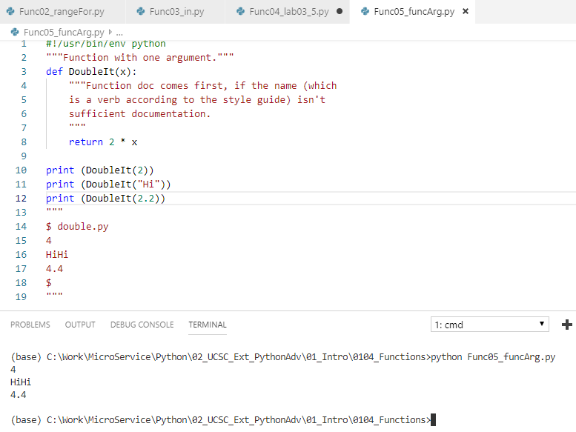
0201 Function
https://www.ucsc-extension.edu/certificate-program/offering/python-programmers
Fun05_funcArg.py

Slide 8
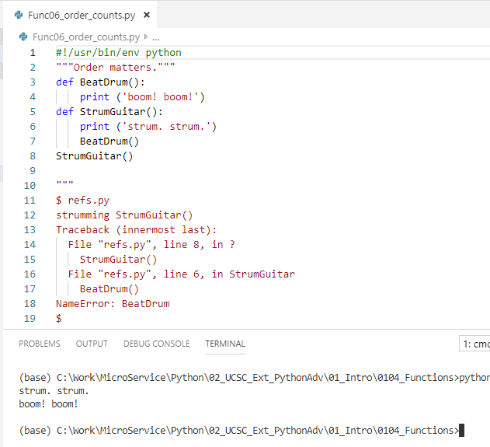
0201 Function
https://www.ucsc-extension.edu/certificate-program/offering/python-programmers
Fun06_order_counts.py

Slide 9
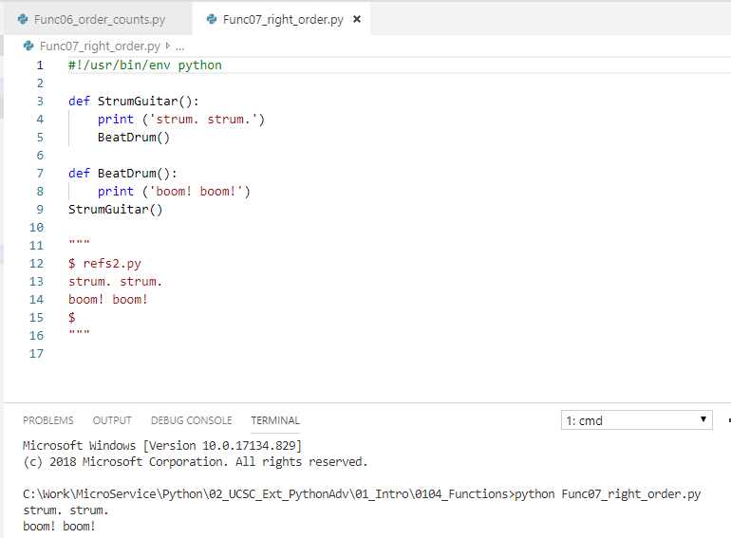
0201 Function
https://www.ucsc-extension.edu/certificate-program/offering/python-programmers
Fun07_right_order.py

Slide 10
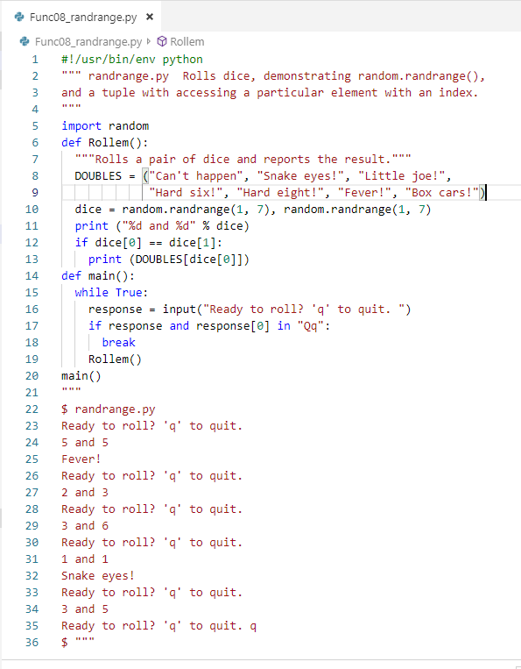
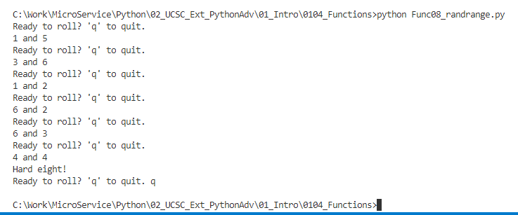
0201 Function
https://www.ucsc-extension.edu/certificate-program/offering/python-programmers
Fun08_randrang.py

Slide 11
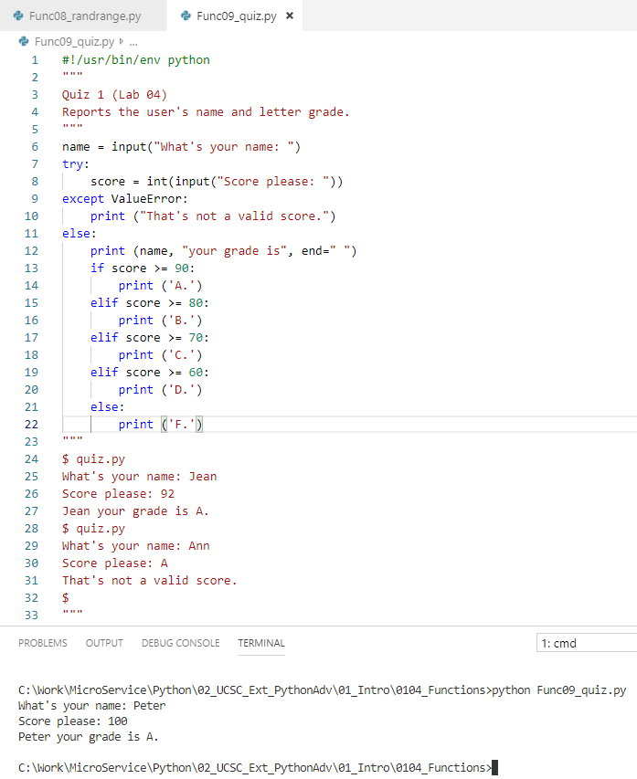
0201 Function
https://www.ucsc-extension.edu/certificate-program/offering/python-programmers
Fun09_quiz.py

Slide 12
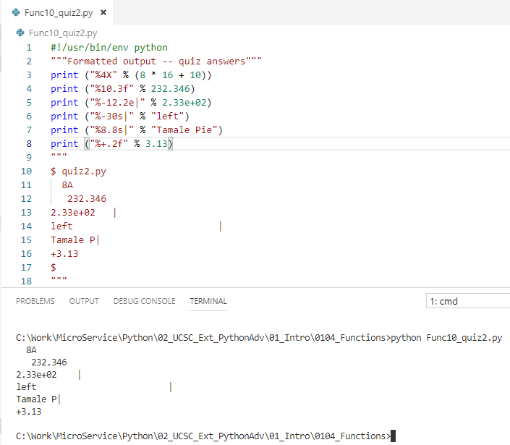
0201 Function
https://www.ucsc-extension.edu/certificate-program/offering/python-programmers
Fun10_quiz2.py

Slide 13
End of Chapter

