Slide 1

02 Quiz
Peter H. Chen

Slide 2
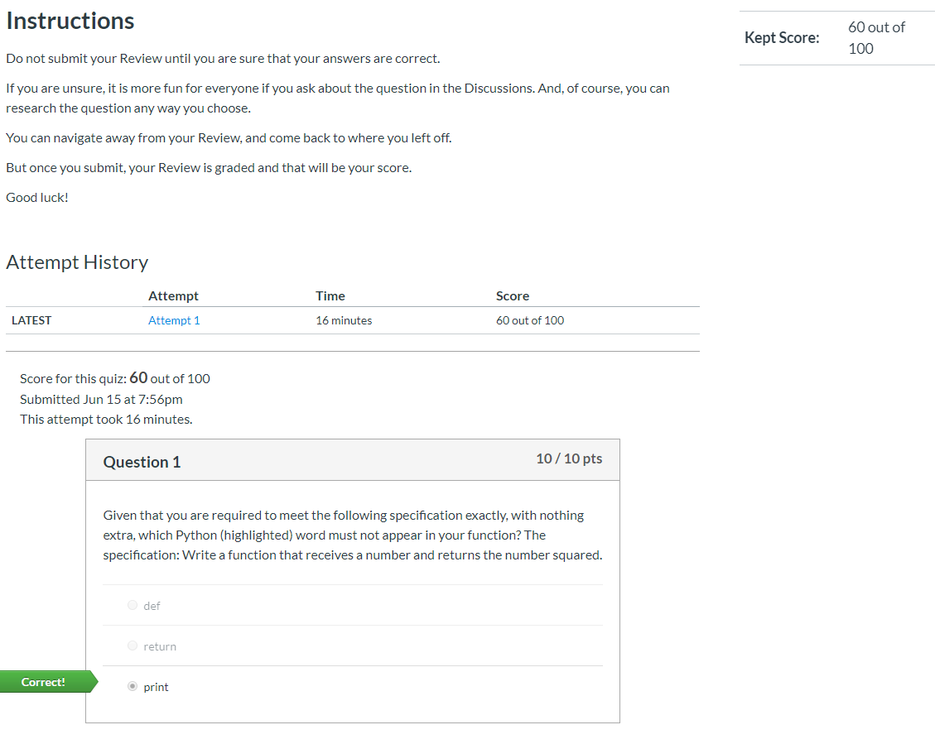
02 Quiz
https://www.ucsc-extension.edu/certificate-program/offering/python-programmers
Quiz:

Slide 3
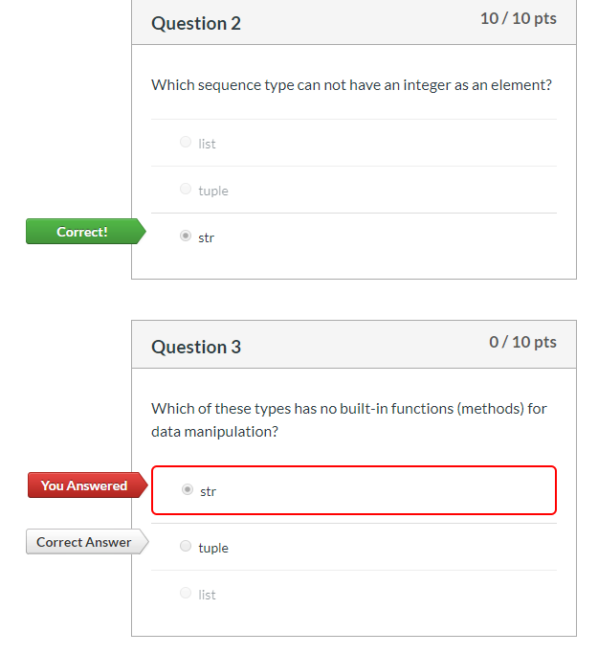
02 Quiz
https://www.ucsc-extension.edu/certificate-program/offering/python-programmers
Quiz:

Slide 4
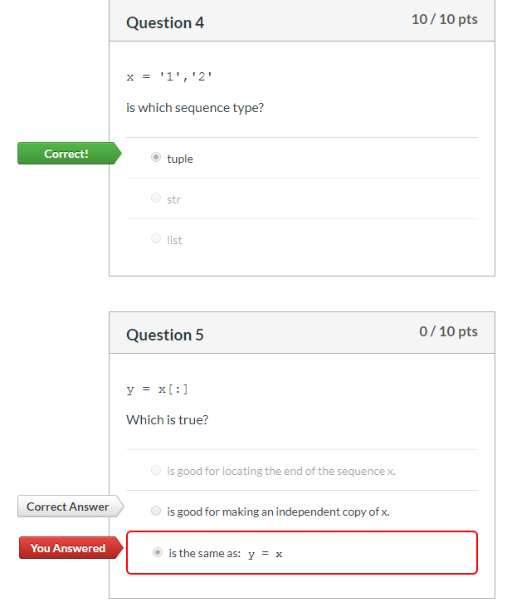
02 Quiz
https://www.ucsc-extension.edu/certificate-program/offering/python-programmers
Quiz:

Slide 5
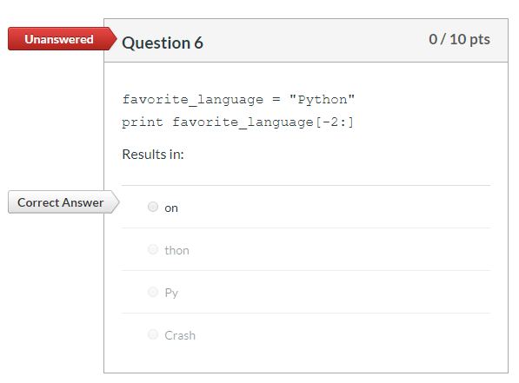
02 Quiz
https://www.ucsc-extension.edu/certificate-program/offering/python-programmers
Quiz:

Slide 6
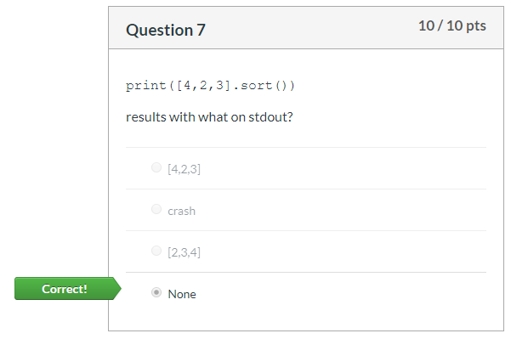
02 Quiz
https://www.ucsc-extension.edu/certificate-program/offering/python-programmers
Quiz:

Slide 7
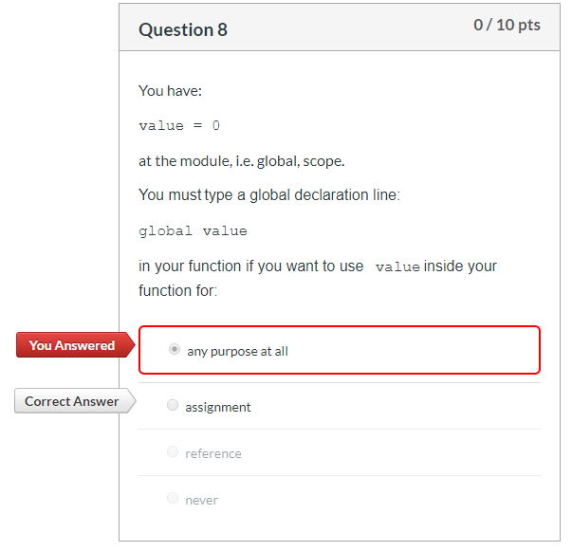
02 Quiz
https://www.ucsc-extension.edu/certificate-program/offering/python-programmers
Quiz:

Slide 8
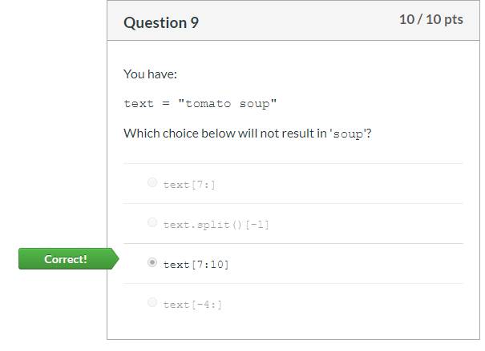
02 Quiz
https://www.ucsc-extension.edu/certificate-program/offering/python-programmers
Quiz:

Slide 9
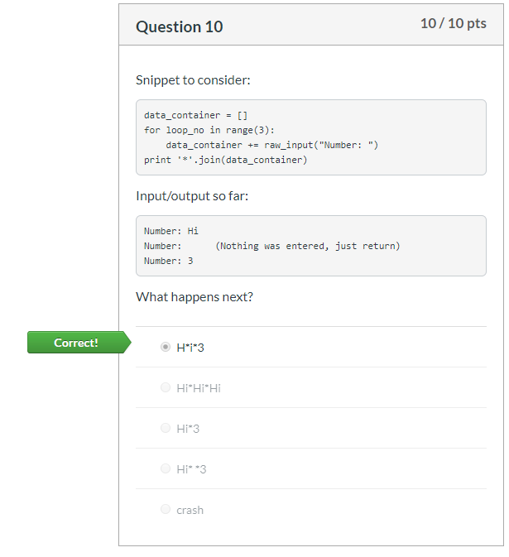
02 Quiz
https://www.ucsc-extension.edu/certificate-program/offering/python-programmers
Quiz:

Slide 10
End of Chapter

